Slide 1
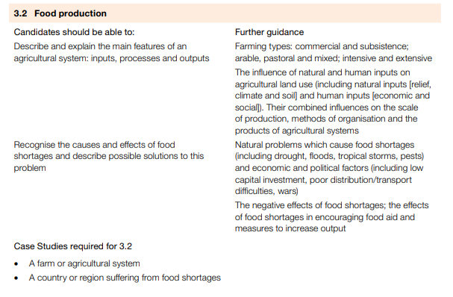
IGCSE GEOGRAPHY 0460: 2.1 THE CHALLENGE OF NATURAL HAZARDS
IGCSE GEOGRAPHY: 3.2 FOOD PRODUCTION

Slide 2
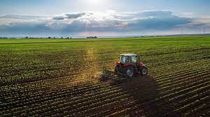
IGCSE GEOGRAPHY 0460: 2.1 THE CHALLENGE OF NATURAL HAZARDS
IGCSE GEOGRAPHY: 3.2 FOOD PRODUCTION
Key terms
Agriculture: Refers to farming. It is the artificial cultivation of plants and the rearing of animals for food and other products.
Commercial farming: Crops are grown and animals are reared (outputs) for profit. Usually modern, large-scale farming. Crops sold for money are known as cash crops.
Subsistence farming: This type of farming is usually much more small scale, whereby the farming is growing crops and or rearing animals for themselves and their family.
Pastoral farming: Rearing of animals
Arable farming: Cultivation of crops
Intensive farming: Farmers use a high level of inputs, such as fertilizers, pesticides, and machinery, to maximize the production of crops or livestock. Aims to increase yields efficiently but can have environmental concerns due to its intensive use.
Extensive farming: Farmers use large areas of land with lower inputs, such as fewer fertilizers and machinery. The goal is to produce crops or livestock with minimal intervention, relying more on natural processes. Extensive farming often involves lower yields per acre but can be more sustainable than intensive farming.
Inputs
Processes
Outputs
Physical inputs
Climate
- Temperature
- Length of growing season
- Precipitation
Relief
- High or low
- Steep or flat
Soils
- Deep or thin
- Rich or poor
Outputs
Crops
- Wheat, barley
- Potatoes
- Vegetables
- Tomatoes
- Flowers
Animal products
- Wool, milk, etc
- Leather
- Beef, mutton, lamb
- Chicken
Animals
- Lambs, calves, chicks etc.
Human and economic impacts
- Labour
- Buildings
- Machinery
- Materials and transport
- Money/capital
- Subsidies
-Seeds and animal breeds
- Pesticides, fertilizer
Processes
- Ploughing
- Planting
- Weeding, pest control
- Harvesting
- Grazing
- Shearing/milking
Feedback: profit, manure, animals

Slide 3
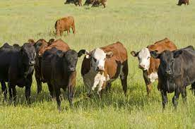
IGCSE GEOGRAPHY: 3.2 FOOD PRODUCTION
CASE STUDY: AGRICULTURAL SYSTEM, BRAZIL COMMERCIAL BEEF FARMING
Physical Inputs
Land: Most important physical input is large areas of land. The density of beef cattle is low - approximately one single animal per hectare.
Climate: The north region is the largest beef producing region. This is mainly due to it’s tropical climate, which allows 2000-3000 mm of rainfall per year, which allows fertile soil and naturally irrigated grass for cattle to graze on.
Human Inputs
Market: As countries become more affluent beef consumption increases so does demand. Brazil is the fifth populous country in the world, therefore it has large domestic market. Major international retail chains operate there e.g. Carrefour (France) and Walmart (USA).
Capital: As an NIC, Brazil attracts a lot of multinational companies who are interested in investing their capital in beef production.
Labour: In the south of the country where beef rearing has been going on a very long time you have skilled workers and regions where there is high level of poverty, labour has been acquired cheaply.
Processes
To access the beef market, Brazil needs to ensure its beef is of top quality - this requires a lot of traceability and standardization of the product.
In the north region, the felling (cutting) of rainforest is followed by seeding and grazing as well as specialist producers concentrate on the breeding stage of cattle.
In the southeast and central-west, production is concentrated on the later stages of growth and fatten of the cattle in pens.
Meat has to be stored and packaged for transportation and market
Context: Brazil is an NIC in South America.
Second largest beef producer in the world.
One of the largest beef exporter.
In 2010 Brazil’s share of the world’s beef export market was 25% and on the increase.
Output
Due to Refrigeration and canning several products can be produced from cattle.
Fresh beef: sold in fast food restaurants sold all over Brazil, Russia and many other countries.
Processed meat: canned and ready meals all the way to Europe.
Leather: primarily shipped to China, Italy and Vietnam use for shoes and clothes which are sold all over the world.

Slide 4
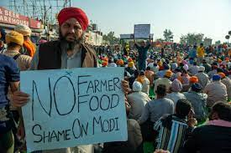
IGCSE GEOGRAPHY: 3.2 FOOD PRODUCTION
``
Causes of Food Shortages
Physical Natural Disasters: Droughts, floods, and tropical storms devastate crops (2011 drought in East Africa). Pest Infestations: Severe pest outbreaks, like locusts (East Africa, 2020-2021), destroy crops. Climate Change: Climate change alters weather patterns, impacting agriculture (flooding in Bangladesh affects rice). | Economic Poverty: Lack income can limit people's ability to access food. The GDP per capita of Swaziland is approx. $1,000 this means farmers do not have enough money to feed themselves or to sell. Market Failures: Issues such as poor transportation or inefficient distribution systems can hinder the flow of food to areas in need e.g. Venezuela. Unemployment: High unemployment in Zimbabwe's economic crisis makes accessing adequate food difficult. | Political Conflict and War: Armed conflicts disrupt agriculture. Farmers may flee their land or fight in conflict. Food used as a weapon by cutting food supplies or crops destroyed (e.g., civil war in South Sudan). Government Policies: Poor governance, corruption, or mismanagement can lead to food crises. Poor governance worsened the 1984-1985 famine in Ethiopia. Trade Policies: International barriers, like North Korea's restrictions, hinder food imports during shortages.
Impacts of Food shortages / Insecurity
Hunger/Malnutrition: Not enough food leads to hunger and malnutrition. About 828 million people worldwide suffer from hunger.
Soil Erosion: Trying to get more from their land, farmers contribute to faster soil erosion, especially in dry areas.
Rising Prices: Less food means higher prices. Global food prices increased by over 30% in 2021, hitting poorer countries the hardest.
Reduced Productivity: Not enough food makes people less productive, hurting economic growth.
Poverty: Farmers earn less, and poverty increases.
Social unrest: Scarcity leads to fights for survival. Example: Riots in Venezuela (2016-2017) were sparked by food shortages, causing a 250% inflation rate and doubling prices.

Slide 5
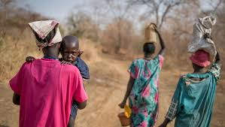
IGCSE GEOGRAPHY 0460: 2.1 THE CHALLENGE OF NATURAL HAZARDS
IGCSE GEOGRAPHY: 3.2 FOOD PRODUCTION
CASE STUDY: SOUTH SUDAN
Solutions
1. Conflict Resolution: Addressing the root causes of political instability to promote peace.
2. Agricultural Development: Invest in sustainable farming practices and agricultural infrastructure.
3. Humanitarian Aid: Provide targeted food assistance and nutritional support to affected populations.
4. Social Improvement : Enhance education and healthcare services to empower communities.
Causes of Food Shortages
Climate and Environment:
Inconsistent rain in South Sudan causes droughts or floods, disrupting crop growth.
Extreme temperatures harm crops, making it difficult for farmers.
Overusing land damages soil, leading to erosion and nutrient loss, making it hard to grow enough food.
Social Reasons:
Widespread displacement due to conflict disrupts traditional farming practices.
Limited access to education and healthcare exacerbates vulnerability.
Economic Reasons:
Economic instability and a reliance on subsistence agriculture hinder income generation.
High poverty rates limit the ability of communities to access and purchase food.
Political Reasons:
Ongoing political instability and conflict disrupt food production and distribution.
Limited infrastructure development hampers efficient transportation and storage of food.
Impacts of Food Shortages
Malnutrition: Many children in South Sudan don't get enough of the right kinds of food. This makes them grow less, get sick more easily, and might cause problems with their learning.
Economic Decline: Reduced agricultural productivity contributes to economic downturns.Farms in South Sudan aren't producing enough food.People who depend on farming lose money, and the whole country becomes poorer.
.
Social Unrest: There's not enough food for everyone, so communities might fight over what's left. People might have to leave their homes, causing more problems and making it harder for everyone to get along.
Context: Approximately 7.2 million people in South Sudan face food insecurity (UN, 2022).
1.4 million children under the age of five are acutely malnourished (UNICEF, 2022).
.

