Slide 1
DEVISING with AMANDA GORMAN’S POEM

Slide 2
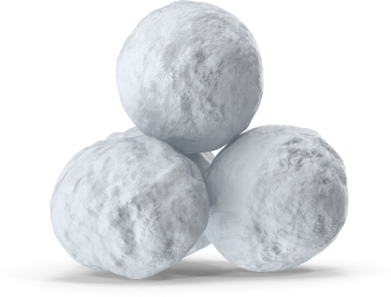
SNOWBALLS (Teacher instructions)
This exercise was learnt from Simon Bell, who does CPD training with ISTA and is an excellent practitioner. We highly recommend him if you get the chance to do some training with him. ‘Snowballs’ make an excellent (and fun) physical warm-up and introduce a new theme in a way which invites students to activate their engagement with the topic. (A great revision activity too.)
Print out the following white pages (A4) marked with snowballs and questions - enough for your whole class. There are 15, so if you have a class of 30, you need two sets.
Scrunch them up into ‘snowballs’ and put them in a box or basket.
At the start of the lesson, toss them out and invite the class to have a snowball fight - fun warm-up for the body and gets whole class engaged. (If social distancing, they can fight from within their boxes)
After a minute or so, make sure everyone has a snowball and a space. Invite them to open their snowball and think of an answer to the question posed.
They should come up with an individual still image in response. Invite them to add a sound/words to their response and explain that when you tap them on the shoulder, they will bring their response to life.
Move around the class tapping as appropriate. You can play with this in repeating a tap, doing more than one at the same time etc.

Slide 3
WHAT IS IMPORTANT TO YOU?
(not your family /PS5 etc - think of a social issue that the world faces that you feel strongly about)
© Jane Fisher & Rachel Caine

Slide 4
WHAT MAKES YOU ANGRY IN THE WORLD?
(Not your little brother or when you lose a game - but think of something people do/ don’t do in our world that makes you mad)
© Jane Fisher & Rachel Caine

Slide 5
WHAT DO YOU THINK THE WORLD NEEDS TO CHANGE?
© Jane Fisher & Rachel Caine

Slide 6
WHAT WOULD YOU DO IF YOU WERE IN CHARGE? (PRESIDENT/ PRIME MINISTER)
© Jane Fisher & Rachel Caine

Slide 7
WHAT IS ONE THING YOU COULD DO TO MAKE THE WORLD A BETTER PLACE?
© Jane Fisher & Rachel Caine

Slide 8
WHAT IS THE BIGGEST PROBLEM THE WORLD FACES RIGHT NOW?
© Jane Fisher & Rachel Caine

Slide 9
WHAT IS REALLY UNFAIR IN THIS WORLD?
(Not your little sister getting a bigger piece of cake than you - think big issues in the world)
© Jane Fisher & Rachel Caine

Slide 10
WHY SHOULD WE CARE ABOUT PEOPLE WE DON’T KNOW?
© Jane Fisher & Rachel Caine

Slide 11
WHAT WOULD YOU LIKE TO CHANGE IN OUR WORLD?
© Jane Fisher & Rachel Caine

Slide 12
WHAT WORRIES YOU ABOUT THE WAY WE LIVE?
© Jane Fisher & Rachel Caine

Slide 13
WHAT DO YOU KNOW ABOUT POVERTY?
© Jane Fisher & Rachel Caine

Slide 14
WHY IS PEACE IMPORTANT?
© Jane Fisher & Rachel Caine

Slide 15
WHY IS EDUCATION FOR ALL IMPORTANT?
© Jane Fisher & Rachel Caine

Slide 16
WHY DO WE VOTE FOR OUR LEADERS?
© Jane Fisher & Rachel Caine

Slide 17
WHEN IS IT RIGHT TO STAND UP FOR WHAT YOU BELIEVE IN?
© Jane Fisher & Rachel Caine

Slide 18
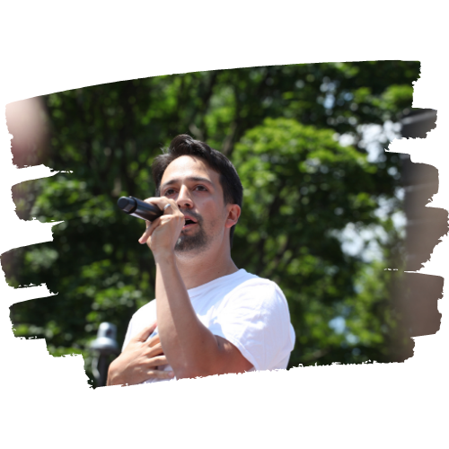
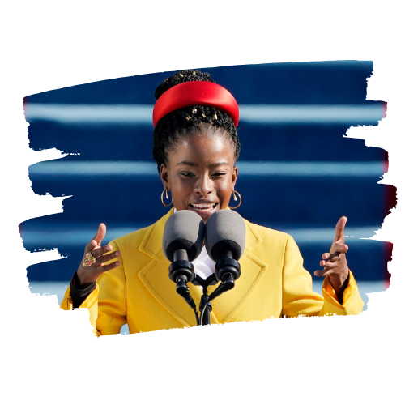
DISCUSSION
Based on what you saw and heard from your peers around the room, what themes & ideas are we exploring today?
“The right words in the right order can change the world…”
Do young people have any power to change the world?
Who said it?
Who was he talking to?
Lin-Manuel Miranda
Amanda Gorman
What does he mean?

Slide 19
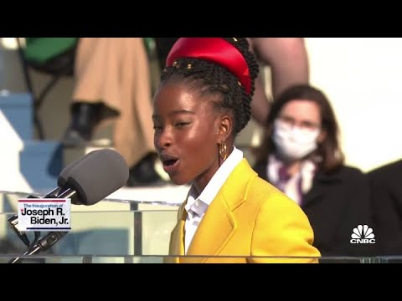
AMANDA GORMAN
(CNBC Television, 2021)

Slide 20
When day comes we ask ourselves,
where can we find light in this never-ending shade?
The loss we carry,
a sea we must wade
We've braved the belly of the beast
We've learned that quiet isn't always peace
And the norms and notions
of what just is
Isn't always just-ice
And yet the dawn is ours
before we knew it
Somehow we do it
Somehow we've weathered and witnessed
a nation that isn't broken
but simply unfinished
And so we lift our gazes not to what stands between us
but what stands before us
We close the divide because we know, to put our future first,
we must first put our differences aside
We lay down our arms
so we can reach out our arms
to one another
We seek harm to none and harmony for all
Let the globe, if nothing else, say this is true:
That even as we grieved, we grew
That even as we hurt, we hoped
That even as we tired, we tried
Choose 2-3 lines you think are powerful that you can commit to memory.

Slide 21
Individual to Group Work
This slide can be used as an instructional slide or the teacher can manage all of this verbally if it’s a distraction.
Individually rehearse saying your chosen lines: speak loudly and clearly and with expression. Don’t worry about what anyone else is doing. Focus on your confidence and expression with your lines.
The teacher will walk around and tap you on the shoulder when it’s your turn to perform.
Add a gesture or movement. Would it be useful or interesting to change levels?
Everyone stand in opening position ready.
The teacher will decide an order so take a note of who goes before you. Rehearse this so it flows with some fluidity. You can play with overlapping some of the pieces and/or repetition and/or pause between sections. Perhaps some of you working with the same lines will perform together or in canon.
Possible underscores: Ghost V (Nine Inch Nails) The Revenant Theme Tune (Ryuichi Sakamoto) Elysium (Amadea)
Add an underscore and dramatic lighting if available.
Perform again with sound and lighting.

Slide 22
EXCERPTS: Small Group Work
This slide can be used as an instructional slide or the teacher can manage all of this verbally if it’s a distraction.
On the next slides are selected excerpts from the poem.
Divide into 6 groups - or fewer, depending on the size of the class.
Each group picks/is given one of the excerpts to learn to perform in unison. All work must be in unison, including movement and gesture that is selected to bring the section to life. (If you’ve done any Greek choral work with the class, you can remind them of that choral speaking with bold gestures.)
Experiment with volume and pace. Make sure the group is working very tightly.
Possible Underscores
Ambient Build Up Music (Audionautics - Navajo Nights) Emotional Build Up Music -Moving Worlds (Secession Studios) Star Spangled Banner - Epic Trailer Version (Hidden Citizens) (
Experiment with groups freezing while others perform; groups performing just their movements/gestures while others perform; groups performing in a whisper/ very low volume while one group performs aloud.
Now all groups can perform together in a cycle, repeating their section a few times until each group is absolutely confident.
Make some choices as to how you will put it all together and add music/ lights if you choose.

Slide 23
And no one shall make them afraid
If we're to live up to our own time
Then victory won't lie in the blade
But in all the bridges we've made
That is the promise to glade
The hill we climb
In this truth
in this faith we trust
For while we have our eyes on the future
history has its eyes on us
This is the era of just redemption
We feared at its inception
We will not march back to what was
but move to what shall be
A country that is bruised but whole,
benevolent but bold,
fierce and free
We will rebuild, reconcile and recover
and every known nook of our nation and
every corner called our country,
our people diverse and beautiful will emerge,
battered and beautiful
When day comes we step out of the shade,
aflame and unafraid
The new dawn blooms as we free it
For there is always light,
if only we're brave enough to see it
If only we're brave enough to be it
But one thing is certain:
If we merge mercy with might,
and might with right,
then love becomes our legacy
and change our children's birthright
Excerpts from The Hill We Climb (Amanda Gorman) (CNN, 2021)

Slide 24
‘VIEWPOINTS’ STYLE EXERCISE (Page 1)
(Amazon.com, 2021)
This exercise is loosely based on a few Viewpoints exercises in the book by Anne Bogart & Tina Landau. It works with shape and space and topography. And is intended to work loosely with the idea of change and perhaps a shift to freedom. It might be best if the teacher uses this slide as a kind of script to guide the work rather than having students look at slides while work. It is also suggested you use some music as they are shaping the work. Some possible suggestions below or you could use any of the previous tracks, or your own choice. Each track will create a different effect. (You can explain Viewpoints or not, depending on what level you are teaching and whether you will/have experimented with other Viewpoints).
TEACHER SCRIPT (We’ve just written it like this as it’s the easiest way to explain the suggestions. Of course you can/will use your own words but this is how we might guide this work.)
Walk the space. But I want you to only walk on a grid. Imagine if there is a giant piece of graph paper painted onto the floor and you can only walk on those lines. You can only turn at 90/180 degree angles. You must be careful not to walk into anybody. Make a sharp turn to avoid clashes. (You can shift through some walks and stops here, working on on sharp lines and complete stops.)
Come to a stop in your own space. Now we are going to be working with shape.
First I want you to experiment with straight lines. See how many straight lines you can create with your body. Be as boldy experimental as you can be. Don’t worry about what anyone else is doing. This is your work with your body. You can have corners but they must be sharp. Play with lines on different levels. Play with using your whole body rather than just your limbs. Which directions can your lines take? We are working in a sharp, angular way.
Now choose three of your straight line shapes and move between them coming to an absolute still moment on each shape as I count. Can you make getting into the shape as ordered (or frantic?) as possible. Let’s keep to very sharp, sudden movements. But don’t come to a stop until I call. And moving in sharp angles to first shape. And 3 and 2 and 1. Stop. Hold. Hold. Hold. Second shape and 3 and 2 and 1. Stop. Hold. Hold. Hold. And third shape and 3 and 2 and 1. Stop. Hold. Hold. Hold. (You can repeat this until they have a good little sequence and have largely same timings. You might use kinaesthetic awareness to know when to stop if your class has that kind of focus.
Lullaby Dream - Balanescu Quartet
Somewhere Over the Rainbow - Lady Gaga
Inception - Dream is Collapsing (Hans Zimmer)

Slide 25
‘VIEWPOINTS’ STYLE EXERCISE (Page 2)
Now walk the space again but you are only going to move in curves. You must never be in a straight line. Your movements might become increasingly light and floaty. Avoiding others is easy as you’re are so light and able to shift in a lovely curve away from them. As we move further into the exercise, you might become faster, breaking into a jog, but keeping it light and effortless.
Come to a stop in your own space. Working with shape again. But this time we are working with curves. See how many curved shapes your body can make. Again, working beyond just your limbs. How can you curve your whole body? In how many different directions can you curve at the same time?
Now choose three of your curved shapes and move between them coming to an absolute still moment on each shape as I count. Can you make getting into the shape as free and floaty and fluid as possible - without it looking silly. Keep movements slow if moving fast makes it feel silly. But again, don’t come to a stop until I call. And moving in fluid curves to first shape. And 3 and 2 and 1. Stop. Hold. Hold. Hold. Second shape and 3 and 2 and 1. Stop. Hold. Hold. Hold. And third shape and 3 and 2 and 1. Stop. Hold. Hold. Hold. (Again, you can repeat this until they have a good little sequence and have largely same timings. You might use kinaesthetic awareness to know when to stop if your class has that kind of focus.)
Hopefully you can see a way to put this all together into a kind of physical theatre piece now. Each teacher and class will create something different and want to play with it in different ways. You may rely on the teacher giving instructions or claps to guide students or they may be able to work effectively as an ensemble. It will depend on age, experience and the number of lessons you have them for.
You may want to add a line or two of the poem at some points or you may choose to keep this section purely physical. If your class has done any lift/contact work, perhaps that could be fun to bring in? (Probably not going to happen while we are in the grips of Covid - but maybe useful in future.)
Lullaby Dream - Balanescu Quartet
Somewhere Over the Rainbow - Lady Gaga
Inception - Dream is Collapsing (Hans Zimmer)

Slide 26
Think carefully. Write your answers on post-it notes.
WHOSE SHOULDERS DO YOU STAND ON?
WHAT DO YOU STAND FOR?
I am the daughter of black writers who descended from freedom fighters who broke the chains and changed the world.
They call me. (Amanda Gorman)

Slide 27
TIME TO WRITE
Individually, write your own bit of performance poetry. It could be 5 lines, 10 lines, 50 lines… whatever you feel inspired to write.
PERFORMANCE POETRY
Performance poetry uses the stage as the page, transforming poetry readings into theatrical events. While the recent resurgence of performance poets is seen as a reaction against mainstream, print-based poetry, the style harkens back to the classic role of the poet, who recited notable happenings, emotions, and perceptions. (Webexhibits, 2021)
Alliteration contributes to theatrical nature
Often has a social / political message
PERFORMANCE POETRY
Varied rhyme and rhythm - often irregular and makes use of surprising internal rhymes
Often playful with language

Slide 28
SHARING
WORK
is a risk we take to get better or enjoy rewards
SHARE YOUR WORK
builds relationships in our class
After each sharing, you can all say something you liked about the poetry
Divide into groups of 3-5 and share your work with your group.
requires both courage and trust
If the sharer chooses to, they can invite suggestions / critical feedback but this is not compulsory
is the best way to get better
MAKE YOUR CHOICE:
As a group, choose whether you want to combine the work into something or use one person’s work or combine two or more.

Slide 29
GROUP DEVISING
Here are just some suggestions for how students might work in groups to devise some work based on their own writing. A teacher might choose to manage this in an entirely different way. You can work with what suits your class and students.
Doing this section in complete silence can build intense focus and precision.
Each individual in the group creates one gesture that represents an idea in the poem. Teach your gesture to the group and learn them in sequence so you can repeat the cycle exactly. Watch each other and identify the slightest differences in how you perform each gesture. Aim for exact precision.
As a group create 3 still images that represent some of the important ideas explored in your chosen text. Aim for variety in this - shifting away from the unison of the previous work.
Put this work together in any way that is interesting. For example, you could:
Repeat your gestures with increasing speed, building up to the three still images.
Start the cycle of gestures in canon, coming into the 3 still images one by one.
Be playful and experimental with pace, emotion and repetition.
Now work out where and how you want to add the words from your selected text to your piece. You might even choose to record them and perform them and do only the physical work on stage. You might be speaking while doing the physical work. You might move between the two.

Slide 30
GROUP WORK WITH ‘THE HILL WE CLIMB’
INDIVIDUAL WORK WITH ‘THE HILL WE CLIMB’
SMALL GROUP WORK WITH OWN POETRY
PULLING IT ALL TOGETHER
PHYSICAL WORK ON CHANGE (VIEWPOINTS)
MUSIC & LIGHTING CHOICES
Do you want to add some bits from your own writing? (Maybe one line from each person’s original work)

