Slide 1
Year 7: Drawing Skills
MATERIAL THINGS
Lesson 2: Photographing Texture

Slide 2
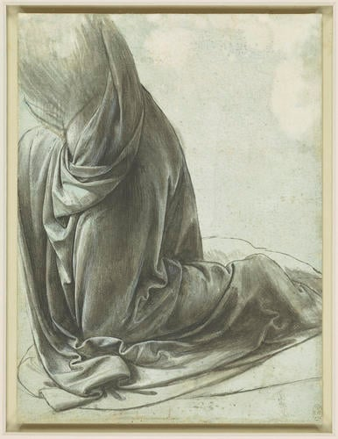
FORMAL ELEMENTS
TEXTURE
TONE
LINE
LEONARDO DA VINCI
The drapery of a kneeling figure c.1491-4
Brush and black ink, white heightening, on pale blue prepared paper
21.3 x 15.9 cm (sheet of paper)
Last lesson, we looked at this image. What can you remember?

Slide 3
Learning Intentions
In this lesson we take primary source photographs, which we will draw from later on in this unit.

Slide 4
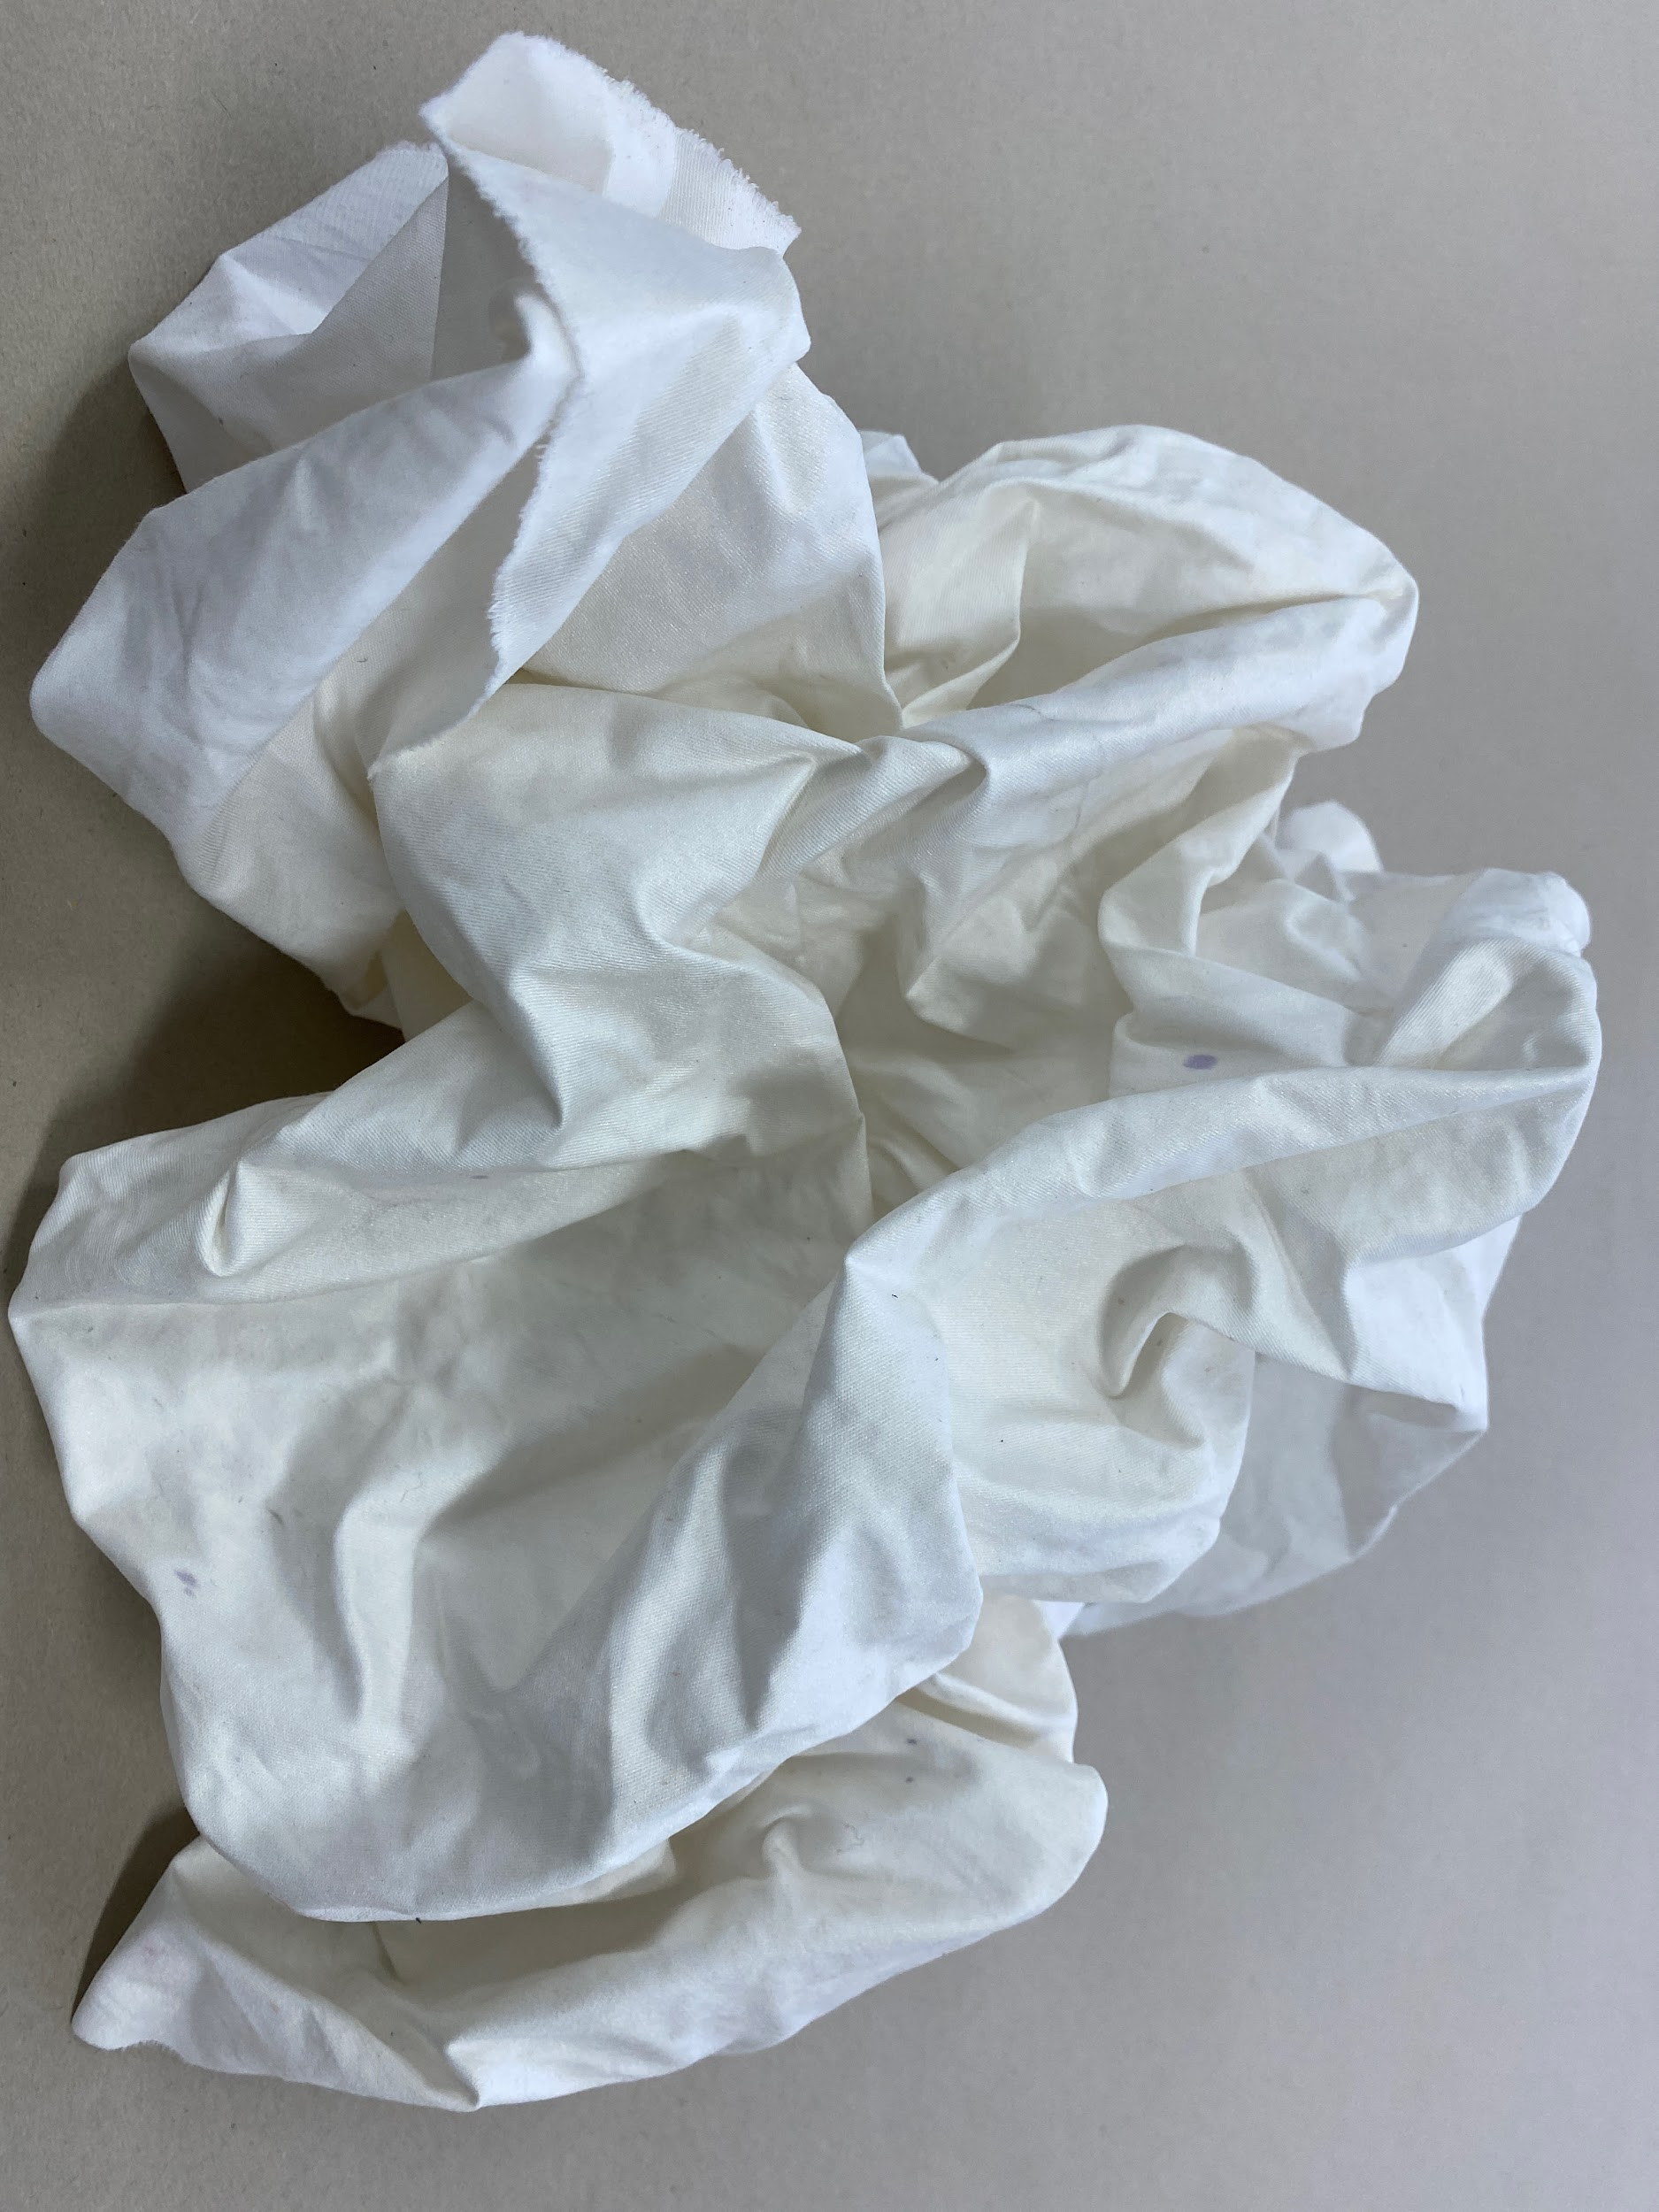
PRIMARY SOURCES
Working from primary source images in art is important for the highest marks. When we say ‘primary source’ we mean ‘an image you have taken yourself’.

Slide 5
TASK 1
TAKING PRIMARY SOURCE PHOTOGRAPHS
Today you will need to use your phone or a camera to take 5 interesting photographs of a t-shirt / shirt / jumper/ hoodie (anything you have to hand that is made of fabric). Try to capture as many creases as you can – scrunch/fold/layer the fabric for the most interesting photographs.
Extension Task: Edit your photographs so they are black and white (this will help you draw from them later)

Slide 6
This is what your t-shirt / shirt / jumper/ hoodie etc should like like in front of you ready for you to to draw

Slide 7
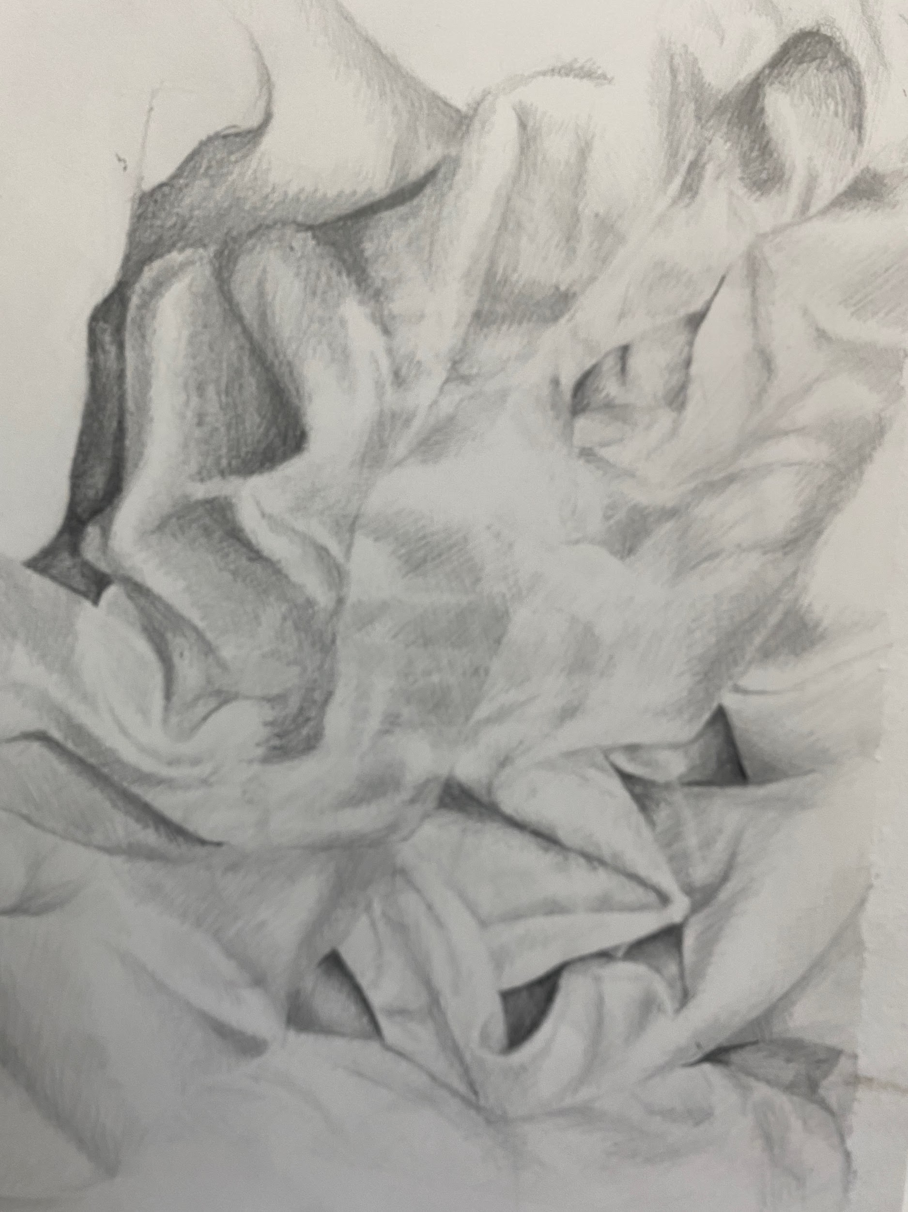
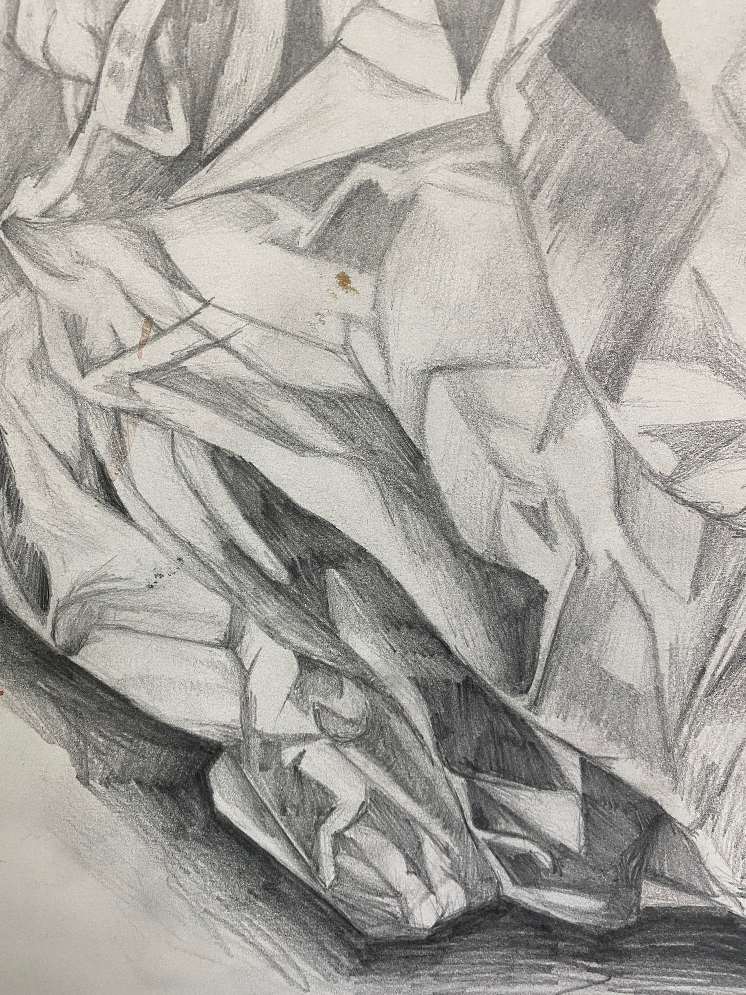
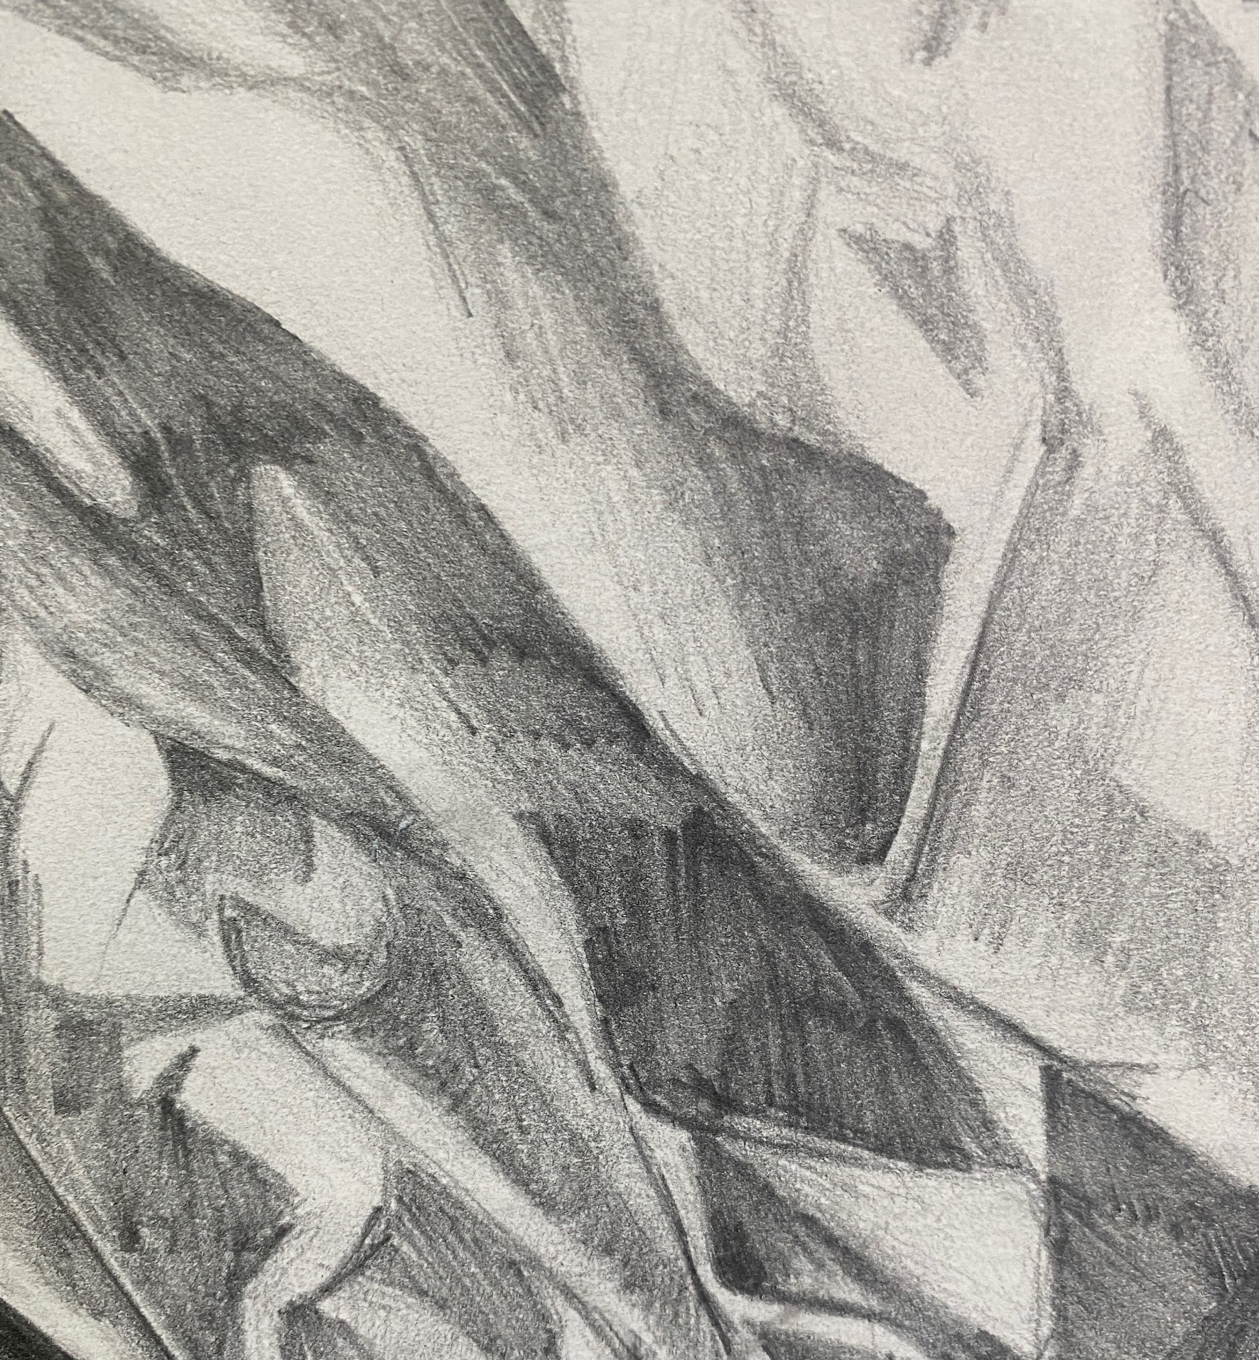
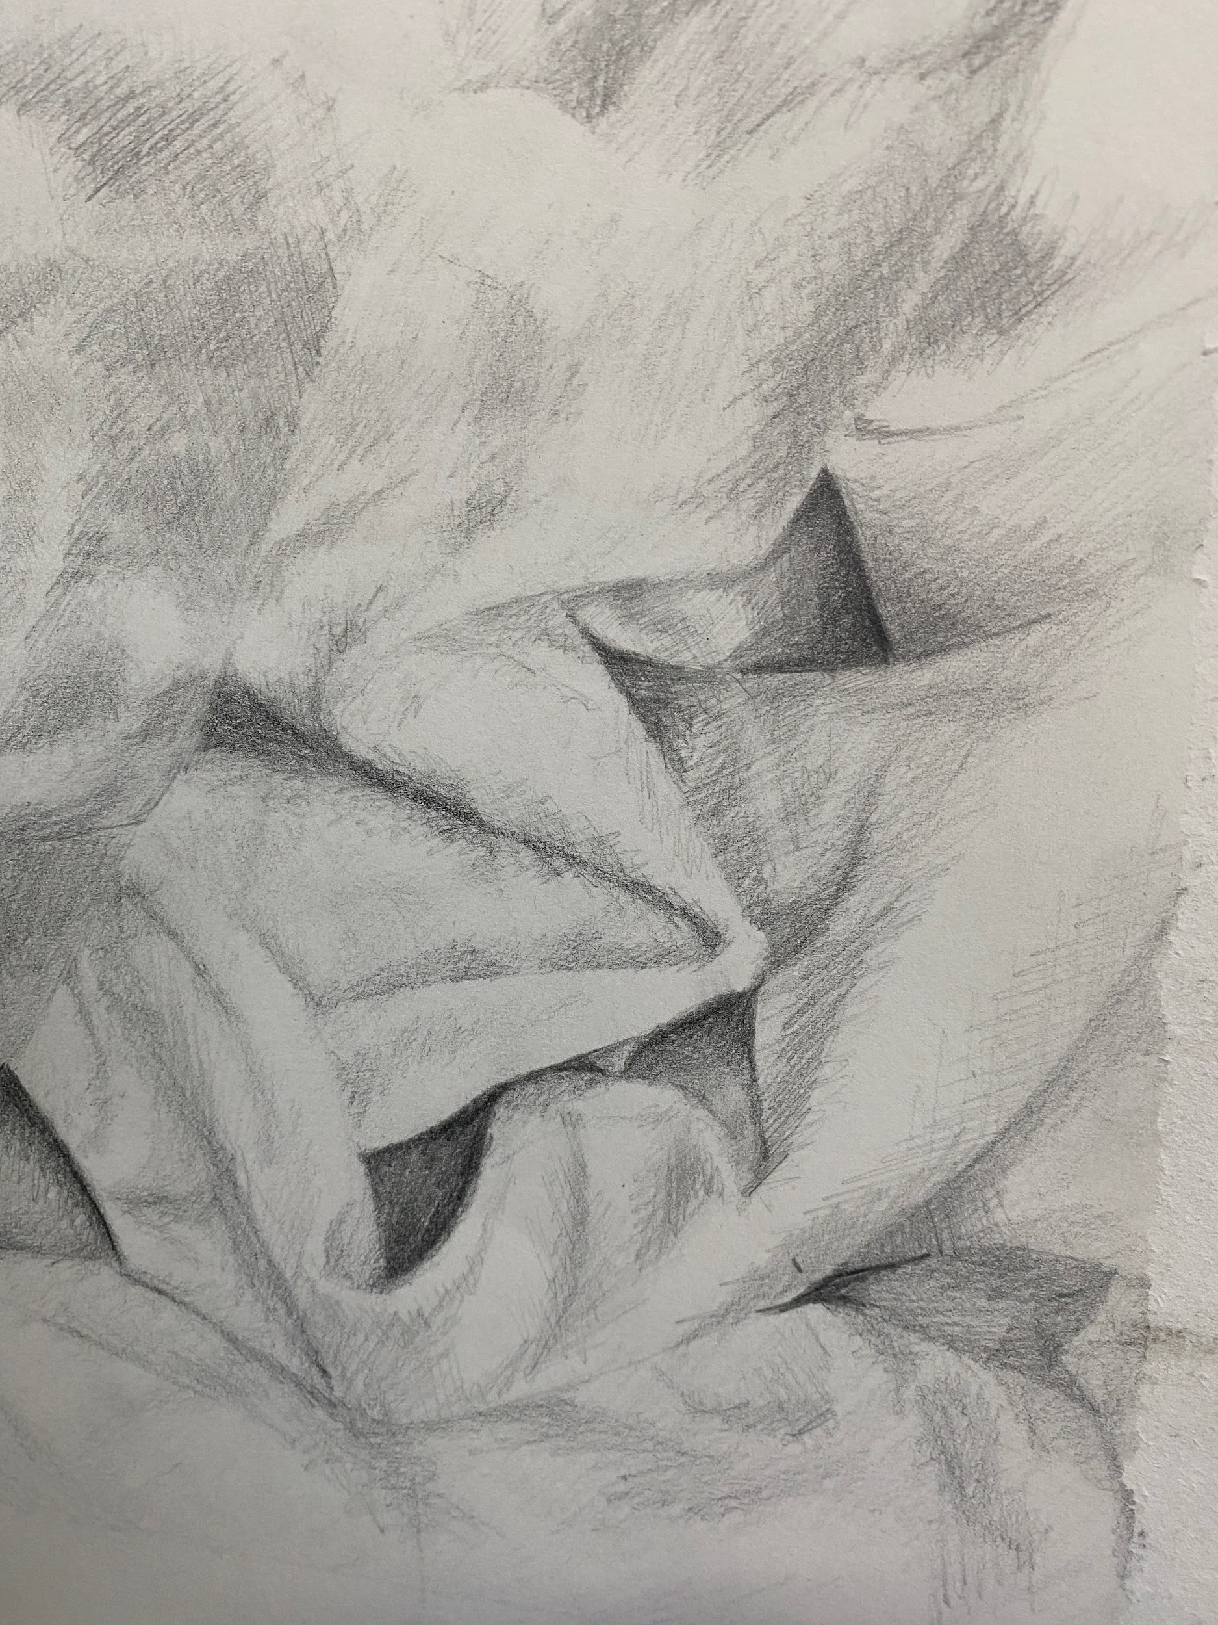
NEXT LESSON YOU WILL CHOOSE ONE OF YOUR PHOTOGRAPHS TO DRAW OUT AS AN A3 ARTWORK.

Slide 8
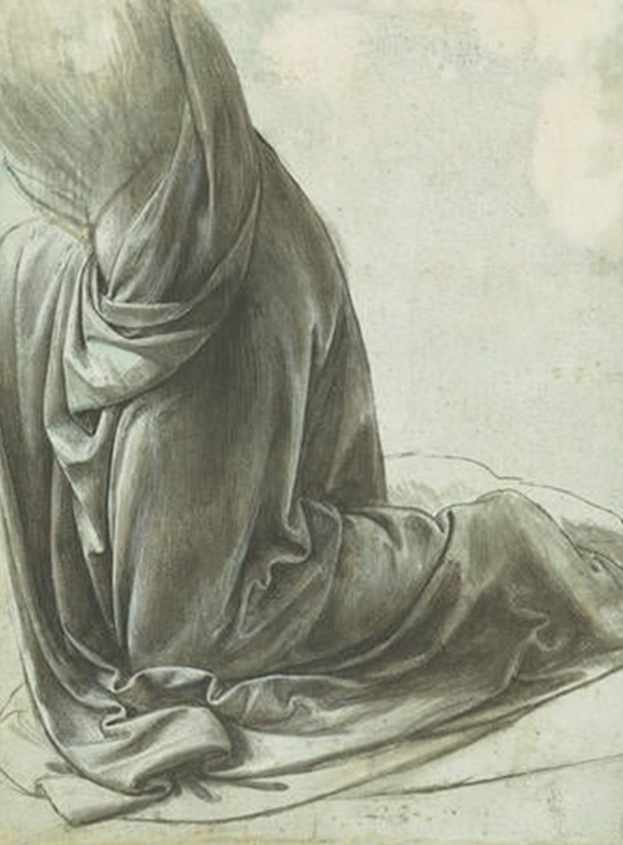
EXIT
Which was your favourite photograph? How do you think you might draw it out as an A3 artwork?

Slide 9
KS3 VISUAL ARTS
HOLISTIC ASSESSMENT MATRIX
1 LIMITED | 2 BASIC | 3 EMERGING + COMPETENT | 4 COMPETENT + CONSISTENT | 5 CONFIDENT, ASSURED + EXCEPTIONAL
Limited ability to observe and record formal elements | Basic ability to observe and record formal elements | Emerging competent ability to observe and record formal elements | Competent and consistent ability to observe and record formal elements | Exceptional ability to observe and record formal elements
1 | 2-3 | 4-5 | 6-7 | 8-9
Formal Elements Line Shape Form Tone Texture Space Pattern Colour Composition | Formal Elements Line Shape Form Tone Texture Space Pattern Colour Composition | Formal Elements Line Shape Form Tone Texture Space Pattern Colour Composition | Formal Elements Line Shape Form Tone Texture Space Pattern Colour Composition | Formal Elements Line Shape Form Tone Texture Space Pattern Colour Composition
Partial Rushed Unrefined Inconsistent Uneven Observation | Unresolved Play safe Simplistic Straight forward Developing Easy Option | Broadening Sufficient Shows Understanding Relevant Individuality Beginning to refine | Effective Purposeful Refined Skilful Imaginative Consistent Realised | Assured Sensitive Independent Comprehensive Unexpected Fluent

