Slide 1
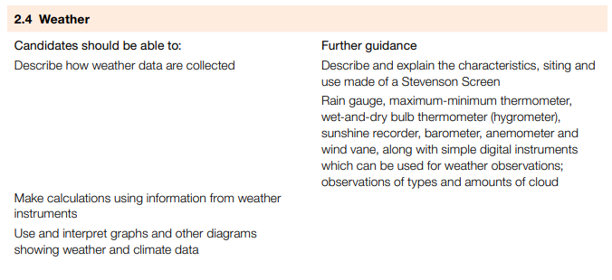
IGCSE GEOGRAPHY: 2.4 WEATHER

Slide 2
IGCSE GEOGRAPHY: 2.4 WEATHER
Recording and understanding the weather is vital for farmers, sailors, and the general public. It enables informed decisions about crops, aids planning for sea voyages, and helps people prepare for severe weather events like thunderstorms and hurricanes. Accurate weather forecasts are essential for safety and efficient planning.
Climate: The average (general/normal) weather conditions that a region or country experiences. Climate is averaged over 30 years.
Weather: The current state of the atmosphere in regards to temperature, cloud cover, wind speed and direction, precipitation, humidity etc
Weather forecast contain references to different weather elements: temperature, pressure, wind, precipitation etc.
Temperature – Degrees centigrade (0C)
Air pressure – Millibars (mb)
Wind direction -Compass direction that the wind comes from
Wind speed- Miles/KM per hour (mph) or knots
Humidity- %
Cloud type and cover- How many eighths of the sky are covered (OKTAS) and name of a cloud type
Precipitation type and amount – Millimetres (mm
Some weather elements are measured by instruments and some by the eye.

Slide 3
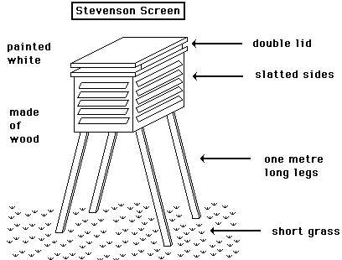
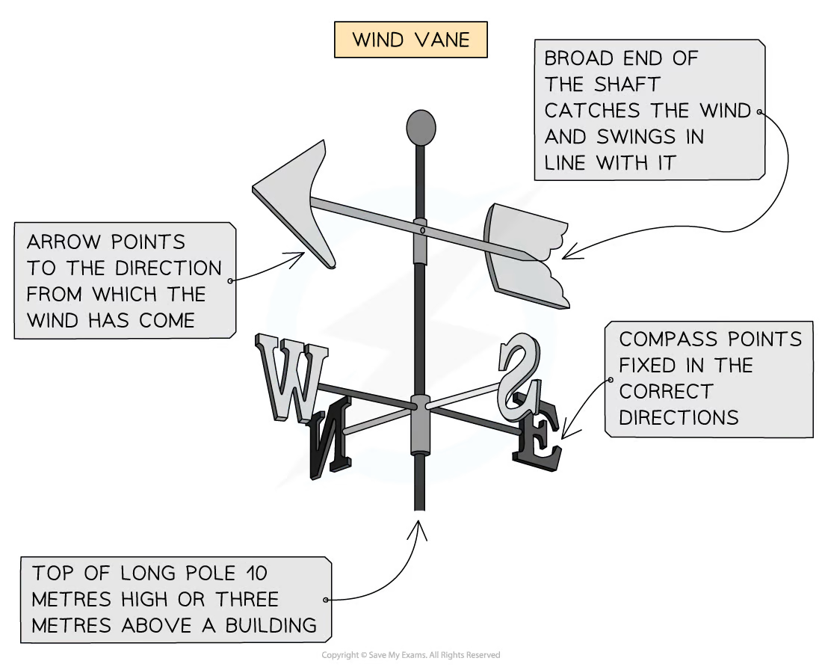
IGCSE GEOGRAPHY: 2.4 WEATHER
The Stevenson screen is a compact weather station for local conditions. It includes a max/min thermometer and a hygrometer. Outside, you find a rain gauge, anemometer, barometer, and wind vane
1. Painted white for sun reflection
2. Wooden to prevent heat conduction,
3. Slatted sides for airflow.
4. Roof has double layers for insulation.
5. Placed on grass to reduce ground heat. Daily readings are taken at the same time.
Site conditions: Barometers and barographs away from strong air, sunlight, and heat. Thermometers kept away from heat-radiating buildings. Wind vanes and anemometers positioned in the open, away from obstacles by at least three times their height. Rain gauge in an open space, twice its height away from objects.
Modern meteorological stations use automated digital instruments transmitting data to the Met. Office's computers.
Wind direction: is measured with a wind vane
Direction is the compass point from where the wind is blowing - south, north, north-east etc.
Site considerations: Open area, elevated and away from buildings & trees. Avoid obstacles & maintain a proper distance to ensure accurate readings. Securely mount it to a stable structure. Place near the anemometer for comprehensive wind data.

Slide 4
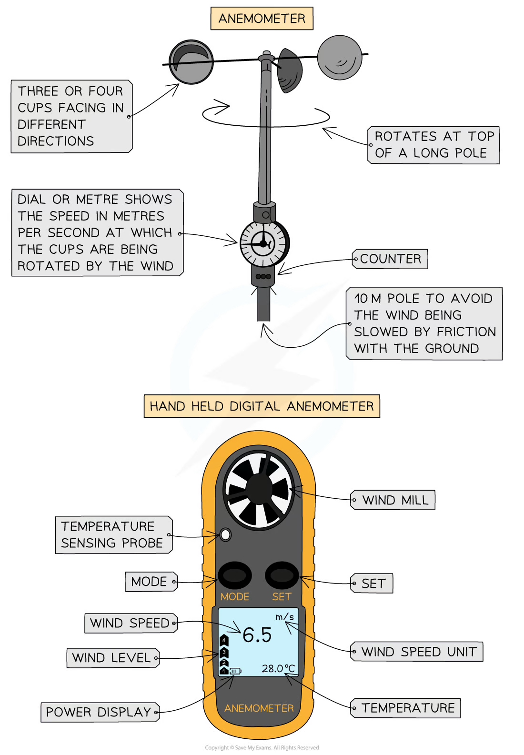
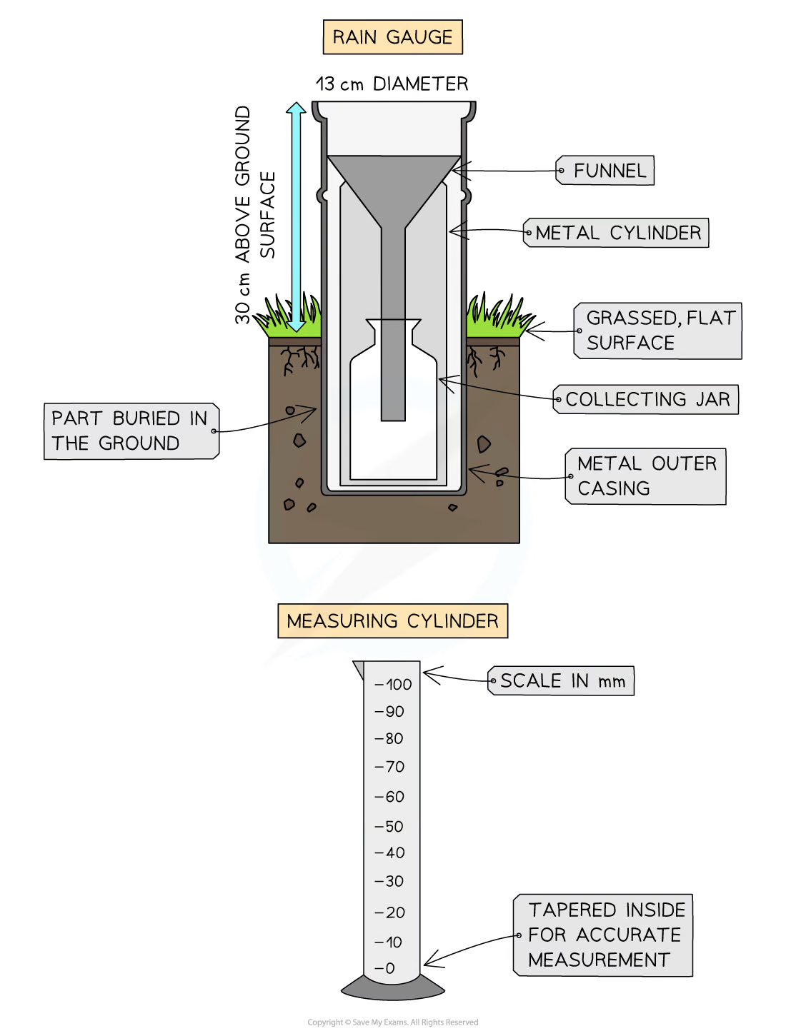
IGCSE GEOGRAPHY: 2.4 WEATHER
Wind speed: Wind speed is measured with an anemometer
The anemometer consists of 3 or 4 cups fixed on metal arms that rotate freely on a 10m vertical shaft. The stronger the wind, the faster the cups rotate, and more rotations are recorded on the counter
The digital handheld anemometers need to be held into the oncoming wind and as the fan rotates, the number is shown on the screen. Many anemometers are digital that transmit data directly to apps and computers to show readings directly
Site consideration: Wind vanes and anemometers are placed well away from any buildings or trees that can interfere with air movement. Buildings can create wind tunnels or slow airflow and therefore, affect the accuracy of any reading
Precipitation: A rain gauge is used to measure precipitation (rain, hail, snow). At the same time each day, any water that has collected is poured into the tapered measuring cylinder
Measuring cylinder needs to be on a flat surface.The water level is then read with the eye at the same level as the lowest part of the meniscus of the water. Measurements are then recorded.
Site consideration: Place the rain gauge in an open, level area away from obstacles. Ensure proper elevation to prevent overflow. Choose an accessible location for easy maintenance and readings.

Slide 5
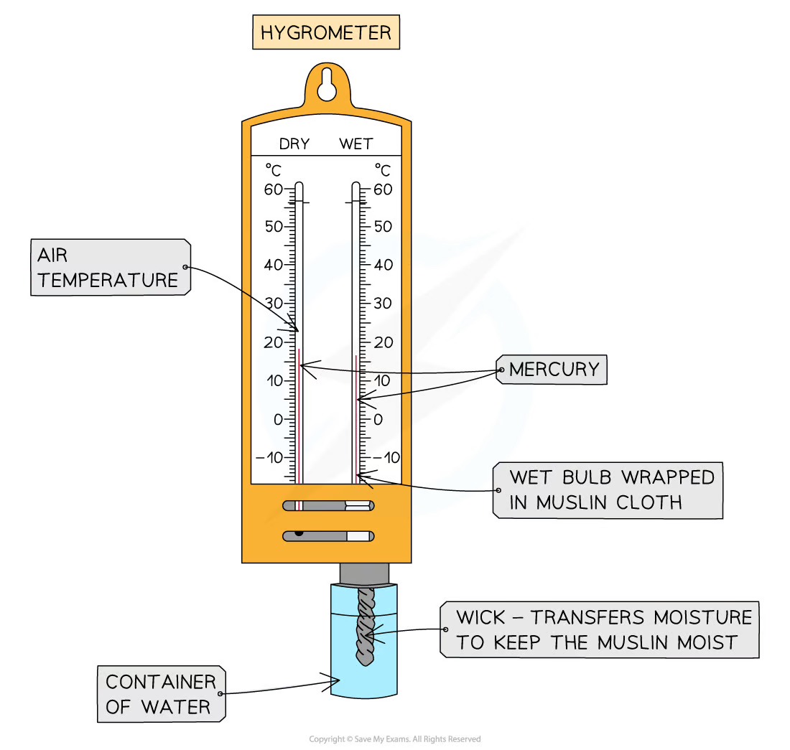
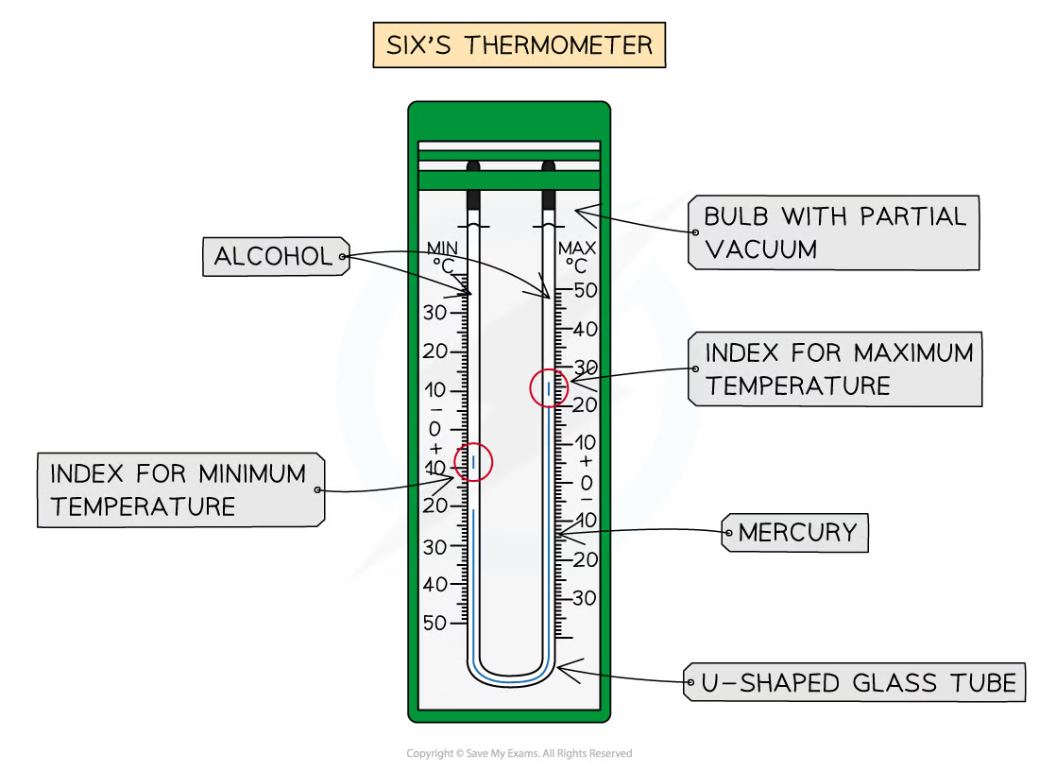
IGCSE GEOGRAPHY: 2.4 WEATHER
Temperature: Temperature is measured using a thermometer or thermograph. Unit of measurement is Celsius ° C, or Fahrenheit ° F. Most traditional is a Six's thermometer, which houses a maximum and minimum thermometer in a U shape
The following measurements can be done:
Daily minimum temperature
Daily maximum temperature
Average temperature calculations for one day
Humidity: Wet and dry bulb thermometers, together known as a hygrometer, measure relative humidity by assessing the evaporative cooling effect. The wet bulb thermometer reading reflects the cooling caused by water evaporation, and the dry bulb thermometer measures the surrounding air temperature. The comparison of these two readings allows for the calculation of relative humidity.
Site considerations: For accurate readings, place the hygrometer in a shaded, well-ventilated location on a level surface, away from direct sunlight and heat sources. This ensures optimal measurement.
Site considerations: Place Six's thermometer in a shaded, well-ventilated area on a level surface to ensure accurate temperature readings. Keep it away from direct sunlight and heat sources to maintain precision.

Slide 6
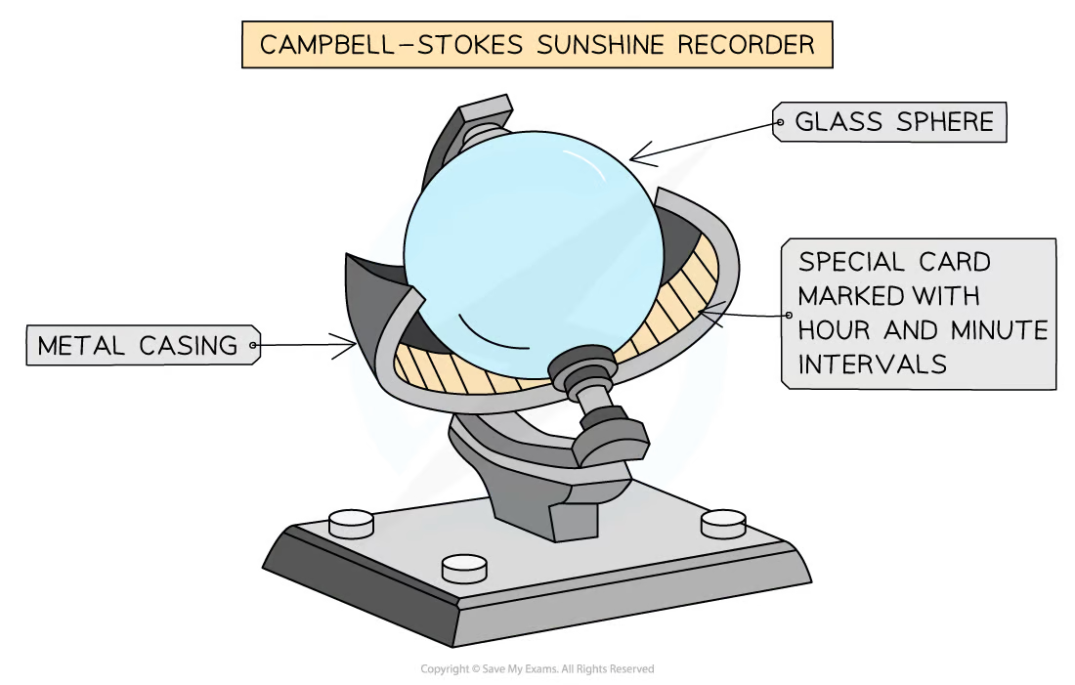
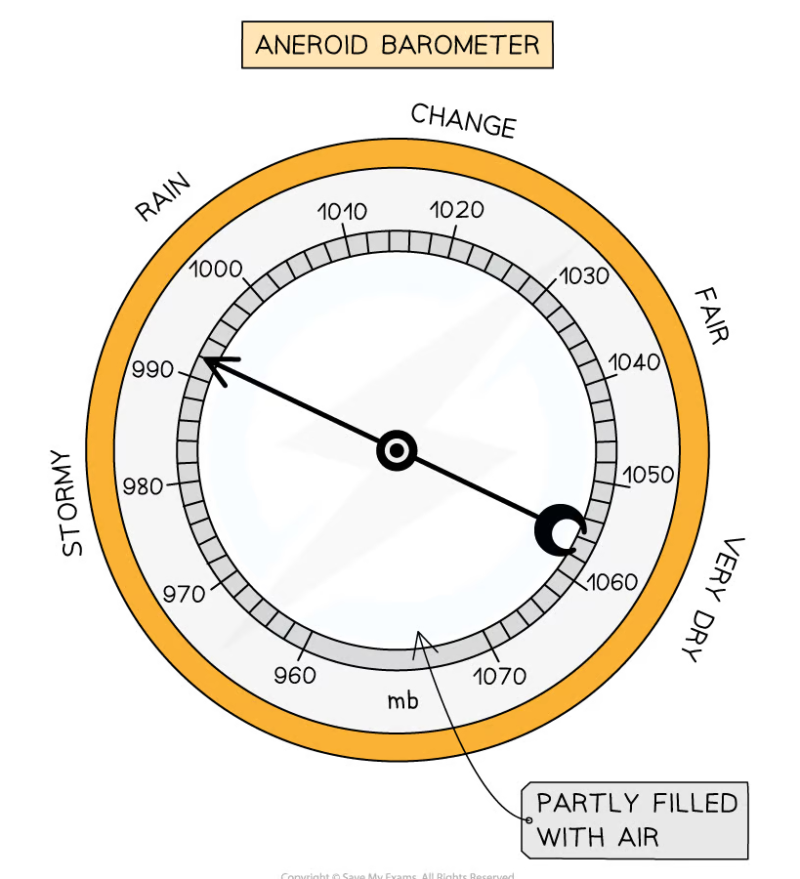
IGCSE GEOGRAPHY: 2.4 WEATHER
Air pressure: is measured using a Barometer, the unit used is mb/millibars.
An aneroid barometer features a vacuumed metal chamber with a resilient spring that expands and contracts with atmospheric pressure changes. Levers amplify these changes, and a pointer indicates the current atmospheric pressure on a calibrated scale. A barograph provides a week-long continuous record of pressure changes, using a flexible arm to trace variations on a rotating cylinder covered with paper divided by 2-hour vertical lines.
Sunshine hours: are measured using a Campbell-Stokes sphere (Heliograph) , a glass sphere surrounded by a metal frame. Unit used is minutes and hours.
Sunlight passing through the sphere burns a trace on a recording card beneath it, with the length of the trace indicating the sunshine duration. To use it, place the recorder in an open, sun-exposed space, ensure the recording card is inside, and measure the burn line at day's end. Replace the card daily, record every 24 hours at the same time, and stop at sunset to determine the daily sunshine duration.
Site conditions: Place the Campbell-Stokes sphere in an open, sun-exposed area facing south (or north in the southern hemisphere). Ensure direct sun exposure without shade, and use a stable structure like a pedestal or roof for mounting. Daily maintenance includes replacing the recording card, measuring the burn line at the same time, and recording sunshine duration.
Site conditions: Place the aneroid barometer in a stable, level location protected from direct sunlight and vibrations for accurate and reliable atmospheric pressure measurements.

Slide 7
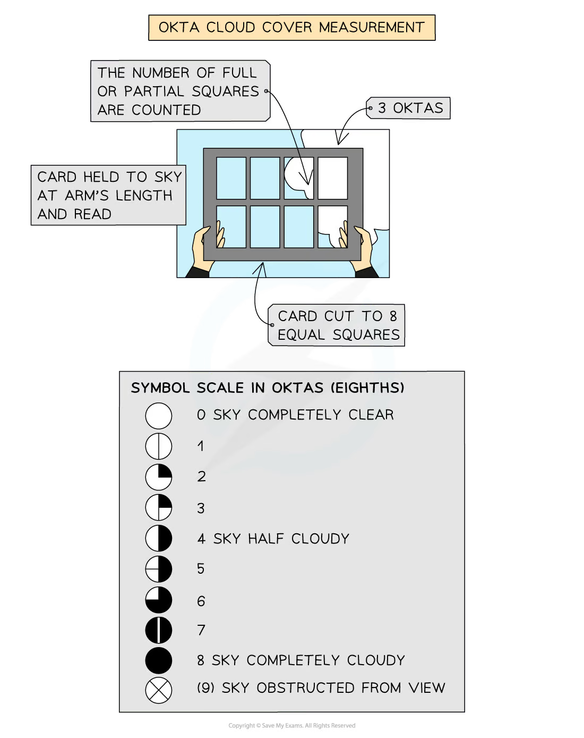
IGCSE GEOGRAPHY: 2.4 WEATHER
Clouds coverage: Meteorologists may use subjective methods, like visual observations, to estimate cloud cover based on their appearance in the sky. Cloud cover is measured in units of oktas. Each okta represents one eighth of the sky covered by cloud
0 oktas = clear sky,
8 oktas = total coverage
Digital weather measuring equipment has revolutionized meteorological observations, offering numerous benefits
Precision and Accuracy: Digital instruments provide highly accurate and precise measurements, reducing the margin of error.
Real-time Monitoring: Digital sensors enable real-time monitoring of weather conditions, allowing immediate data collection and analysis.
Remote Sensing: Many digital weather instruments can be remotely operated and monitored, making them suitable for harsh or inaccessible environments.
Data Logging: Digital equipment comes with built-in data logging, allowing for continuous recording of weather parameters over time.
Integration with Technology: Digital weather instruments can be easily integrated with computer systems and networks, facilitating data sharing, analysis, and dissemination.
Cost-Effective: While initial costs may be higher, digital equipment often proves cost-effective in the long run due to lower maintenance and operational expenses.
Site considerations: For accurate cloud coverage measurements, choose an open area with an unobstructed sky view, away from light pollution. Place instruments at a consistent, elevated location, ensuring regular maintenance for reliable data collection.

Slide 8
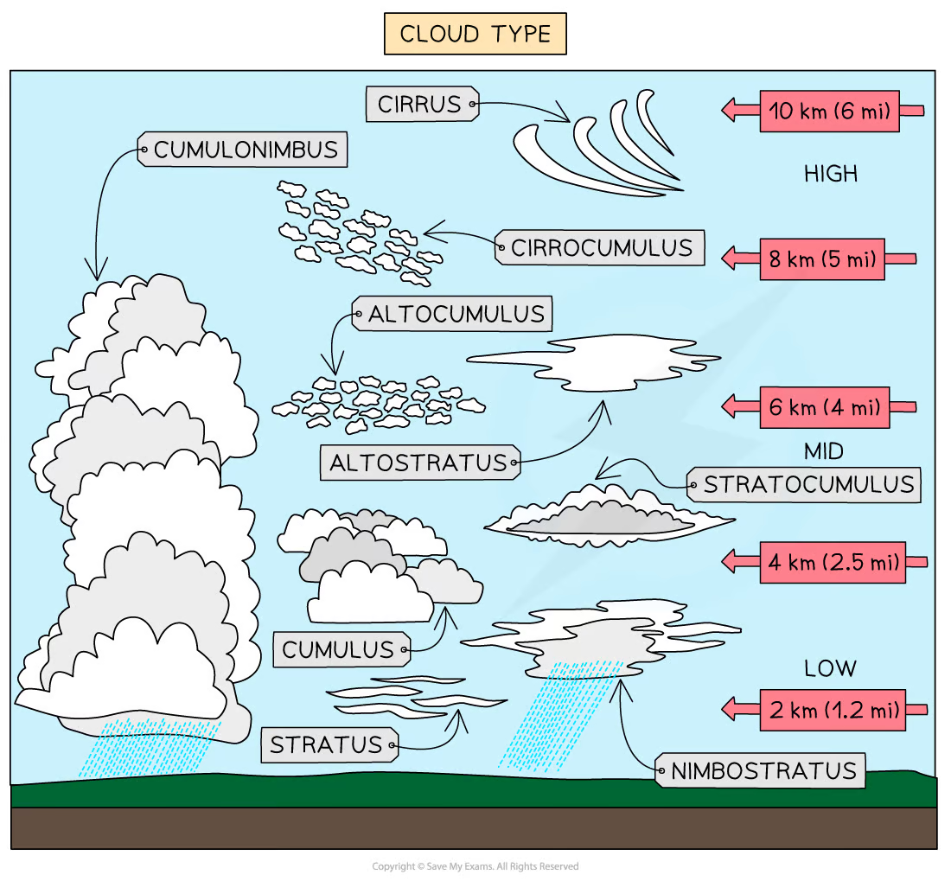
IGCSE GEOGRAPHY: 2.4 WEATHER
Types of Clouds
Cirrus Clouds: Wispy, high-altitude clouds usually indicate fair weather.
Cumulus Clouds: Fluffy, white clouds with a flat base, often associated with fair weather, but can develop into larger storm clouds.
Stratus Clouds: Low, gray clouds covering the sky like a blanket, often bringing overcast conditions and light precipitation.
Altostratus Clouds: Gray or blue-gray clouds found at middle altitudes, often preceding storms with continuous rain or snow.
Altocumulus Clouds: White or gray clouds at middle altitudes, appearing as a layer of cotton balls and sometimes signaling changing weather.
Stratocumulus Clouds: Low, lumpy clouds covering the sky, usually not bringing precipitation but can lead to overcast conditions.
Nimbostratus Clouds: Thick, dark clouds covering the sky and associated with continuous, steady precipitation.
Cumulonimbus Clouds: Towering clouds with an anvil-shaped top, capable of producing severe weather such as thunderstorms, heavy rain, and tornadoes.

Slide 9
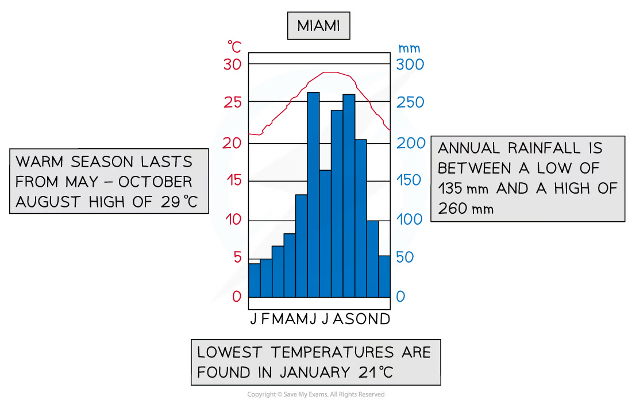
IGCSE GEOGRAPHY: 2.4 WEATHER
Climate graphs: A climate graph shows mean monthly temperatures and precipitation rates over 30 years
They can be local, national, or global
Precipitation is always shown as a bar graph and temperature as a line graph. Remember to quote units, e.g. Celsius or millimetres.
Describe the overall shape of the graph:
Is the temperature line steep or gentle?
Are there changes throughout the year?
Always mention the months but do not give a month-by-month account
Note the highest and lowest temperature and rainfall plus the month in which they occur.
Note anomalies - something that isn't following a trend
Range: by subtracting the lowest number from the highest:
Total: Add the rainfall totals for each month together to work out the total annual rainfall
Average: Add each month and then divide this by 12 to find the average monthly rainfall

Slide 10
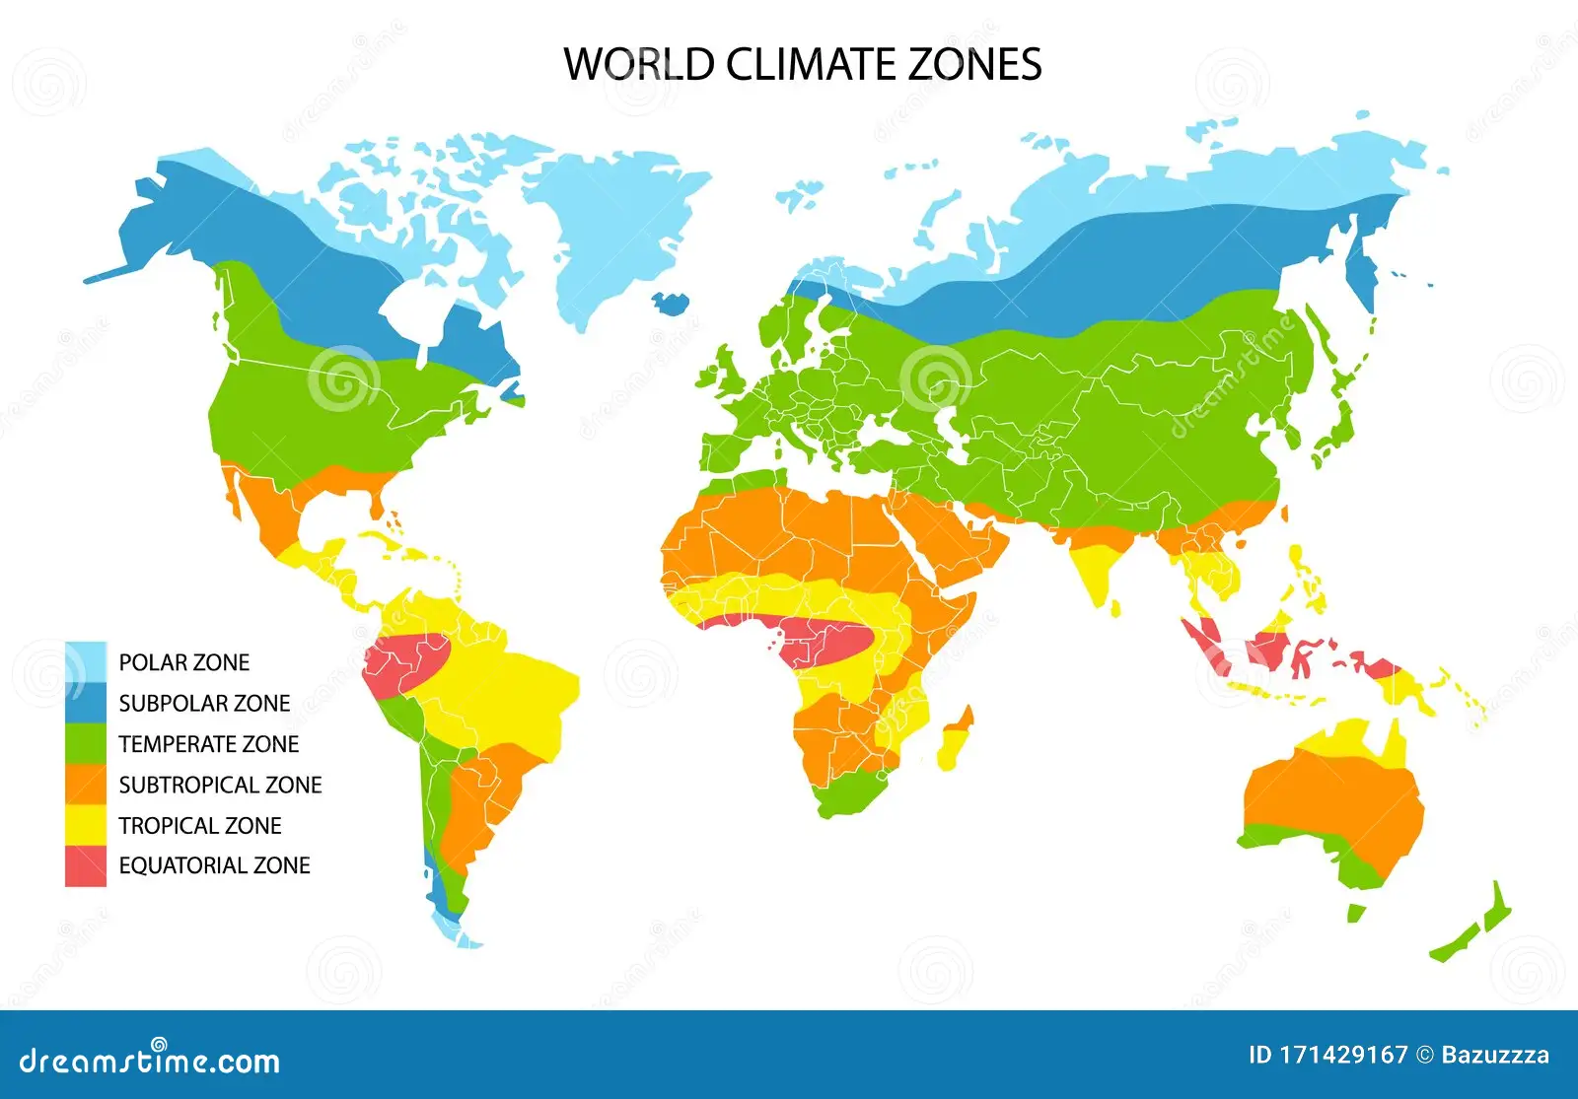
IGCSE GEOGRAPHY: 2.5 CLIMATE
Climates vary across the world. Factors that affect climate:
Latitude: closer to the equator = higher temperature
Distance from the sea: coastal area = warmer winters and cooler summers
Prevailing winds: seasonal difference in heating between land and sea affects temperature of prevailing wind. Warm prevailing wind = rise in temperature
Ocean currents: warm currents raise winter temperatures in coastal areas; cold currents cool them down in summer
Altitude: higher altitude = lower temperature (1° per 100m)
Continentality: locations further inland heat up more quickly in the summer and cool more quickly in the winter
Aspect: in the northern hemisphere slopes facing south are warmer
Pressure systems: areas usually affected by low pressure such as the equator have rising air, condensation and cloud formation leading to more precipitation, whereas areas affected by high pressure have dry conditions due to the sinking air
The number of climatic zones but the main are:
Tropical Zone: High temperatures throughout the year and abundant precipitation. It is typically found near the equator.
Temperate Zone: Experiences distinct seasons, with warm to hot summers and cool to cold winters. It is found between the tropical and polar zones.
Polar Zone: Low temperatures and is characterized by the presence of ice caps and glaciers. It is located near the poles.
Hot Desert Zone: Extremely high temperatures, particularly during the day, and minimal precipitation.
Cold Desert Zone: Experience low temperatures, especially in winter, and still receive minimal precipitation.

