Slide 1
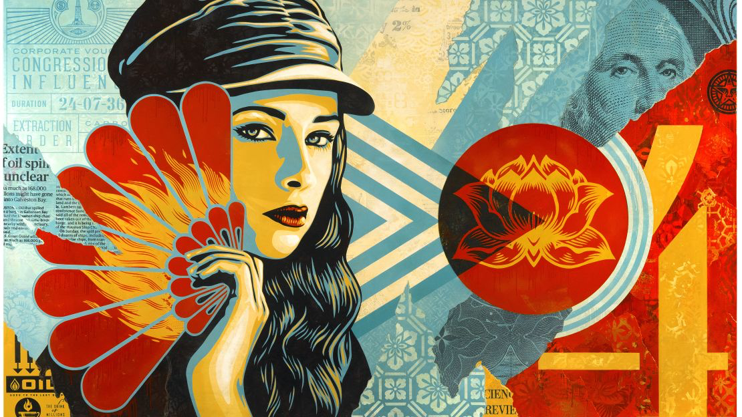
HEROES & LEADERS
Year 9: Art Activism Unit
Lesson 7: Portrait Photography

Slide 2
Learning
Intentions
Express and Represent: Learn to express and represent themes through body language and pose.
Photography Skills: Develop photography skills to capture a compelling self portrait that conveys your chosen theme.

Slide 3
Starter Task In pairs, discuss this artwork by Shepard Fairey. Consider the following:
The Key Characteristics of Shepard Fairey’s Artwork
Line: Describe the types of lines used.
Tone: Explain the use of light and dark areas.
Colour: Discuss the colour palette and its significance.
Texture: Describe any visual or physical textures.
Pattern: Identify patterns in the artwork.
Shape and Form: Discuss the shapes and forms present.
Contrast and Scale: Explain the use of contrast and scale.
Proportion and Emphasis: Describe the focus areas and proportions.
Balance, Harmony, Rhythm, and Movement: Discuss how these elements create a sense of harmony and movement.

Slide 4
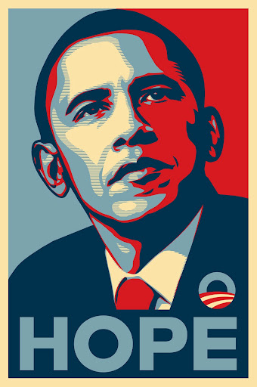
Task Take a photograph of yourself in a pose that represents your chosen theme. Consider body language, pose and facial expression to effectively convey your message.
Activity: Capturing Your Leadership Pose
Pose Ideas:
Leadership: Standing tall with a confident posture, hands on hips, or pointing forward.
Determination: Fists clenched, eyes focused, body leaning forward.
Compassion: Gentle expression, open arms, relaxed posture.

Slide 5
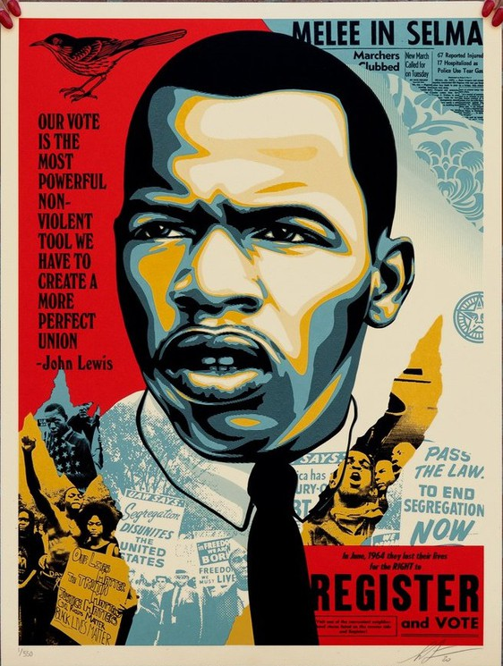
Activity: Capturing Your Leadership Pose
Instructions:
Plan Your Pose:
Think about your chosen theme and the message you want to convey. Consider how body language can represent leadership, determination, or any other quality related to your theme.
Prepare Your Setting:
Choose a location with a plain background.
Capture the Photograph:
Use a camera or a smartphone with a good-quality camera.
Experiment with different poses and angles.
Take multiple shots to find the one that best represents your theme.
Review and Select:
Review the photographs you’ve taken.
Select the best one that clearly conveys your chosen theme.

Slide 6
Self-Assessment
Exceeding (Level 7-9)
I have captured a high-quality photograph that clearly represents my chosen theme.
My pose, body language, and facial expression effectively convey my message.
Meeting (Level 4-6):
I have captured a good-quality photograph that represents my chosen theme.
My pose and body language convey my message, though some aspects may need refinement.
Working towards (Level 1-3):
I have captured a good-quality photograph that represents my chosen theme.
My pose and body language convey my message, though some aspects may need refinement.

Slide 7
