Slide 1
Year 7: Drawing Skills
MATERIAL THINGS
Lesson 3-6: Drawing Texture

Slide 2
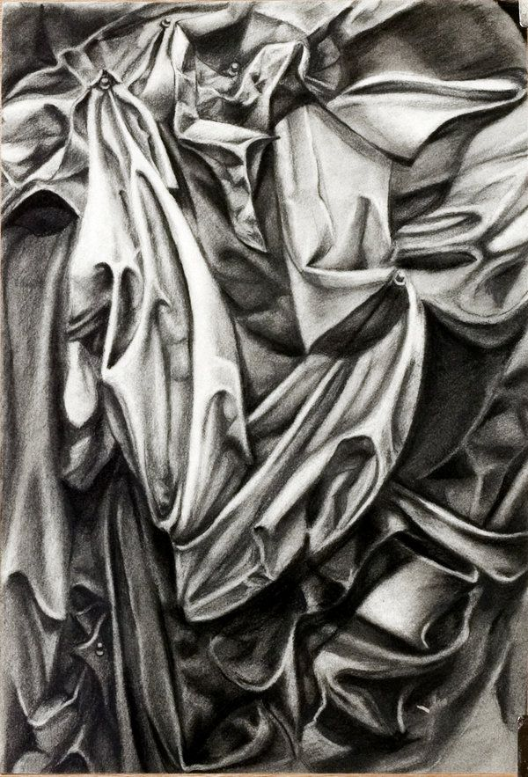
FORMAL ELEMENTS
TEXTURE
TONE
LINE
MOVEMENT?
What is successful about this drawing?

Slide 3
Learning Intentions
In this lesson we will learn to draw different textures using different pressures with your pencil to create tone.

Slide 4
FORMAL ELEMENTS
TEXTURE
TONE
LINE
DRAWING - Texture
WATCH THIS SHORT VIDEO TUTORIAL TO GET YOU STARTED

Slide 5
DRAWING - Texture
Over the next several lessons we are going to produce an A3 observational drawing observing TEXTURE. You will plan out lightly (holding your pencil about half way up the stem) and observe the basic SHAPES / FORM as a very light LINE drawing and then you will add TONE.
We will need to prepare quickly so you have enough time to complete your drawing - as always, if you’d like to continue (EXTENSION) at home, to add more to your study or make your drawing a more in depth and better quality piece of work, then please do (this is your choice) but will make a difference to your assessment and progress.
REMEMBER TO FILL THE PAGE, DON’T TRY TO SQUEEZE YOUR DRAWING ON TO THE PAPER – LET YOUR VIEWER IMAGINE WHAT IS HAPPENING BEYOND THE PAGE.
FORMAL ELEMENTS
TEXTURE
TONE
LINE

Slide 6
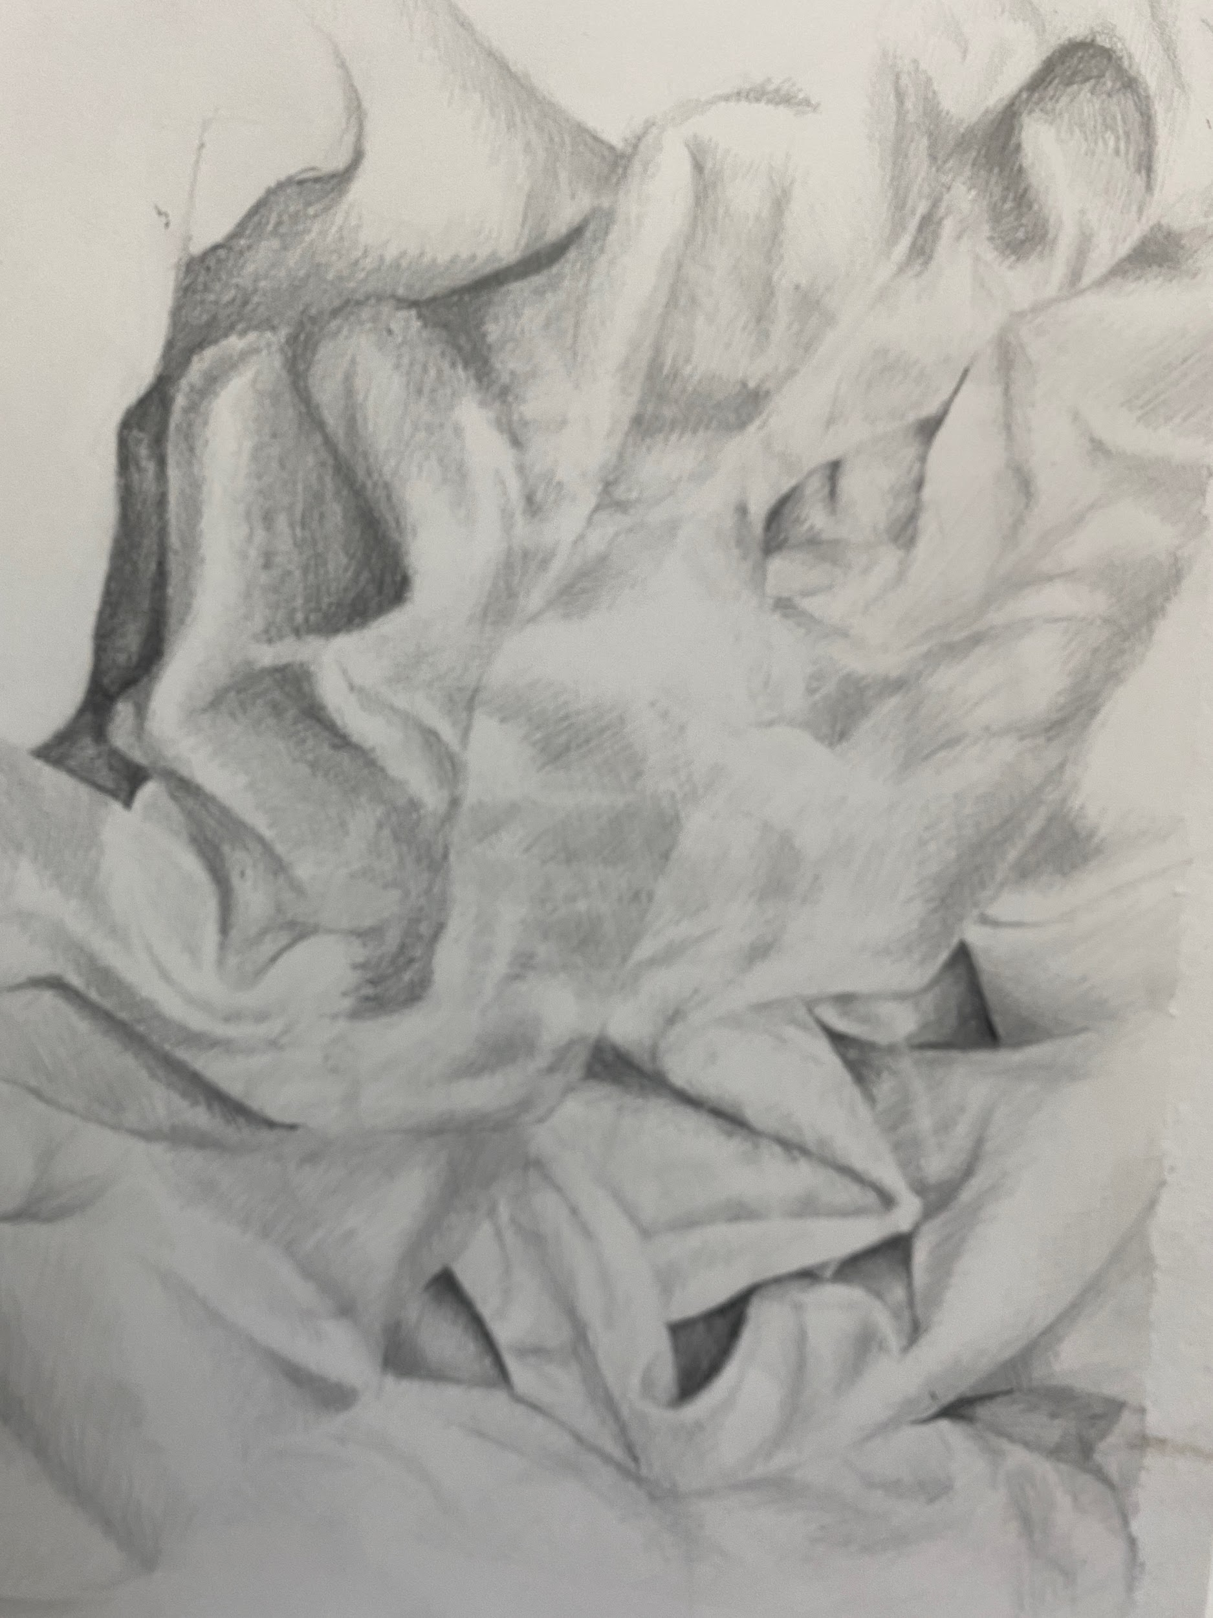
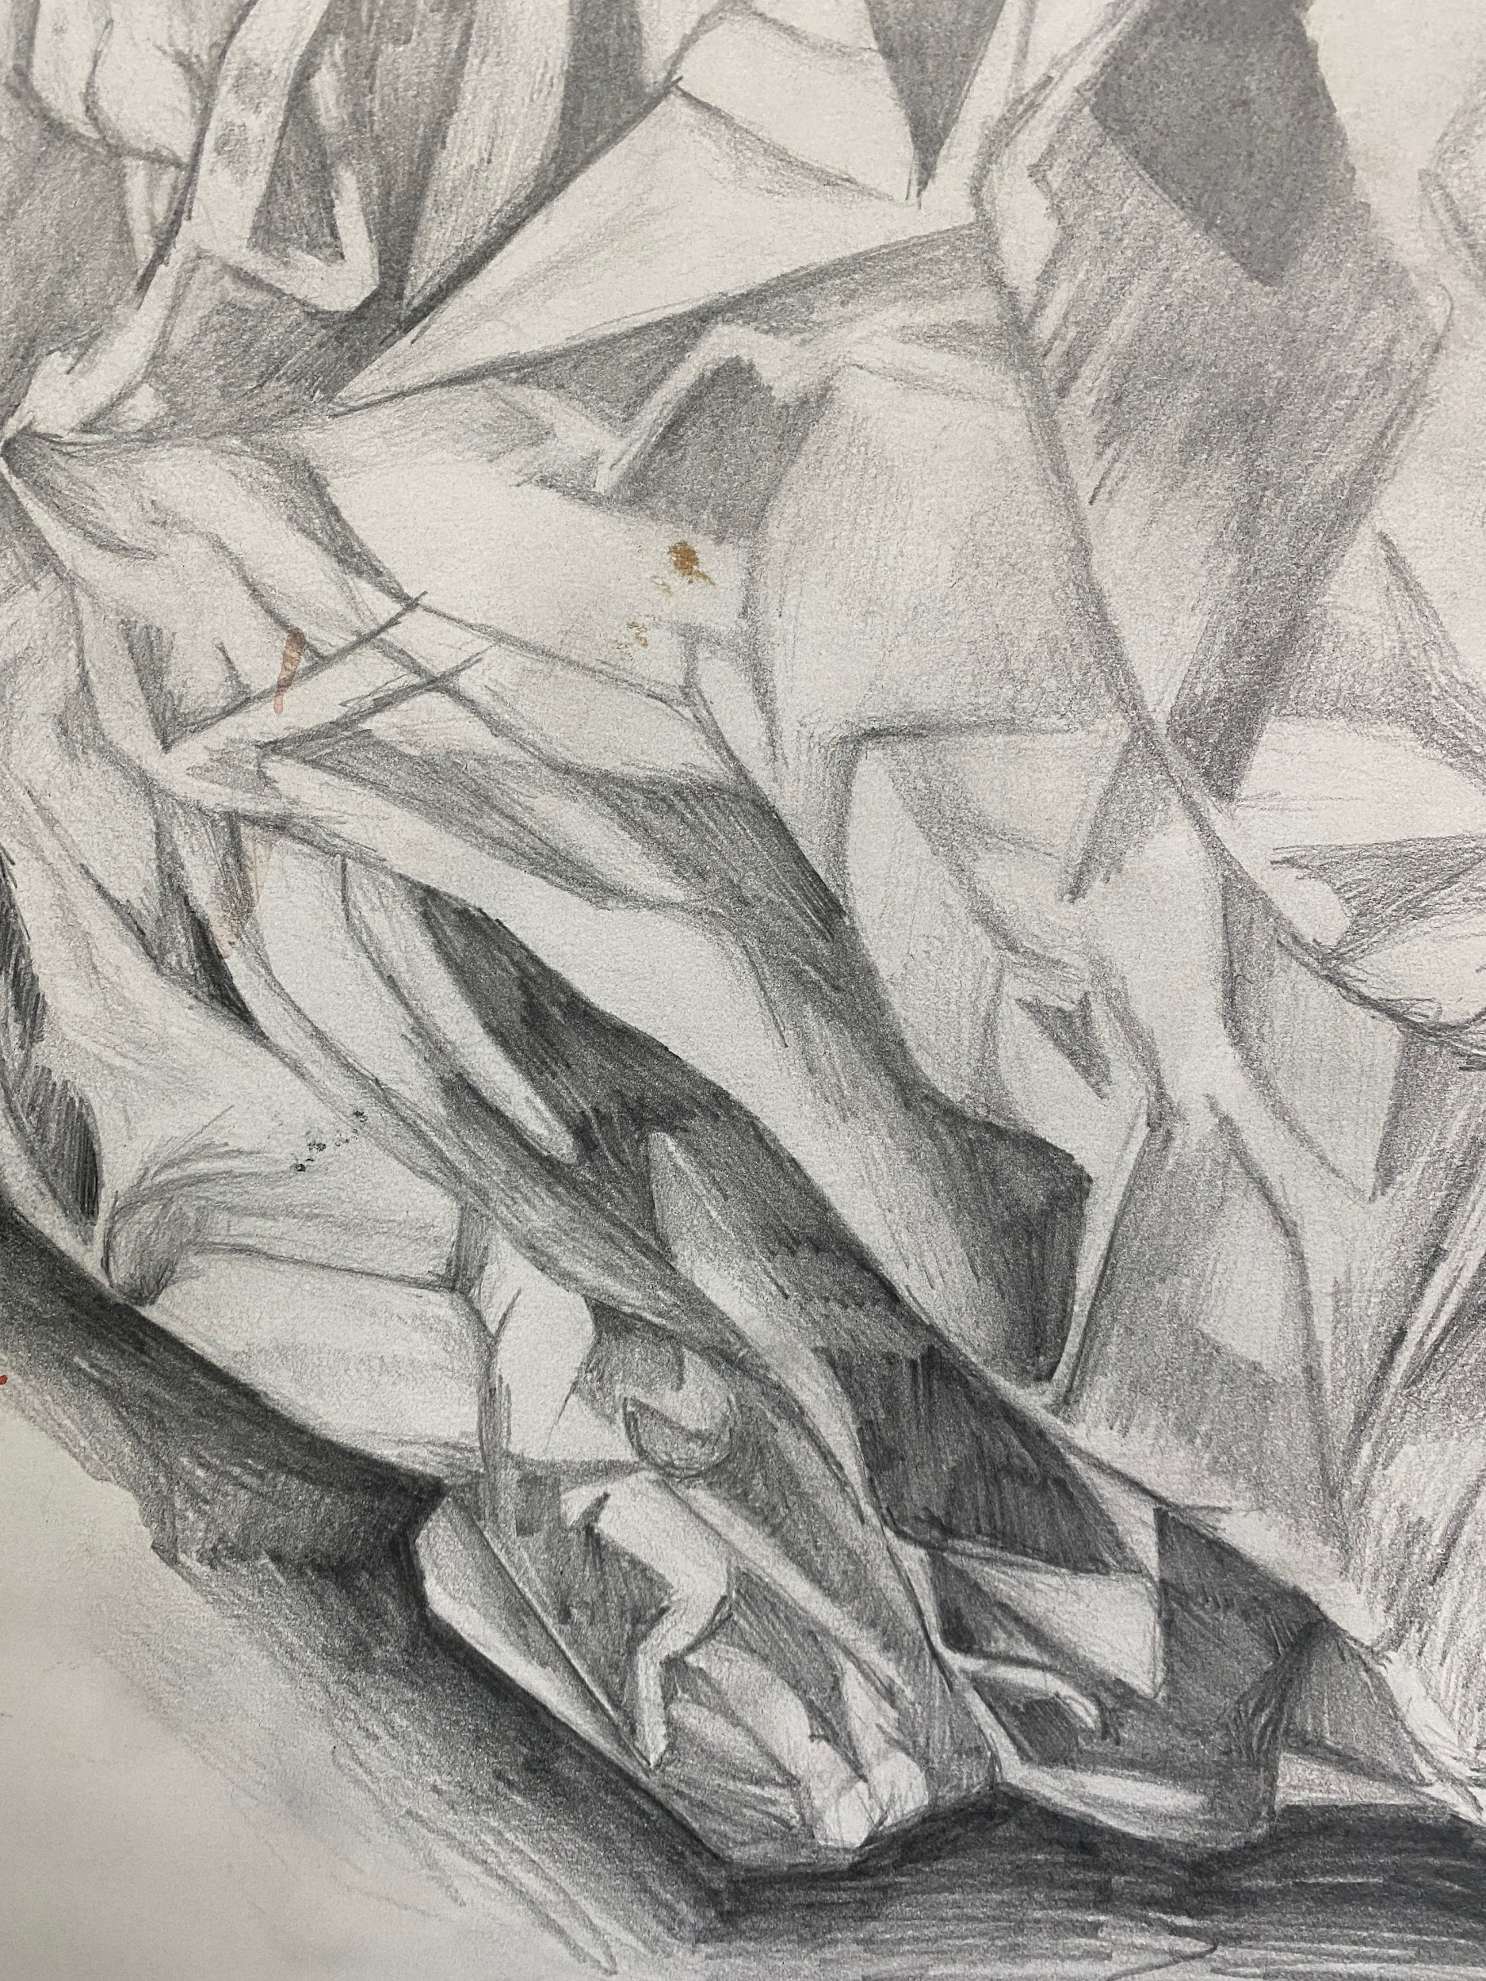
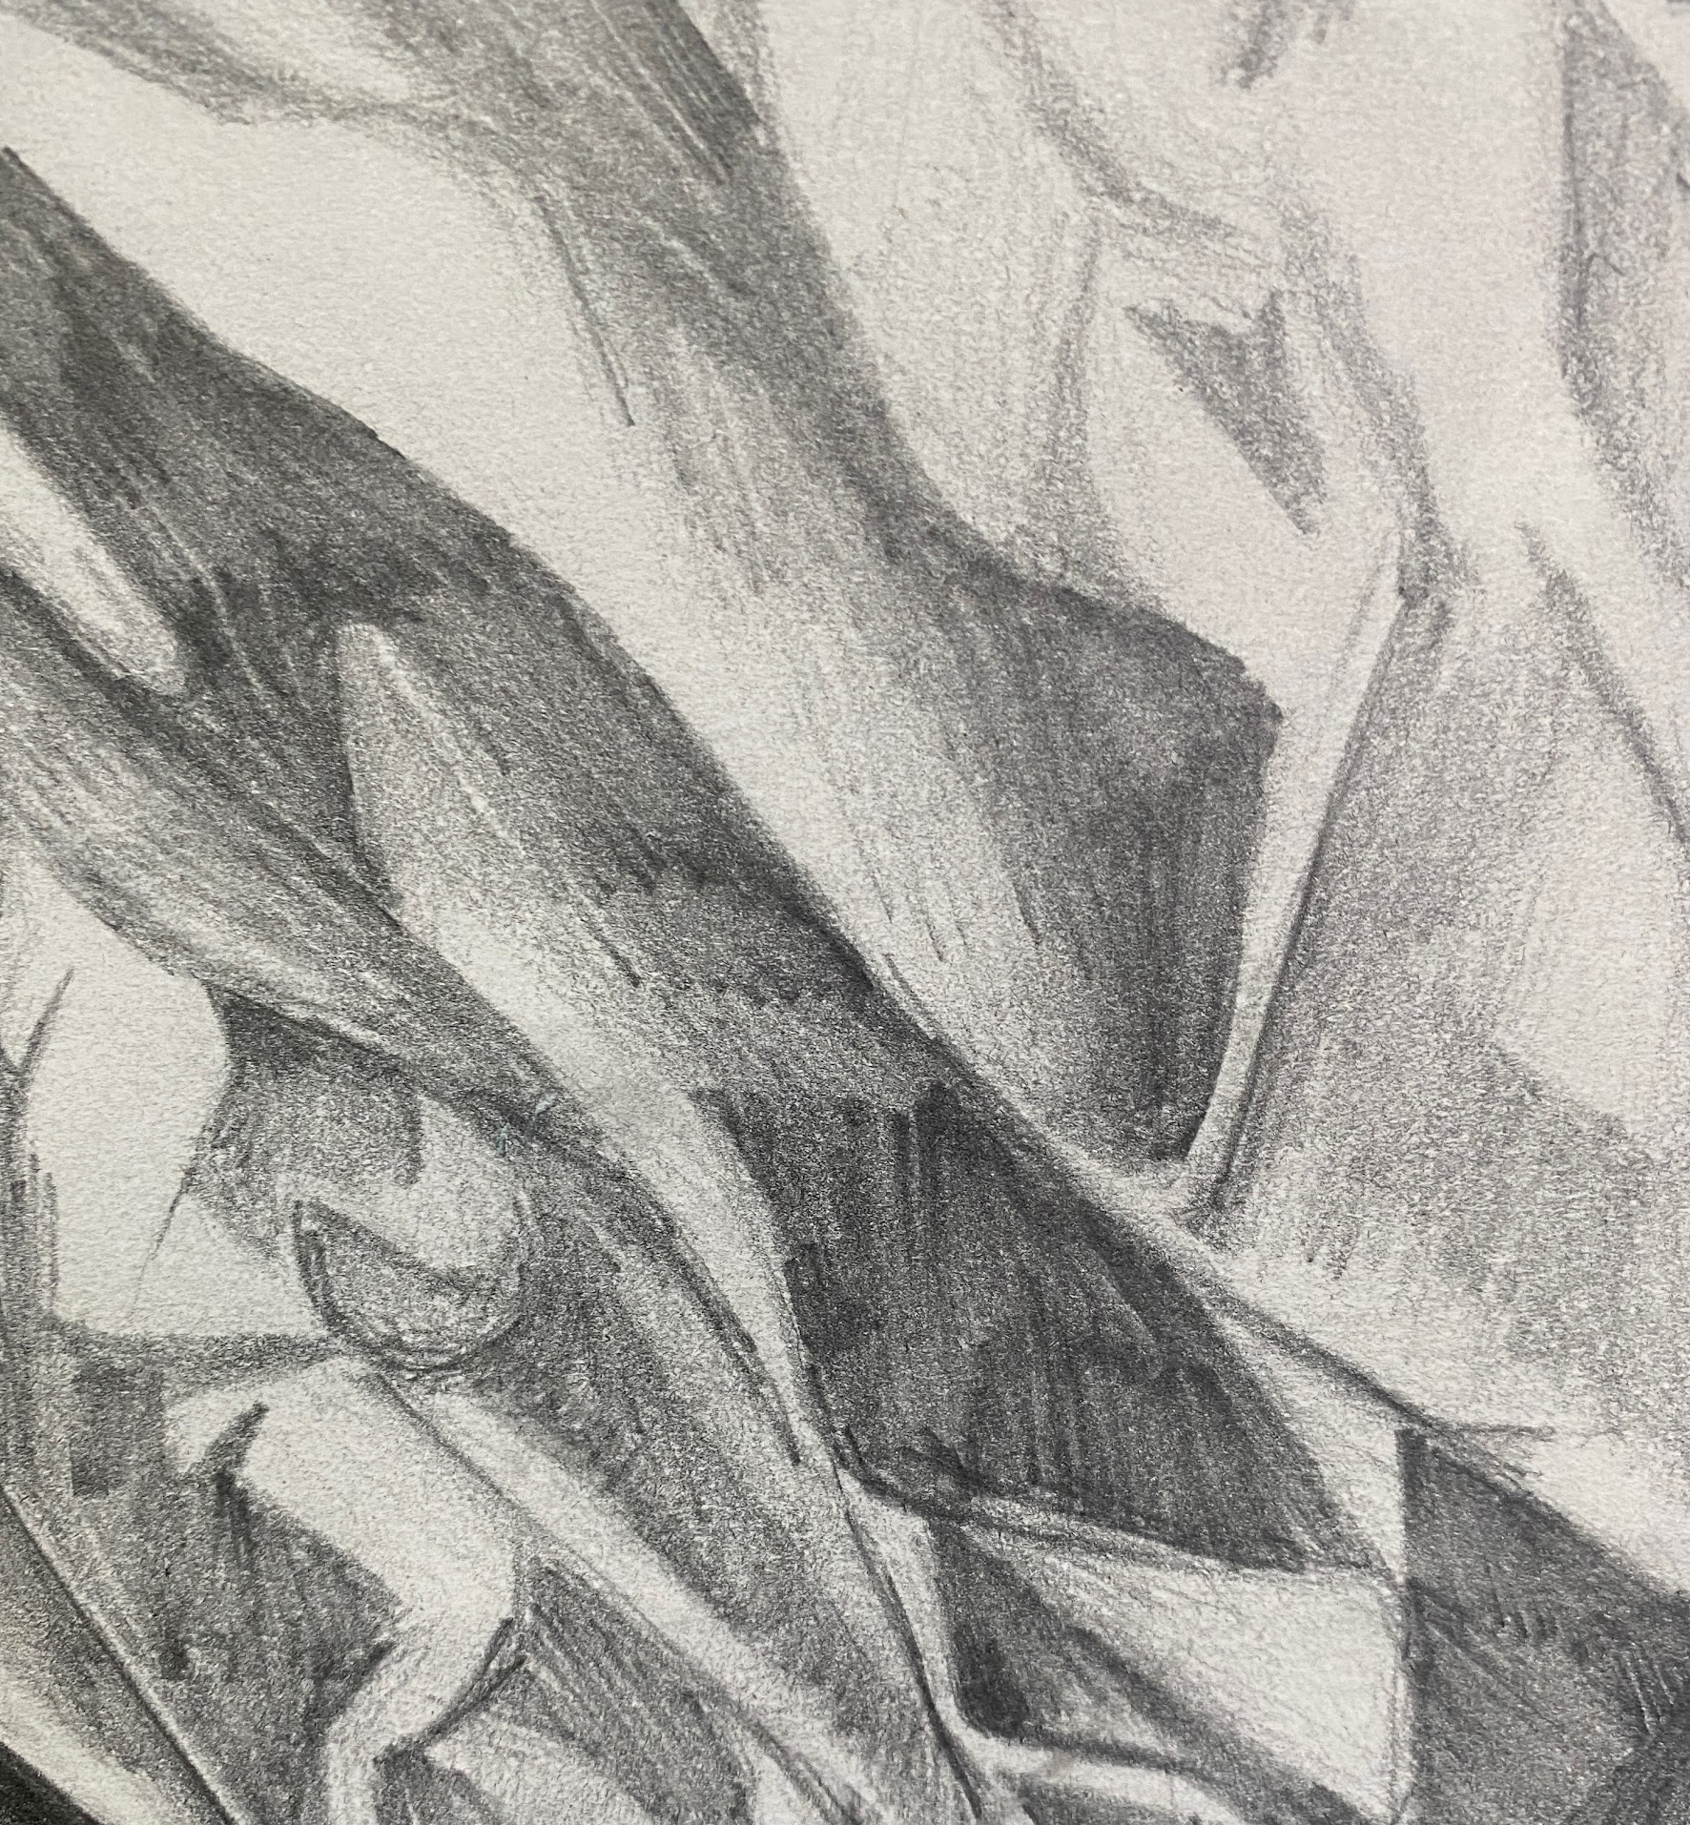
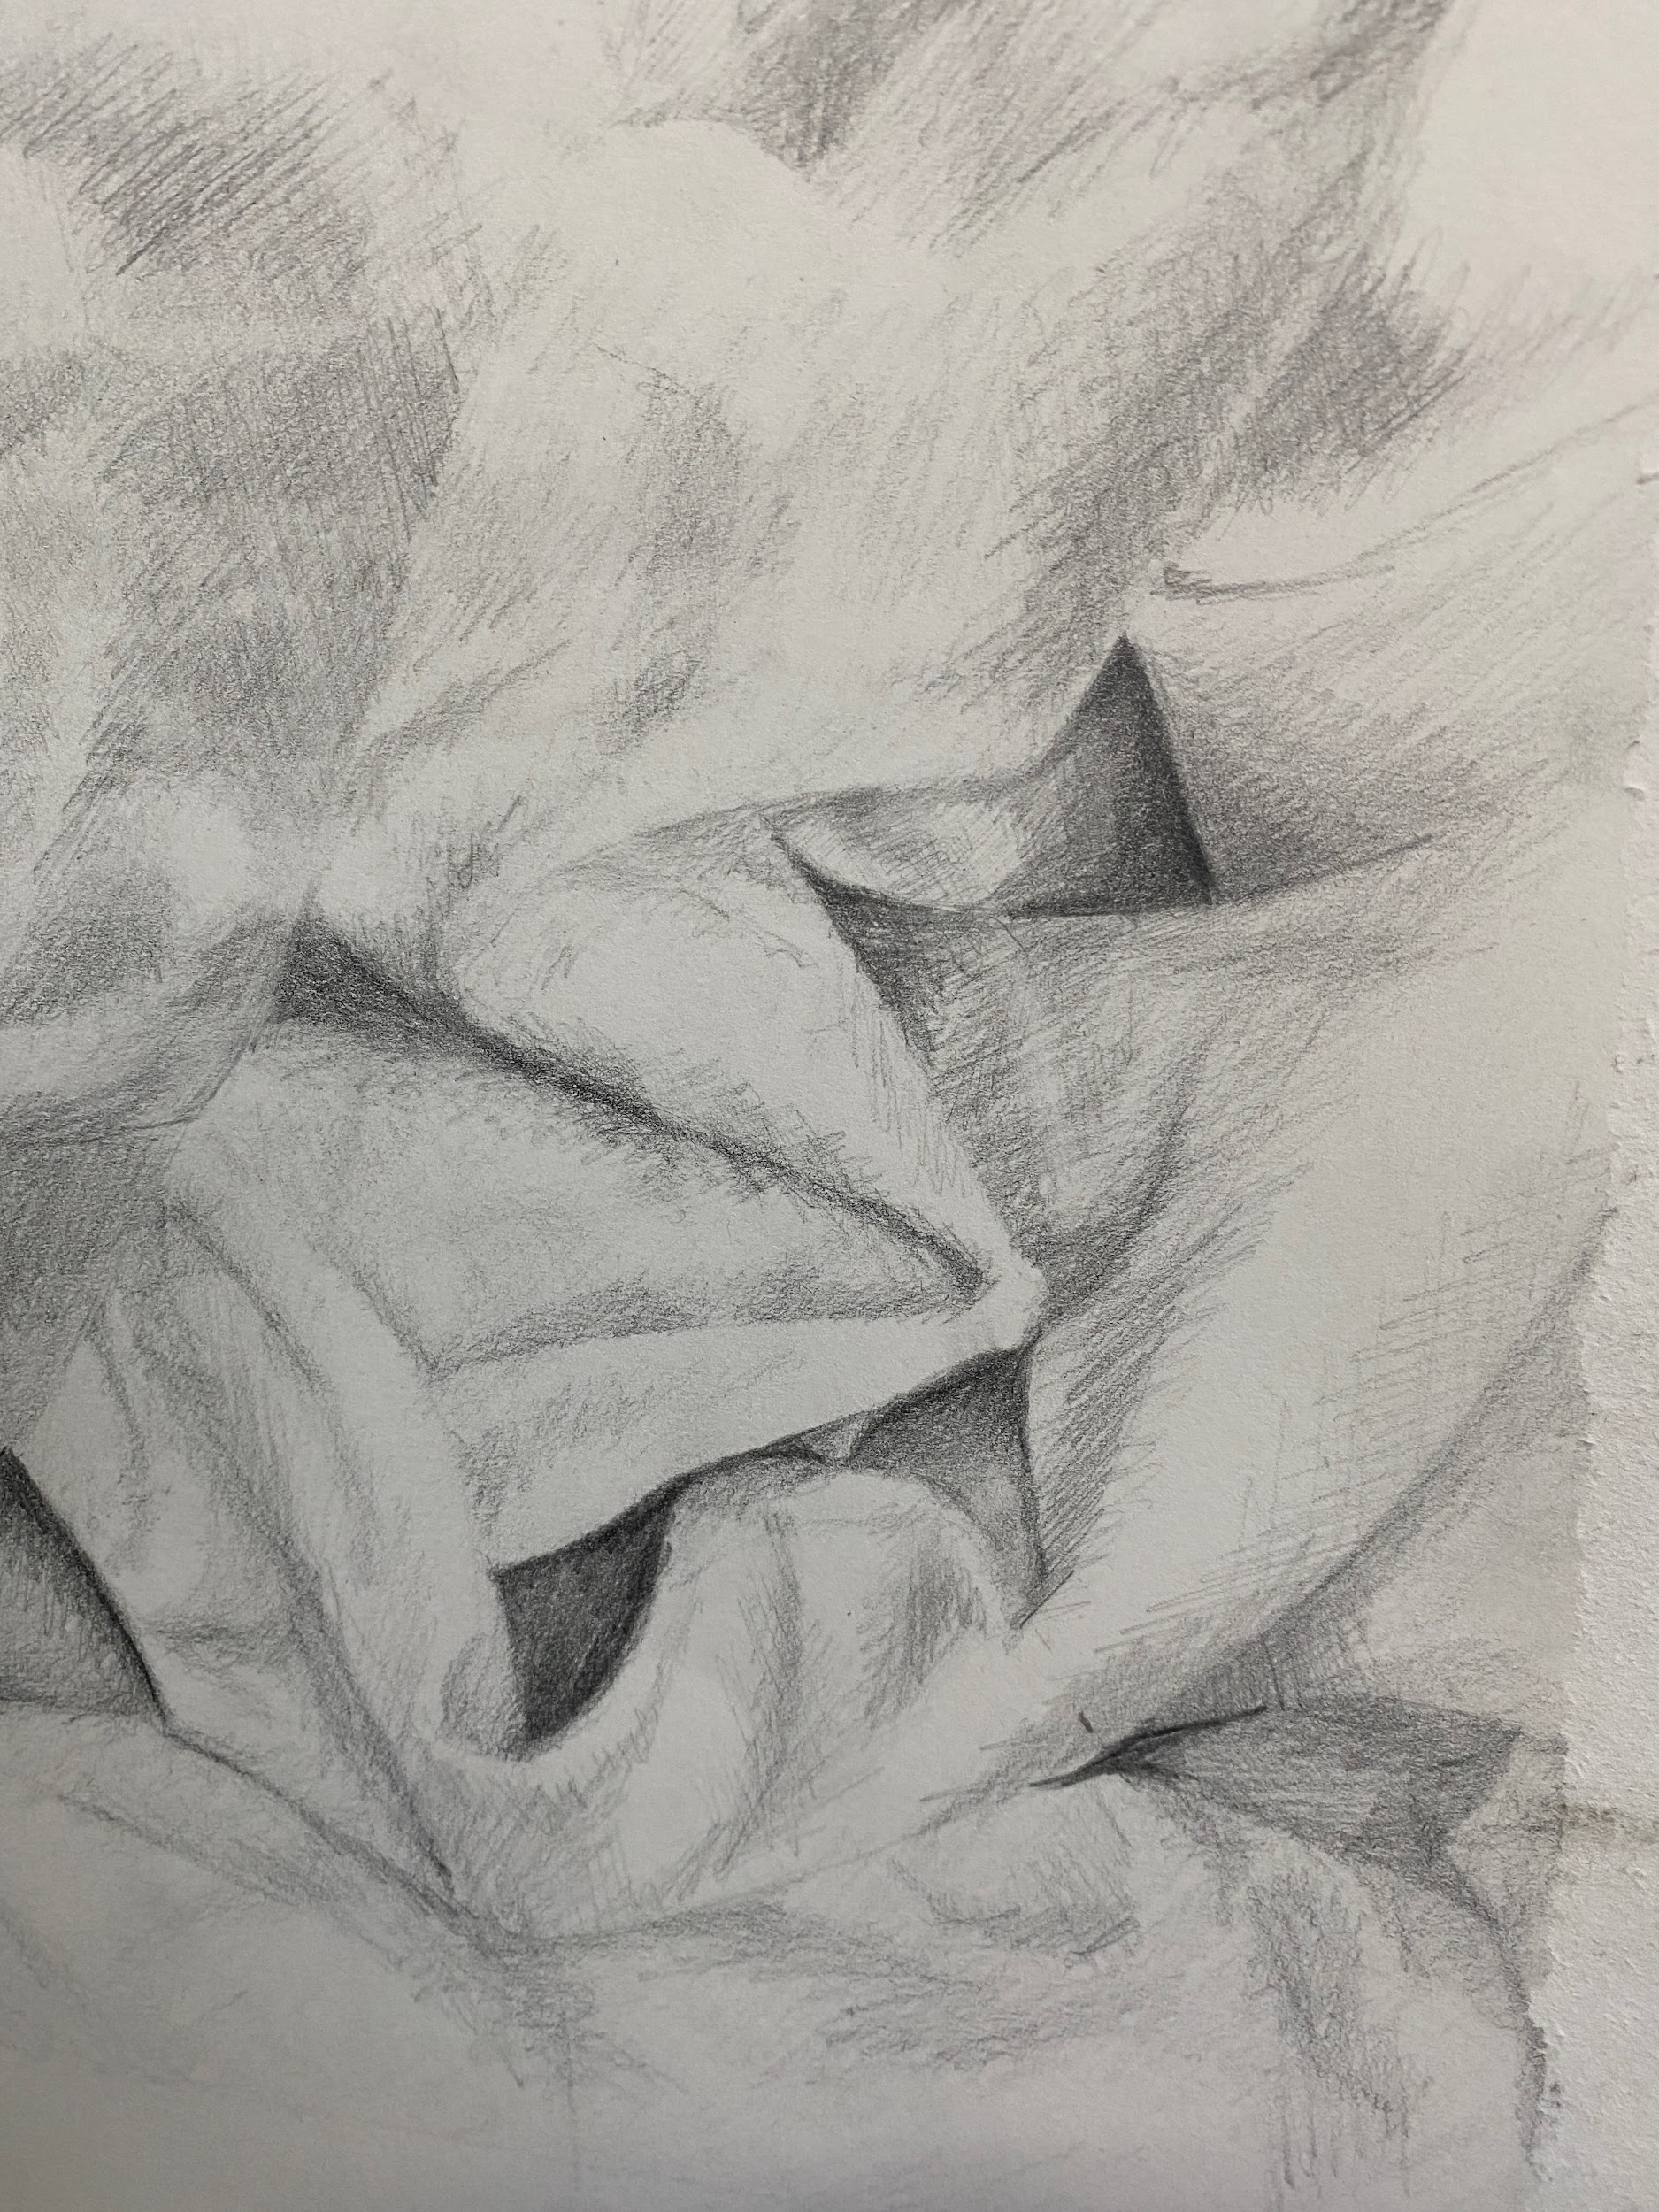
EXAMPLES OF STUDENTS’ OBSERVATIONAL DRAWINGS OF TEXTURE - OBSERVING MATERIAL

Slide 7
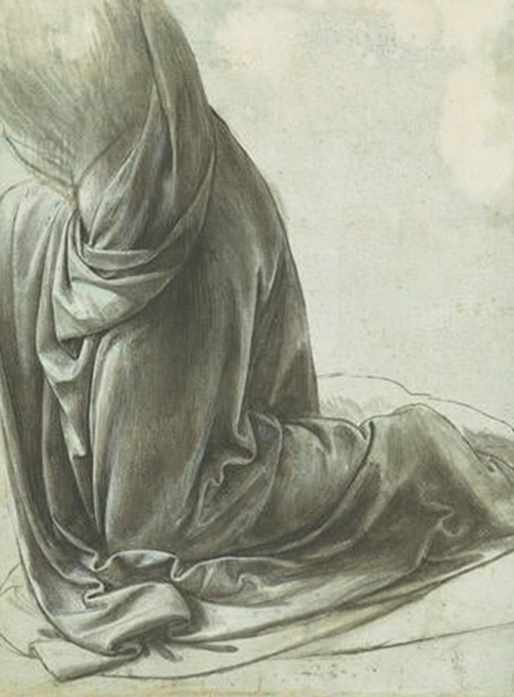
EXIT
What is successful about your drawing so far? What could you do to improve it?

Slide 8
KS3 VISUAL ARTS
HOLISTIC ASSESSMENT MATRIX
1 LIMITED | 2 BASIC | 3 EMERGING + COMPETENT | 4 COMPETENT + CONSISTENT | 5 CONFIDENT, ASSURED + EXCEPTIONAL
Limited ability to observe and record formal elements | Basic ability to observe and record formal elements | Emerging competent ability to observe and record formal elements | Competent and consistent ability to observe and record formal elements | Exceptional ability to observe and record formal elements
1 | 2-3 | 4-5 | 6-7 | 8-9
Formal Elements Line Shape Form Tone Texture Space Pattern Colour Composition | Formal Elements Line Shape Form Tone Texture Space Pattern Colour Composition | Formal Elements Line Shape Form Tone Texture Space Pattern Colour Composition | Formal Elements Line Shape Form Tone Texture Space Pattern Colour Composition | Formal Elements Line Shape Form Tone Texture Space Pattern Colour Composition
Partial Rushed Unrefined Inconsistent Uneven Observation | Unresolved Play safe Simplistic Straight forward Developing Easy Option | Broadening Sufficient Shows Understanding Relevant Individuality Beginning to refine | Effective Purposeful Refined Skilful Imaginative Consistent Realised | Assured Sensitive Independent Comprehensive Unexpected Fluent

