Slide 1
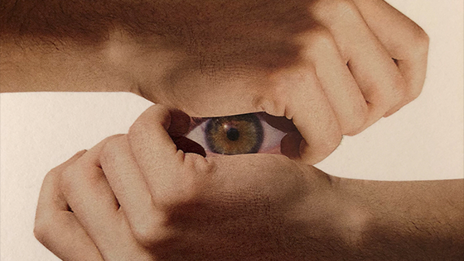
WHO AM I?
Year 7: An Introduction to Art
Lesson 13 & 14: Adam Hale (Part 2)

Slide 2
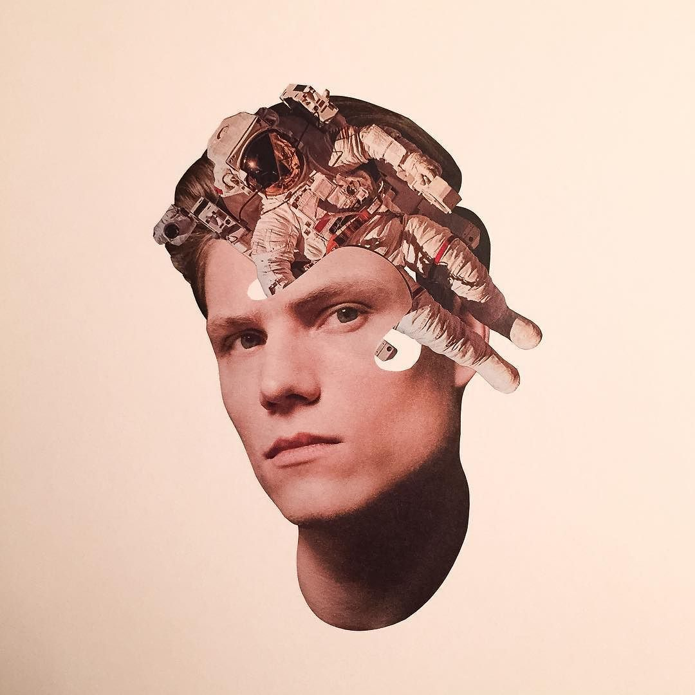
What can you tell me about this image?

Slide 3
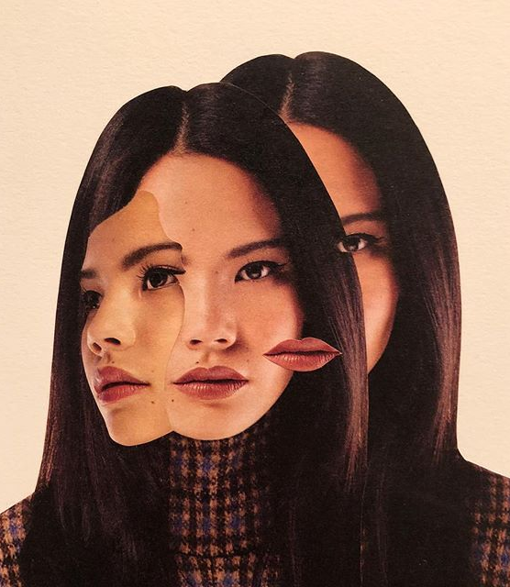
Learning Intentions
In today's lesson we are going to develop some surreal collage responses to Adam Hale using collage techniques.
Who is Adam Hale
How can is artwork influence my own?
What skills do I need to create an Adam Hale influenced piece of artwork?

Slide 4
Task 1: Who am I?
Adam Hale… Surreal Collages
“I like to create metaphors to depict what it is to be human and our relationship with the world around us.
I use elements of nature a lot because they tend to offset the idea that humans are organic – when a flower or landscape is used alongside a glossy airbrushed portrait, it’s easy to see humans as manufactured.”
Consider: What is it to be human to you?

Slide 5
We are going to create our own surreal collage in response to Adam Hale’s work.
Take your time when creating your artwork. It is not a case of getting it done, but rather doing it to the best of your ability. Be experimental!
If you need to practice, please do, this is about developing your skills to create something new and original.

Slide 6
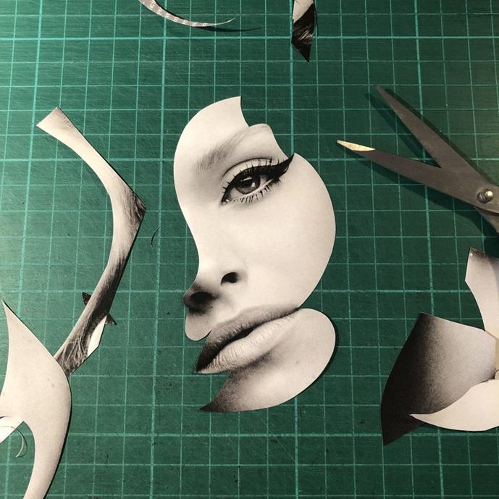
Task 2: Collage
Resources
Today you are going to need the following:
Photo or print-outs from magazines, the web…
Glue
Scissors

Slide 7
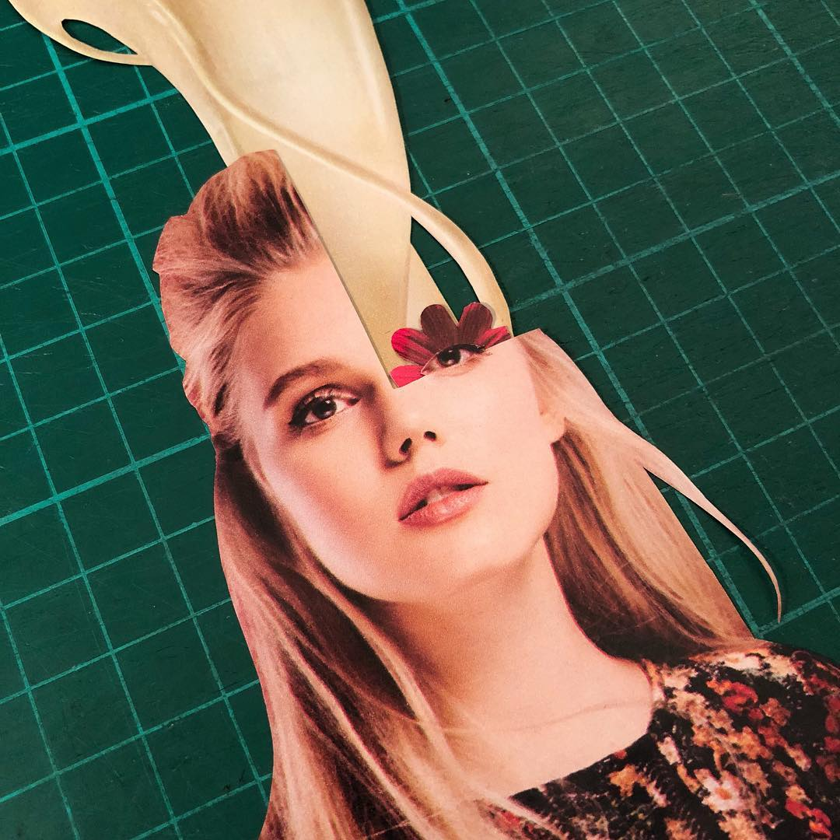
Theme: My identity surreal collage
Gather and collect printed materials from magazines and photographs.
Your task is to create a surrealist self portrait in the style of Adam Hale by spicing an image of yourself with the images you have found in magazines.
Extension: How might you bring in elements from the other artists we have learned about this term into your final artwork?

Slide 8
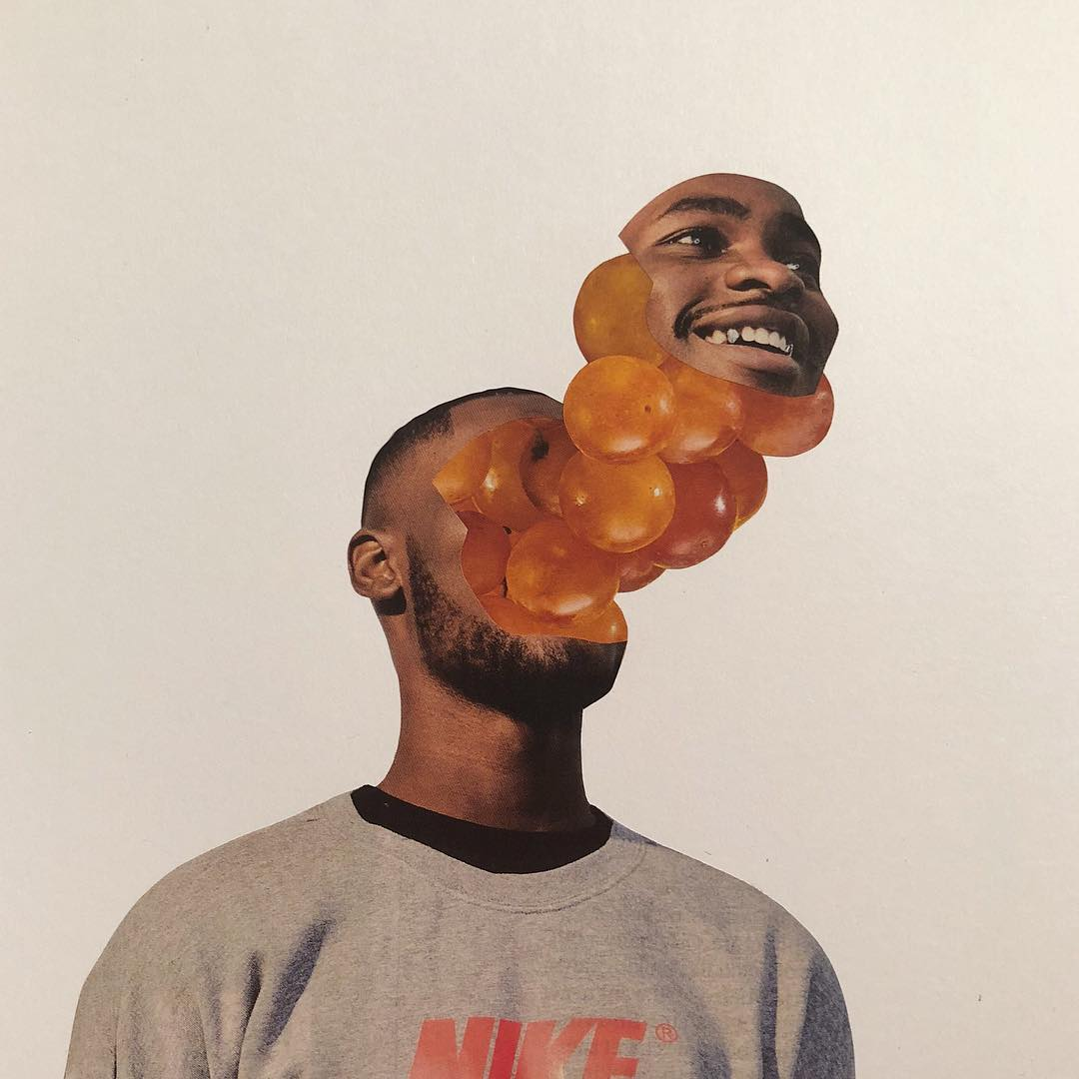
Task 3
Evaluate
WWW:
Creative use of gathered images to create a new image.
EBI:
Could have considered the background to add more colour.

Slide 9
Success Criteria
Level 4 | I completed my Adam Hale inspired collage using my photograph and images from magazines.
Level 6 | I have completed everything above and… My work includes some elements of Surrealism. I have tried to include some drawing in my work with some success.
Level 8 | I have completed everything above and… I have been really creative with how I have been inspired by Hale’s work, using images I have taken myself in my Surrealist collage. I have included my own drawings in my collage as an extension to the images I selected with success.

Slide 10
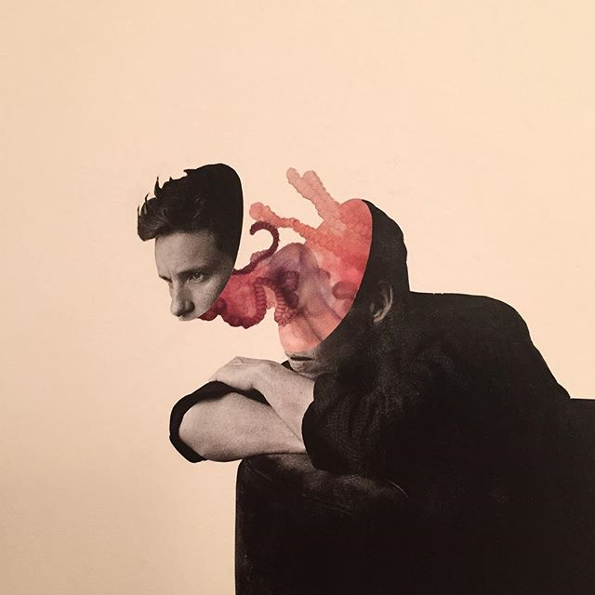
EXIT
Post a photograph of your final artwork on the Teams page to share it with the rest of your class.

Slide 11
