Slide 1
POWER
Year 8: Eduardo Paolozzi
Mid Year Assessment

Slide 2
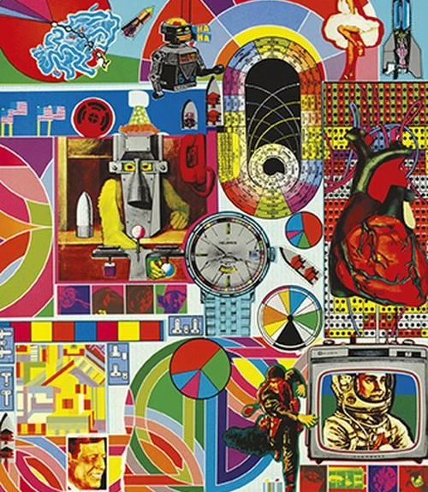
Learning
Intentions
1. Be able to describe some of the qualities of Paolozzi’s work.
2. Create a personal response to the work of a given artist.
IB Learner Profile: Be able to make links between a range of different imagery and use imitation skills to help you make a detailed analysis of an image.

Slide 3
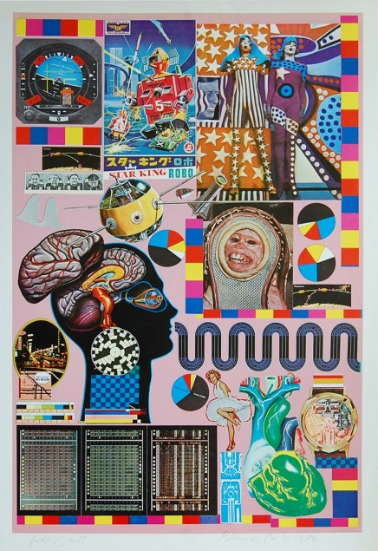
You will create an A3 collage using printed images from the internet and magazines in response to the theme ‘Power’. You will have the next 3 weeks to work on this. Some of the time will be in class, but the rest will be at home. This task forms an important part of your assessment this term, so you should aim to spend at least 3 hours on it!
MID YEAR ASSESSMENT

Slide 4
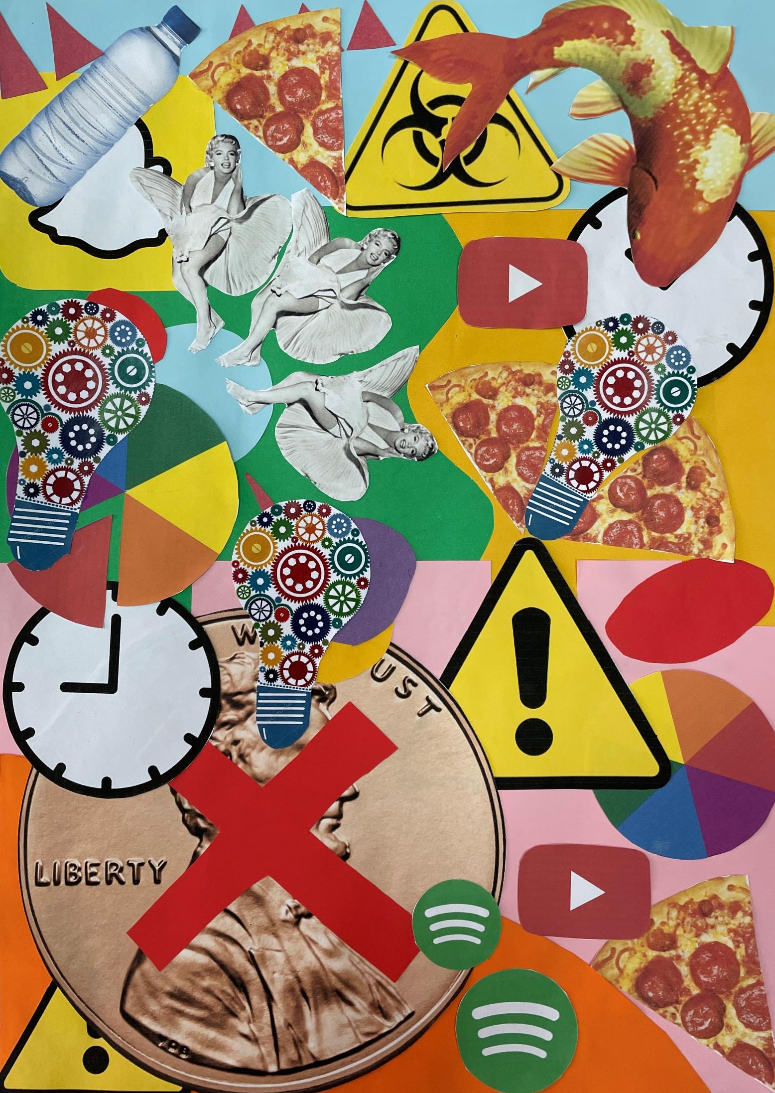
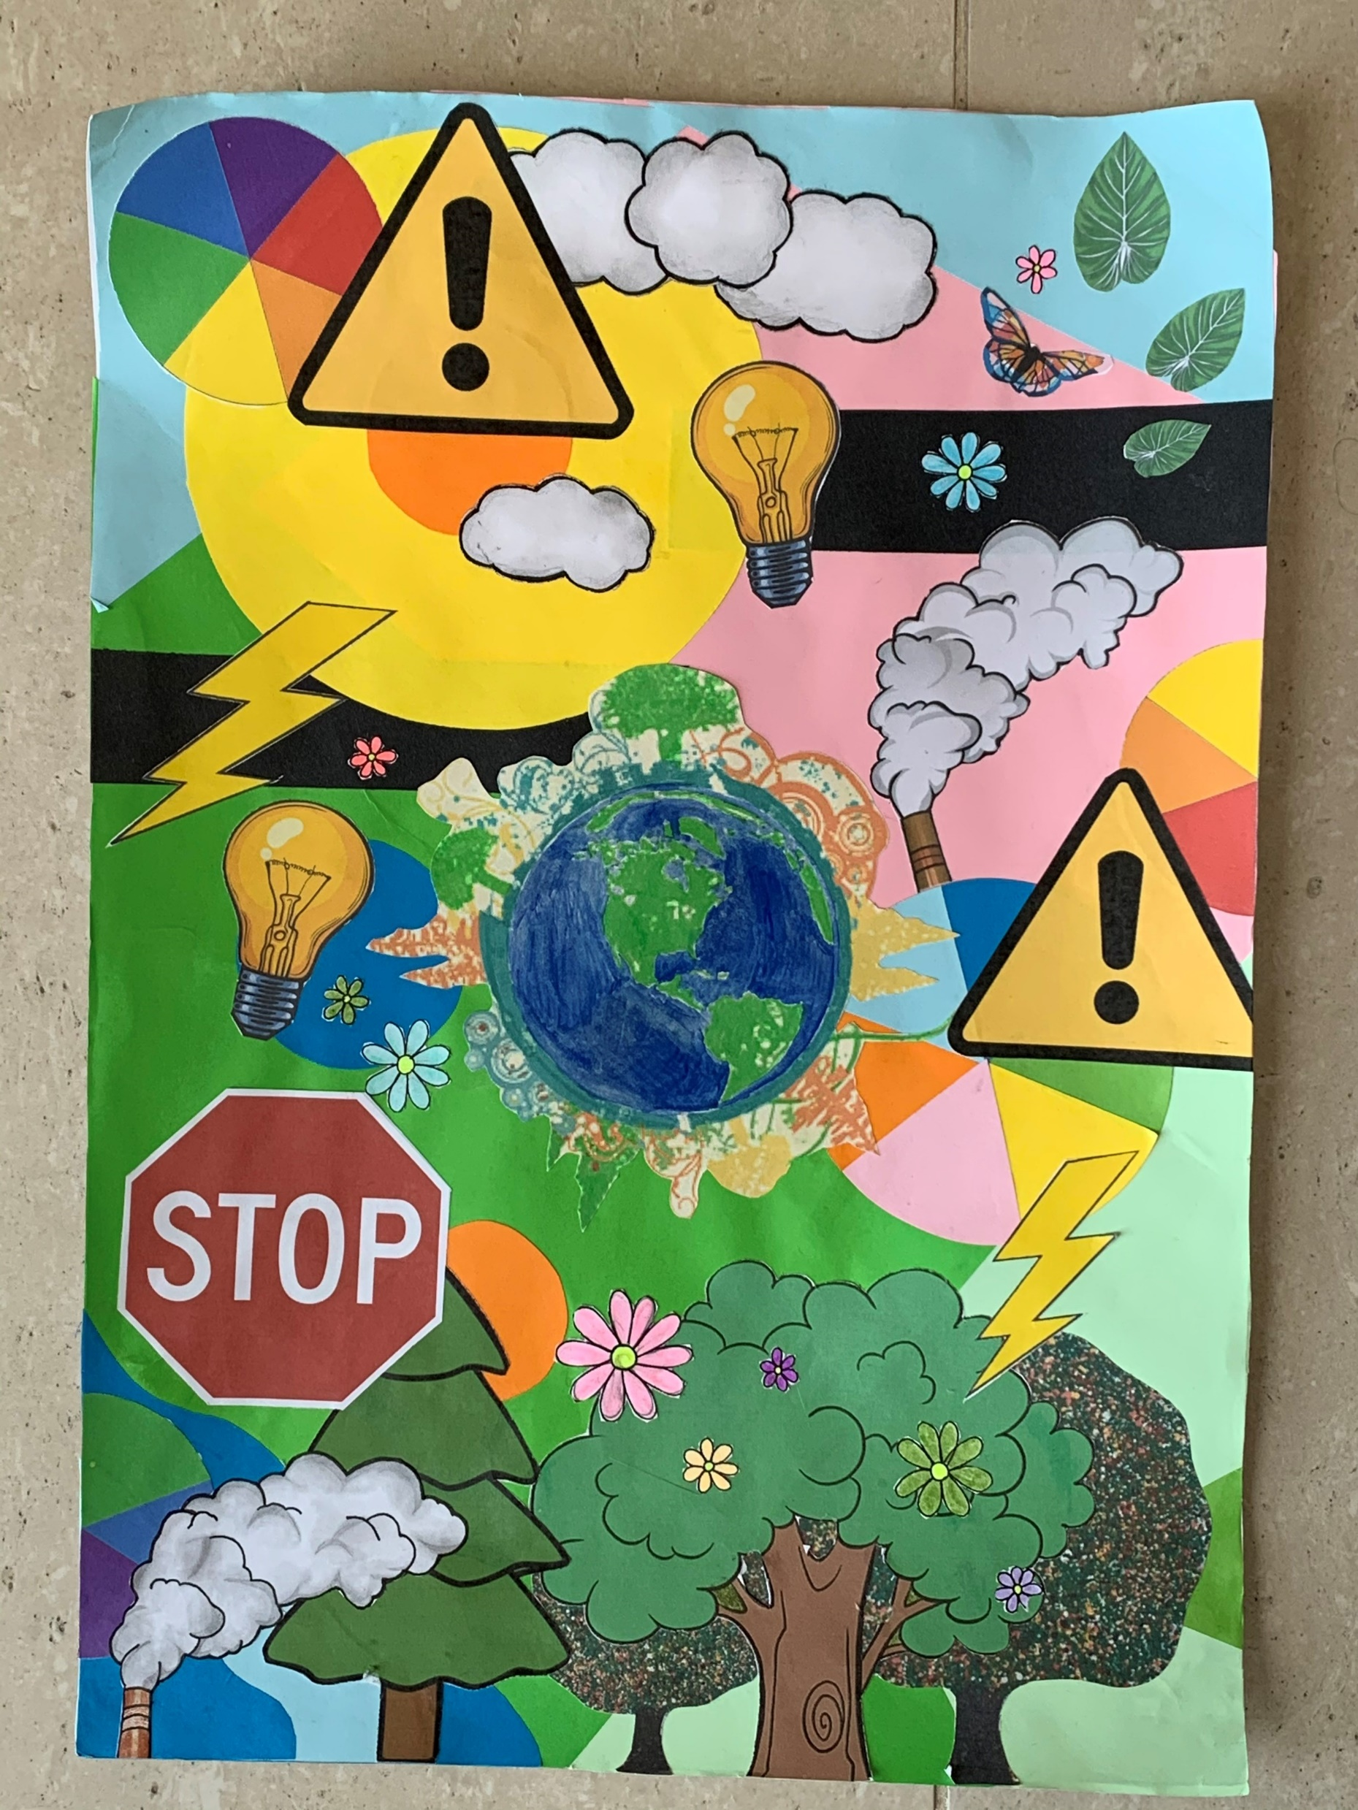
Here are a couple of examples made by previous students. Use them to inspire you!

Slide 5
These are the qualities that you will need to produce in your own work.
What are we looking for?
Colourful.
Collage.
Lots of different shapes.
Repetition of shapes (pattern).
Machine part images.
Images from popular culture (magazines etc).
Abstract.

Slide 6
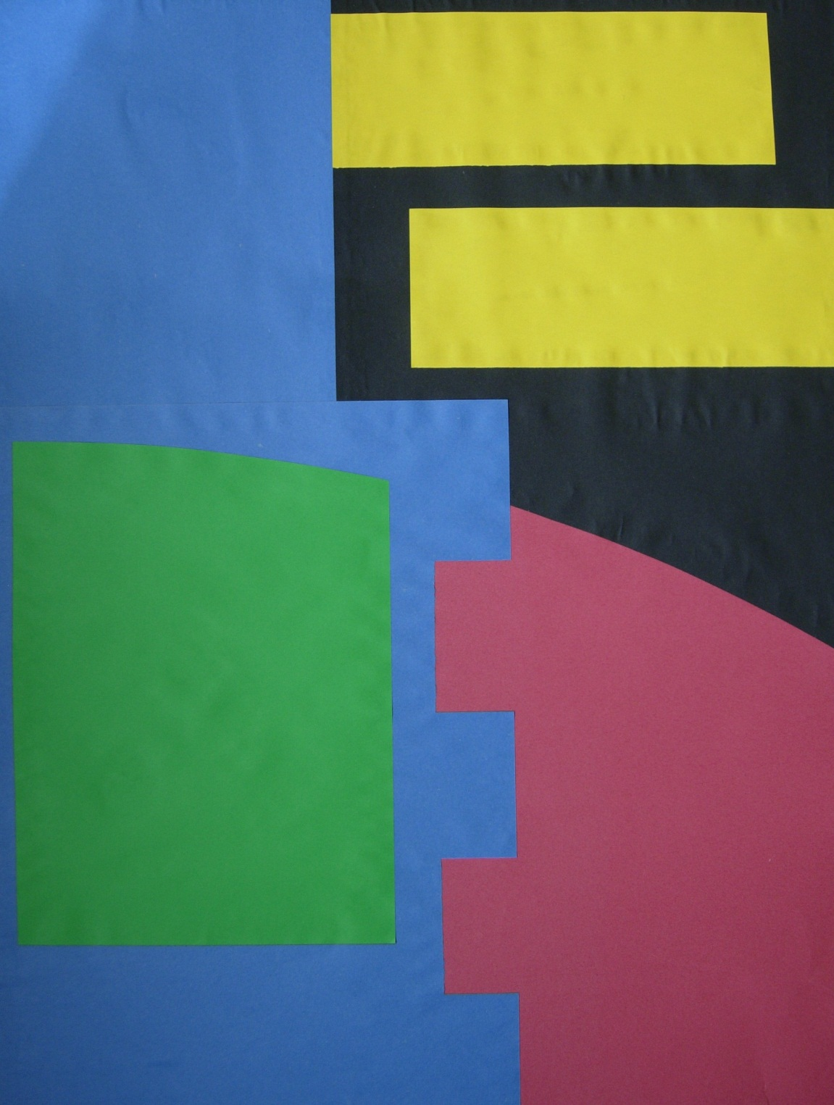
How do I do it?
STEP 1:
Large sheets of black,
blue and pink paper
have been roughly cut
and glued to the
cardboard to cover up
the white as simply and
as quickly as possible.
STEP 2:
Yellow and green
pieces of paper
have been added for
a more colourful
effect. This will now make
a good background
for a Paolozzi style
final piece.

Slide 7
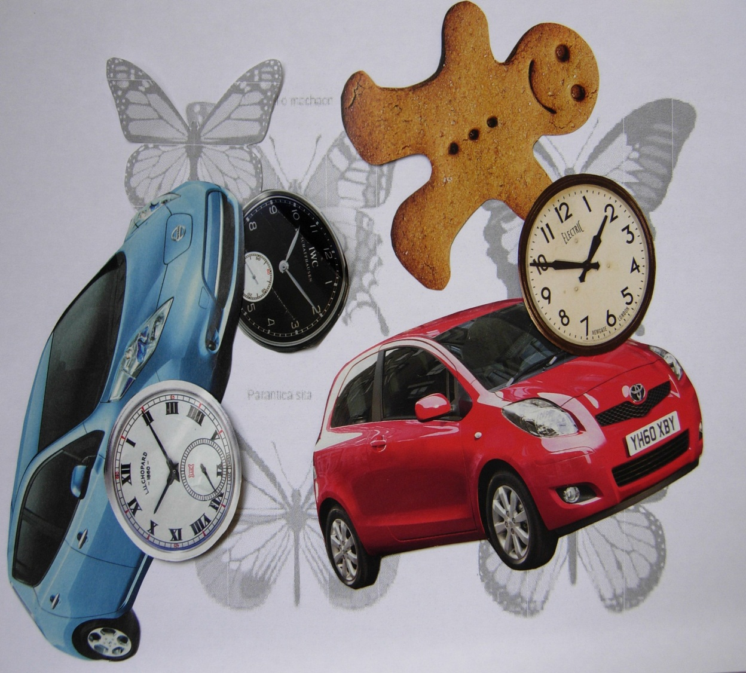
STEP 3:
As well as machine part imagery, Paolozzi often has brightly coloured abstract elements in his work.
You might want to try making some using different coloured papers.
STEP 4:
Paolozzi often combines images from popular culture in his work.
If you haven’t already brought images in, you could use magazines to source some.

Slide 8
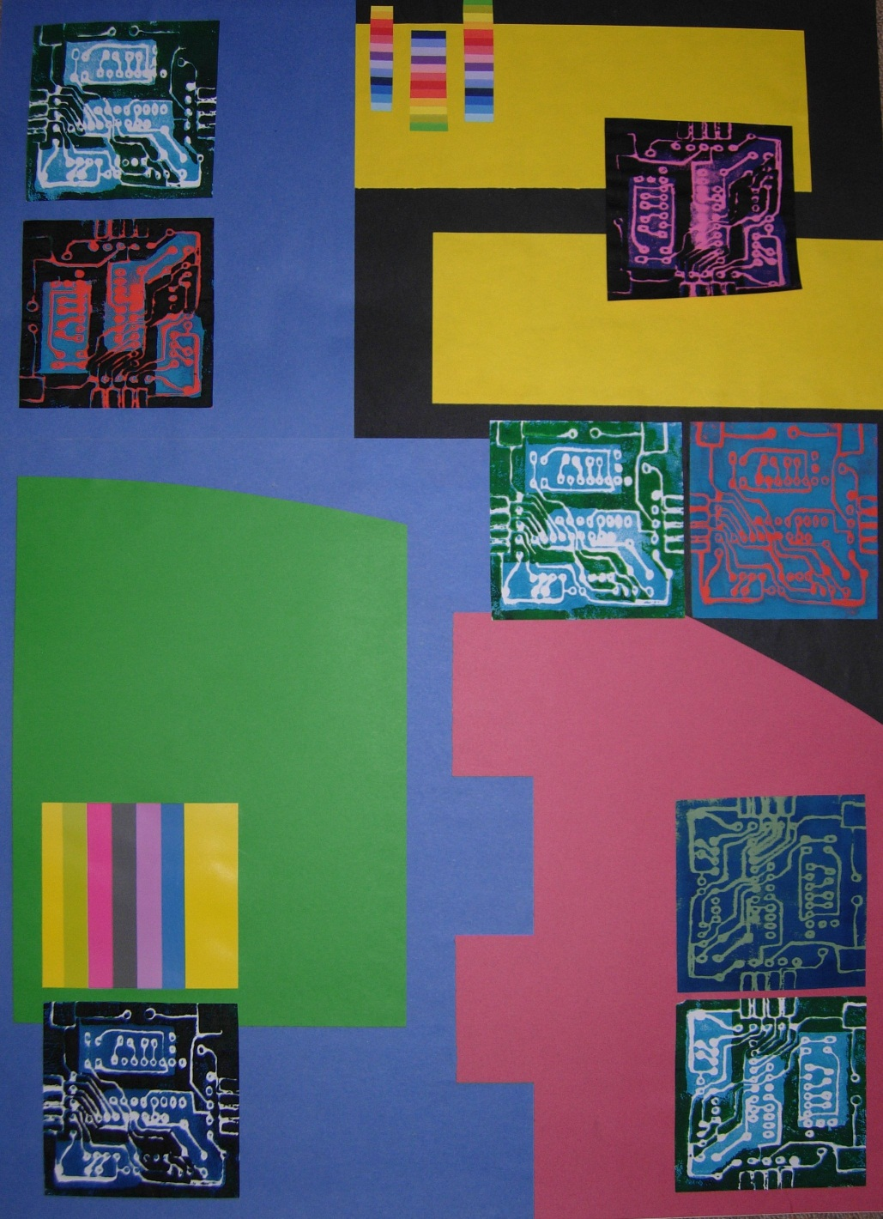
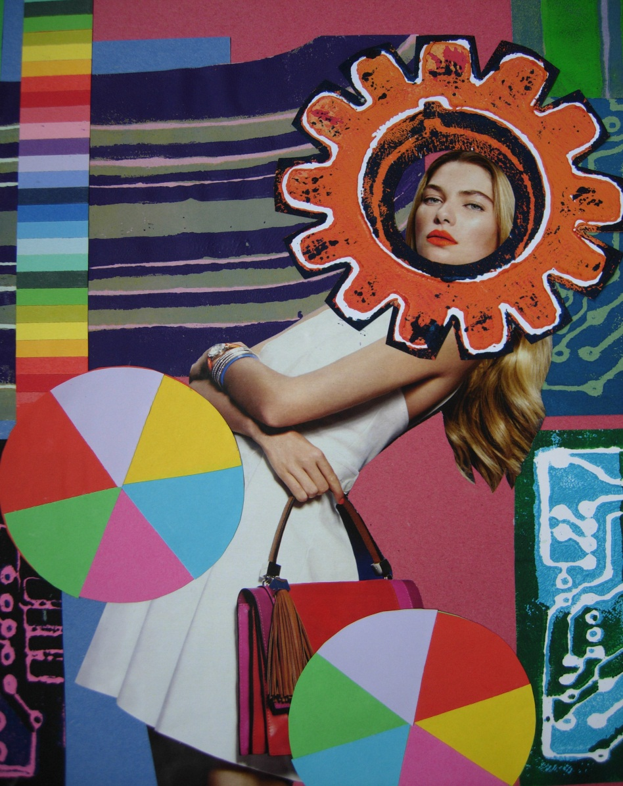
Remember not to stick anything down until you are happy.
STEP 5:
Start positioning all your different collage elements onto your background. Use the Paolozzi images to help you compose your final piece.

Slide 9
IMPORTANT! Make sure your full name and form is written on the back of your work before you hand it in!!

