Slide 1
MATERIAL THINGS
Year 7: Drawing Skills
Lesson 1: An Introduction

Slide 2
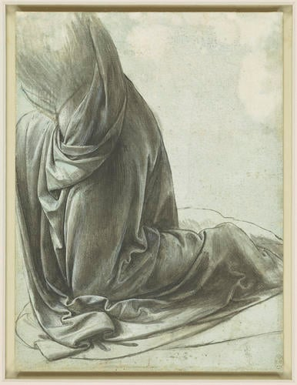
FORMAL ELEMENTS
TEXTURE
TONE
LINE
LEONARDO DA VINCI
The drapery of a kneeling figure c.1491-4
Brush and black ink, white heightening, on pale blue prepared paper
21.3 x 15.9 cm (sheet of paper)
What can you tell me about this artwork?

Slide 3
Learning Intentions
In this lesson we will learn about different types of texture.

Slide 4
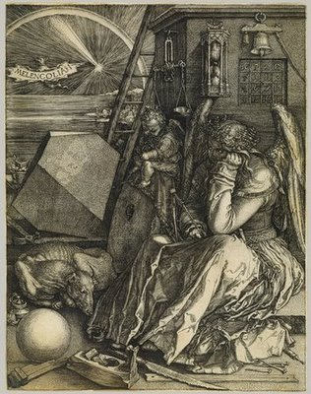
FOLDS IN FABRIC
The world offers unlimited numbers of cool things to draw. Yet, artists seem to have special affection for drawing folds in fabric.

Slide 5
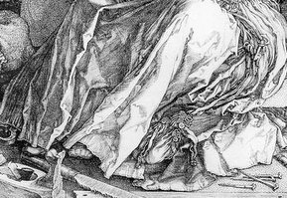
FOLDS IN FABRIC
Folds dominate so many pictures, it is clear that artists are fascinated by them. Their complexity, their movement and their abstract quality give artists a lot to play with. Sometimes folds are such fun to draw that artists go a little overboard.

Slide 6
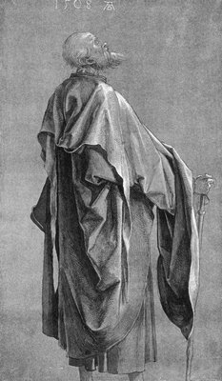
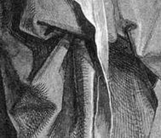
FOLDS IN FABRIC
Although folds in cloth have remained basically unchanged through the ages, the artist’s treatment of them has changed dramatically. Folds in medieval art were generally angular, while folds in Renaissance art were rounded. For a contrast between two different cultures, compare the carefully controlled, tightly rendered folds drawn by the great illustrator Durer in 16th century Germany...

Slide 7
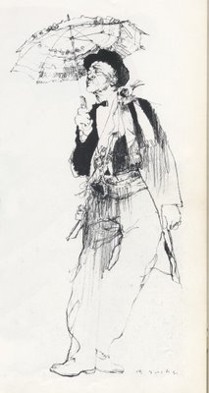
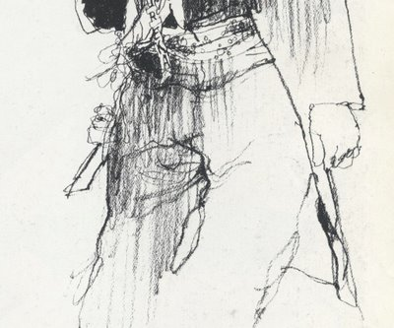
FOLDS IN FABRIC
...with the lush, spontaneous lines of another great illustrator, Bernie Fuchs, in the U.S. in the 1970s

Slide 8
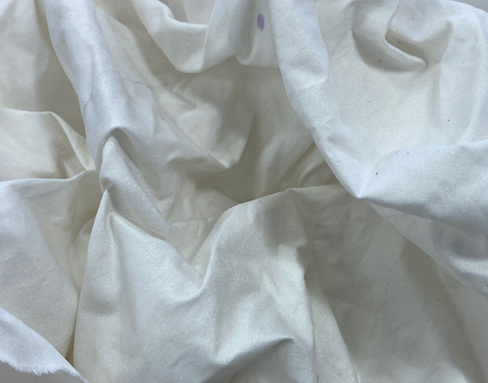
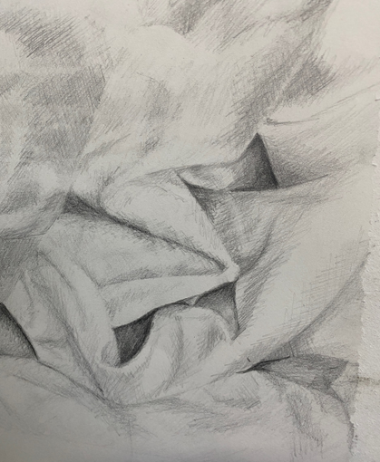
TYPES OF TEXTURE
There are two types of texture you need to know about in art.
Actual vs. Implied
Actual texture is touchable. It’s real. Think about a drawing that makes use of collage. The collaged element would stand in relief against the supporting paper, giving the artwork a texture, you can both see and feel.
Implied texture is the illusion of a textured surface created through changes in value using mark-making.

Slide 9
TASK 1
LOOKING AT ART
DA VINCI - The drapery of a kneeling figure c.1491-4
FORMAL ELEMENTS: SHAPE / LINE / TONE
Today we are going to look at and discuss the drawing ‘The drapery of a kneeling figure’ by Leonardo Da Vinci. You will independently, and in groups, identify and discuss how Da Vinci used SHAPE / LINE / TONE in his drawing.

Slide 10
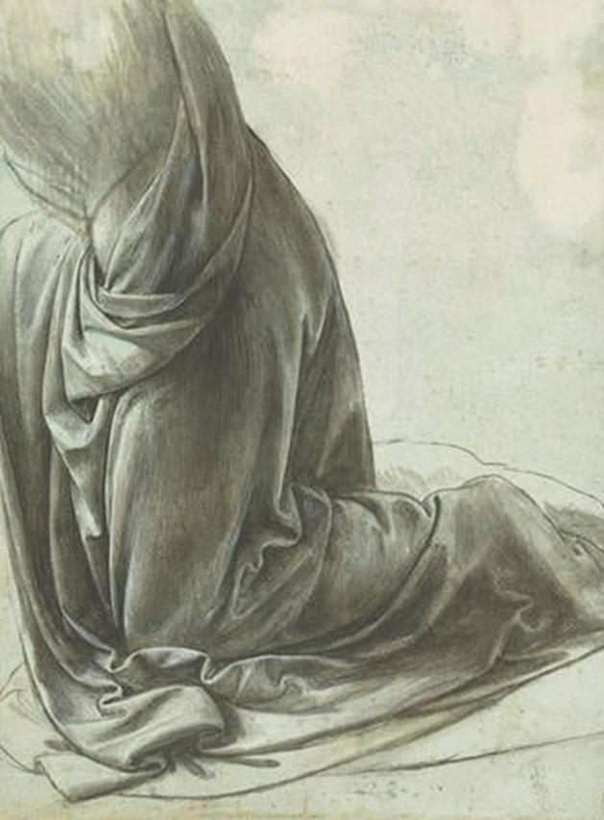
LOOKING AT AN ARTWORK IN DETAIL: DA VINCI Formal Elements: SHAPE / LINE / TONE
Shape
organic
Enclosed area
Irregular
Abstract
Length
Width
Shape
Visual analysis
Line (path between two points)
Curved
Vertical
Horizontal
Continuous
layered
Landscape Format
Portrait Format
Square Format
Tone
Visual analysis
Tone
light
dark
contrast
light source
natural light
Line
Visual analysis

Slide 11
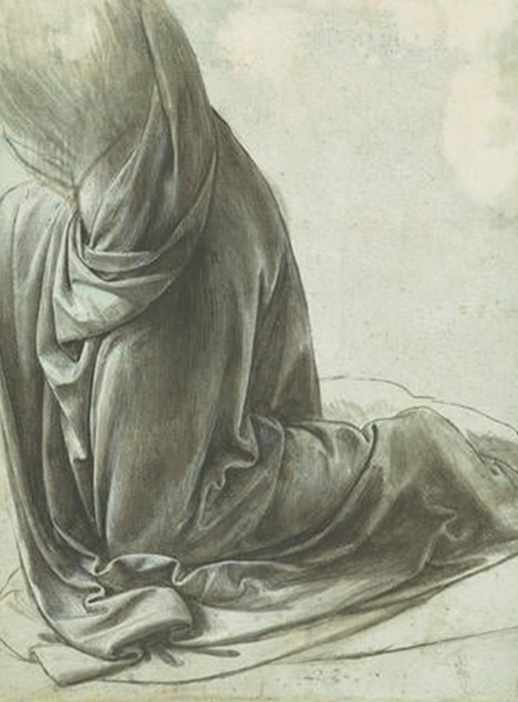
EXIT
Have you completed your written work? What could you do between now and next lesson to improve it?

Slide 12
KS3 VISUAL ARTS
HOLISTIC ASSESSMENT MATRIX
1 LIMITED | 2 BASIC | 3 EMERGING + COMPETENT | 4 COMPETENT + CONSISTENT | 5 CONFIDENT, ASSURED + EXCEPTIONAL
Limited ability to observe and record formal elements | Basic ability to observe and record formal elements | Emerging competent ability to observe and record formal elements | Competent and consistent ability to observe and record formal elements | Exceptional ability to observe and record formal elements
1 | 2-3 | 4-5 | 6-7 | 8-9
Formal Elements Line Shape Form Tone Texture Space Pattern Colour Composition | Formal Elements Line Shape Form Tone Texture Space Pattern Colour Composition | Formal Elements Line Shape Form Tone Texture Space Pattern Colour Composition | Formal Elements Line Shape Form Tone Texture Space Pattern Colour Composition | Formal Elements Line Shape Form Tone Texture Space Pattern Colour Composition
Partial Rushed Unrefined Inconsistent Uneven Observation | Unresolved Play safe Simplistic Straight forward Developing Easy Option | Broadening Sufficient Shows Understanding Relevant Individuality Beginning to refine | Effective Purposeful Refined Skilful Imaginative Consistent Realised | Assured Sensitive Independent Comprehensive Unexpected Fluent

