Slide 1
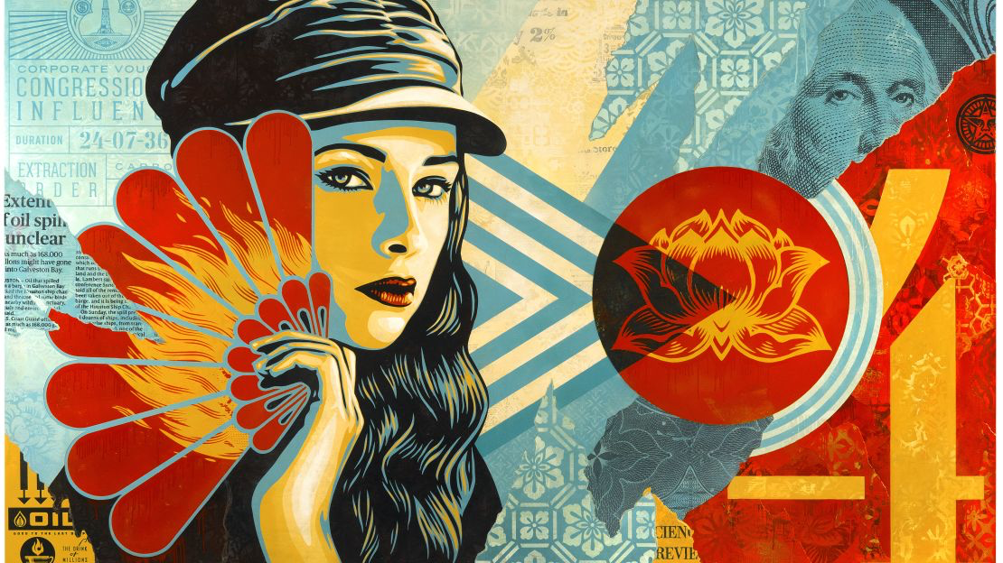
HEROES & LEADERS
Year 9: Art Activism Unit
Lesson 1 & 2: Who is Shepard Fairey?

Slide 2
Learning
Intentions
Research: Effectively gather information on Shepard Fairey.
Describe: Identify key characteristics of Fairey’s artwork.
Explain: Understand how art can influence public opinion.
Today's Lesson:
Introduction to Shepard Fairey
Understanding the impact of art on society

Slide 3
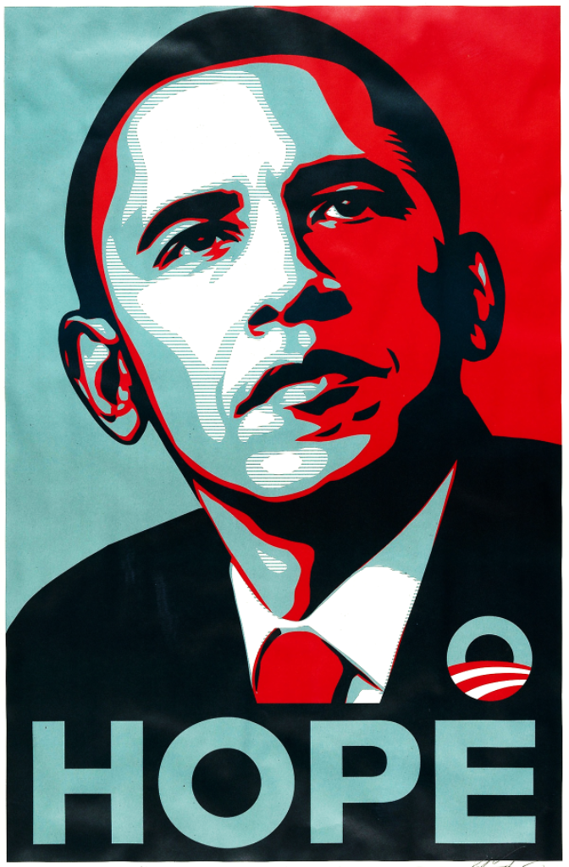
Use your laptop to find the answers to the following questions:
Who is the person in this image?
Why is it significant?
Who created the poster?
Why is this artist significant?

Slide 4
An American street artist, designer, illustrator, activist, and founder of OBEY Clothing.
Who is Shepard Fairey?

Slide 5
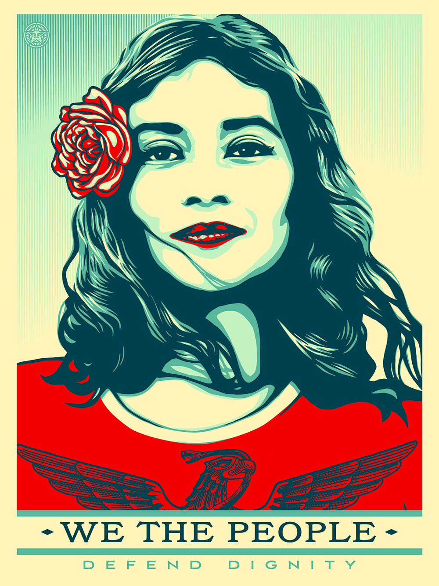
Use the internet to gather information and images about Shepard Fairey. Save your findings in a PowerPoint presentation. You can work in pairs to create a well-laid-out, informative, and visually engaging presentation. Follow the template and tips to ensure your presentation is thorough and polished.
Research Activity

Slide 6
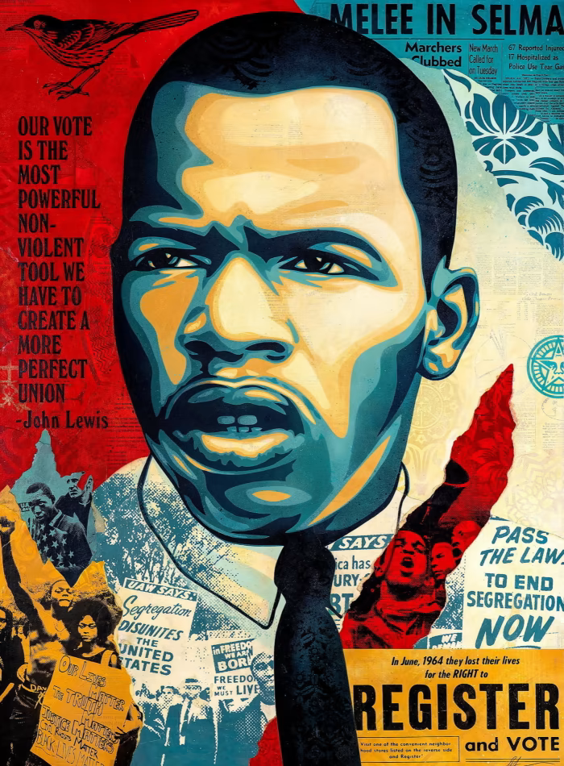
Who is Shepard Fairey? Where is he from? What and where did he study? What subjects does his artwork cover? How and where does he create his artworks? What materials, techniques, and processes does he use? Why does he create his artworks? What is the meaning or purpose behind his artwork?
Key Questions to Guide Your Research

Slide 7
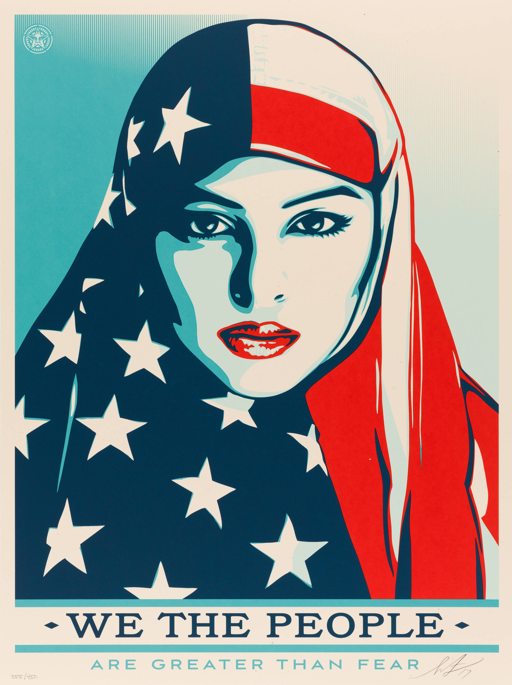
Research: Compile a comprehensive collection of information and images on Shepard Fairey. Opinion: Formulate and express an opinion on Fairey’s artwork based on your research. Understanding: Grasp the intention and meaning behind some of Fairey’s key artworks.
Success Criteria

Slide 8
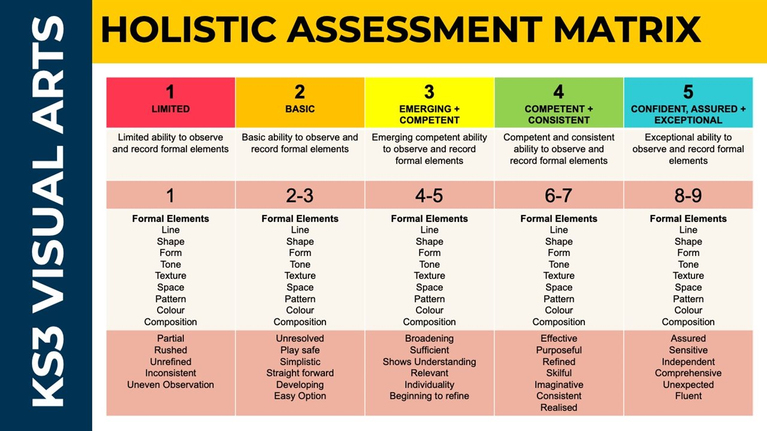

Slide 9
Self-Assessment
Exceeding (Level 7-9)
I have produced a detailed and accurate research presentation.
I have included all key information about Shepard Fairey.
My slides are well-organised and visually engaging.
I have used high-resolution images to illustrate key points.
I have clearly expressed my opinion on Fairey’s artwork, supported by thorough research.
Meeting (Level 4-6):
I have created a research presentation with most of the key information about Shepard Fairey.
My slides are organised but may need a bit more work.
I have used some high-resolution images to illustrate key points.
I have expressed my opinion on Fairey’s artwork, supported by some research.
Working towards (Level 1-3):
I have created a research presentation but it lacks some key information about Shepard Fairey.
My slides are somewhat disorganised and need more attention to detail.
I have used a few images, but they are not all high-resolution or relevant.
I have expressed my opinion on Fairey’s artwork, but it is not well-supported by research.

