Slide 1
An Introduction to Photo Editing
End of Year 10: Summer Project
Editing in the style of Tommy Ingberg​

Slide 2
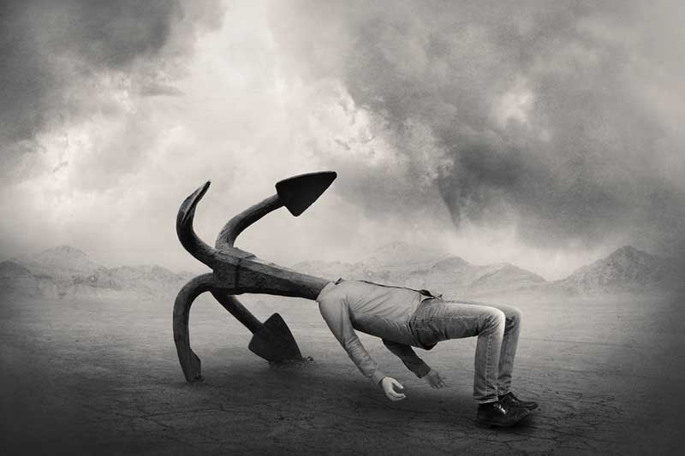
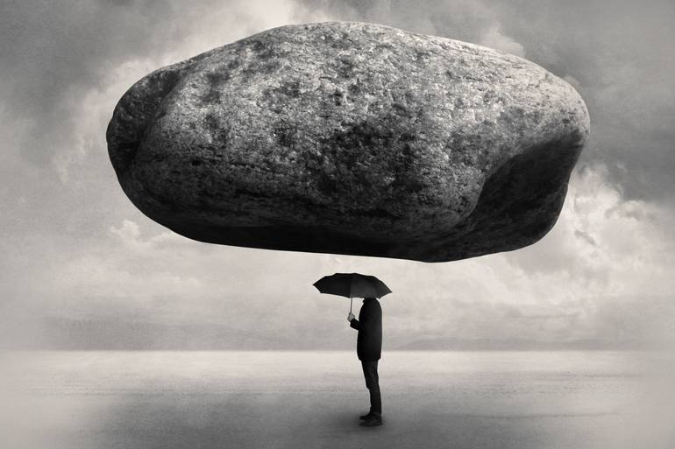
What can you tell me about these images by Tommy Ingberg​​?

Slide 3
Learning Intentions
AO2: Refine work by exploring ideas, selecting and experimenting with appropriate media, materials, techniques and processes.
To explore a range of photo editing skills using Photopea and Photoshop in the style of Tommy Ingberg​​.
.

Slide 4
Tommy Ingberg​
Follow the tutorial below to create your own version of his work and to learn how to replicate his technique.
Use your own photos if possible or found photos if you don't have any good photographs.
You will need a landscape photo, a bubble photo and a figure. Please upload the original pictures below your edit to prove that you have created it from scratch.
Open the video split screen with photoshop so you can watch it, pause then have a go at a section etc.
Create a sketchbook page about the photographer, including your own edit in his style.

Slide 5
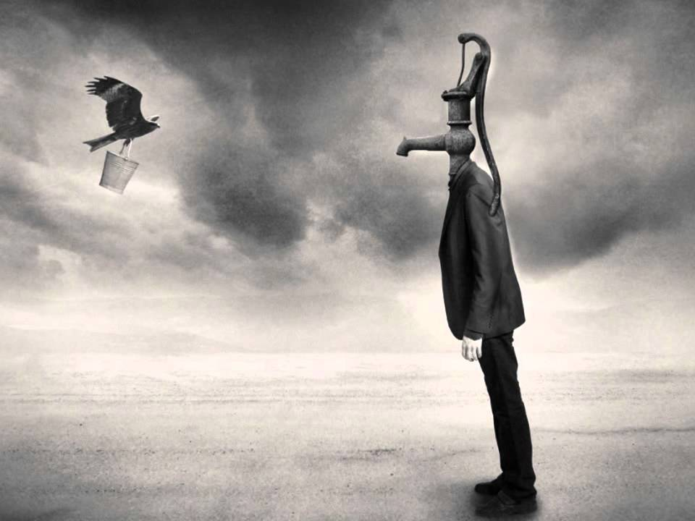
Tommy Ingberg​

Slide 6
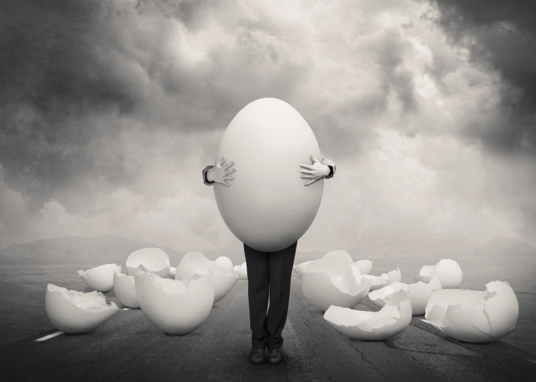
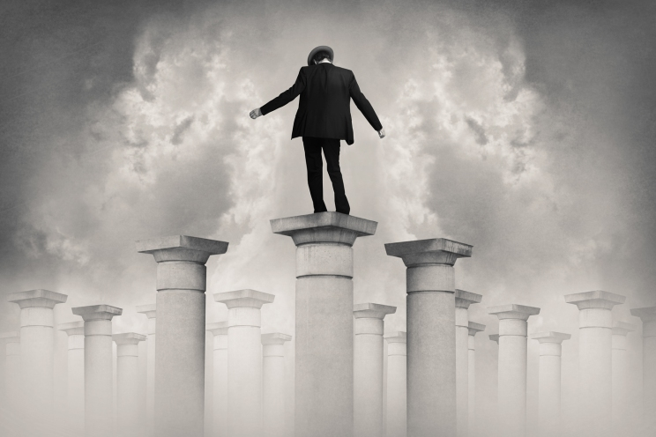
Tommy Ingberg​

Slide 7
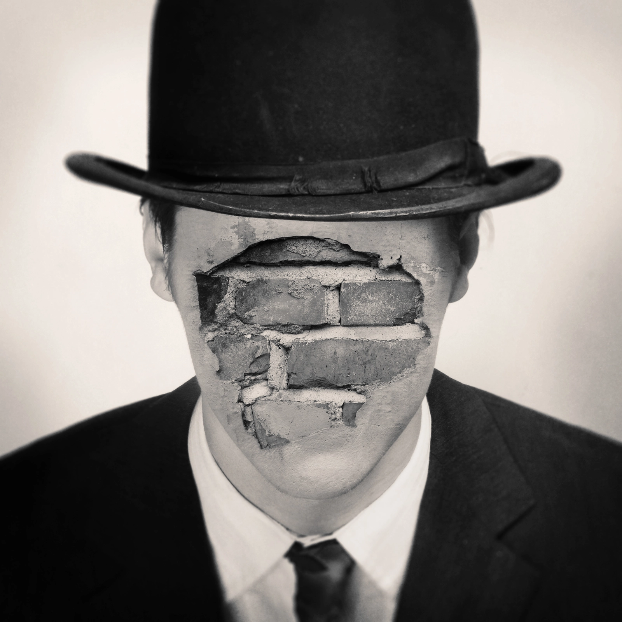
EXIT
What evidence do you now have in your sketchbook to meet AO2?

