Slide 1
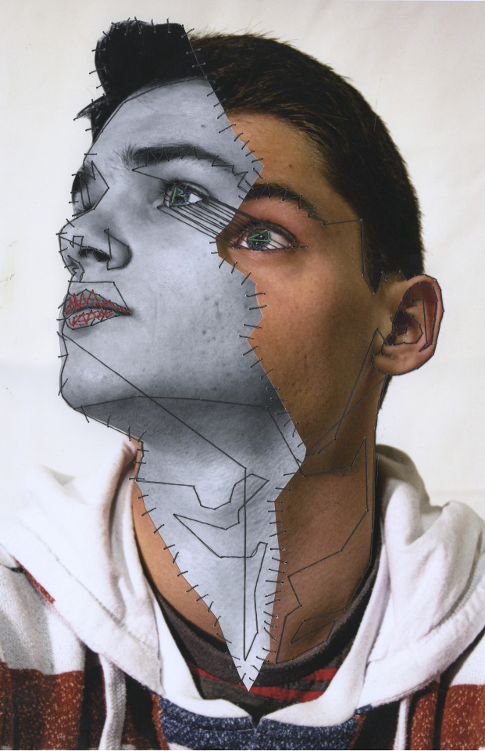
MANNY ROBERTSON
EMBROIDERED METROPOLIS (2009)
Line
The photographer uses line in a very direct way. The dashed lines emphasise the fragmentation between the young boy’s face and neck, giving the impression that areas are being sectioned, potentially being prepared for dissection. The lines create angular forms, suggesting a surgical precision penetrating the skin.
The photographer mostly uses the stitched lines to create geometric and angular sections in the photograph, creating an almost mechanical theme. These shapes contrast sharply with the organic curves of the unchanged portions of the face, emphasising the contrast between the monochromatic section and the boy’s face.
The two-dimensional photograph is combined with the illusion of the three-dimensional mechanical elements overlaid over the original image. This creates a sense of depth and complexity as if the viewer could reach out unpick the stitches that hold the two fragments together, which makes me feel uneasy.
Positive and negative spaces are cleverly manipulated in this image. The space where the machine like parts are shown create a focus in the photograph which might be considered the positive elements. This alters our perception of the original image which almost becomes the negative space in this image, almost making the boy seem less important, like a shadow.
The colour of the mechanical parts has been changed to be monochromatic and becomes the focus in the image. This contrasts with the warm skin tones of the original subject, which whilst familiar to us as viewers, emphasises the contrast between the organic and inorganic themes of this photograph.
Shape
Form
Space
Colour

Slide 2
MANNY ROBERTSON
EMBROIDERED METROPOLIS (2009)
Form: The form of the photograph appear to be a mixed-media composition that combines photography with graphic manipulation. The subject is a young person, depicted as a realistic portrait, overlaid with a second, more staged portrait, that might represent a mechanical or robotic theme. The use of dashed lines to segment the face and neck creates an illusion of depth and is suggestive of a transformative process. The mechanical parts are precise and have an element of intent and appear three-dimensional due to the careful use of perspective.
Content: Robertson appears to comment on the fusion and blurring between the organic and the synthetic, suggesting a cyborg-like creature. It could be interpreted as a metaphor for the integration of technology into our lives or it could be a more literal representation of a futuristic vision where humans and machines merge, like the ideas behind the Terminator movies. The image causes the viewer to ask questions about identity, the nature of humanity, and the potential for humans and technology to merge within the body due to the distinct synthetic nature of the monochromatic overlay.
Process: This artwork likely began with a photoshoot, followed by digital editing techniques to edit the colours of the selected images. A program like photoshop would have been used to overlay and integrate the robotic like elements onto the young boy's face. The precision of the mechanical elements suggests a careful approach and its possible this is a manually manipulated image where the artists physically cut up printed images, sewing them back together again. The photographer would have had to consider the light, shadow, and texture and how these worked together to achieve a believable combination of flesh and what I believe are the metallic components of the image.
Mood: The mood of the artwork is quite unsettling. It evokes a sense of wonder mixed with apprehension and makes me question the future of our relationship with technology. The contrast between the warm, lifelike skin tones and the cold, monochrome parts create a feeling of tension in the viewer, potentially commenting on the conflicted feelings we have about the advances of technology and the implications this might have for us in the future.

Slide 3
MY PHOTOSHOOT IN THE STYLE OF MANNY ROBERTSON
WHAT DID I WANT TO CAPTURE IN MY SHOOT?
For my initial photoshoot, I want to create a series of portraits that explore the tension between people and machinery. I will focus on capturing a natural expression of the face which I will later edit using Photoshop to create 3 portraits in the style of Robertson. My aim is to blur the lines between the human and the engineered.
In my shoot, I plan to concentrate on lighting and angle to capture the contrast between skin and something that when desaturated, looks metallic. The mood of my subjects will be important as I want the images, I capture to encourage my viewers to reflect on the relationship between humans and technology. In some way, I want the viewer to question their own identity in a technologically advancing world.
INSERT ANNOTATED CONTACT SHEET FOR PHOTOSHOOT

Slide 4
MY BEST PHOTOGRAPHS
EVALUATION OF PHOTOSHOOT
Short written evaluation of the photoshoot.
INSERT ANNOTATED CONTACT SHEET FOR PHOTOSHOOT

