Slide 1
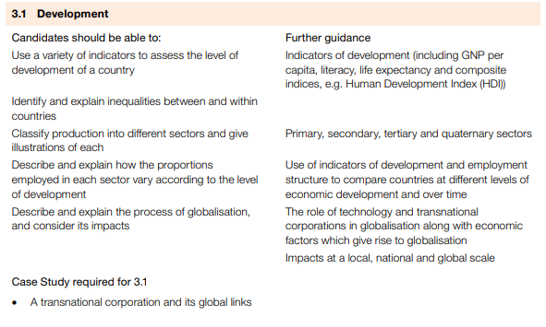
IGCSE GEOGRAPHY 0460: 3.1 DEVELOPMENT

Slide 2
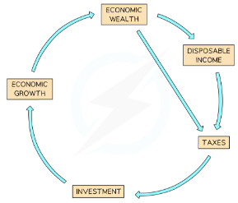
IGCSE GEOGRAPHY 0460: 3.1 DEVELOPMENT
Development is the progress that a country makes to improve the quality of life for its population and make the country more independent
Physical - Water supply, housing, power and heat, climate, diet and nutrition etc
Social/Psychological - Family and friends, education, health, happiness, security, freedom etc.
Economic - Income, job security, standard of living, mobility etc
LEDC: Less Economically Developed Country
NIC: Newly Industrialised Country
MEDC: More Economically Developed Country
Cycle of wealth: One of the key indicators of development is the cycle of wealth also known as multiplier effect.
Development Indicators
GNP per capita | The dollar value of a country's final output of goods and services in a year, divided by its population.
GDP per capita | The total value of goods and services produced within a country in a year divided by the population of the country
Literacy rate | % of adults who can read and write
Life expectancy | Average age a person can expect to live
Human Development Index (HDI) | A composite indicator that takes into account: life expectancy, literacy rate and GNI per capita.
Infant Mortality rate | The number of babies who die before they reach the age of 1, per 1000 babies

Slide 3
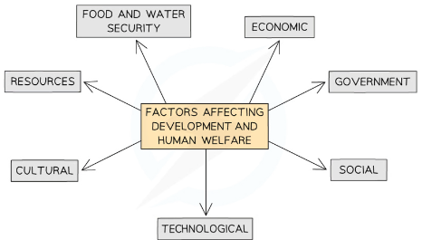
IGCSE GEOGRAPHY 0460: 3.1 DEVELOPMENT
The development gap: iis the difference in levels of development between the least developed and most developed countries in the world. There are many factors which lead to the differences in development
Physical geography
Landlocked countries find trade more difficult and so often develop more slowly
Small countries develop more slowly due to have fewer human and natural resources
Extreme climates results in slower development
Availability of natural resources such as water, soil, fossil fuels etc,
Economic
Trade Policies: The economic policy of country also impacts development. Countries open to trade develop faster than countries that are closed to trade
Government policies
Stable government: can have a significant impact on development and human welfare
Democracy: Development and human welfare are greatest where there is a elected government
Corrupt governments: do not invest in the country's development or in improving the quality of life for the population
Demography
Population structure of a country: The birth and death rates, as well as immigration, affect the available workforce
Fallen Birth rates: where birth rates have fallen the most, show the highest rates of grow
Technology
Increase resources: water, food and energy security
Mechanisation: of farming increases yields and improved land surveying may reveal more energy sources
Efficiency: can also mean that existing resources are used more efficiently
Social
Levels of education: affect the skills people have. The more educated a population is the more a country will develop
Healthcare: affects how well people are which affects their ability to work

Slide 4
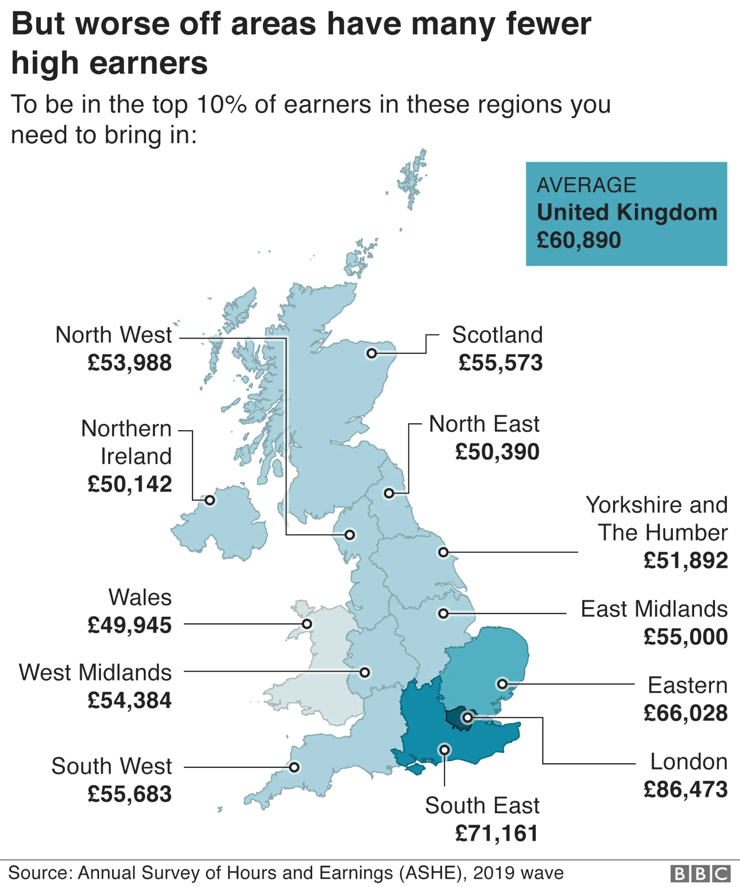
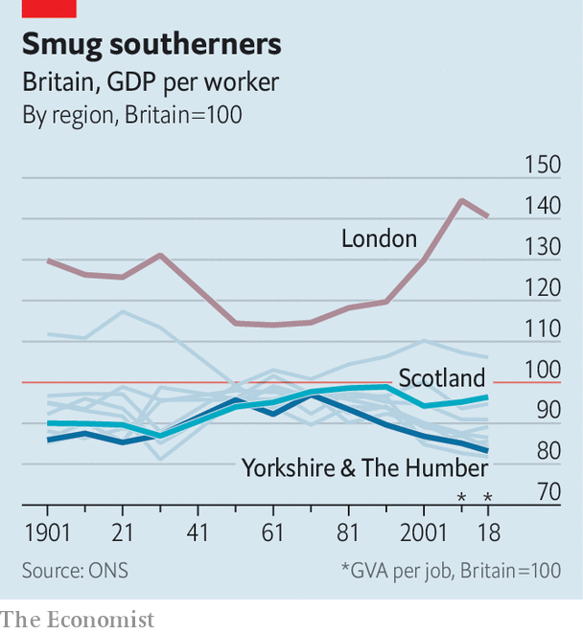
IGCSE GEOGRAPHY 0460: 3.1 DEVELOPMENT
Causes of regional inequalities
Residence - Urban areas generally attract greater levels of investment leading to increased business and incomes: There may also be inequality within the urban area
Ethnicity - Discrimination can result in ethnic groups having income levels significantly below the dominant groups within a country. This reduces the opportunities open to these groups
Employment - The split between formal and informal employment impacts incomes. Formal jobs usually have higher incomes and greater benefits, such as holidays and sick pay
Education - Those with higher levels of education usually gain higher paying employment
Land ownership -Inequalities in land ownership are strongly linked to inequalities in income

Slide 5
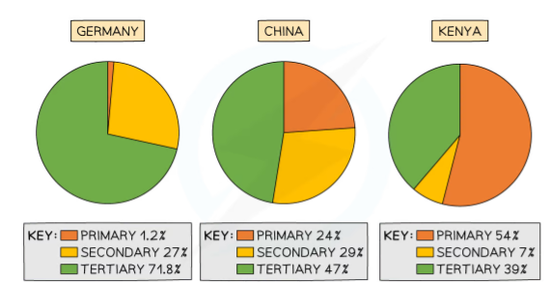
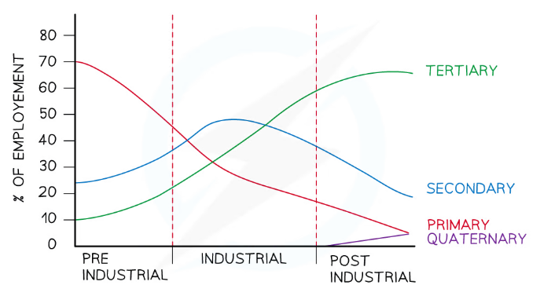
IGCSE GEOGRAPHY 0460: 3.1 DEVELOPMENT
Economic Sectors
Economic activities can be grouped into four sectors:
Primary - mining, fishing, farming etc.
Secondary - factory workers, clothing, steel production etc.
Tertiary - nurses, lawyers, teachers, shop assistants, chefs
Quaternary - hi-tech scientists, research and development
Employment in Economic Sectors
Economic sectors are an indicator of a country's economic development using either:
The amount each sector contributes to the Gross Domestic Product (GDP)
The percentage of the population they employ
The proportions of each economic sector GDP and employment changes over time:
In the pre-industrial period, the primary sector dominates with steady increases in the secondary and tertiary sectors
As countries develop the reliance on the primary sector for GDP and employment rapidly decreases
During the industrial period the amount of GDP and employment in the secondary sector increases to become dominant and then decreases. The primary sector continues to decrease and tertiary sector increases
In the post-industrial phase, the tertiary and quaternary sectors increase whilst the secondary and primary sectors decrease.
The tertiary sector dominates employment and GDP in the post-industrial period

Slide 6
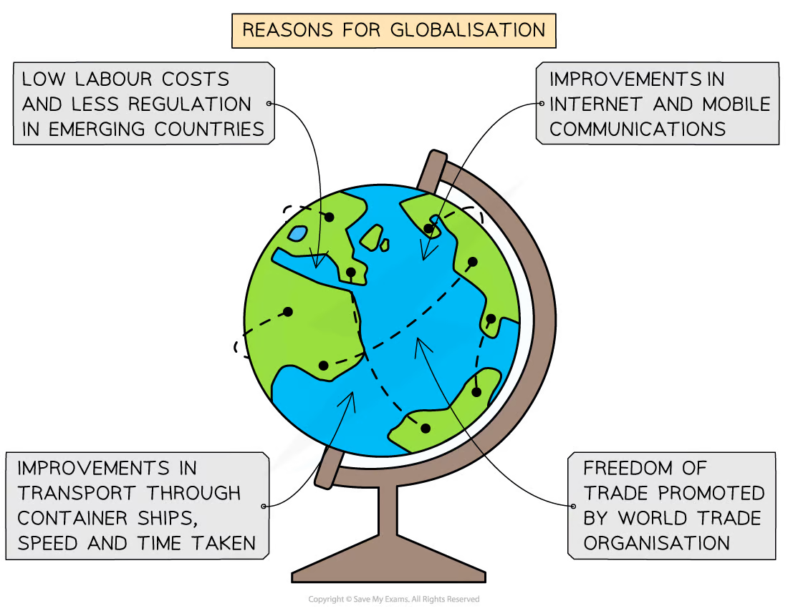
IGCSE GEOGRAPHY 0460: 3.1 DEVELOPMENT
Globalisation is where the world has become more interconnected through the processes of three T’s: Trade, Transport and Technology.
Overall, connections around the globe are:
Faster - faster speeds for talking, travel, money exchange etc
Deeper - connecting lives with faraway places
Longer - connecting links between places are further apart
These connections are considered as network flows to places and populations through four significant developments:
Appearance of large transnational corporations (TNCs)
Growth of regional economics and trading blocs
Development of modern transport networks - air travel
Advances in IT and communications, particularly the WWW and the internet
Transport
Air Travel: Faster and more accessible air transportation allows people and goods to move quickly across the globe.
Shipping Advances: Larger and more efficient cargo ships enable cost-effective movement of goods between countries.
Technology
Internet Communication: Instant communication through the internet facilitates global business transactions and information exchange.
Digitalization: Automation and digital technologies streamline production, making it easier to connect global supply chains.
Trade
Trade Agreements: Agreements like NAFTA and the EU promote easier movement of goods and services between participating countries.
Global Supply Chains: Companies sourcing materials and components from various countries create intricate global supply networks.

Slide 7
IGCSE GEOGRAPHY 0460: 3.1 DEVELOPMENT
Globalisation comes with a variety of impacts locally, nationally and globally, Some impacts can be for good whilst others can have a negative impact.
Local | National | International
✓ Increased Job Opportunities - Local businesses may benefit from expanded markets, leading to more job opportunities for residents. ✓Access to Global Products - Local consumers gain access to a wider variety of goods and services from around the world. ✓Cultural Exchange - Globalization fosters cultural exchange, allowing local communities to experience and appreciate diverse traditions. | ✓Economic Growth - Increased trade and investment can contribute to national economic growth. ✓Technological Advancements - National economies may benefit from the transfer of technology and knowledge across borders. ✓Improved Infrastructure - Globalization can attract foreign investment, leading to improved infrastructure such as roads and communication networks. | ✓ Global Cooperation - Countries can collaborate on global issues like climate change and health, fostering a sense of shared responsibility. ✓ Innovation and Research - Globalization facilitates the sharing of scientific and technological advancements on a global scale. ✓ Poverty Reduction - Economic development and increased trade can contribute to poverty reduction worldwide.
❌ Job Displacement: Local businesses may struggle to compete with global companies, leading to job displacement. ❌ Cultural Erosion: Exposure to global cultures may overshadow and erode local traditions. ❌ Negative: Environmental Impact - Local ecosystems may suffer due to increased industrialization and resource extraction. | ❌ Income Inequality - Globalization can exacerbate income inequality within a country. ❌ Loss of Cultural Identity - Dominance of global cultures may lead to a loss of national cultural identity. ❌ Dependency - Overreliance on global markets may make national economies vulnerable to global economic fluctuations. | ❌ Exploitation of Resources - Globalization may lead to the exploitation of resources in less economically powerful regions. ❌ Unequal Distribution of Benefits - Some countries may disproportionately benefit from globalization, leading to global disparities. ❌ Cultural Homogenization - Contributes to the spread of a globalized culture, overshadowing unique local cultures.

Slide 8
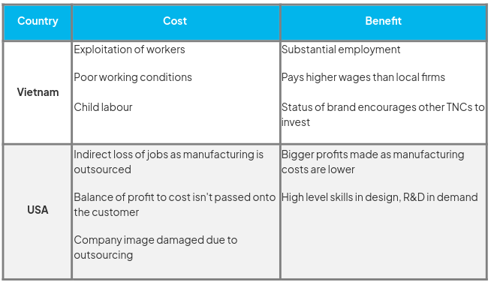
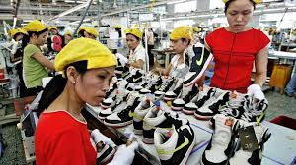
IGCSE GEOGRAPHY 0460: 3.1 DEVELOPMENT
CASE STUDY: NIKE, TNC
A transnational corporation (TNC) is a company which operates in at least two countries. The organisation is hierarchical, with the headquarters and research and development (R&D) often located in the country of origin, with centres of production overseas. Examples include: Nike, Mcdonalds, Amazon.
Context
Headquarters is based in Oregon, USA, the company has over 700 shops worldwide, offices across 45 countries and over 700 contract factories with nearly 1 million workers across 50 countries.

