Slide 1
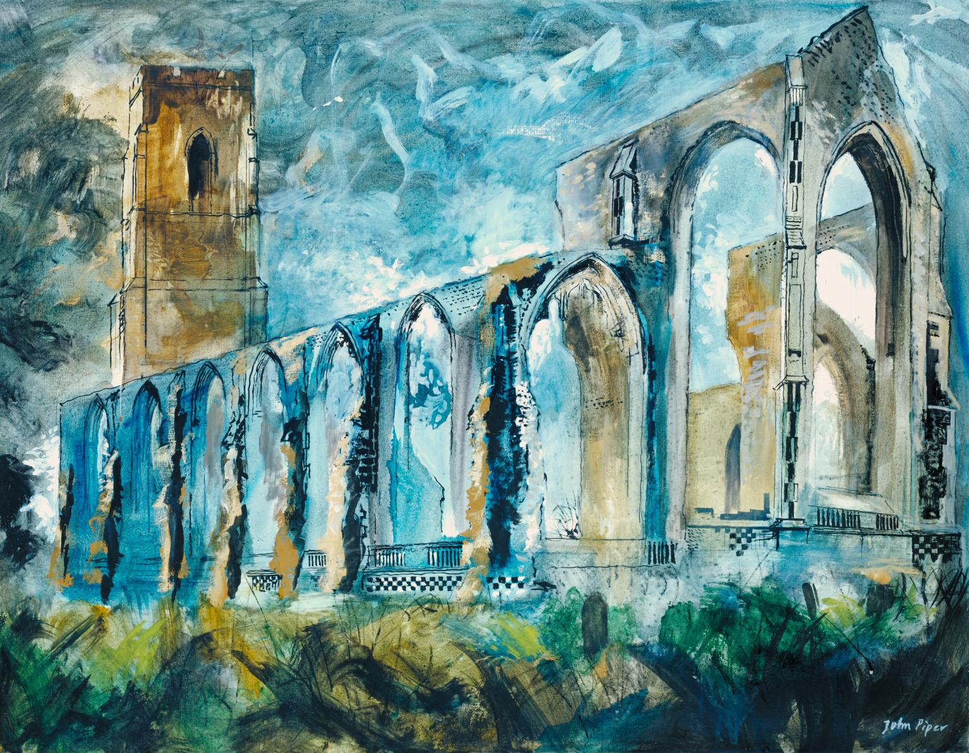
ARCHITECTURE
Year 8: Painting & Drawing Unit
Lesson 4: Finishing Touches

Slide 2
Learning
Intentions
Who was John Piper?
What skills do I need to complete a piece of work in the style of John Piper?

Slide 3
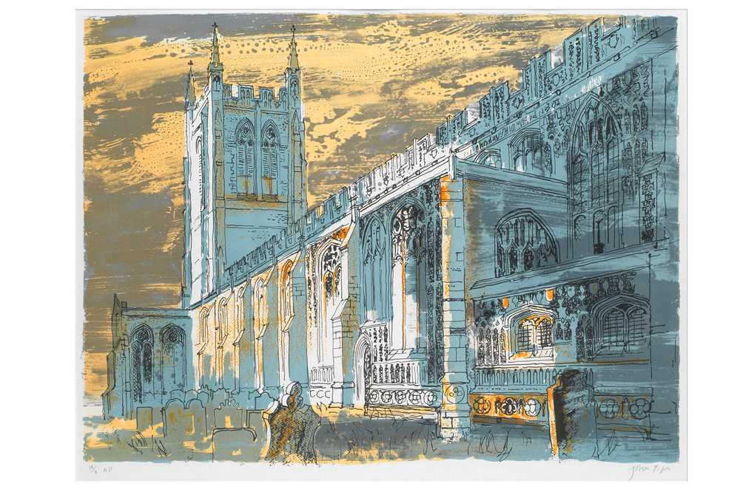
What can you tell me about this image?

Slide 4
This is a close up of an artwork by John Piper. In this section he used watercolour and Ink. The ink is used to outline the building, this makes it stand out on the page. What do you think the artist did first? (the watercolour or the ink?)
Task 1: Discuss

Slide 5
Here’s the full image…
What other details do you notice?
St Nicholas Church, Alcester (1947)
Charcoal and watercolour on paper

Slide 6
Task 2
Resources
You are going to need the following:
Your drawing from last lesson
A black pen

Slide 7
Task 2: Architecture Drawing
Step 1: Choosing a subject (selecting a building)
Step 2: Using ‘wet media’ to create a background
Step 3: Using ‘dry media’ to add shape
Step 4: Finishing touches and details

Slide 8
Step 4: Adding Details

Slide 9
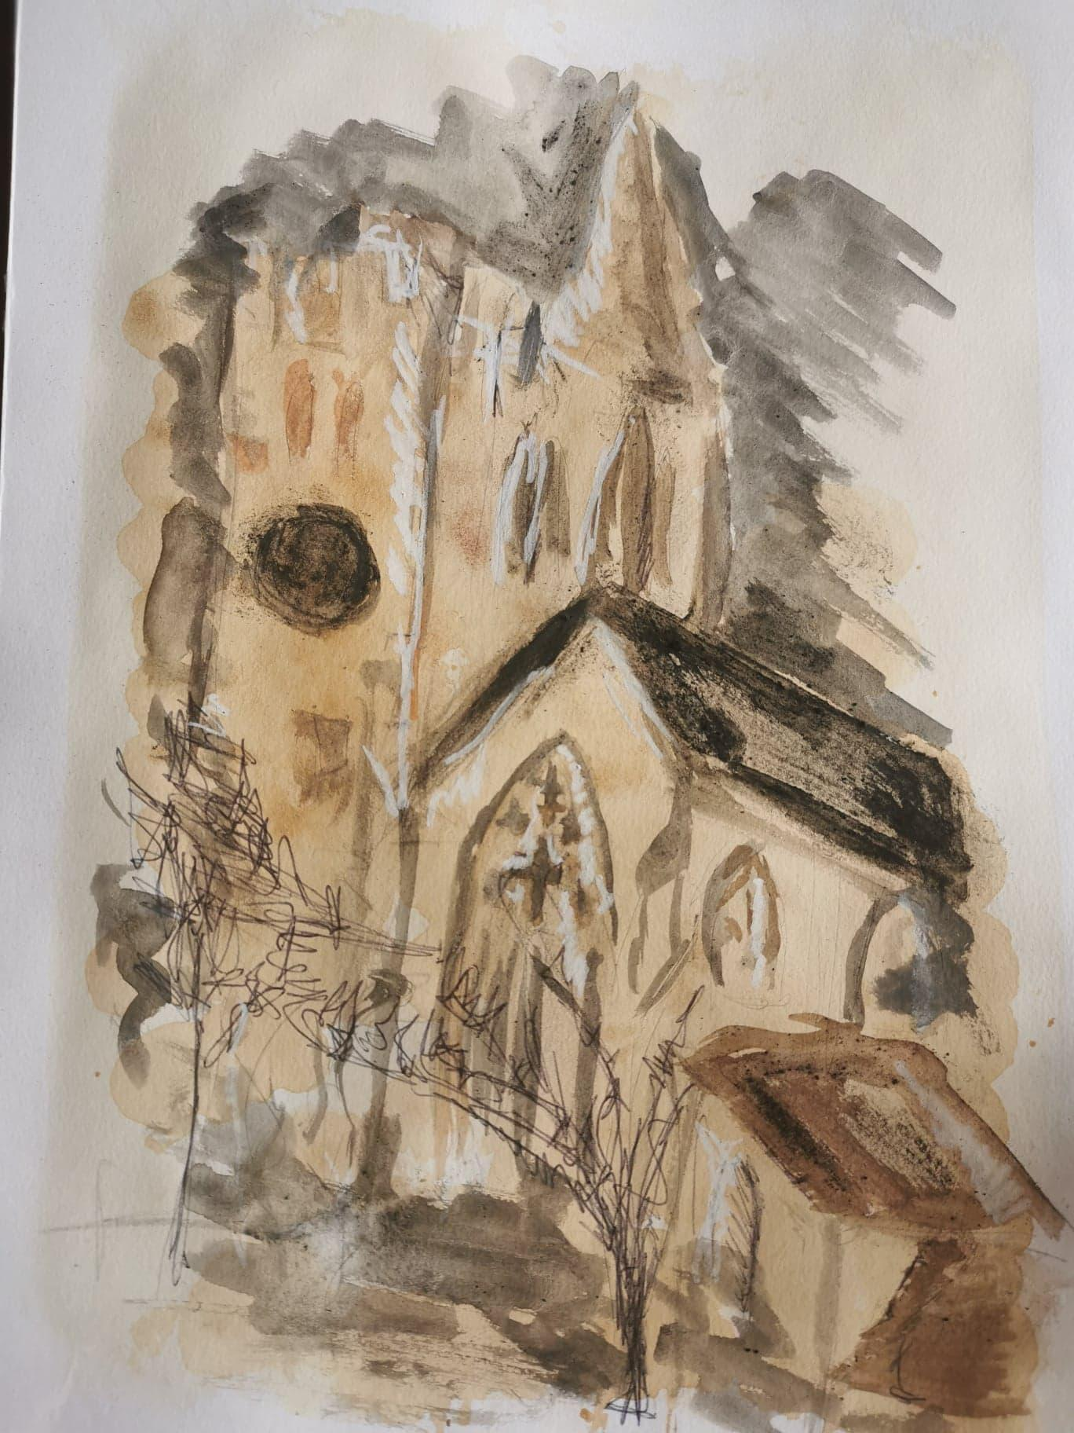
Task 3
Evaluate
WWW
Good use of highlights.
Lots of expressive marks.
EBI
More dark tones are needed.

Slide 10
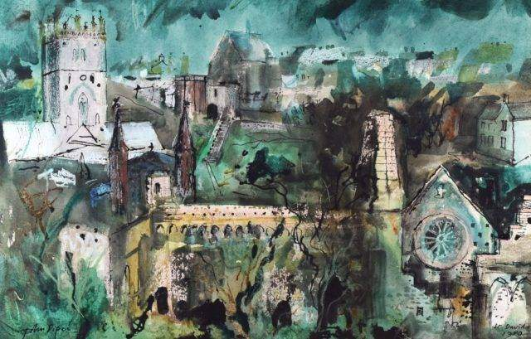
EXIT
Post a photograph of your John Piper Inspired artwork to your Teams channel.

