Slide 1
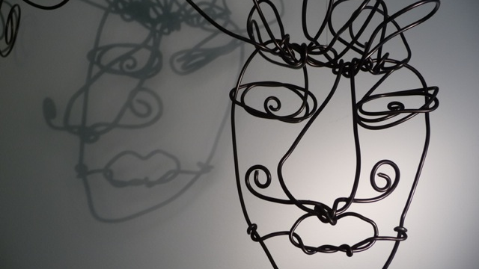
WHO AM I?
Year 7: An Introduction to Art
Lesson 9: Alexander Calder (Part 1)

Slide 2
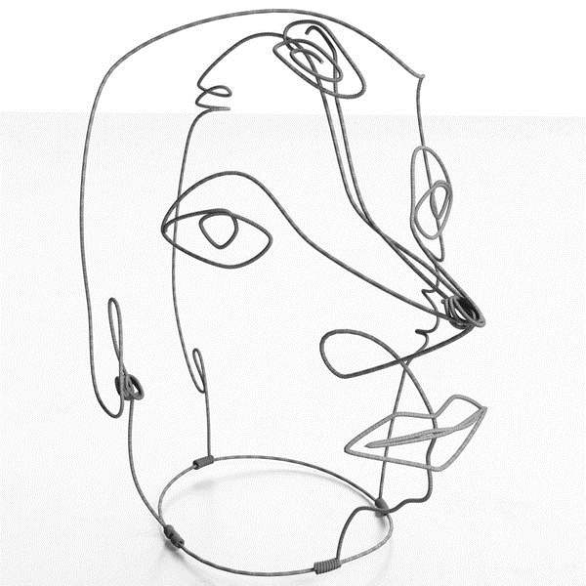
What can you tell me about this image?

Slide 3
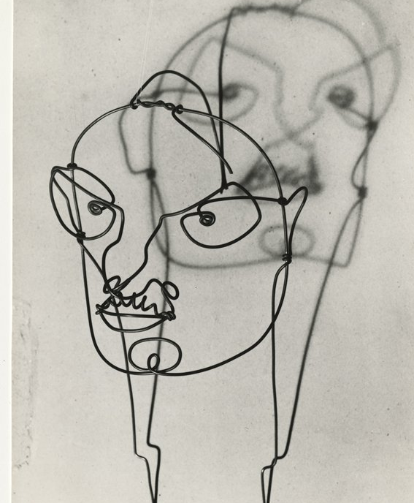
Learning Intentions
In this lesson we are going to be experimenting with line and sculpture.
Who is Alexander Calder
How can his artwork influence my own?
What skills do I need to create an Alexander Calder influenced piece of artwork?

Slide 4
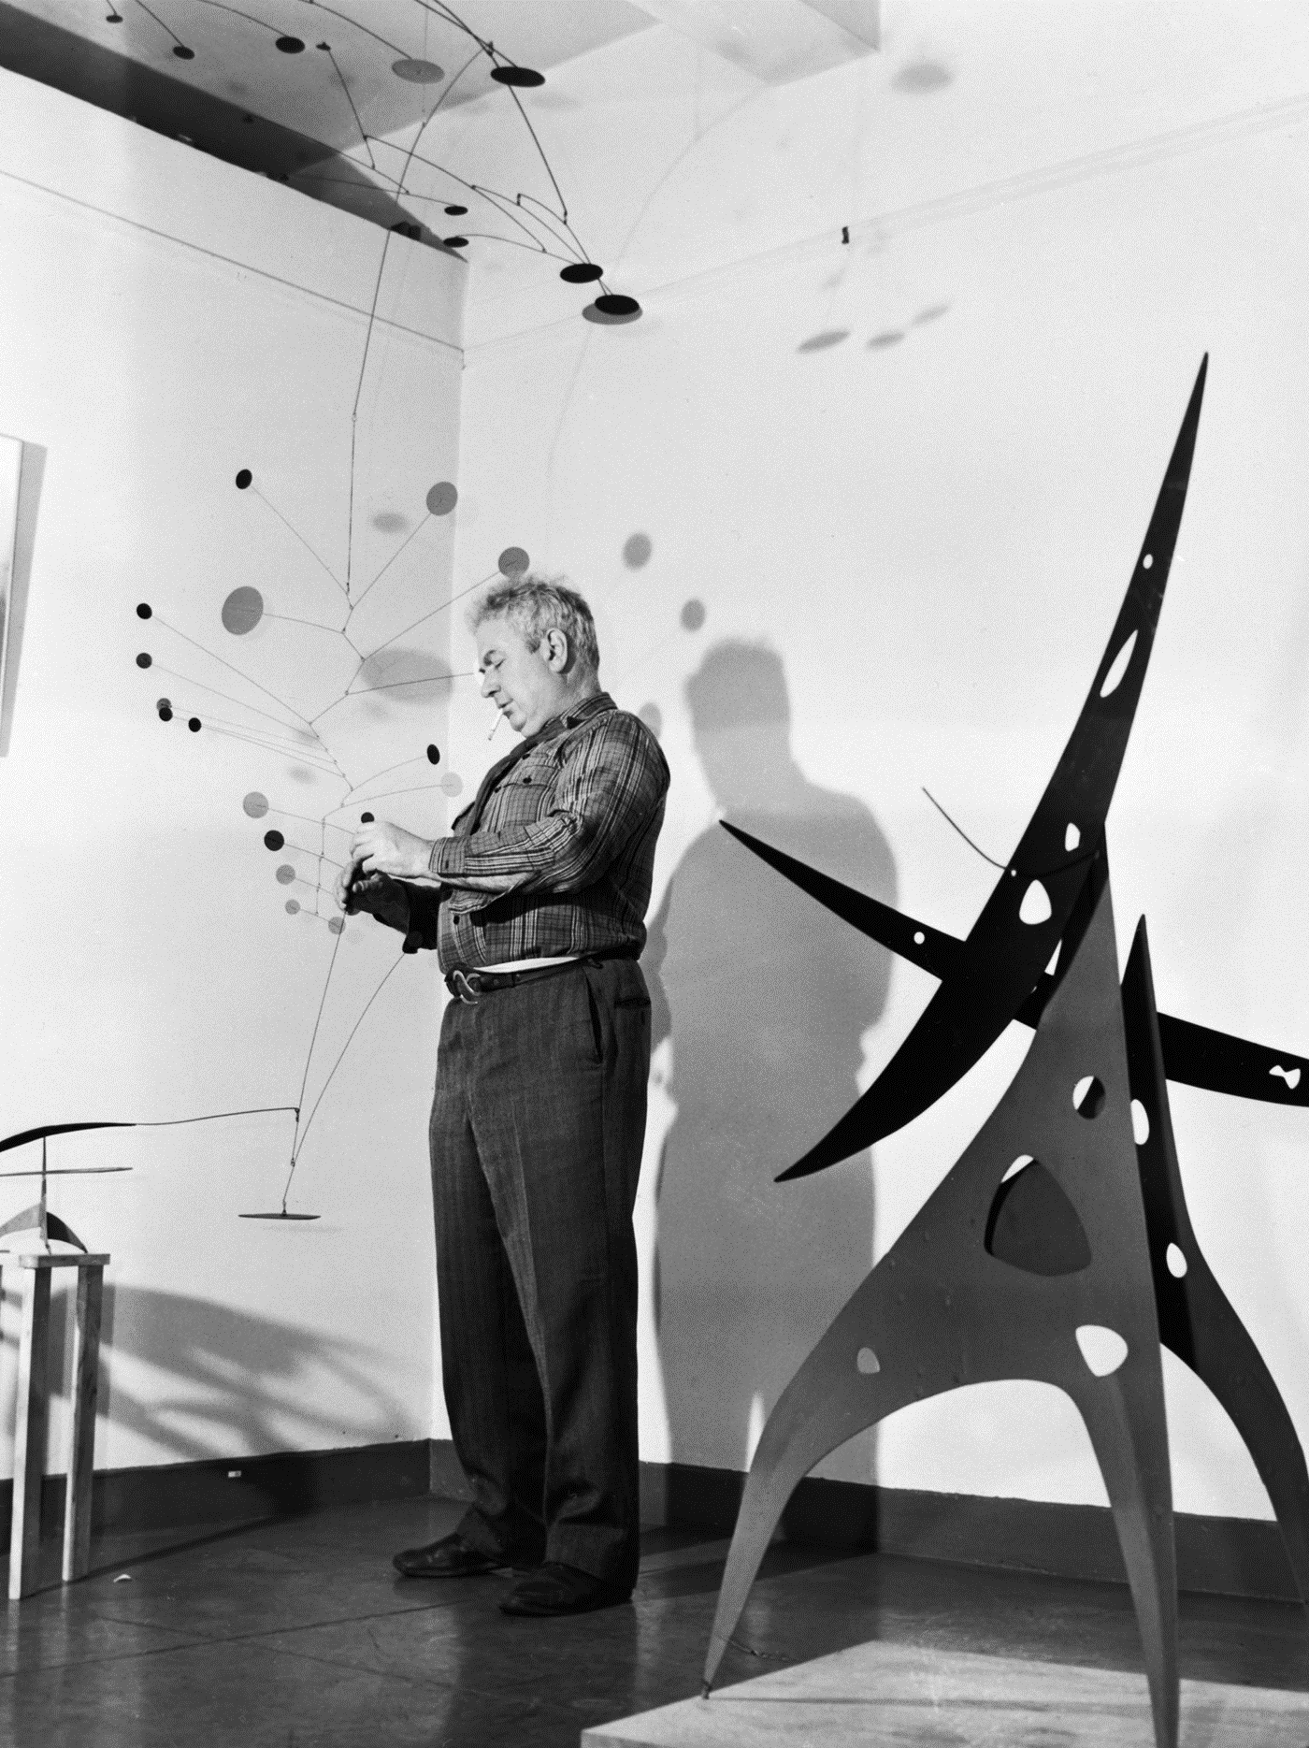
Who is Alexander Calder?
Alexander Calder was an American sculptor
He was known both for his innovative mobiles that embrace ‘chance’ in their aesthetic, and monumental public sculptures.
He didn't limit his art to sculptures; he also created paintings, jewelry, theatre sets and costumes.

Slide 5
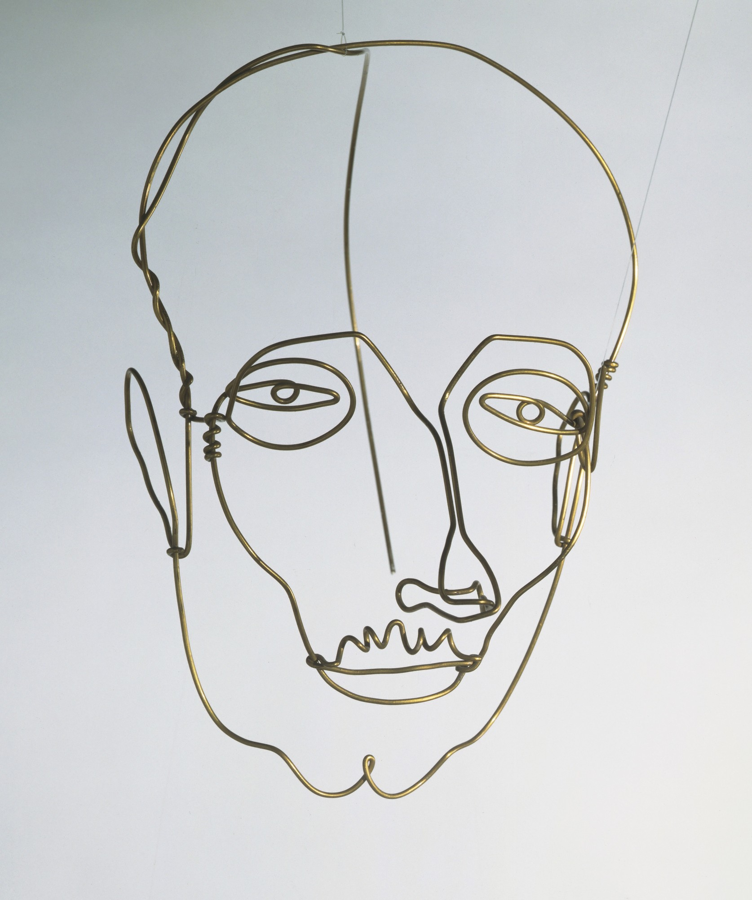
Portrait of a Man (1928)
This artwork by Alexander Calder is made from one long piece of wire.

Slide 6
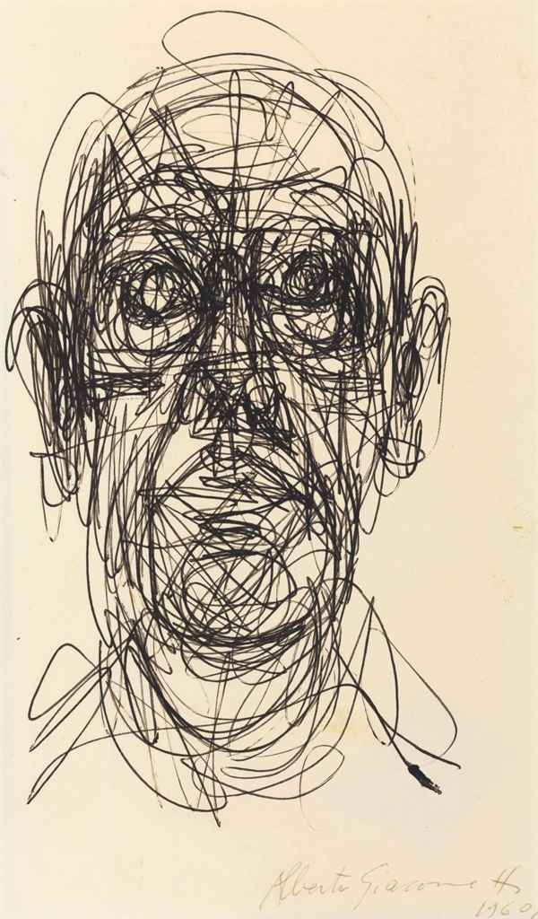
Task 1: Consider…
This portrait was made by looking at drawings similar to the ones you made last lesson.
In what ways is Calder’s work similar to that of Giacometti’s?

Slide 7
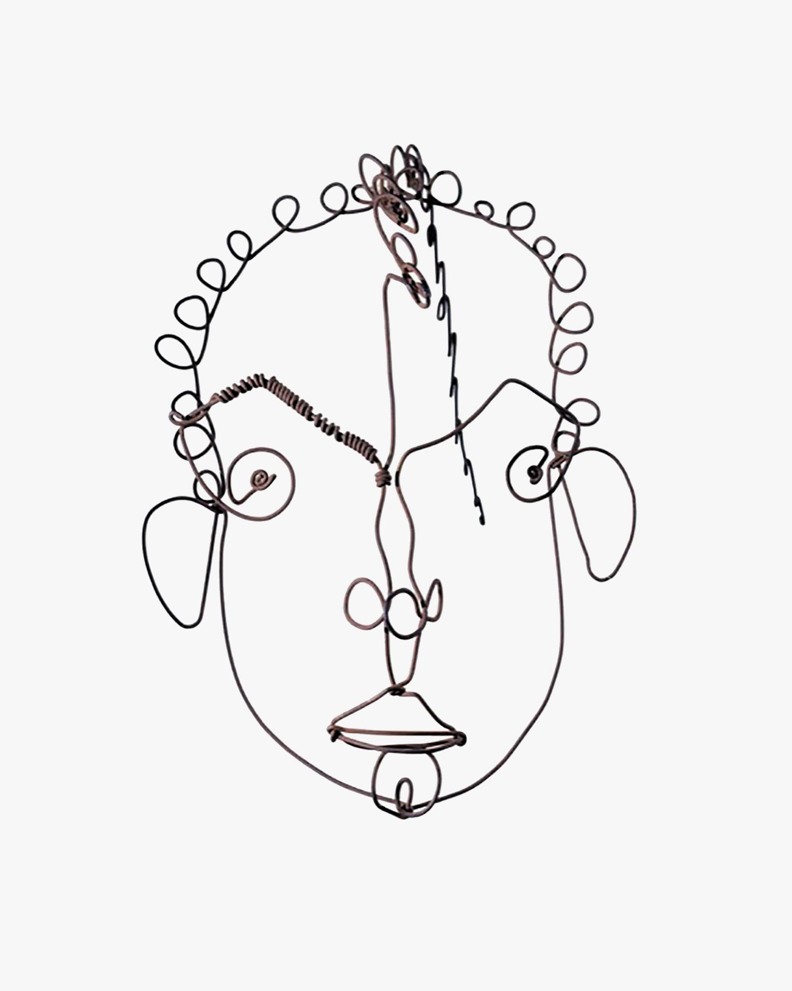
Task 2: Consider…
Untitled (1929)
How do you think Calder made this sculpture?

Slide 8
Now we have considered Alexander Calder’s process. Let’s begin!

Slide 9
We are going to create an artwork, inspired by Alexander Calder style of scultpure.
Take your time when creating your artwork. It is not a case of getting it done, but rather doing it to the best of your ability. Be experimental!
If you need to practice, please do, this is about developing your skills to create something new and original.

Slide 10
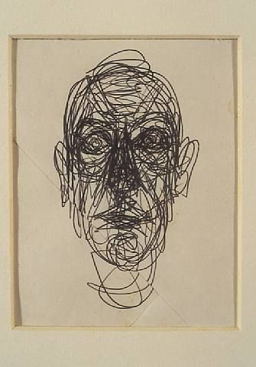
Task 3
Resources
Today you are going to need the following:
Sketchbook
A long piece of wire (about 50cm)

Slide 11
Demonstration
Start at 0:46

Slide 12
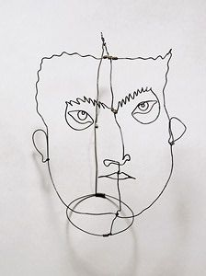
EXIT
What do you need to do next lesson to finish your Alexander Calder inspired sculpture?

Slide 13
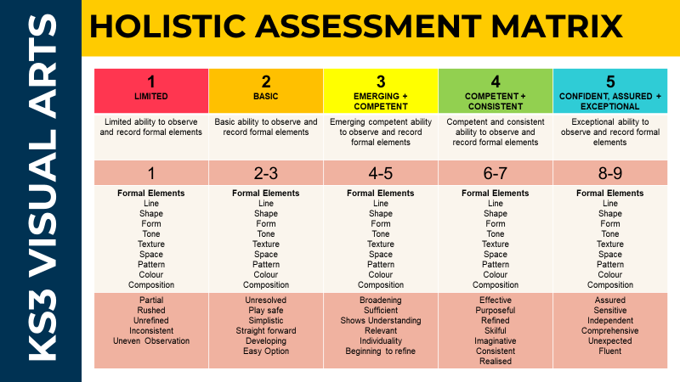

Slide 14
WHO AM I?
Year 7: An Introduction to Art
Lesson 10: Alexander Calder (Part 2)

Slide 15
Learning Intentions
In this lesson we are going to be experimenting with line and sculpture.
What materials did Alexander Calder use?
How can I develop my own work in the style of Alexander Calder?
What skills do I need to create an Alexander Calder inspired piece of artwork?

Slide 16
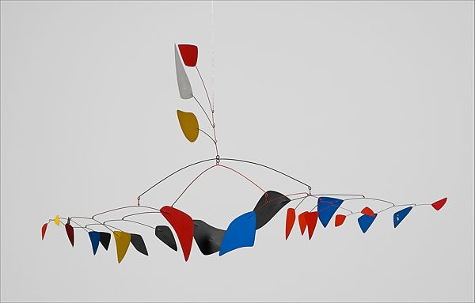
Four Directions (1956)
‘Four Directions’ is one of Calder’s signature mobiles, a type of multifaceted sculpture he typically constructed with cut pieces of lightweight painted aluminum connected by wire.
Hung from the ceiling, the piece responds to its environment, especially changes in airflow, by setting into slow, drifting motion.

Slide 17
Task 1: Discuss
Four Directions (1956)
How does this artwork make you feel?
Why do you think it makes you feel this way?

Slide 18
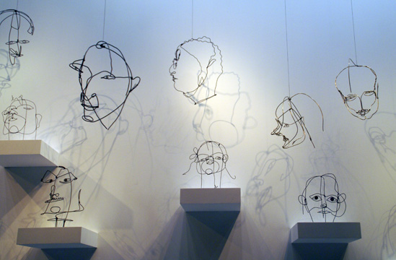
Drawing in Space (1926-1933)
This is a collection of Alexander Calder’s artwork in an exhibition which was called ‘Drawing in Space’.
Look at the way the work has been exhibited to show the shadows on the walls.

Slide 19
Drawing in Space (1926-1933)
Task 2: Discuss
Look at the title of this exhibition. What clues does this give us about what the artist wanted to achieve with this artwork?

Slide 20
Now we have considered the intentions behind Calder’s artwork. Let’s continue!

Slide 21
We are going to finish our sculptures inspired by Alexander Calder.
Take your time when creating your artwork. It is not a case of getting it done, but rather doing it to the best of your ability. Be experimental!
If you need to practice, please do, this is about developing your skills to create something new and original.

Slide 22
Demonstration
Start at 0:46

Slide 23
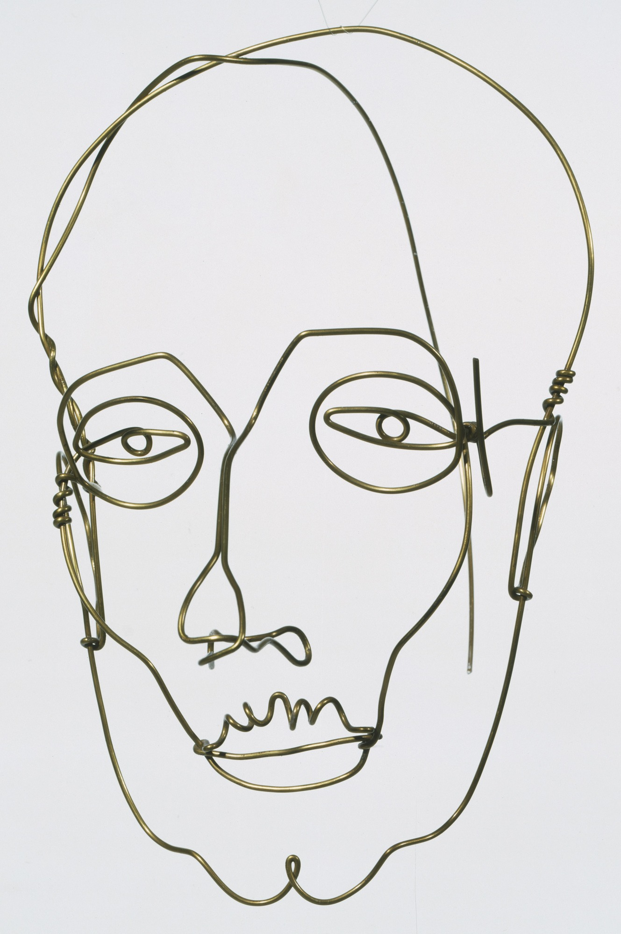
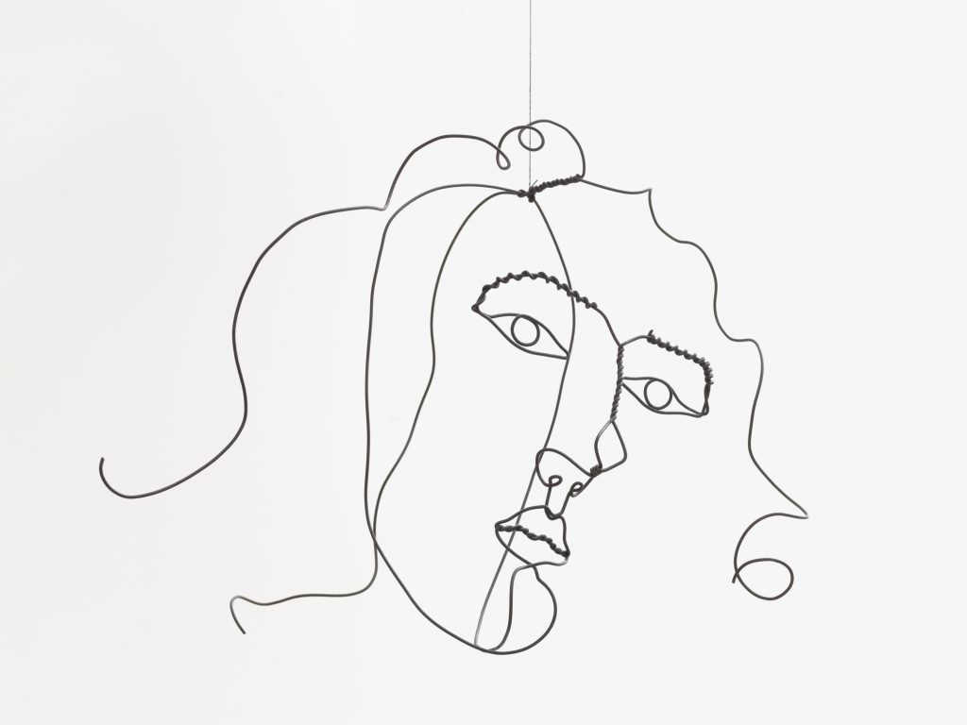
Inspiration

Slide 24
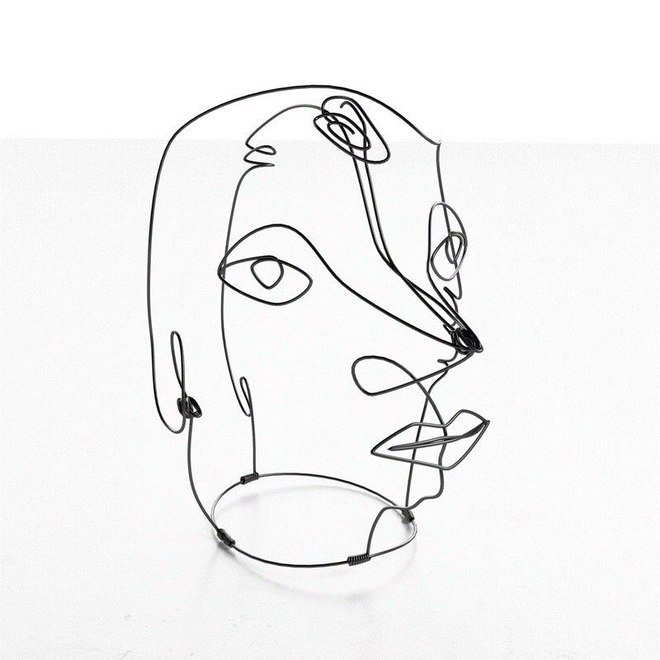
EXIT
Post a photograph of your final artwork on the Teams page to share it with the rest of your class.

