Slide 1
ALIVE
Year 8: Photography Unit
Lessons 6-8: Photographer Investigation

Slide 2
What can you tell me about this image?

Slide 3
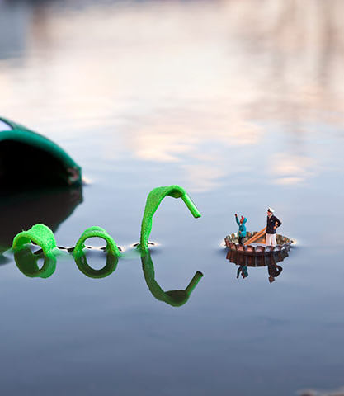
Learning Intentions
Demonstrate an understanding of a chosen photographer's style, themes, and artistic approach.
Analyse a favourite photograph in relation to an investigated theme or idea
Create a visually appealing double-page spread in their sketchbook that reflects the photographer's work
Reflect on personal inspiration and future artistic exploration stimulated by the photographer's work.

Slide 4
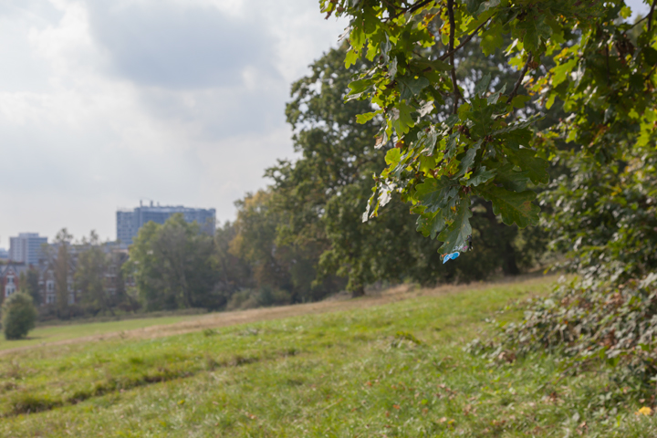
Slinkachu
The 'Little People Project' started in 2006. It involves the remodelling and painting of miniature model train set characters, which I then place, photograph and leave on the street. It is both a street art installation project and a photography project.
The street-based side of my work plays with the notion of surprise and I aim to encourage city-dwellers to be more aware of their surroundings. The scenes I set up, more evident through the photography and the titles I give these scenes, aim to reflect the loneliness and melancholy of living in a big city, almost being lost and overwhelmed. But underneath this, there is always some humour. I want people to be able to empathise with the tiny people in my works.

Slide 5
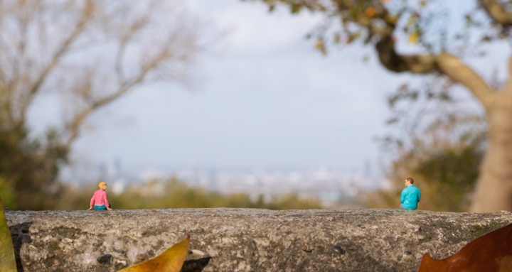

Slide 7
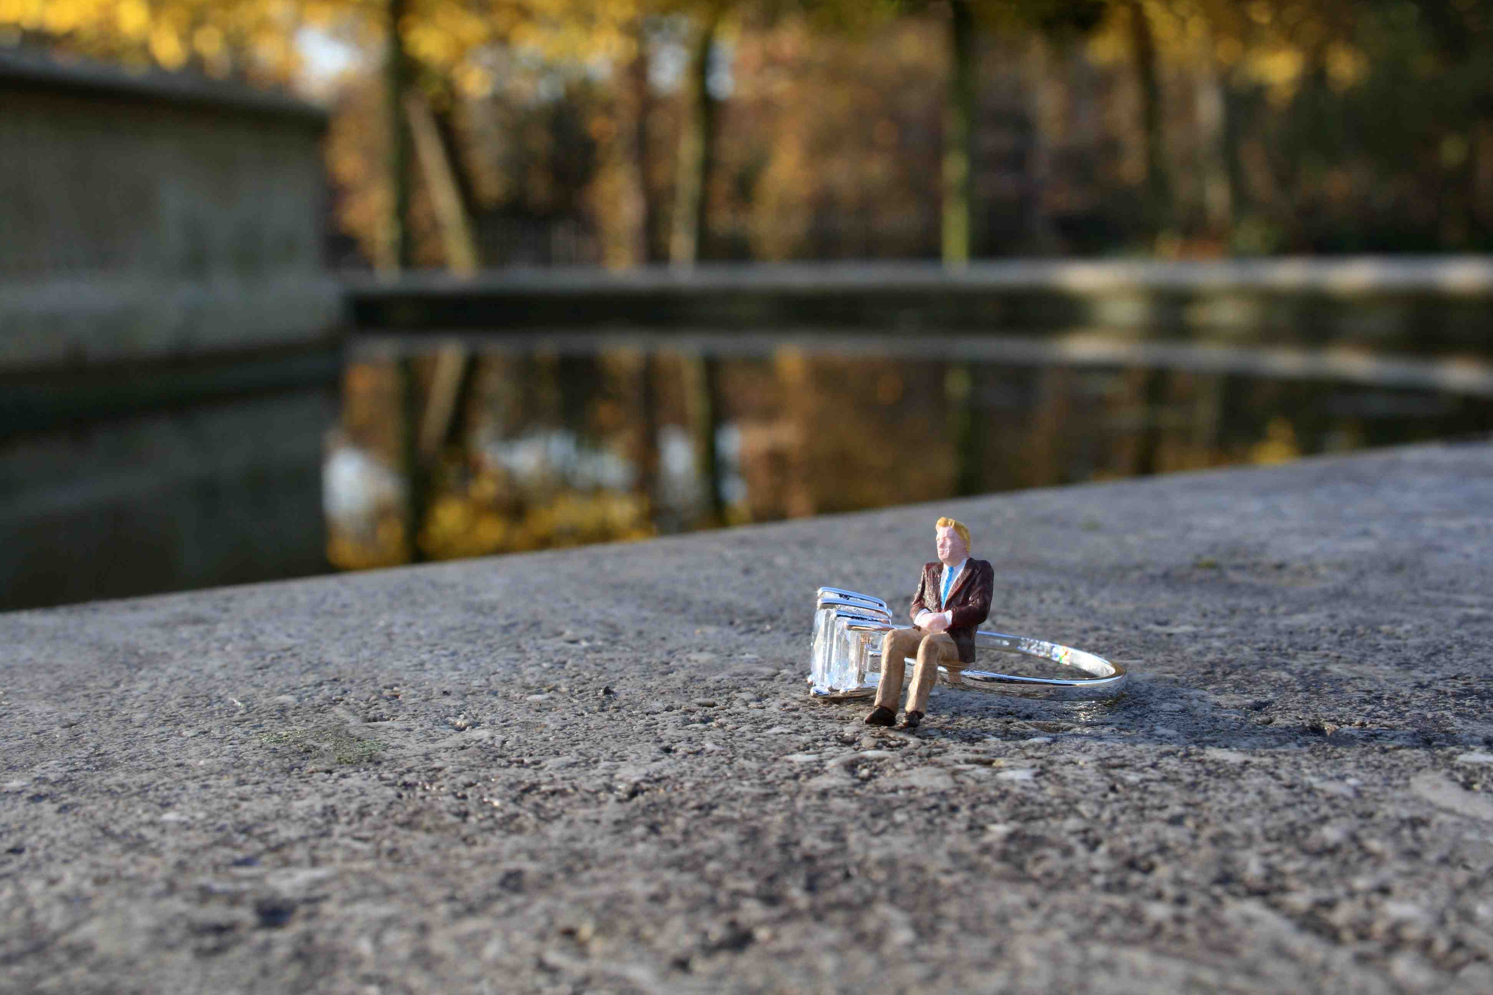

Slide 8
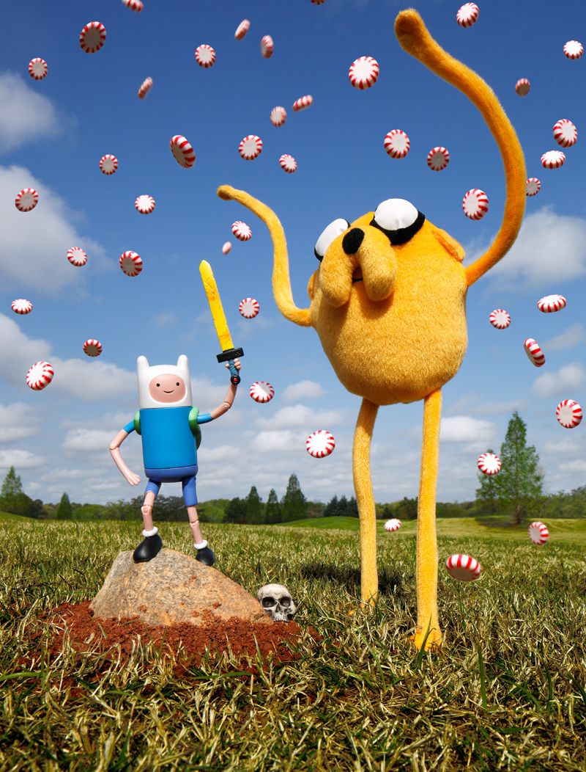
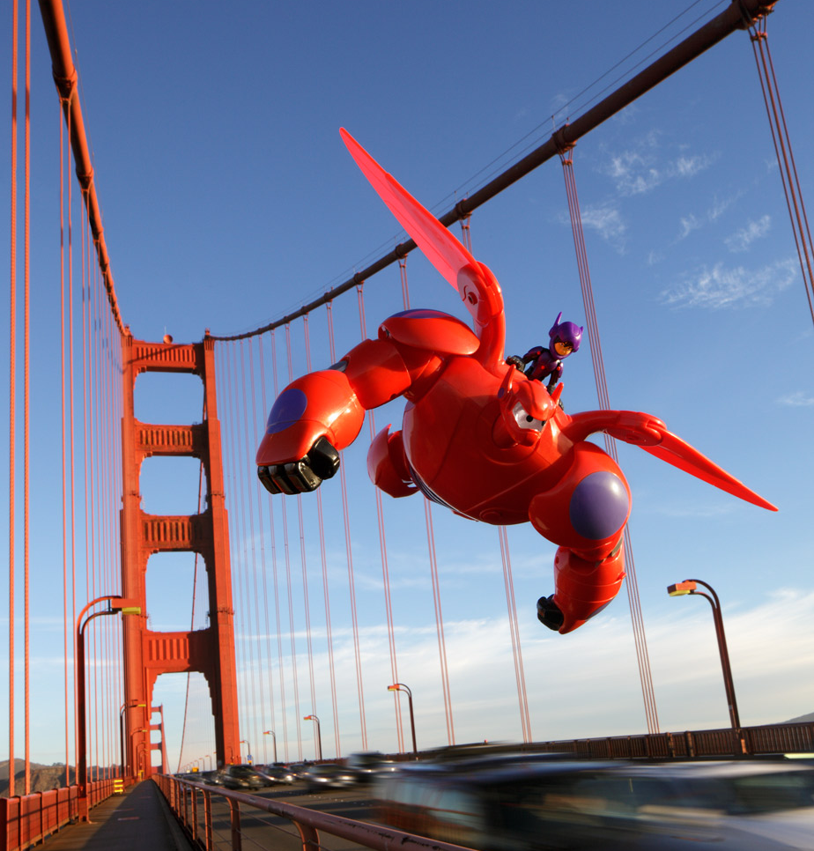
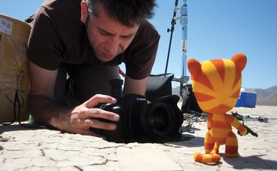
Brian McCarty
Brian McCarty is a contemporary artist and photographer known for his work with toys. McCarty has been using toys in his photography for over twenty years.
His approach is based upon integrating toy characters into real-life situations through the use of forced perspective in carefully crafted scenes. McCarty creates his photographs by sometimes traveling to exotic locations, including active war zones.

Slide 9
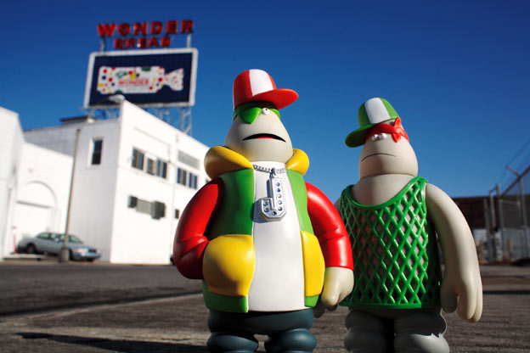

Slide 10
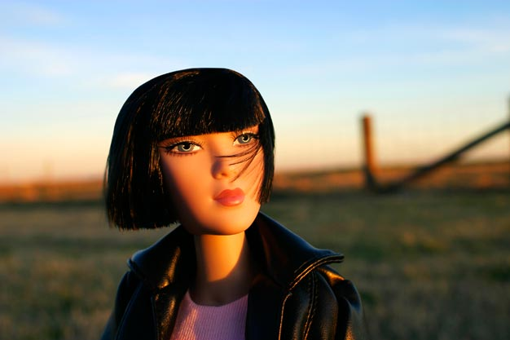

Slide 11
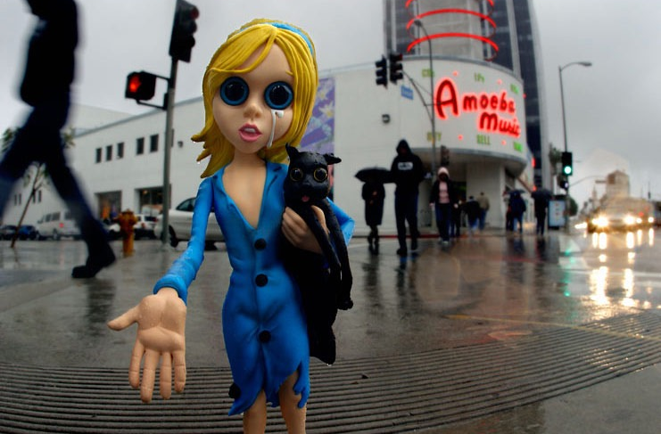

Slide 13
Task 1
Exploring the World of Photography - Investigating Slinkachu or Brian McCarty
Instructions
Choose one photographer: Slinkachu or Brian McCarty.
Research their work and select the one you find most intriguing.
Create a double-page spread in your sketchbook dedicated to the photographer. The pages should be decorated in a way that reflects the photographer's style and themes.
Your research page should be visually appealing and incorporate embellishments that reflect the style of the photographer you have chosen. You can use collage, drawings, or any other artistic techniques to create an engaging and reflective presentation.
Present your completed double-page spread to the class, sharing your findings, favorite photograph, and how it has inspired you.
Your photographer research page should include the following elements:
Photographer's name: Clearly state the photographer's full name.
Images of their work: Include a minimum of three high-quality images that represent the photographer's artistic style.
Annotation about the photographer: Write a brief paragraph describing the photographer's background, artistic approach, and any notable achievements or awards.
Analysis of a favorite photograph: Choose one photograph that stands out to you and explain why it is your favorite. Discuss how it relates to the theme or idea you are investigating. Consider the composition, subject matter, use of colour, and any emotions or ideas it evokes in you.
Inspiration for your own work: Reflect on how the photographer's work inspires you. Explain what it motivates you to do next, whether it's experimenting with similar themes, techniques, or exploring a different aspect of photography.

Slide 14
Task 1
Assessment Criteria for Photographer Research Page
Criteria | Assessment | Max Points
Understanding of Photographer's Style, Themes, and Artistic Approach | 0 points: Limited or no understanding demonstrated. 1 point: Basic understanding shown, but lacks depth and clarity. 2 points: Adequate understanding presented, with some detail and insight. 3 points: Comprehensive understanding demonstrated, showcasing in-depth knowledge of the photographer's style, themes, and artistic approach. | 3
Analysis of Favorite Photograph and Connection to Investigated Theme/Idea | 0 points: Analysis is missing or lacks relevance to the theme/idea. 1 point: Analysis is superficial and lacks clear connection to the theme/idea. 2 points: Analysis shows understanding of the photograph and its relationship to the theme/idea, but lacks depth or originality. 3 points: Thoughtful and insightful analysis provided, highlighting a strong connection between the photograph and the investigated theme/idea. | 3
Creative and Visually Appealing Presentation with Reflective Embellishments | 0 points: Presentation lacks creativity, visual appeal, and embellishments related to the photographer's work. 1 point: Some attempts at creativity and visual appeal, but lacking consistency or relevance to the photographer's work. 2 points: Presentation is visually engaging, demonstrates creativity, and incorporates embellishments that reflect the photographer's style and themes. | 2
Reflection on Personal Inspiration and Future Artistic Exploration | 0 points: Limited reflection provided but lacks clarity or depth. 1 point: Clear reflection on personal inspiration and articulation of specific future artistic exploration inspired by the photographer's work. | 1

Slide 16
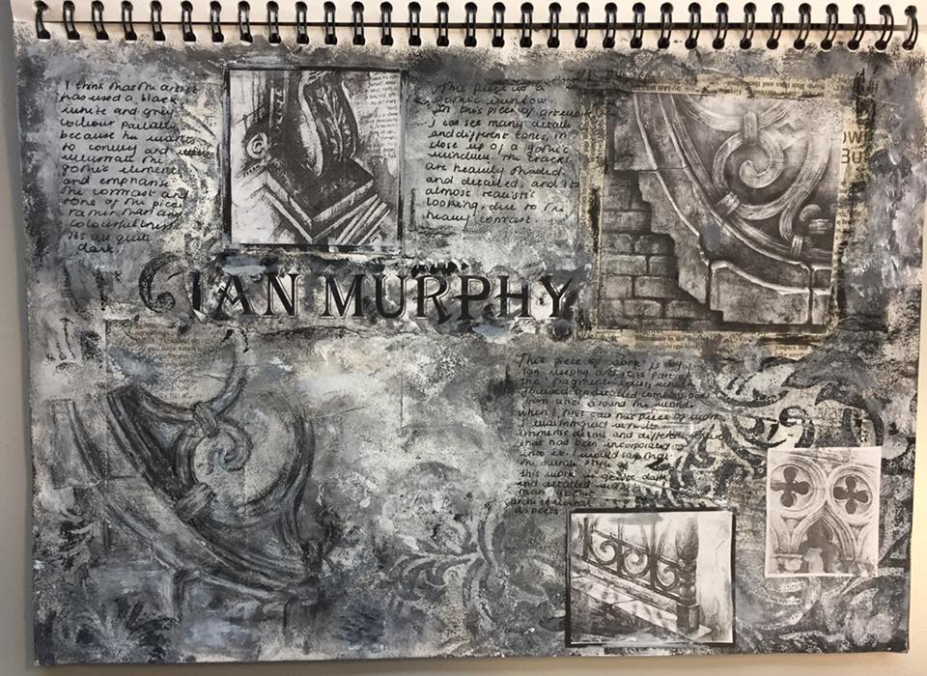
Examples
Every aspect of the research page below reflects the artist Ian Murphy. It shows the artists name and includes annotation and images. The student has created a drawing in the bottom left-hand corner inspired by the artist's work. The white and grey paint reflects the stonework of Murphy’s work.

Slide 17
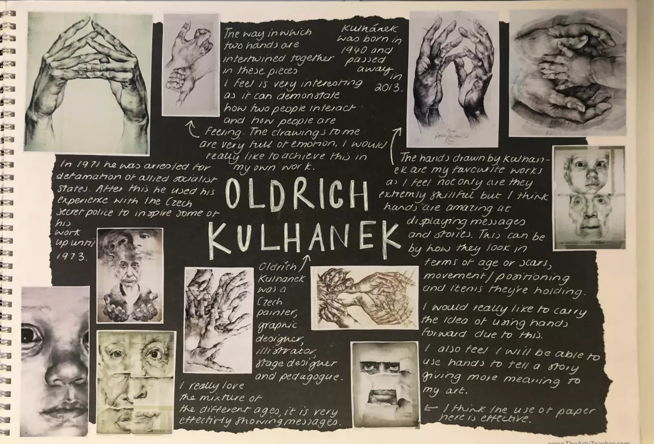
Examples
The simple black and white presentation with torn edges here, reflects the artists work. There’s nothing like a bit of white pen on black paper to create an artistic-looking page. Over 50% of the annotation is the student’s response to the work. I think this is a good ratio to have in mind. The annotation is intelligent and includes the students' own ideas. The student is interpreting the work.

Slide 18
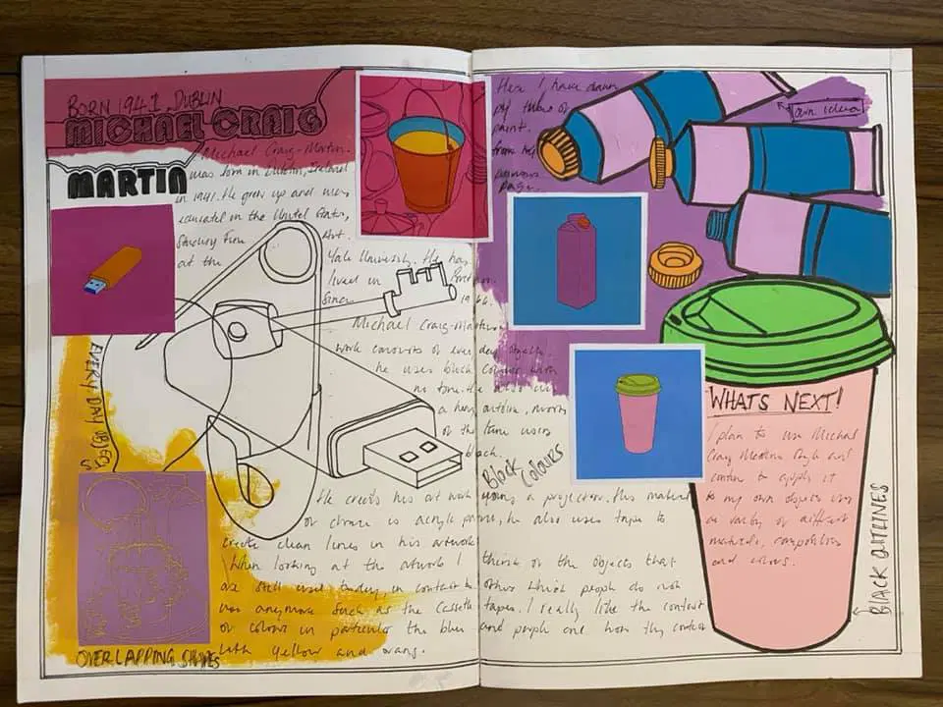
Examples
Here, a combination of the artist work and the students work create a striking, colourful page. Keywords describe the artist's work. The annotation is a combination of information about the artist and the student’s response to the work. I like the ‘What Next!’ in the cup. It shows the student is thinking ahead.

Slide 19
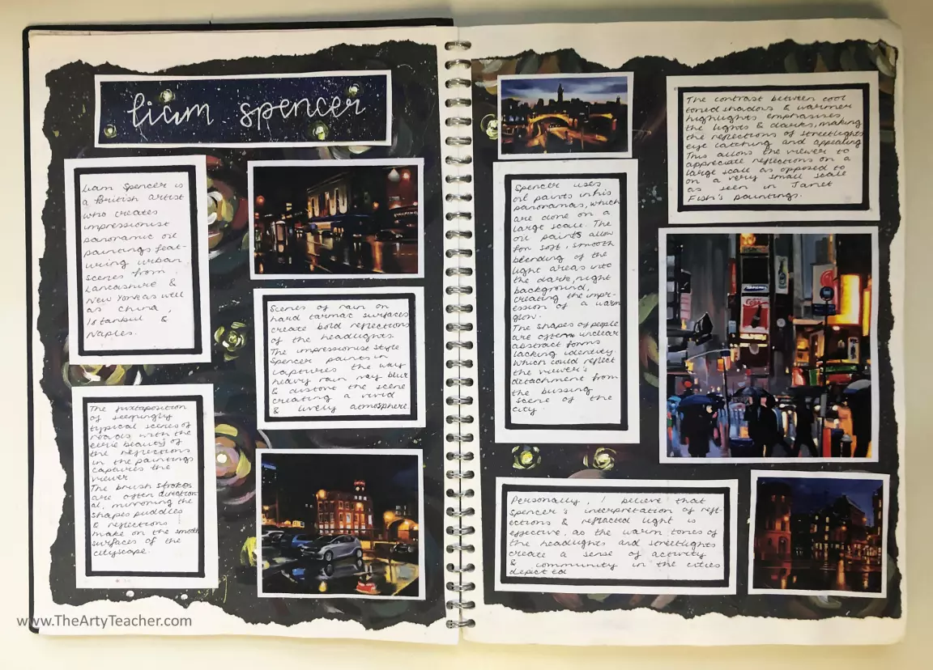
Examples
For the research page here, the student first painted with acrylic on black paper. They picked up on the reflected light that can be found in Liam Spencer’s work and used daubs of paint to create impressionistic car and streetlights. This student's theme was ‘reflected light’ so they carefully chose Spencer’s work that shows this. Their annotation is detailed, intelligent and uses subject-specific language.

Slide 20
EXIT
What can you tell me about this photographer?
What ideas does this artist give you for your own photography work?

Slide 21
