Slide 1
The students can revise the words related to the topic through the following assignments.
Practice the vocabulary through languagenut assignment based on your level.
Travel and tourism level 1 – Travel and tourism level 2 – Travel and tourism level 3
Practice the vocabulary through languagenut assignment based on your level.
Tourist destinations level 1 – Tourist destinations level 2 – Tourist destinations level 3

Slide 2
Level 1 writing assessment information:
writing assessment level 1 focus to practice:
1- vocabulary on languagenut.
2- writing sentences using techniques.
3- practice writing information about your self (name, age, nationality, place of residence, hobby,
year group, school)
4- practice writing sentences describing you city ( historical, modern, big, tourism), what is the
Capital.
Use your book to practice and the slides in the ppt based on your level.

Slide 3
Level 2 writing assessment information:
writing assessment level 1 focus to practice:
1- vocabulary on languagenut.
2- writing sentences using techniques.
3- practice writing information about your self (name, age, nationality, place of residence, hobby,
year group, school)
4- practice writing sentences describing you city ( historical, modern, big, tourism), what is the capital.
5- practice writing paragraph from 70- 90 words about visiting country by answering the following questions:
اكتب فقرة من( 70-90) كلمة حول بلد زُرته .
عرف بنفسك (اسمك ، عمرك ، جنسيتك ، أين تسكن) Identify yourself (name, age, nationality, where you live)
اسم البلد الذي ذهبتَ إليه ؟ Name of the country you went to?
مع من ذهبت؟ Who did you go with?
صف هذا البلد ( مدينة أم قرية( – )عصري ، سياحي ، تاريخي ، جميل ، كبير( ) موقعه ). Describe this country (city or village) – (modern, touristic, historical, beautiful, large) location).
ماهي المعالم السياحية التي زرتها في هذا البلد؟ What landmarks have you visited in this country?
ما رأيك في هذه الرحلة. What is your opinion of this trip.
Use your book to practice and the slides in the ppt based on your level.

Slide 4
Level 3 writing assessment information:
writing assessment level 1 focus to practice:
1- vocabulary on languagenut.
2- fill the from with information of advertisement ( revise advertisnment elements – previous leasrning)
3- practice writing paragraph from 100- 130 words about visiting country by answering the following questions:
اكتب فقرة من( 100 - 130) كلمة حول بلد زُرته .
عرف بنفسك (اسمك ، عمرك ، جنسيتك ، أين تسكن) Identify yourself (name, age, nationality, where you live)
اسم البلد الذي ذهبتَ إليه ؟ Name of the country you went to?
مع من ذهبت؟ Who did you go with?
صف هذا البلد ( مدينة أم قرية( – )عصري ، سياحي ، تاريخي ، جميل ، كبير( ) موقعه ). Describe this country (city or village) – (modern, touristic, historical, beautiful, large) location).
كيف كان الطقس؟How is the weather
ماهي الأنشطة التي قمت بها أثناء سياحتك؟. What activities did you do during your tourism?
ماهي المعالم السياحية التي زرتها في هذا البلد؟ What landmarks have you visited in this country?
السلبيات التي واجهتها في هذا البلد مواقف السيارات – الفندق – وسائل النقل –- الغلاء - ممارسة الأنشطة – الطقس advantages you faced in this country: car parking's – hotel – transportation – doing activities – weather – high prices )
ما رأيك في هذه الرحلة. What is your opinion of this trip.
Use your book to practice and the slides in the ppt based on your level.

Slide 5
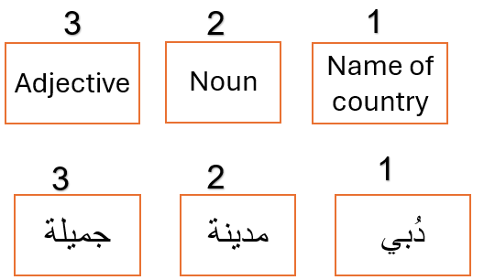
Writing techniques to create sentences.

Slide 6
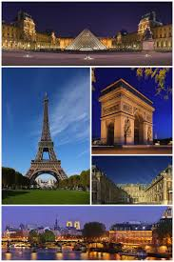
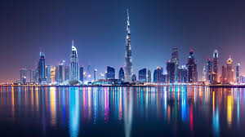
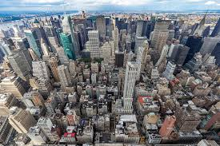
Writing task
Level 2: To write sentences describing the pictures
After you learned the meaning of the words on languagenut , write
Sentences describing the pictures

Slide 7
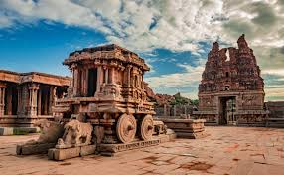
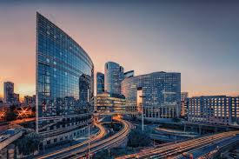
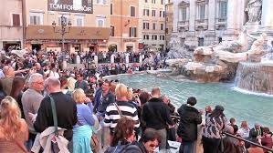
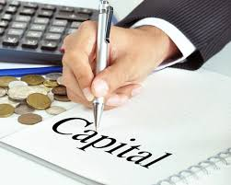
Writing task
Level 1: To write words related to the topic.
After you learned the meaning of the words on languagenut , use the letters
to form words related to places.
ســ - عــ - ـــة - ـــر - ـــيـــ - صــ - ـــا – ر – يـــ - ـــمــ
ـــد – مــــ - أ - ــــن - ـــكـــ - ــــصـــ - ـــــنـــ - ــــخـــ - جـــ - ـــــلــــ - تـــ

Slide 8
Writing task
Level 2: To write words related to the topic.
After you learned the meaning of the words on languagenut , write
words describing the pictures

