Slide 1
Pattern Project
Year 10: GCSE Photography
Lesson 13 & 14: Experimenting with Shadow Photography

Slide 2
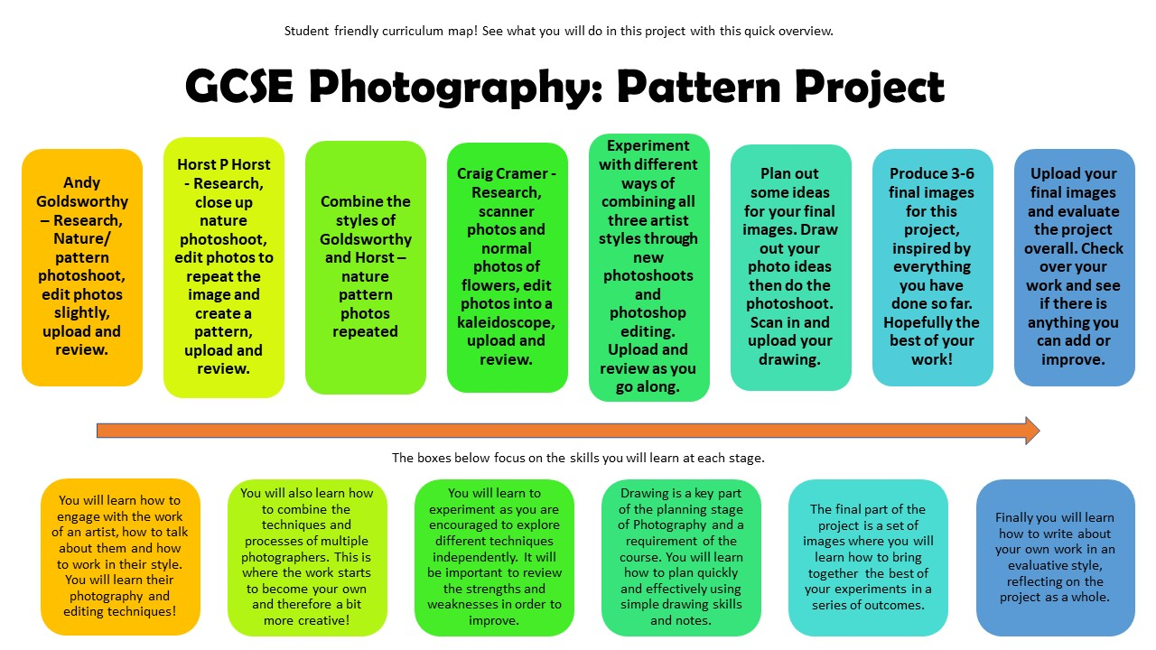

Slide 3
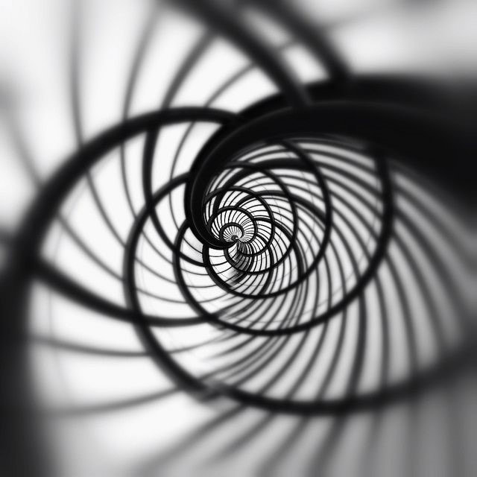
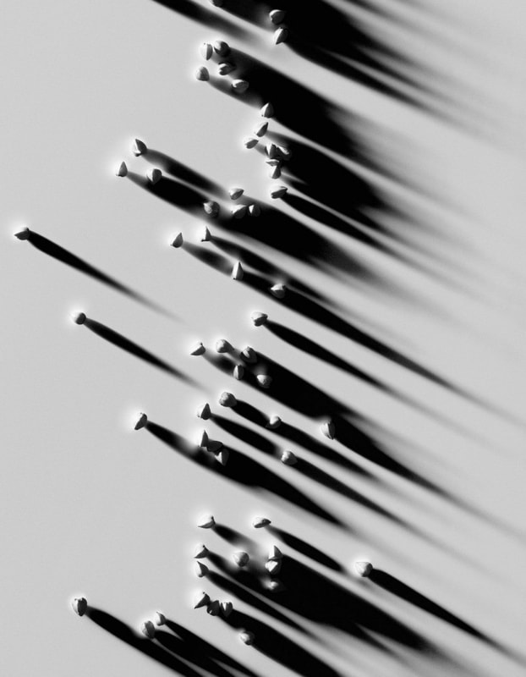
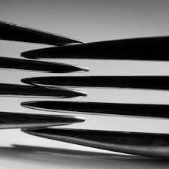
What has been used to create these patterns?

Slide 4
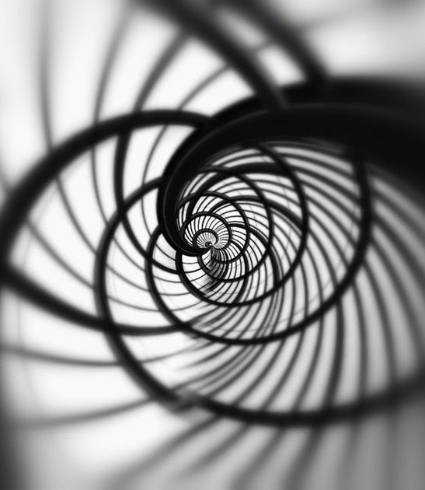
Learning Intentions
To explore shadow photography by capturing a variety of shadow patterns using the DSLR camera.

Slide 5
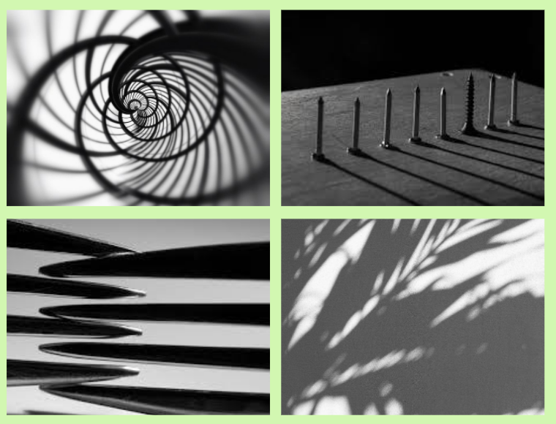
Task 1: Guided Exploration
Look around the room at the various set ups. Take 30 photos of different patterns using a torch to cast shadows.
Arrange items in patterns and photograph them. Rearrange them and photograph again.
Try different directions with your torch to cast different shadows
Vary the angle of your light and the distance from the objects you are photographing.

Slide 6
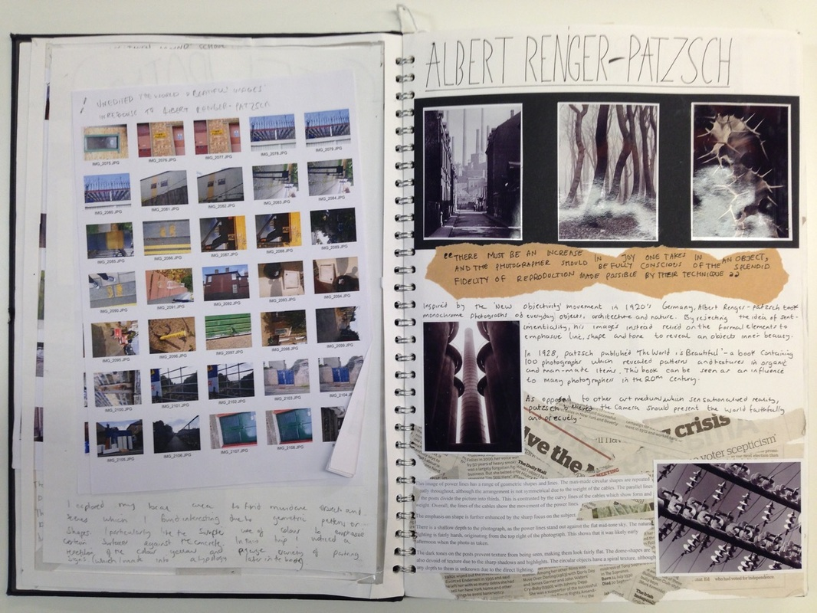
Task 2: Write Up
1) Create a contact sheet including all your photographs from this shoot. Don’t delete any, even if you think they are terrible! Add a title (Photoshoot to Capture Shadows).
2) Print and annotate your contact sheet using the ‘how do I annotate a Contact Sheet?’ handout. Stick this in your black sketchbook.
3) Choose 2 (or more) of your best photographs from your shoot, print them slightly larger and present them on the next page in your black sketchbook. Try to find a photographer to link your shadow photographs to for the highest marks! Look at the example here for ideas.

Slide 8
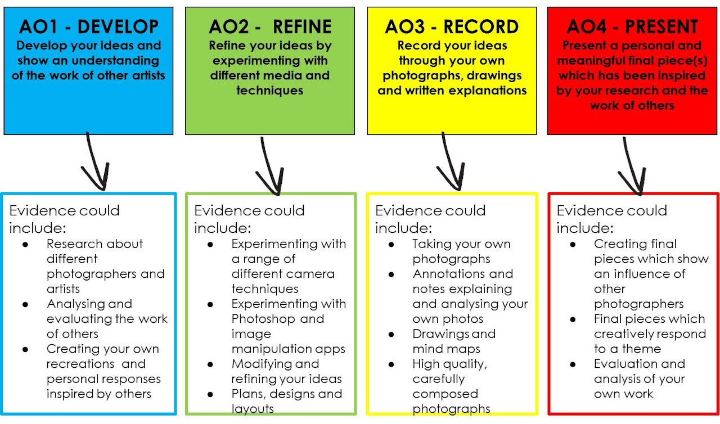
Assessment Objectives

Slide 9
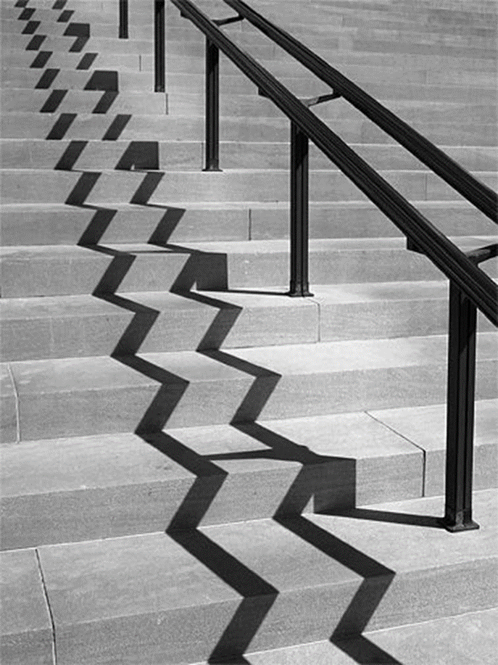
EXIT
How do you plan to present your Kertesz research in your black sketchbook?

Slide 10
Pattern Project
Year 10: GCSE Photography
Lesson 15: Introducing Andre Kertesz

Slide 12
What are the similarities between these photographs?

Slide 13
Learning Intentions
To explore the shadow photography work of Andre Kertesz.

Slide 14
Who was Andre Kertesz?
Andre Kertész was highly regarded as a still-life photographer. Nothing was too ordinary for his lens since he did not document but instead interpreted what was in front of him. He composed many still life's with the aim of transforming the mundane and ordinary - such as utensils, eyeglasses and pigeons- into something interesting and creative. He made use of bold monochrome (black and white) lines and the use of reflections and shadows as a means of creating a still life that was simplified, geometric and abstract. Though his still life's can be viewed as abstractions, the identity of the object(s) is never hidden.
Scan the QR code to find out more.
Notes:
70 Years of André Kertész's Photography Surveyed | Widewalls

Slide 15
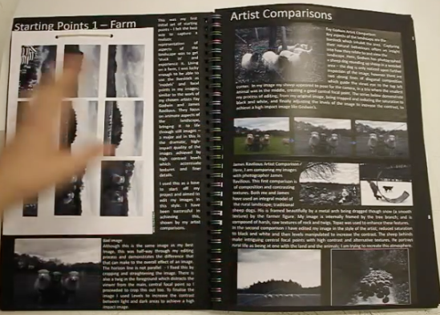
Task 1: Andre Kertesz Research
Don’t not copy and paste or write up random information about the artist! You only get marks for your own analysis and observations.
Include 2-3 pictures of his work – choose images that are relevant to pattern.
First, use the ‘How do I analyse a photographer's work?’ handout to help you annotate the images you selected.
Then, add a paragraph using the questions opposite.
Write a paragraph about these photographs as a whole. Describe the way he uses shadows and patterns. Analyse them.
What makes them effective?
Which do you like best – what do you like about it?
How could you take inspiration from Kertesz’s style?

Slide 17
Homework
Complete your write up for Task 1 in your black sketchbook.
Title: Andre Keretsz.

Slide 18
Assessment Objectives

Slide 19
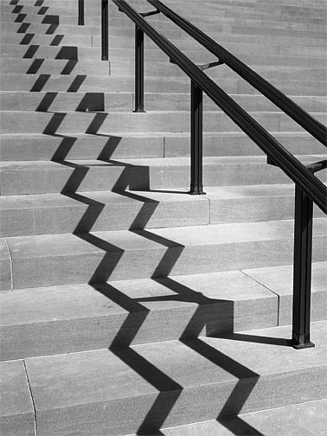
EXIT
Share with the person next to you – what do you like about Keretsz shadow photography?

