Slide 1
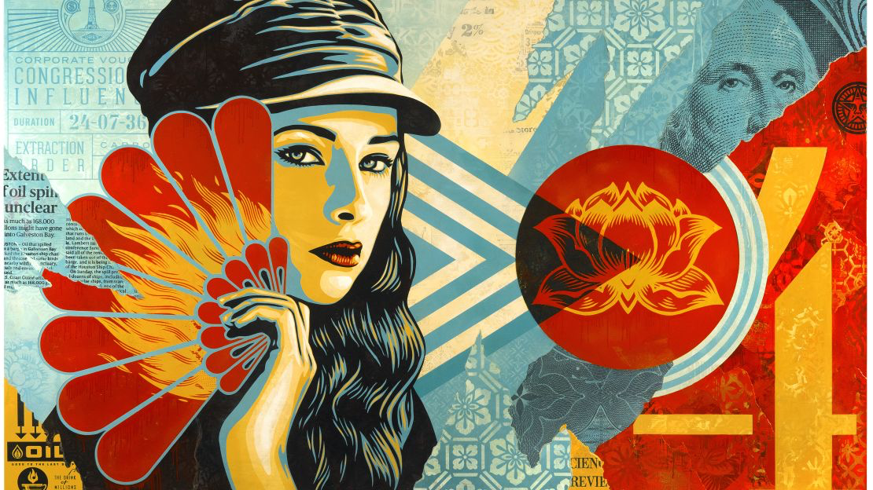
HEROES & LEADERS
Year 9: Art Activism Unit
Lesson 13 & 14: Reflection

Slide 2
Learning
Intentions
Reflect on the learning and creative process.
Evaluate personal and peer artwork.
Identify strengths and areas for improvement.
Celebrate achievements and set future goals.

Slide 3
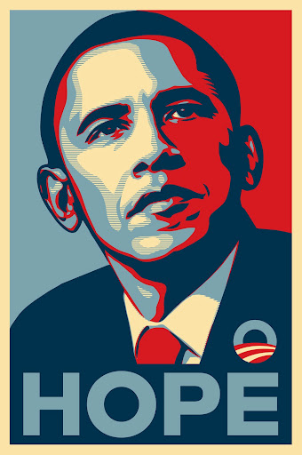
Starter Task Take 15 minutes to reflect on your artwork and learning process. Use the following prompts to guide your reflection: What did you enjoy most about this unit? What was the most challenging part of creating your Shepard Fairey style artwork? How did you overcome any challenges you faced? What skills did you develop or improve during this unit? How do you feel about your final artwork? Why? Write your goals on the final slide of your Powerpoint presentation for this unit.
Beginning to Reflect

Slide 4
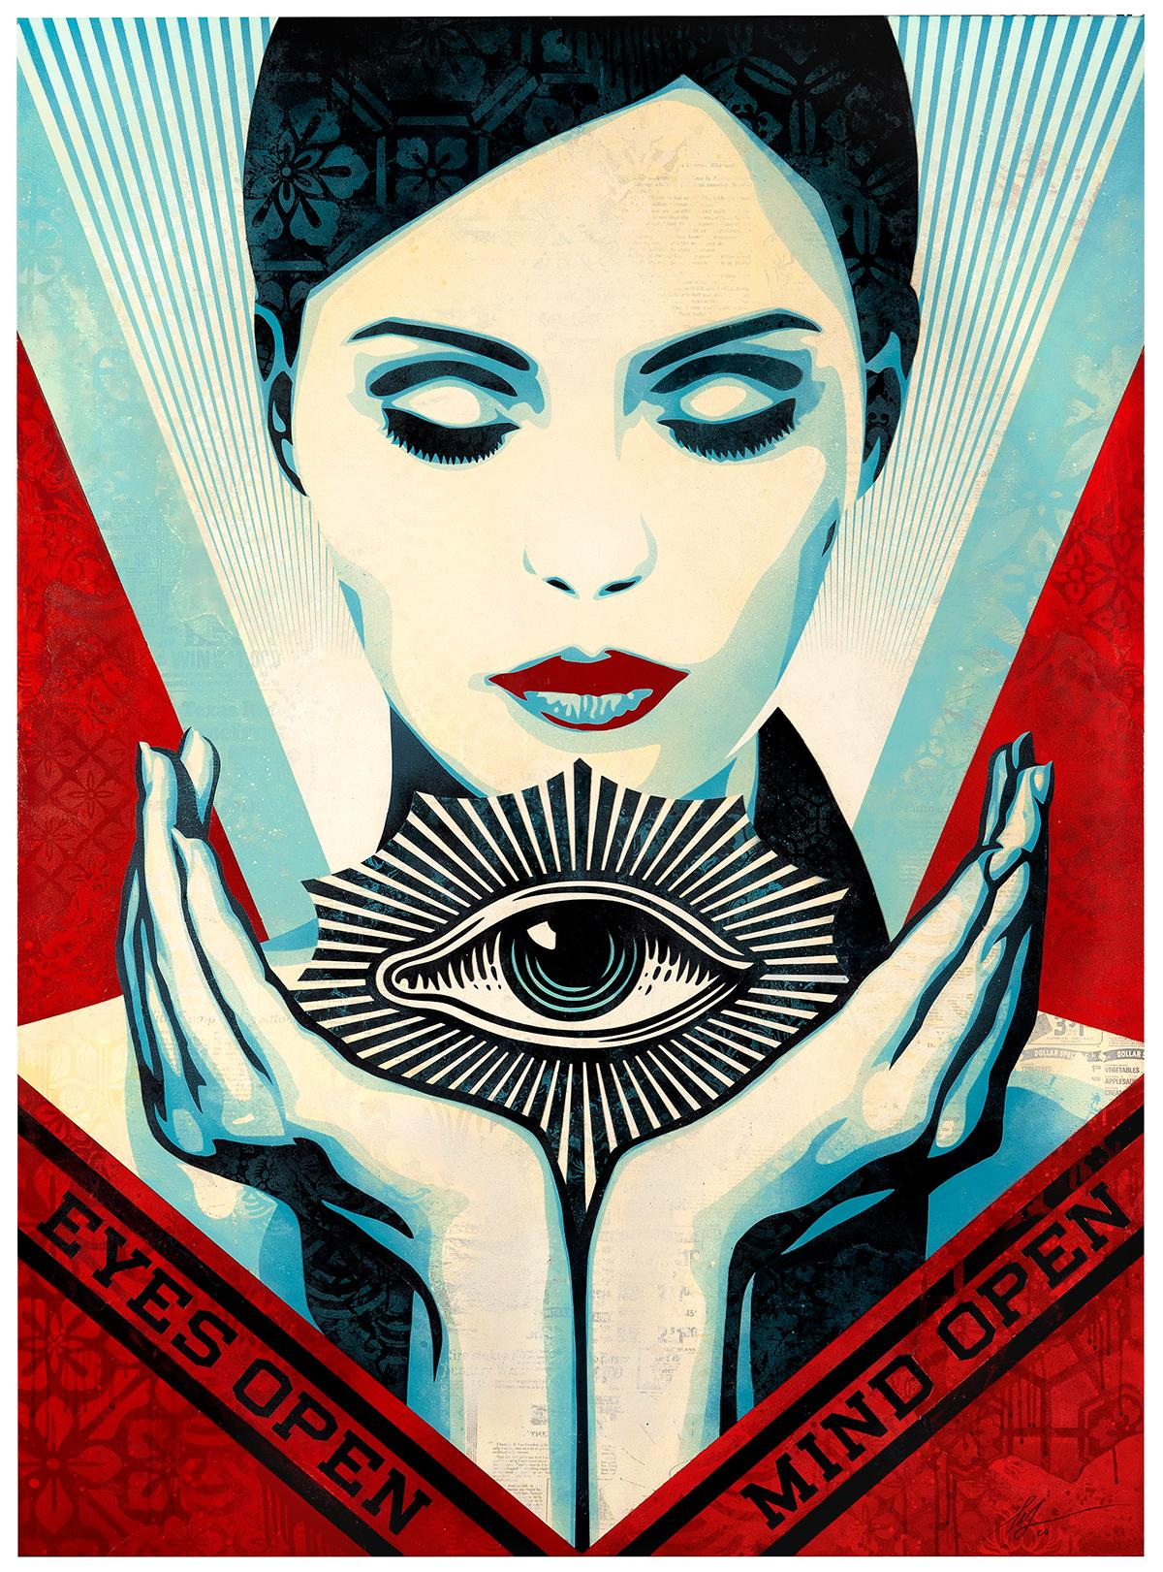
Task Pair up with a classmate and evaluate each other's artwork. Use the following criteria to guide your evaluation: - How well does the artwork emulate Shepard Fairey's style? - Is the use of colour, texture, and composition effective? - Does the artwork convey a clear message or theme? - What are the strengths of the artwork? - What areas could be improved? Provide constructive feedback to your partner. Be specific and respectful. Update your reflections on your Powerpoint presentation.
Pair & Share

Slide 5
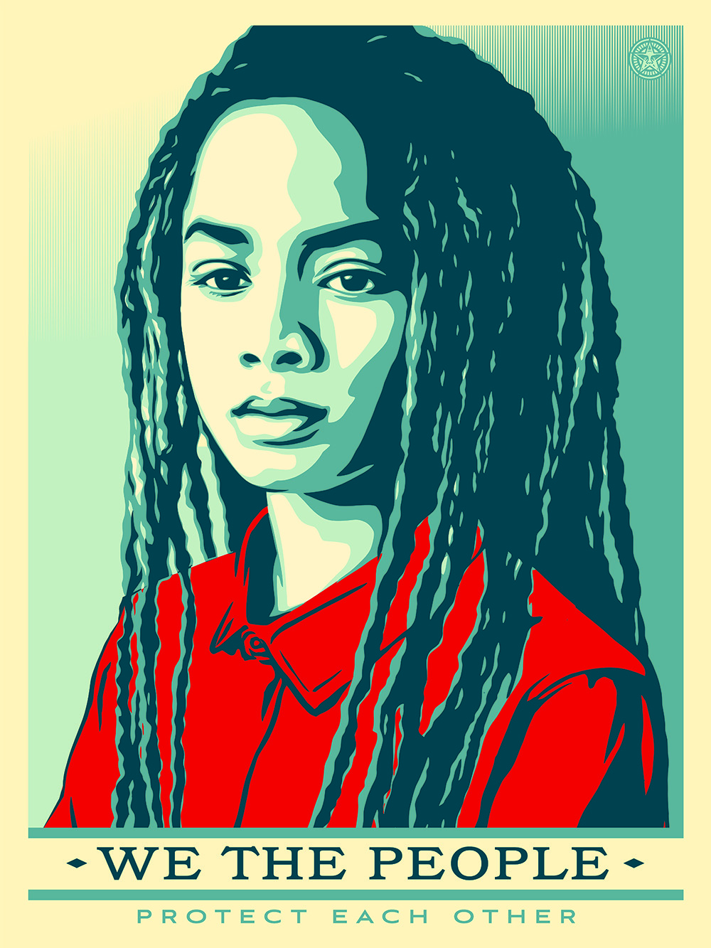
Written Reflection
Task
Take 10 minutes to set personal goals for your future art projects. Use the following prompts to guide your goal setting:
- What specific skills or techniques do you want to improve?
- How will you apply what you learned in this unit to future projects?
- What new styles or mediums do you want to explore?
- How can you challenge yourself creatively in your next project?
Write your goals on the final slide of your Powerpoint presentation for this unit.

Slide 6
Self-Assessment
Exceeding (Level 7-9)
I have created a high-quality digital artwork that effectively emulates Shepard Fairey’s style.
My use of Photoshop and Illustrator tools is proficient and demonstrates a clear understanding of the techniques.
The colour palette, textures, and patterns are chosen thoughtfully to enhance the overall design.
My PowerPoint slide is well-organised, visually appealing, and clearly presents my digital artwork.
I have provided a detailed and thoughtful explanation of my creative process and choices.
Meeting (Level 4-6):
I have created a good-quality digital artwork that represents Shepard Fairey’s style.
My use of Photoshop and Illustrator tools is adequate but may need some refinement.
The colour palette, textures, and patterns are appropriate but could be improved for greater impact.
My PowerPoint slide is organised and includes relevant information about my digital artwork.
I have provided a clear explanation of my creative process and choices.
Working towards (Level 1-3):
I have created a digital artwork, but it may lack clarity in representing Shepard Fairey’s style.
My use of Photoshop and Illustrator tools needs more practice and improvement.
The colour palette, textures, and patterns are not effectively used to enhance the design.
My PowerPoint slide is somewhat disorganised and lacks sufficient detail.
My explanation of the creative process and choices is brief and needs more depth.

Slide 7
