Slide 1
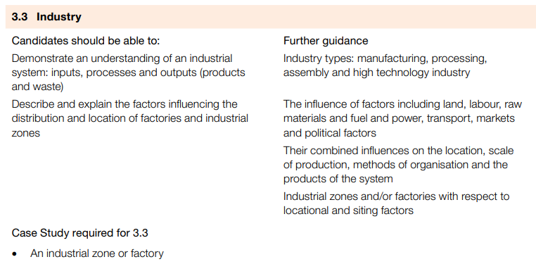
IGCSE GEOGRAPHY: 3.3 INDUSTRY

Slide 2
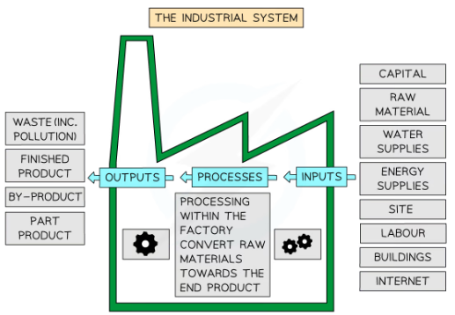
IGCSE GEOGRAPHY: 3.3 INDUSTRY
Industrial Systems
Inputs basic items needed to begin the process
Raw materials, labour, energy, capital, land and buildings etc.
Processes activities that take place to make a finished product (goods)
Cutting, sewing, welding, brewing, painting, steel moulding etc.
Outputs finished products, byproducts, products for continued manufacturing elsewhere and waste
Finished products such as cars, clothing, mobiles, shoes etc.
Continued manufacturing (part manufacturing) such as cleaning wool or cotton, weaving wool or cotton for material, material made into clothes for a finished product etc.
Waste is produced with all manufacturing; it has no value but creates a cost for disposal
Manufacturing can be classified as:
Heavy iron and steel manufacturing is heavy industry as it uses large, bulky raw materials on a huge scale producing big items
Light computer manufacturing, smart phone assembly, clothing, microbrewing etc.

Slide 3
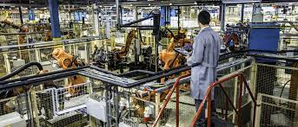
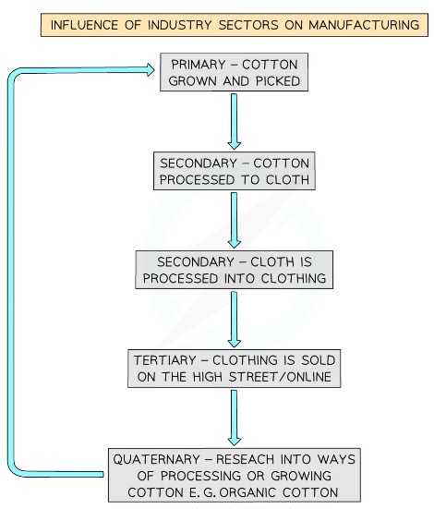
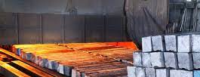
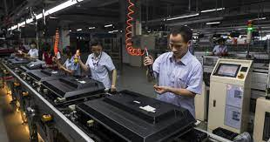
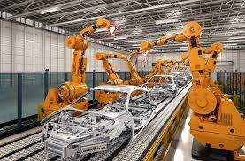
IGCSE GEOGRAPHY 0460: 3.3 INDUSTRY
Manufacturing
Input: Raw materials and components
Process: Physical transformation and assembly
Output: Finished goods
Processing
Input: Raw materials or semifinished goods
Process: Transformation, refinement, or alteration
Output: Processed or refined products
Assembly
Input: Components or parts
Process: Putting together parts to create a final product
Output: Assembled products
High Technology Industry
Input: Advanced materials, technology, and skilled labor
Process: Cutting Edge manufacturing or innovation
Output: Advanced technological products/services

Slide 4
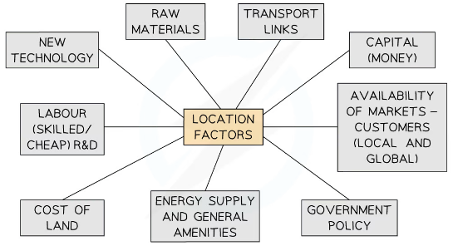
IGCSE GEOGRAPHY 0460: 3.3 INDUSTRY
Physical Factors in Industrial Location
Raw Materials: Industries requiring bulky materials locate near the source for efficiency.
Site: Large factories need flat, well-drained land, considering expansion potential.
Climate: Certain industries, like aerospace and film, benefit from sunnier climates, reducing energy costs.
Energy: Energy-intensive industries may move to areas with readily available or cheaper energy.
Natural Routeways: Harbors, motorways, airports, and railways are ideal for industrial complexes, ensuring good access for inputs and outputs.
Water Supplies: Water-dependent industries locate near reliable sources like lakes or rivers, e.g., paper and cotton processing
Human and economic factors in Industrial Location
Capital:some areas naturally attract inward investment as the returns will be higher
Markets: location and size of the potential market is a major influence for some industries
Government influence: incentives, grants and policies can make areas attractive for industries to invest in
Transport: Accessibility to motorways, railways, ports, and airports reduces transport costs for industries.
Communications: being able to communicate effectively and quickly with customers and suppliers is vital to successful manufacturing
Labour force: quality and cost of labour is central to effective manufacturing, having a reliable workforce is necessary, but also mobility, turnover and reputation is also a factor
Quality of life: highly skilled workers will prefer areas where the work/life balance is good
High-tech industry: High-tech companies are involved in research and development, aerospace technology, guidance systems, medical robotics, software, computer hardware etc
High-tech industries are usually group together in science parks
Usually close to the university or a research centre with good security systems
Close to transport networks (including airports) to allow for knowledge transfer
Further away from housing estates and retail parks to reduce sound, air and visual pollution

Slide 5
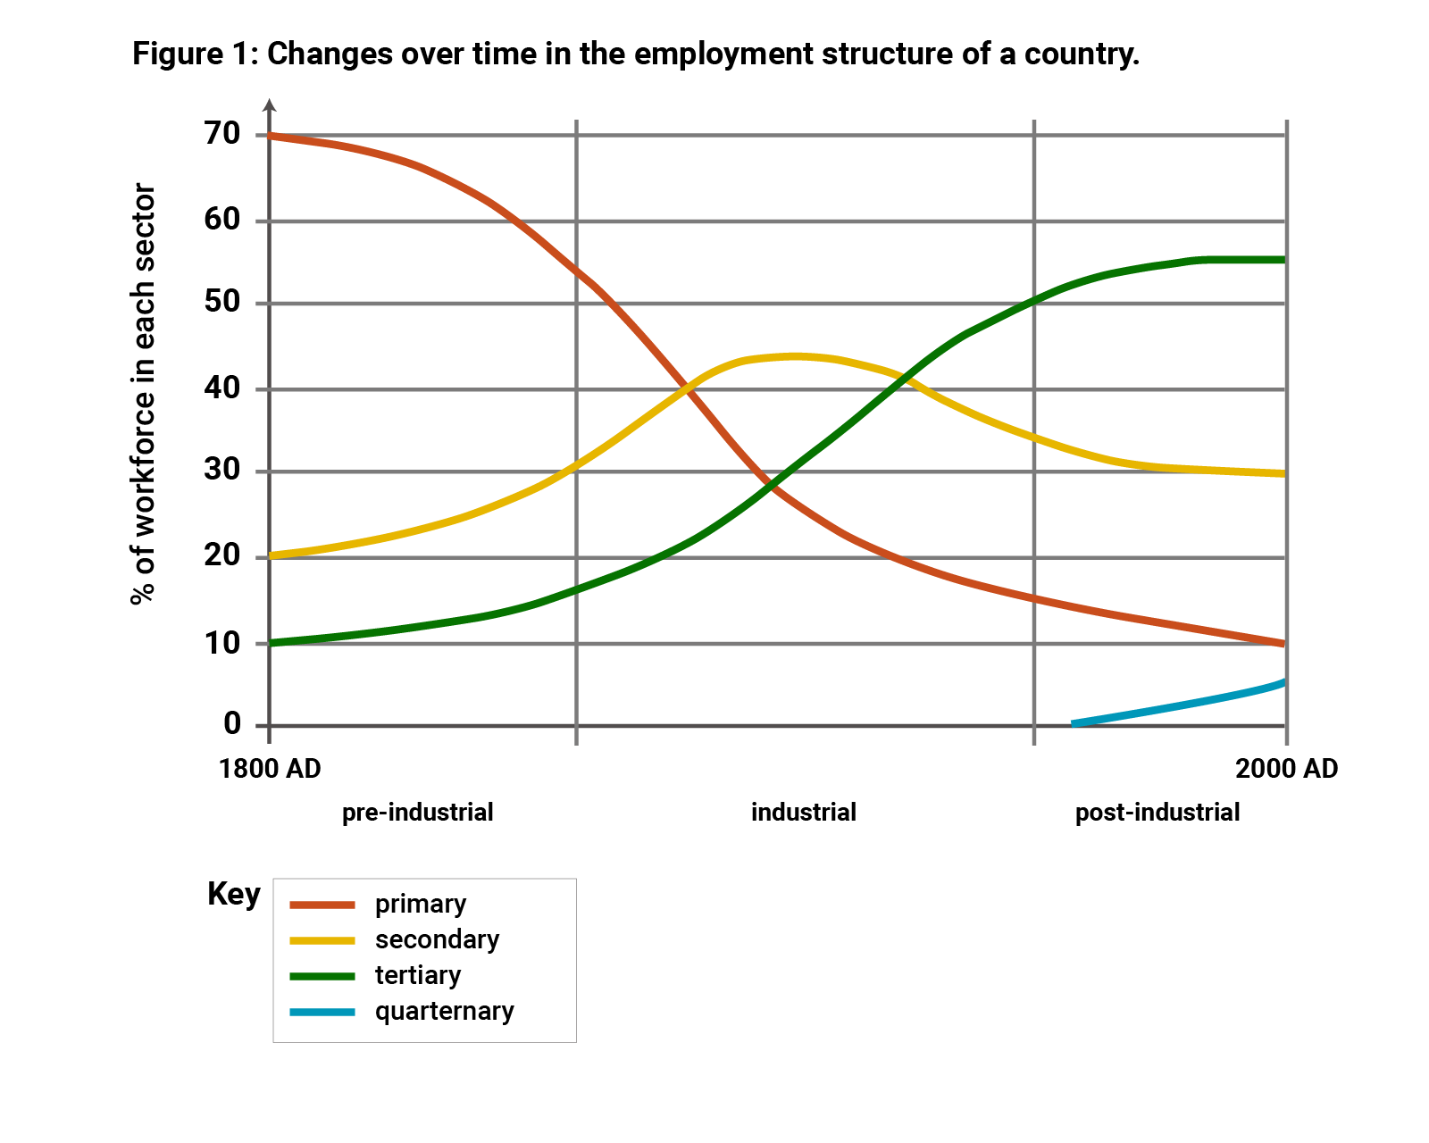
IGCSE GEOGRAPHY 0460: 3.3 INDUSTRY
Changes to manufacturing and location over time
Raw Materials = sources of raw materials often run out
Manufactures will move in response
Infrastructure means business not tied to energy centres –coalfields etc.
Rising costs = wage levels / laws etc, means costs go up in MICs so work moves elsewhere (e.g. manufacturing)
Transport = commuting & migrating easier because there are now fewer barriers to travel
Competition = fewer people are needed to complete work now, e.g. banking uses ICT
Technology = advances in ICT means more work from home, air travel, etc.
Outsourcing = saves money, work sent elsewhere to save costs (e.g. call centres)
Employment structure changes over time. You often get what are called pre-industrial, Industrial and Post-Industrial Periods

Slide 6
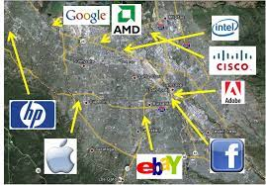
IGCSE GEOGRAPHY 0460: 3.3 INDUSTRY
CASE STUDY: SILICON VALLEY - HIGH TECH INDUSTRIES
Location Physical Factors
Climate: Silicon Valley benefits from a Mediterranean climate, providing mild temperatures conducive to year-round business operations.
Geography: The valley's topography allows for easy transportation and infrastructure development.
Seismic Activity: Despite seismic risks, Silicon Valley's technological infrastructure is designed to withstand earthquakes, ensuring business continuity.
Location Human Factors
Talent Pool: Proximity to top-tier universities like Stanford and UC Berkeley facilitates access to a skilled workforce.
Networking Opportunities: Concentration of tech firms fosters collaboration, innovation, and knowledge exchange.
Entrepreneurial Culture: A culture that encourages risk-taking and innovation attracts visionaries and pioneers.
Physical Inputs:
Raw Materials: Silicon Valley relies on intangible inputs like intellectual property, software, and data.
Energy: A consistent and reliable energy supply is crucial for data centers and tech infrastructure.
Human Inputs:
Workforce: A highly educated and diverse talent pool contributes to the region's innovation.
Entrepreneurial Ideas: The influx of creative minds fosters a culture of continuous ideation and experimentation.
Outputs:
Technological Products: Silicon Valley is renowned for cutting-edge technologies, including hardware, software, and innovative solutions.
Data: The region generates massive amounts of data, driving advancements in AI and machine learning.
Skilled Workforce: Employees gain valuable skills contributing to the global tech ecosystem.
Processes:
Research and Development: Intensive R&D activities fuel continuous technological advancements.
Supply Chain Management: Efficient processes ensure timely production and distribution of tech products.
Collaboration: Cross-industry collaboration and knowledge sharing are fundamental to the region's success
Context:
Silicon Valley, located in the southern part of the San Francisco Bay Area, has emerged as a global hub for the high-tech industry.

