Slide 1
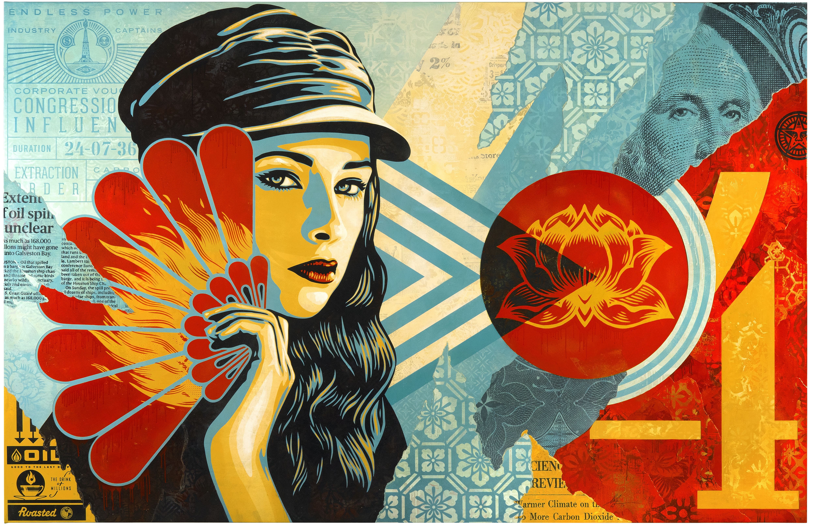
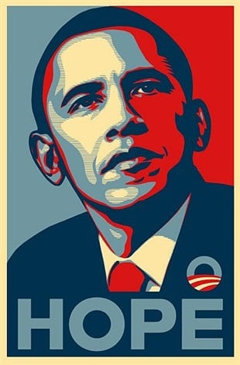
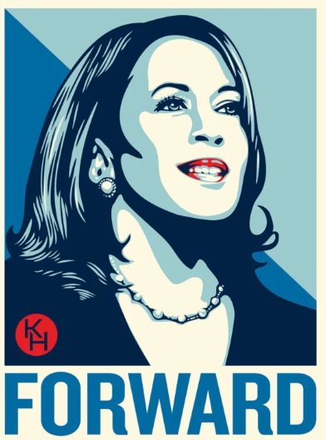
SHEPARD FAIREY SHEPARD FAIREY
Who is he?
Shepard Fairey” is a very famous graphic artist, muralist, and overall artist. He was born on February 15, 1970 in Charleston, South Carolina in the United States.
School
He attended School in Charleston and transferred to high school at arts academy in California from which he graduated in 1988. Fairey became involved with art in 1984, when he started to place his drawings on skateboards and T-shirts. He then moved to Rhode Island in 1988 to attend the Rhode Island School of Design (risd). In 1992, he earned a degree in illustration from risd.
Meaning of his work
Much of Fairey's Street Art is intended to stimulate curiosity and make people think about their surroundings, placing their own interpretation on the work based on its context and their personal thoughts and experiences. This in turn helps to initiate conversations about social, political, and legal constructs.

Slide 2
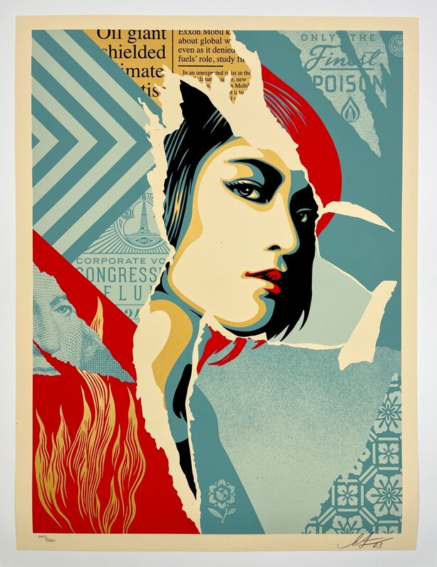
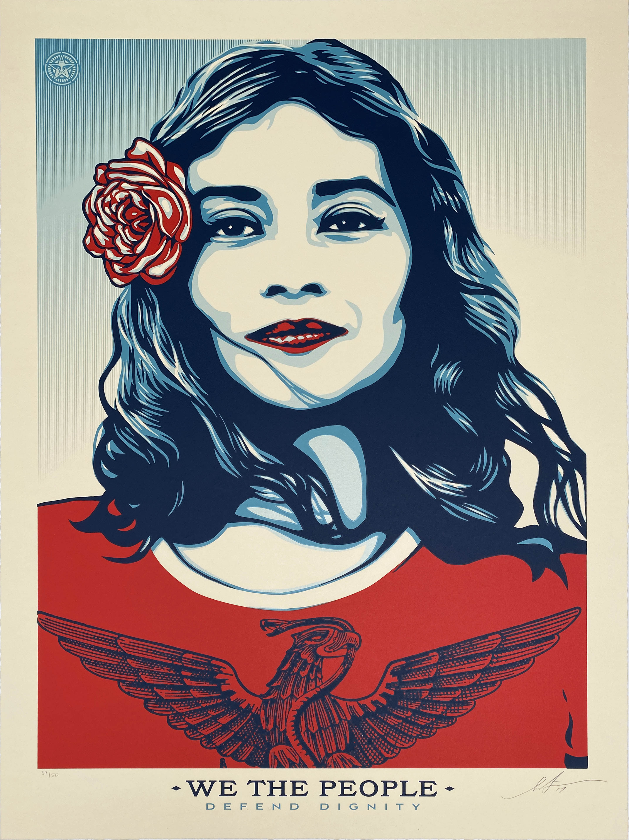
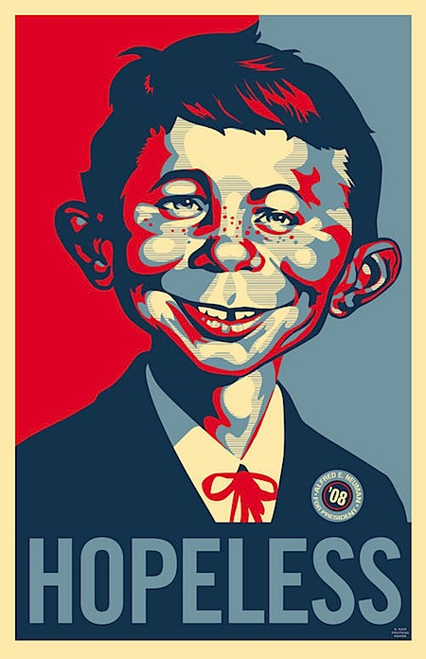
How does Shepard Fairey do his work?
Fairey builds up layers within much of his work, using paper, glues, spray-paints. He makes use of templates, which are used to effectively mask areas when using spray-paint. Fairey's work is often political: he makes comments on world leaders, world events, and our place/meaning in society.
My opinion
I really enjoy Shepard Fairey’s work because it has so much detail of such little aspects like where to place all of those little lines, colour and tone. It it a beauty to my eye especially because the colours stand out and his idea of trying to send a message really inspires me. Personally I love Fairey’s artwork.
ANALYSIS
Shepard Fairey uses tone to create depth in this piece of artwork, Fairey’s use of colour choices show a range of shadows within the face and hair. His work often uses a colour palette of red, blue and white to represent America by using the colours of the flag. The use of white space within this artwork gives a plain, calm background. The use of line and pattern in this piece shows details for the whole face. The form of colours and shades used gives the viewer an effect of warmth and a feeling of America.

