Slide 1
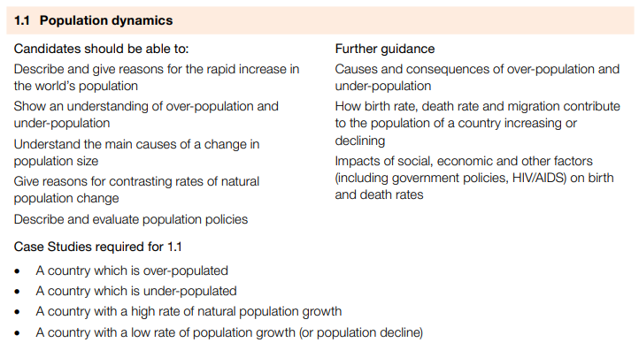
IGCSE GEOGRAPHY: 1.1 POPULATION DYNAMICS

Slide 2
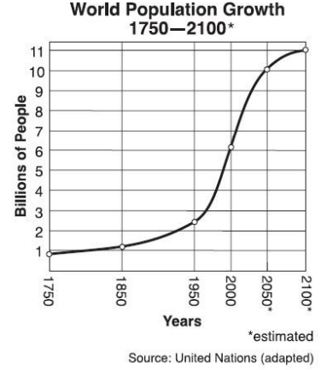
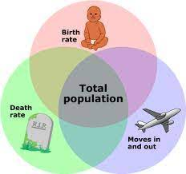
IGCSE GEOGRAPHY: 1.1 POPULATION DYNAMICS
Global population growth
At present, the world's population is growing fast.
Until the 1800s the world's population grew steadily but slowly for thousands of years.
In 1820 the world's population reached one billion.
In 1970s, the world's population reached three billion.
In 1999, less than 30 years later, the population doubled to six billion. The global rate of population growth is now very fast (rone billion every 15 years).
There are three main causes of population change:
Births - usually measured using the birth rate (BR: number of live births per 1000 of the population).
Deaths - usually measured using the death rate (DR: number of deaths per 1000 of the population) .
Migration - the movement of people in and out of an area.
Population rate
Births and deaths are natural causes of population change
Natural Increase: BR greater than DR
Natural Decrease: DR greater than BR
Country | BR | DR | N.Increase | %
Bulgaria | 9 | 14 | -5 | -0.5
South Africa | 25 | 15 | 10 | 1
MEDCs have low population-growth rates, with both low death rates and low birth rates. Population will decline if death rate is greater than birth rate.
LEDCs on the other hand have high population-growth rates. Both birth rates and death rates in LEDC populations tend to be high. As LEDCs develop, however, improving healthcare leads to death rates falling - while birth rates remain high. It is easy to see how this leads to even higher population-growth rates.

Slide 3
IGCSE GEOGRAPHY 0460: POPULATION
IGCSE GEOGRAPHY: 1.1 POPULATION DYNAMICS
Overpopulation is when there is not enough resources for the inhabitants in an area.
Under population is when there is more resources than inhabitants in an area.
Optimum population is when there is enough resources for the number of inhabitants (population demand for goods is equal to the supply)
Impacts of overpopulation | Impacts of underpopulation
Water: More than 1 billion people do not have access to safe drinking. | Labour: shortage of workers, services will decline.
Food: By 2050, global food demand may outstrip production, with nearly a billion people facing food insecurity in 2015. | Taxes: There will be less "working population" this has a negative impact on a countries economy and will lead to an increase taxes
Environment: Increased energy demand which leads to greater greenhouse gas emissions leading global warming and climate change. | Decline in services: Schools and hospitals will then not have enough demand to run so the cost per capita for the service will increase.
Factors that affect population
Social factors, such as family size preferences.
Economic conditions, like job opportunities, can impact migration and birth rates.
Political policies, such as immigration laws, shape population composition.
Cultural and religious, norms affect fertility rates and family planning choices e.g. through practices and attitudes towards contraception.
Historical events, such as wars and epidemics, can alter population dynamics and demographics

Slide 4
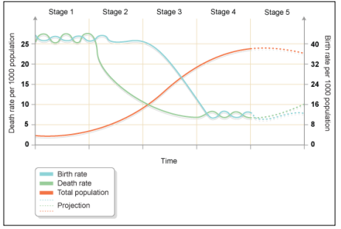
IGCSE GEOGRAPHY 0460: POPULATION
IGCSE GEOGRAPHY: 1.1 POPULATION DYNAMICS
The demographic transition model shows population change over time. The model studies how birth rate and death rate affect the total population of a country.
Stage 1 - the total population is low but it is balanced due to high birth rates and high death rates.
Stage 2 - the total population is starting to rise as death rates start to fall due to improvements in health care and sanitation but birth rates remain quite high.
Stage 3 - the total population is still rising rapidly, but the gap between birth and death rates narrows due to fewer children needed to work in farming and the availability of contraception. Now the natural increase is high.
Stage 4 - the total population is high, but it is balanced due to a low birth rate and a low death rate. Birth control is widely available and there is a desire for smaller families.
Stage 5 – The total population is high but going into decline due to an ageing population and a continued desire for smaller families, with people opting to delay having children until later in life
Most LEDCs are at stage 2 or 3 (with a growing population and a high natural increase). Most MEDCs are now at stage four of the model and some such as Germany and Italy have entered stage 5.
Limitations of the model The demographic transition model has two limitations:
1. The model was developed after studying the experiences of countries in Western Europe and North America. Conditions might be different for LEDCs in different parts of the world.
2. The original model doesn't take into account the fact that some countries now have a declining population and a fifth stage. Most texts will now show this stage as it is relevant to an increasing number of MEDCs in the 21st century. Population can also be affected by disease and governmental policies.

Slide 5
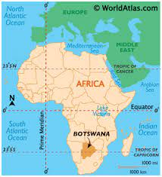
IGCSE GEOGRAPHY 0460: POPULATION
IGCSE GEOGRAPHY: 1.1 POPULATION DYNAMICS
CASE STUDY: BOTSWANA HIV AND AIDS
Context
There are several countries in the world where death rates are rising. One major cause of this is HIV/AIDS. This particularly affects Africa.
Botswana has been hard hit by AIDS. In 2007 there were an estimated 300,000 people living with HIV - almost one-in-four adults.
Considering Botswana’s population is below 2 million, the epidemic has reached disturbing proportions.
The country has an estimated adult HIV prevalence of 23.9%, the second highest in the world after Swaziland.
Impacts
Life expectancy at birth fell from 65 years in 1990-1995 to less than 40 years in 2000-2005, a figure about 28 years lower than it would have been without AIDS.
Loss of adults in their productive years has serious economic implications, with families being pushed into poverty through the costs of HIV and AIDS medical care, loss of income, and funerals.
Economic output of Botswana has been reduced by the loss of workers and skills; agriculture and mining are among the worst affected sectors.
Children in Botswana: an estimated 95,000 children have lost at least one parent to the epidemic. It is vital these children have access to education, but this is problematic in families already weakened by AIDS where children may be providing care for ill relatives or supporting siblings.
HIV prevention in Botswana
Public education & awareness AIDS education for young people
Condom distribution & education
Targeting of high risk adult populations
Improvement of blood safety
Prevention of mother-to-child transmission of HIV

Slide 6
IGCSE GEOGRAPHY 0460: POPULATION
IGCSE GEOGRAPHY: 1.1 POPULATION DYNAMICS
Pro-natalist policy encourages or supports higher birth rates and larger families within a population.
Anti-natalist policy seeks to reduce birth rates and limit population growth.
Pro natalist policies are often implemented in response to concerns about declining birth rates and aging populations.
Pro-natalist measures can include:
financial incentives, such as tax breaks or cash bonuses for parents
Improved parental leave, and child care benefits
Campaigns promoting the benefits of having more children
Example: France's pro-natalist policy offers financial incentives, extended parental leave, and child care subsidies to boost birth rates, support families, and counteract declining birth rates and an aging population, ultimately aiming to bolster the nation's population and secure its demographic stability.
Anti natalist policies are typically implemented in response to concerns about overpopulation, resource scarcity, and environmental sustainability.
Anti-natalist measures may include
family planning programs
access to contraception
education on the advantages of smaller families
policies restricting the number of children a family can have.
Example: Indian states have implemented “Two child policy” which restricts individuals with more than two children from running for certain local government positions and receiving government benefits. The objective is to curb population growth and promote family planning in a country with a rapidly growing population

Slide 7
IGCSE GEOGRAPHY 0460: POPULATION
IGCSE GEOGRAPHY: 1.1 POPULATION DYNAMICS
CASE STUDY: CHINA’S ONE CHILD POLICY 1979
Context
The one-child policy in China, which was implemented in 1979 and relaxed in 2015. It was an anti-natalist policy aimed at slowing population growth
The one-child policy restricted families to have only one child, with late marriage requirements, sterilization for men after one child, and forced abortions.
"Carrot and stick" approach, benefits like free education & healthcare for compliant families, potential salary raise, while non-compliance led to fines, imprisonment, social ostracism, & demotion from senior positions.
Exceptions: Some rural areas were allowed to have two or if the first child became deceased.
Why was the one child policy implemented?
Worries of overpopulation -Strain on resources - food, housing
Pop. growth rate before the policy 117% or fertility rate was 6.7 per women. The population growth was unsustainable.
Impacts
The one-child policy caused problems like:
1. More boys than girls, affecting marriages and society.
2. An older population with challenges for work & support systems.
3. Forcing abortions and sterilizations, causing trauma.
4. Stress on the one child to support the parents
5. Girl abandonment as families preferred boys over girls.
Some benefits included:
1. China's lowered fertility rates (2.75) prevented approximately 400 million births, curbing population growth.
2. This reduction alleviated resource pressures and averted predicted famines.
3. Living standards improved for many impoverished families.
4. More educational opportunities were available for girls, contributing to female empowerment

Slide 8
IGCSE GEOGRAPHY: 1.1 POPULATION DYNAMICS
CASE STUDY: - LOW RATE OF NATURAL POPULATION GROWTH
Causes of high rate of growth
Low Birth Rates: One of the primary causes of population decline is low birth rates. Factors contributing to low birth rates: delayed family planning, changing social norms, and economic challenges.
Outmigration: When people leave a country in search of better opportunities elsewhere
Aging Population: As a population ages, the proportion of elderly individuals increases, and the number of women in childbearing age decreases, leading to fewer births.
Social and Cultural Factors: Shifts in societal values, changing attitudes towards marriage and family, and increasing emphasis on career can influence birth rates.
Economic Challenges: High living costs and job insecurity, can discourage individuals from having children.
Impacts
Economic Consequences: A declining population can lead to a smaller workforce, potentially resulting in labor shortages, reduced economic growth, and difficulties supporting social welfare programs.
Aging Society: An aging population places pressure on healthcare systems and pension programs, potentially leading to increased healthcare costs and social welfare burdens.
Reduced Innovation: A smaller and older workforce may lead to reduced innovation and productivity, impacting technological advancements and economic competitiveness.
Social Services Challenges: Providing healthcare and other services to an aging population can be financially challenging for the government.
Context: Japan is a known case study for population decline.
Japan's population was declining at a rate of approximately 0.3% annually.
Japan has experienced a consistently low birth rate and an aging population, leading to a decrease in its overall population.

Slide 9
IGCSE GEOGRAPHY: 1.1 POPULATION DYNAMICS
CASE STUDY: NIGERIA - HIGH RATE OF NATURAL POPULATION GROWTH
Causes of high rate of growth
Cultural Factors:. In some regions, cultural norms and values encourage larger families, contributing to higher birth rates.
Limited Access to Family Planning: Access to contraception and family planning services may be limited, particularly in rural areas, leading to more unintended pregnancies and higher birth rates.
Low Education Levels: Lower levels of education, especially among women, can lead to early marriages and larger families.
Economic Factors: Economic dependence on children for labor or future support can motivate families to have more children.
Impacts
Resource Strain: Rapid population growth can strain essential resources like food, water, and energy, leading to resource scarcity.
Urbanization Challenges: Cities face overcrowding and limited housing, emergence of slums as a result.
Healthcare and Education Demands: Increased demand for healthcare and education services can be challenging to meet
Unemployment: A growing population, particularly the youth, can result in higher unemployment rates.
Environmental Stress: Environmental degradation, pollution, and deforestation can occur as a result of increased population pressure.
Economic Opportunities: A large and youthful population can present opportunities for economic growth and development if effectively harnessed.
Context: Nigeria is a country in West Africa known for its high rate of natural population growth. This means that the country's population is increasing rapidly due to a significantly higher birth rate than the death rate.
Nigeria's population growth rate was estimated to be around 2.6% per year.

Slide 10
IGCSE GEOGRAPHY: 1.4 POPULATION DENSITY AND DISTRIBUTION

Slide 11
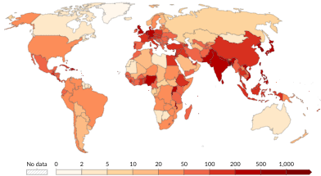
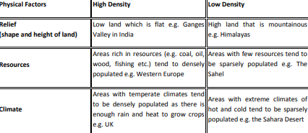
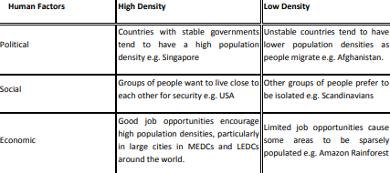
IGCSE GEOGRAPHY: 1.4 POPULATION DENSITY AND DISTRIBUTION
Population density is the average number of people per square kilometre.
It is a way of measuring population distribution. It shows whether an area is sparsely or densely populated.
Population density is calculated using the following formula: Population density = total population divided by total land area in km²
From the map, it is clear that population density in some regions has increased as the population has grown. It is also clear that population density is uneven, with some regions, such as Western Europe, being densely populated and others, such as Australia being sparsely populated.

Slide 12
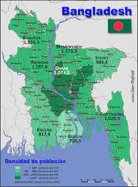
IGCSE GEOGRAPHY: 1.1 POPULATION DYNAMICS
CASE STUDY: BANGLADESH AN OVERPOPULATED COUNTRY
Physical factors that affect overpopulation: - Limited arable land for agriculture due to its small size and frequent flooding. - Vulnerability to natural disasters like cyclones and floods, which can displace populations. |  | Human factors that affect overpopulation - High fertility rates and a lack of access to family planning services. - Limited awareness and education regarding family planning. - Cultural and societal factors promoting large families. - Girls leave education and get married young
Impacts of overpopulation
Food shortages Too many people strain farms, water, and land, causing food shortages and hunger for some. | Housing Shortage Growing cities due to more people cause not enough homes and more slums. | Living in vulnerable areas Many in Bangladesh live in low coastal areas, so they're at risk from rising sea levels and storms, especially because of climate change. | Additional problems More job and resource competition, stress on healthcare and schools, and environmental damage and pollution.
Context: Bangladesh = high population density 1169 per km²
Bangladesh is in South Asia. In 2021, Bangladesh had an average income of $2,000 per capita with a growing GDP.
Population: As of 2021, it had over 160 million people, making it highly densely populated.
Population Growth: Bangladesh experiences rapid population growth due to a balanced birth and death rate
Solutions to address overpopulation:
Promote family planning and reproductive health.
Invest in education and awareness.
Implement sustainable agricultural practices.
Enhance disaster preparedness and urban planning.
International cooperation to address climate change

Slide 13
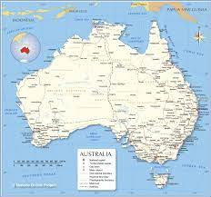
IGCSE GEOGRAPHY: 1.1 POPULATION DYNAMICS
CASE STUDY: AUSTRALIA UNDERPOPULATED COUNTRY
Context: Australia = low population density of 3 per km².
The world's 6ths largest country by land area, with most people living in the East and Southeast. The total population is 25.69 million, resulting in a The current natural increase rate is 1.1%.
It is very rich in resources, with a large reserve of iron, ore, coal, gold, copper, natural gas and uranium - and abundant potential for solar and wind power development.
Physical factors that affect underpopulation?
Australia's population density is low because most of the country's interior is desert (also known as the outback) and present extremely difficult living conditions.
Can it support a higher population?
Australia boasts high education standards with a 99% literacy rate, 20 years of available education, and excellent healthcare, as seen in its low infant mortality rate of 0.46%. These factors, along with a high GDP, enable the country to support a large population. As the world's thirteenth largest economy with the fifth-highest per capita income, increased population could likely lead to improved living standards through resource utilization and increased production.
What issues does it face?
• Shortage of workers which has led to lower optimum productivity..
• Not possible to exploit all resources and large areas of outback undeveloped/ utilised.
• Less people paying tax. 43% of the labour force will be due to retire in next 20 years. Taxes will have to be raised to fund retirement.
• Schools & hospitals may close because there are not enough people to support them.
• Public transport links might close because of less customers. It is unlikely that new transport systems will develop as there is not enough people to support them. This increases peoples reliance on cars.
• There may be less innovation and development.
• Hard to defend country.

