Slide 1
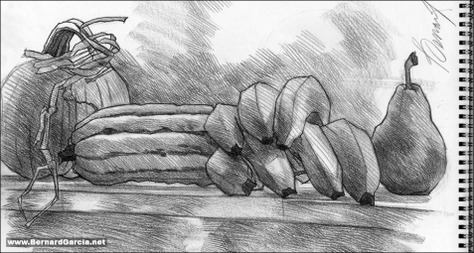
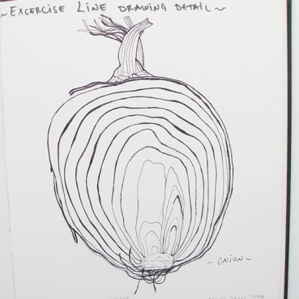
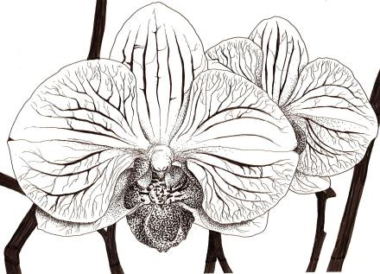
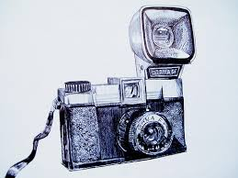
Still Life - What is observational drawing?
What does it mean to observe?
When you observe something, you look at it very closely.
How can we be good observers?
We can look at something very closely. We want to notice all the details.
Pencil
fineliner pen
Fine Liner drawing
Biro

Slide 2
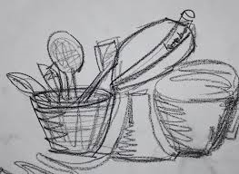
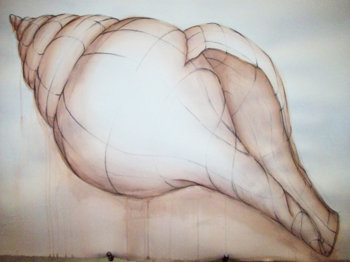
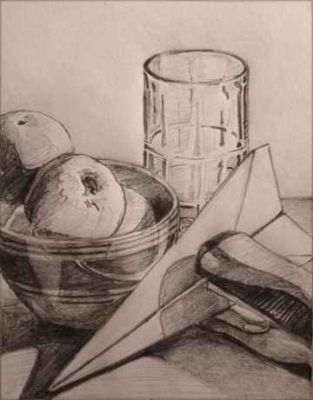
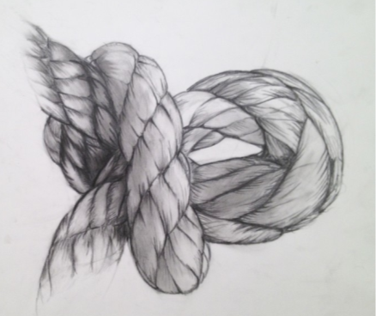
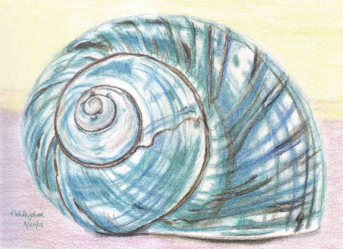
Draw what you see, not what you know!
Look at the object(s) in front of you and really observe what you see. If there are shapes of light, draw them in. If something looks smaller or larger than you think it should be, then draw it the size you see it.

Slide 3
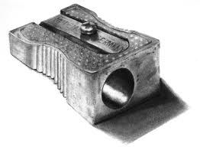
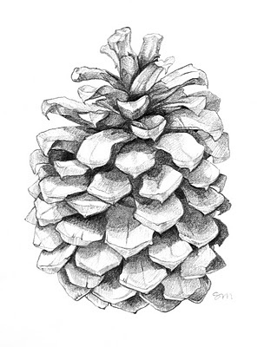
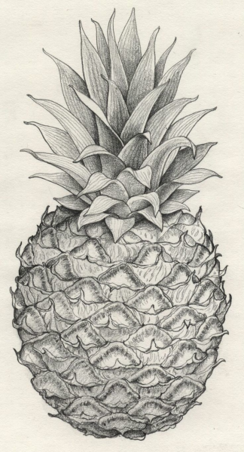
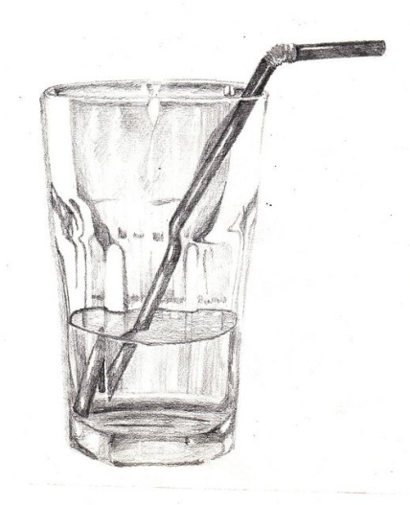
Observational Drawings in pencil
Use your pencil to create the lines of the object and also the tone and texture. Make sure that when you do the lines you don’t press on too hard! Most things don’t have a dark line around them.
The more or less pressure that you put on your pencil creates tone and texture – this is what makes your drawing look life like.
Sarah Melling
Hannah Heaf

Slide 4
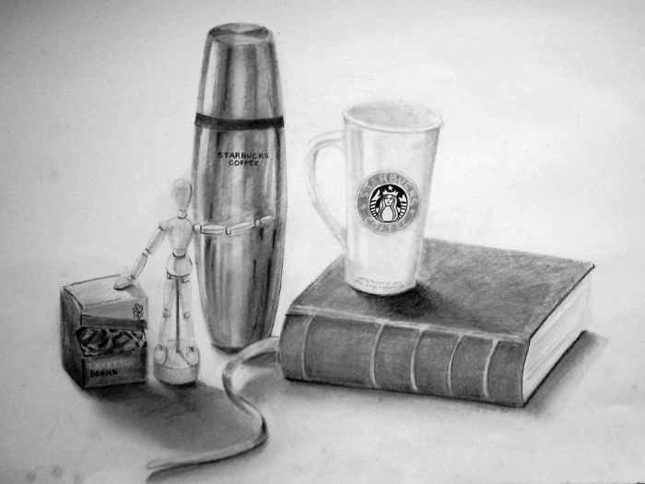
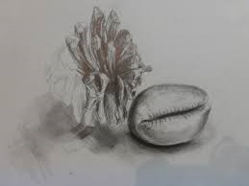
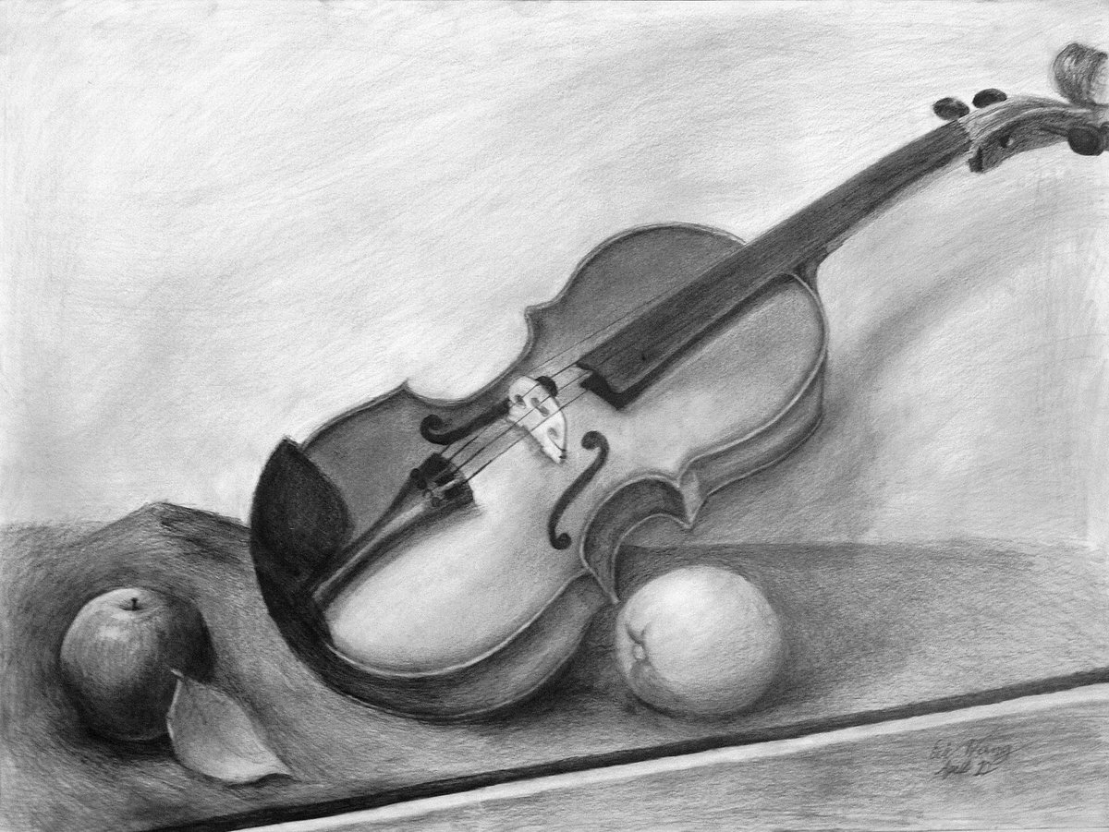
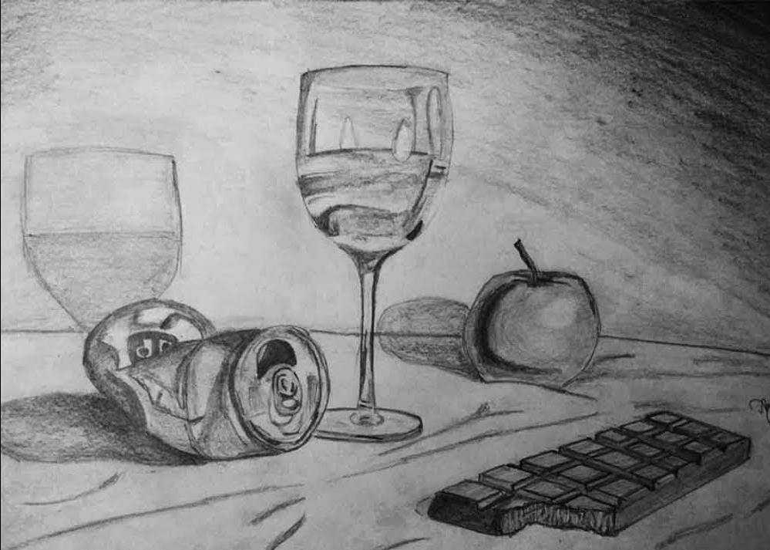
Adding tone and texture

Slide 5
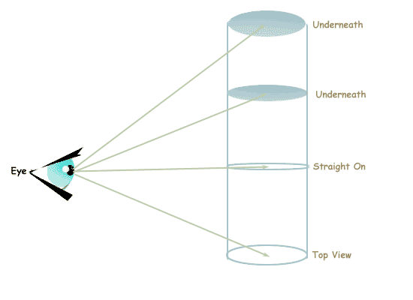
What is an ellipse? How and where do you draw one?

