Slide 1
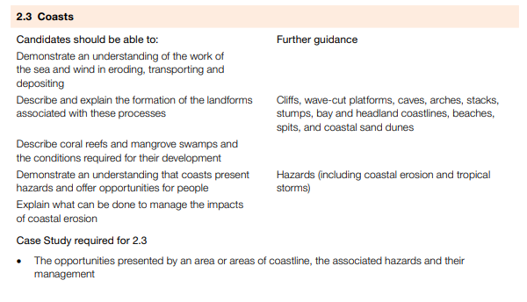
IGCSE GEOGRAPHY 0460: 2.2 RIVERS
IGCSE GEOGRAPHY 0460: 2.3 COASTS

Slide 2
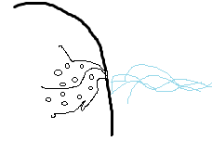
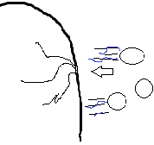
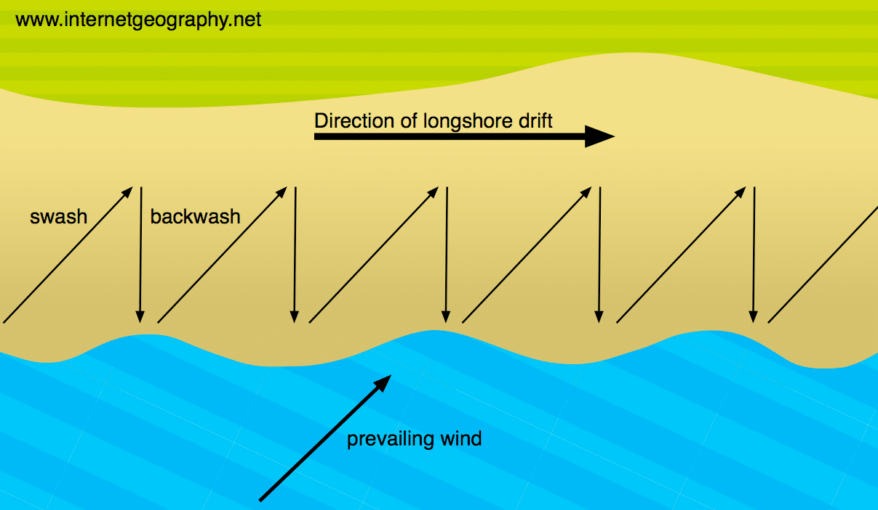
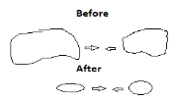
IGCSE GEOGRAPHY 0460: 2.3 COASTS
Waves
Term | Definition
Coastal Zone | Where land meets sea
Swash | Movement of the water UP the beach in the direction of the prevailing wind.
Backwash | Movement of water DOWN the beach at right angles (90o ) due to gravity.
Types of waves
Constructive waves: Build up the beach. Strong swash. Weak backwash. Low height, long wave length. Low frequency.
Destructive waves: Erode the coast. Weak swash. Strong backwash. Tall height, short wave length. High frequency.
Erosional processes | Diagram
Hydraulic Action: The sheer force of the water compressing air into cracks causes bits to break off.
Abrasion: Sediment scraping against the cliff (like sandpaper) removing small pieces.
Attrition: Waves smash rocks and pebbles on the shore into each other, becoming rounder, smoother and smaller.
Solution: Chemical erosion caused by the dissolving of rocks by sea water
Deposition
Dropping of material | Occurs when there is a loss of energy. e.g.. Sheltered bays, when the wind drops.
Transportation
Longshore drift | 1. Prevailing wind pushes the swash and the sediment at an angle up to the beach. 2. Backwash brings the sediment straight back down. 3. This process repeats itself in a zigzag motion. 4. Transporting sediments down the coast.

Slide 3
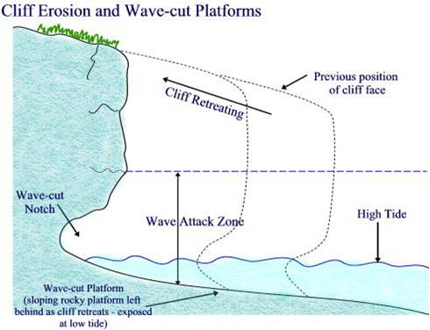
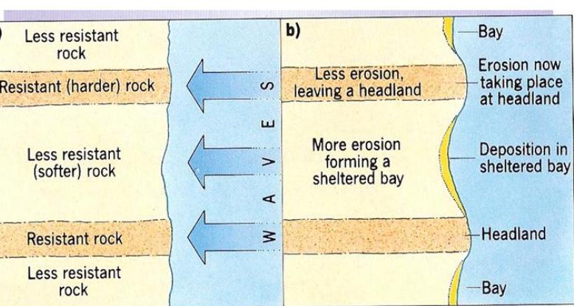
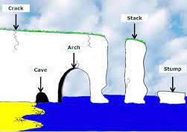
IGCSE GEOGRAPHY 0460: 2.2 RIVERS
IGCSE GEOGRAPHY 0460: 2.3 COASTS
Erosional landforms include: cliffs headland and bays, wave cut platforms and crack, cave, arch, stack and stump. Top Tip!: You need know how each one is formed and also be able to draw an annotated diagram.
Cliffs and Wave-cut platform:
Step 1. Waves hit the cliff, between the low and high water marks. Processes such as hydraulic action, abrasion and solution take place.
Step 2. As a result of continued erosion undercuts the cliff and forms a wave-cut notch and leaves an overhang.
Step 3. Overtime, the notch gets larger making the overhanging cliff unstable.
Step 4. It eventually will reach a critical point where it can no longer support its weight and collapses.
Step 5. The cliff will then retreat and the process repeats, a wave cut platform is left where the cliff used to be.
Headlands and Bays
Step 1: Discordant coastlines have alternating bands of more resistant (chalk) and less resistant rock (clay).
Step 2: The less resistant rock is eroded faster through abrasion, creating bays.
Step 3: he more resistant rock erodes slower and is left jutting out to sea forming a headland.
Step 4: Overtime, the two headland protects the bay from erosion and may form a sheltered bay.
Caves, Arch, Stack, Stump
Step 1: Weaknesses in a headland turn into cracks due to erosional processes hydraulic action.
Step 2: Further erosion causes the crack to open and creates a cave.
Step 3: Through continued erosion like abrasion an arch is formed.
Step 4: The arch roof collapses and leaves a stack. This is due to weathering processes.
Step 5: Finally more erosion wears the stack into a stump.

Slide 4
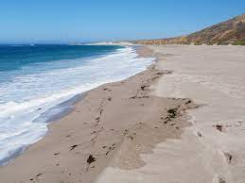
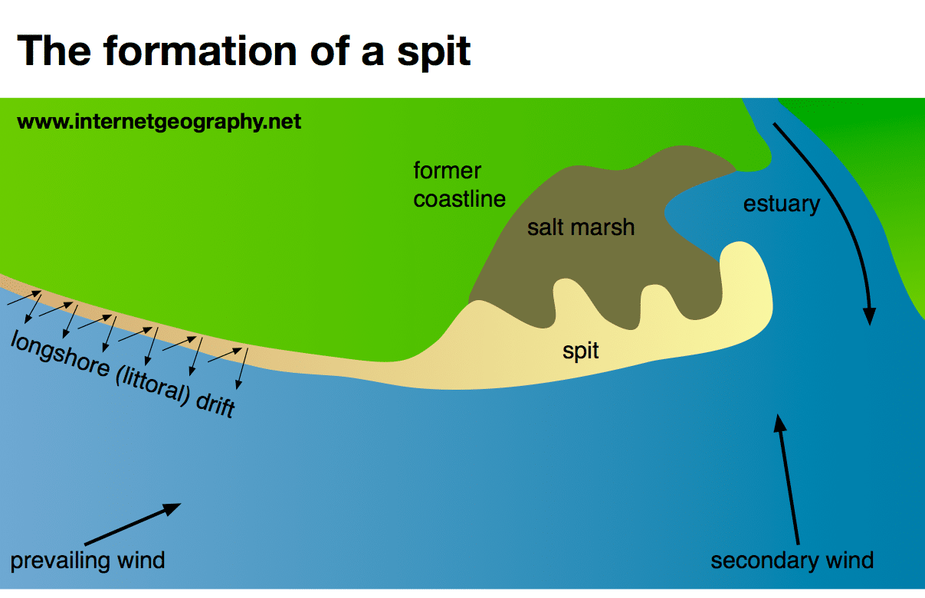
IGCSE GEOGRAPHY 0460: 2.2 RIVERS
IGCSE GEOGRAPHY 0460: 2.3 COASTS
Depositional landforms include: beaches, spitsand sand dunes. Top Tip!: You need know how each one is formed and be draw an annotated diagram.
Beaches
Step 1: Beaches when deposition occurs.
Step 2: There needs to be a source of sediment nearby like soft cliffs.
Step 3: Constructive waves deposit material in sheltered areas like bay.
Spits
Step 1: Sediment is carried by longshore drift. When there is a change in the shape of the coastline, deposition occurs.
Step 2: A long thin ridge of material is deposited. This is the spit.
Step 3: A hooked end can form if there is a change in wind direction.
Step 4: Waves cannot get past a spit, which creates a sheltered areas where mud flats or salt marshes may form.
Sand dunes
Step 1: Prevailing wind blows sand up the beach.
Step 2: Obstacles such as seaweed, driftwood which traps the sand and leads to deposition and the build up of sand.
Step 3: Over time sand dunes build up and are colonised by marram and lyme grass.
Step 4: Vegetation stabilizes the sand dunes in a process called succession from an embryo dune to mature dune.

Slide 5
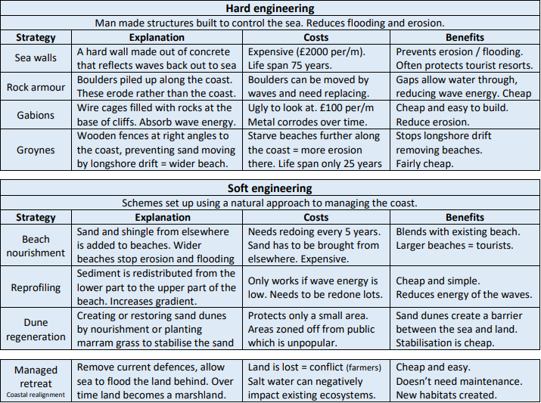
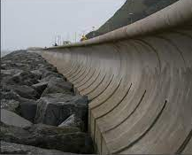
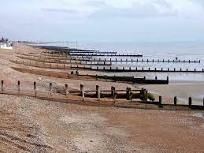
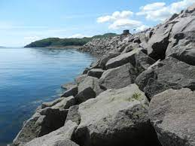
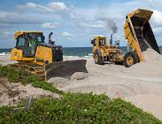
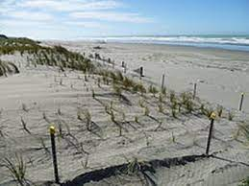
IGCSE GEOGRAPHY 0460: 2.2 RIVERS
IGCSE GEOGRAPHY 0460: 2.3 COASTS
Opportunities
Tourism and Recreation: Coast attract tourists for activities like swimming, surfing, and beachcombing.
Fishing and Aquaculture: Opportunities for commercial fishing and aquaculture = job opportunities, good for local economy
Port and Shipping Industry: Coastal ports facilitate global trade and shipping activities.
Renewable Energy Generation: Coasts are suitable for harnessing wind and tidal energy for sustainable power.
Biodiversity and Conservation: Coasts support diverse wildlife, providing opportunities for research, eco-tourism & conservation.
Hazards
Climate Change: As temperatures rise, storms are expected to increase in intensity and frequency.
Sea Level Rise: Melting ice on land adds more water to the oceans, further increasing the risk of flooding.
Storms surges: Can destroy houses, affect livelihoods and impact local economy
Overfishing; impacts on other species as a result; litter and oil on beaches; water pollution;introduction of invasive alien species; habitat damage
Coastal erosion: gradual wearing away of land, undermines ecosystems and threatening human settlements, infrastructure and exacerbates the risk of flooding.

Slide 6
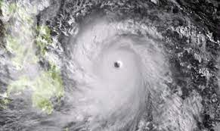
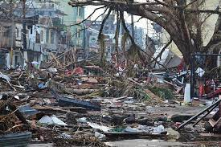
IGCSE GEOGRAPHY 0460: 2.3 COASTS
Case study: Typhoon Haiyan, threat to coastlines.
Impact
Wind Speeds: Haiyan was one of the strongest typhoons recorded, with wind speeds = 195 mph
Storm Surge: Reaching up 6 meters caused widespread flooding along coastal areas.
Casualties: Approximately 6,000 lives were lost, with many more injured and missing.
Displacement: Over 4 million people were displaced from their homes
Infrastructure Damage: Homes, schools, hospitals, infrastructure were damaged
Responses
International Aid: Global community provided humanitarian aid: financial assistance, food medical supplies.
Philippine Government: Faced with a massive humanitarian crisis, the government struggled to provide immediate relief and recovery efforts.
NGOs and Relief Organizations: Red Cross and UN agencies played a vital role in delivering aid, providing healthcare, and supporting rebuilding initiatives.
Long-Term Impact:
Economic Setback: The Philippines faced significant economic setbacks due to the destruction of infrastructure and disruption of livelihoods.
Environmental Consequences: The typhoon contributed to deforestation, soil erosion
Recovery: Efforts were made to enhance community resilience through improved infrastructure, early warning systems, and disaster preparedness initiatives.
Preparing for future typhoons
Importance of Preparedness: Haiyan underscored the importance of early warning systems and disaster preparedness.
Global Collaboration: The international response highlighted the significance of global collaboration in addressing humanitarian crises.
Climate Change Awareness: The typhoon drew attention to the increasing impact of climate change on extreme weather events.
Context
Date: November 8, 2013
Location: Primarily impacted the Philippines
It was a category 5 typhoon

Slide 7
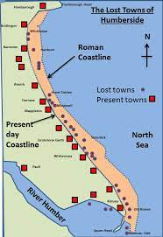
IGCSE GEOGRAPHY 0460: 2.2 RIVERS
IGCSE GEOGRAPHY 0460: 2.3 COASTS
Case study: Holderness Coasts
The impacts of coastal erosion in Mappleton
Land Loss: Coastal erosion results in the gradual loss of land, threatening the stability of the village and its infrastructure. Homes, buildings, and other infrastructure endangered to potential property damage and loss to the sea.
Community Displacement: Displacement for the local community, as homes and structures become increasingly vulnerable to the encroaching sea.
Economic Consequences: Coastal erosion can affect property values and potentially impact local businesses as the threat to infrastructure persists.
Environmental Changes: Erosion alters the local environment, impacting ecosystems and potentially leading to changes in coastal habitats and biodiversity.
Tourism and Historical Sites: Erosion may lead to the loss of historical sites or landmarks in Mappleton. It affects scenic or recreational areas, it can have consequences for tourism, affecting the local economy and community livelihoods.
Coastal Management Measures:
Rock Revetments: Large rock revetments were constructed along the coastline to act as a physical barrier against wave action and erosion.
Groynes: Wooden groynes were installed perpendicular to the shore to trap sediment, promoting beach stabilization.
Seawalls: vertical structures built along the coast to act as a barrier against wave action and erosion. They are designed to absorb wave energy and protect the land behind them
Managed Retreat: In some cases, managed retreat strategies involve allowing controlled erosion in certain areas while protecting others. This approach aims to prioritize valuable or critical areas for protection.
Context
The Holderness Coast in East Riding of Yorkshire, England, along the North Sea.
Rapid coastal erosion at 1.5m per year, making it among Europe's fastest eroding coastlines.
What were the negative outcomes?
Environmental Impact: The construction of coastal defenses can disrupt local ecosystems and natural sediment transport processes.
High Costs: Implementing and maintaining extensive coastal management measures involve significant financial investments.
Altered Coastal Processes: Some argue that interrupting natural erosion processes may lead to issues elsewhere along the coastline

Slide 8
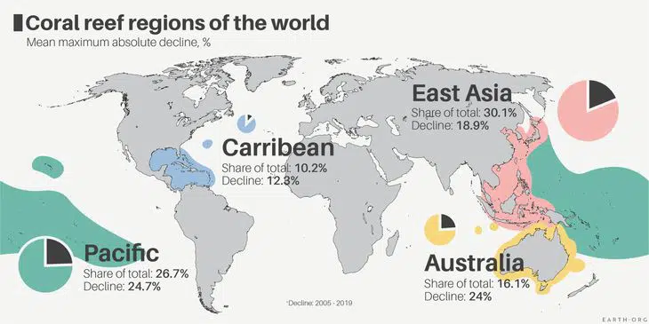
IGCSE GEOGRAPHY 0460: 2.2 RIVERS
IGCSE GEOGRAPHY 0460: 2.3 COASTS
Coral Reefs Location
Most are found in the Pacific
All are found in tropical, marine areas
All are found in warm and shallow seas a
Conditions for Coral Reefs
Warm Water Temperatures 18–27°C: Optimal environment for coral = grow & reproduce.
Shallow Water (Less than 60 meters deep): Enables sunlight penetration for photosynthesis for coral growth.
Plentiful Plankton and Nutrients: Vital food source. Small fish - nutrition
Calm Water Conditions: Protects delicate corals from physical damage. caused by strong currents & waves.
Abundant Oxygen Supply: Crucial for the respiration process of corals. Supports overall health and vitality of coral reefs.
Alkaline pH: Essential for structural foundation of coral reefs. Acidic water prevents coral growth, leading to deterioration and death.
Impact of Human Activities on Coral Reefs
Overfishing: Disrupts reef ecosystem balance and depleted fish populations. Overfishing of parrotfish in the Caribbean
Pollution: Coastal development, industrial activities, and sewage discharge introduce harmful substances. Causes coral bleaching and disease; Gulf of Mexico's
Climate Change: Rising sea temperatures and ocean acidification threaten coral reefs globally. Severe bleaching events, like in the Great Barrier Reef, result from warmer waters.
Coral reefs offer opportunities for human activity:
1. Tourism and Recreation: Coral reefs e.g. Great Barrier Reef attract tourists e.g. diving and snorkeling.
2. Fisheries and Seafood Industry: Coral reefs provide habitats for fish species and support local fishing communities and seafood industry.
3. Scientific Research Opportunities: Coral reefs allows biodiversity research, climate change assessment, and coral reef ecology.
Sustainable management of Corals
Marine protected areas:
Sustainable fishing practices:
Waste management and pollution control:

Slide 9
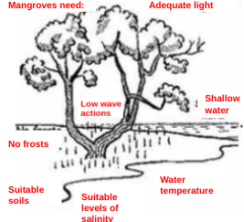
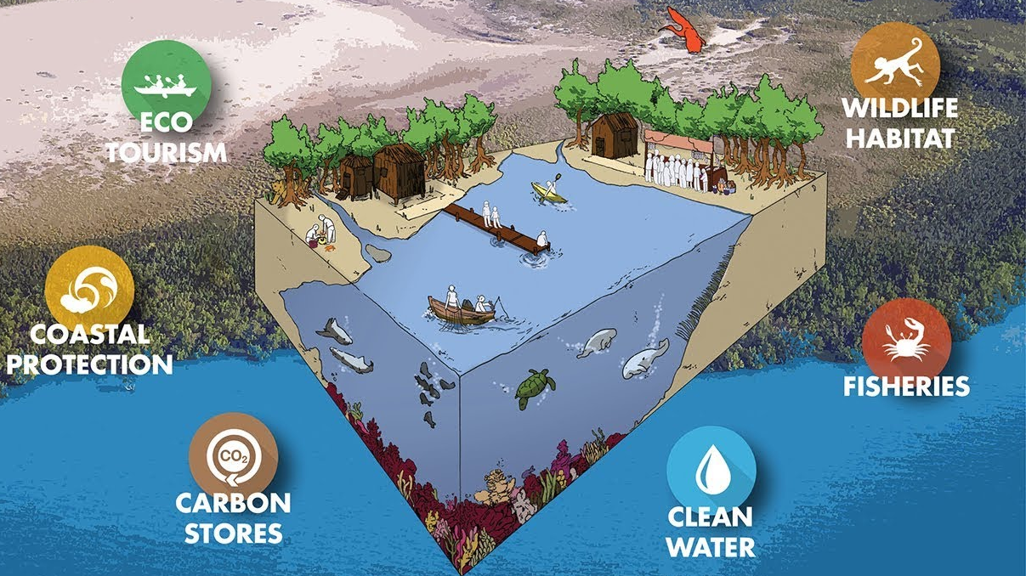
IGCSE GEOGRAPHY 0460: 2.3 COASTS
Mangrove swamps
Mangrove swamps are trees and shrubs that grow in saline coastal habitats in the tropics and subtropics.
Provide a habitat and protection for many fish & other sea animals, especially when young.
They slow water flow encouraging any sediment to be deposited, keeping sea water clear.
Protect the coast from erosion, storm surges, hurricanes, and tsunamis
They are a source of food and material.
Mangroves Conditions
Mangroves are salt-tolerant trees adapted to harsh coastal conditions.
They contain a complex salt filtration system and root system to cope with salt water and wave action.
They are adapted to the low oxygen conditions of waterlogged mud.
Mangroves Opportunities
Fishies: Mangroves serving as habitats and nurseries for fish species, and their preservation is essential for food and income for locals.
Tourism: Opportunities for revenue through activities like snorkelling expeditions of mangroves and marine life
Coastal protection: Mangrove protect coastlines by trapping sediments, prevent erosion, and act as a buffer from storms.
Threats to Mangroves
Deforestation: Clearing mangrove forests for development
Pollution: Contamination from industrial and urban runoff harms mangroves and their ecosystems.
Sea Level Rise: Climate change-induced rising sea levels pose a threat to mangroves by altering their habitat and increasing vulnerability to storms.
Managing Mangroves
Protected Areas: Establishing and enforcing protected areas to limit human activities that harm mangroves.
Reforestation: Initiating mangrove planting and restoration projects to replace damaged or lost mangrove areas.
Community Involvement: Engaging local communities in conservation efforts, promoting sustainable practices, and raising awareness about the importance of mangroves.

