Slide 1
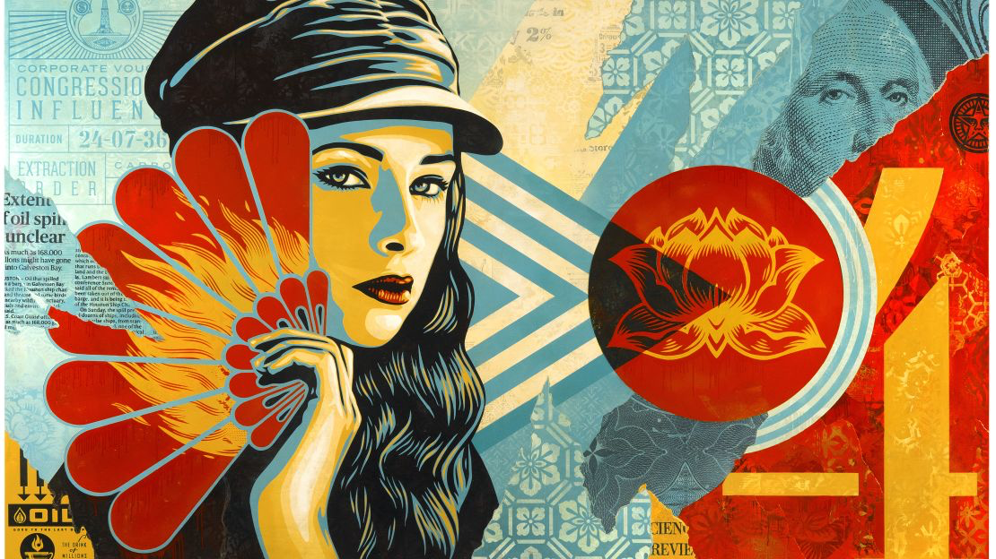
HEROES & LEADERS
Year 9: Art Activism Unit
Lesson 8-12: Digital Art Creation

Slide 2
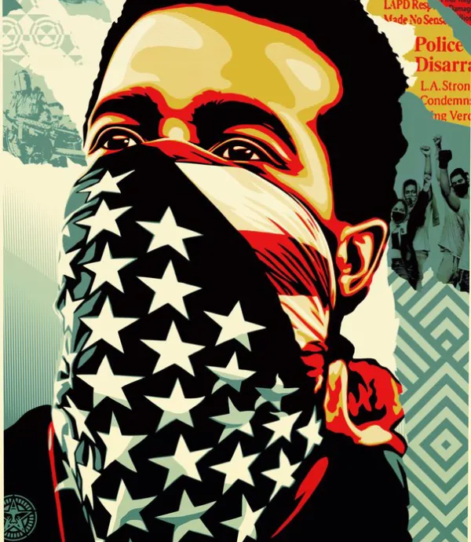
Learning
Intentions
- Understand the key characteristics of Shepard Fairey's artwork.
- Learn to create Shepard Fairey style artwork using Photoshop and Illustrator.
- Develop skills in digital art and design techniques.

Slide 3
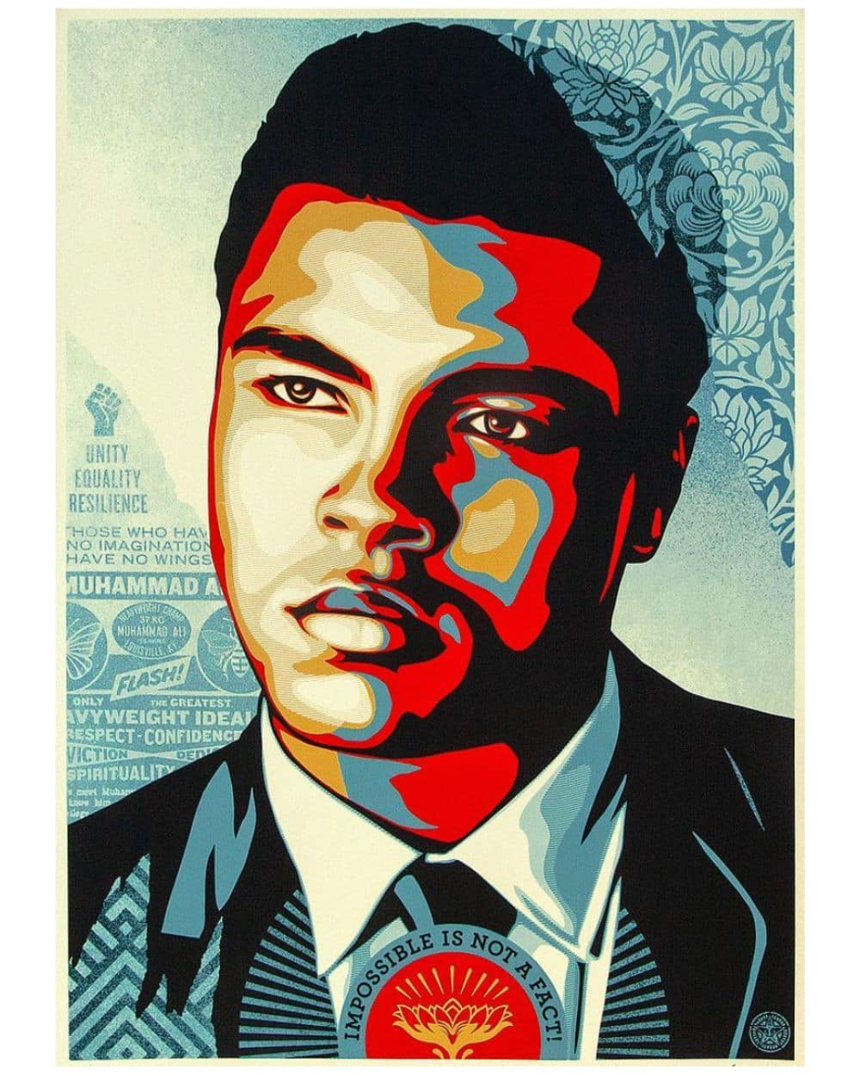
Starter Task In pairs, discuss this artwork by Shepard Fairey. Consider the following:
The Key Characteristics of Shepard Fairey’s Artwork
Line: Describe the types of lines used.
Tone: Explain the use of light and dark areas.
Colour: Discuss the colour palette and its significance.
Texture: Describe any visual or physical textures.
Pattern: Identify patterns in the artwork.
Shape and Form: Discuss the shapes and forms present.
Contrast and Scale: Explain the use of contrast and scale.
Proportion and Emphasis: Describe the focus areas and proportions.
Balance, Harmony, Rhythm, and Movement: Discuss how these elements create a sense of harmony and movement.

Slide 4
Lesson 1: Creating a Digital Artwork
Follow These Steps:
1) Open your photograph from last lesson in Photoshop:
- Choose a high-resolution photograph.
2) Use the Desaturate Tool to make your image black and white.
3) Applying Filters and Adjustments to Create High Contrast:
- Click ‘Filter’ > Filter Gallery > Cutout
4) Use ’Curves’ to edit the contrast.

Slide 5
Lesson 2: Creating a Digital Artwork
Follow These Steps:
1) Importing the Edited Image into Illustrator:
- Save the high-contrast image from Photoshop and open it in Illustrator.
2) Using the Pen or Pencil Tool to Trace the Main Features:
- Outline the key features of the image.
3) Simplifying the Shapes and Adding Details:
- Use basic shapes and lines to create a clean, stylised look.
4) Choosing a Limited Colour Palette:
- Typically, 6-8 colours that reflect Fairey’s style.

Slide 6
Lesson 3: Creating a Digital Artwork
Follow These Steps:
1) Importing the Edited Image into Illustrator:
- Save the high-contrast image from Photoshop and open it in Illustrator.
2) Using the Pen or Pencil Tool to Trace the Main Features:
- Outline the key features of the image.
3) Simplifying the Shapes and Adding Details:
- Use basic shapes and lines to create a clean, stylised look.
4) Choosing a Limited Colour Palette:
- Typically, 6-8 colours that reflect Fairey’s style.

Slide 7
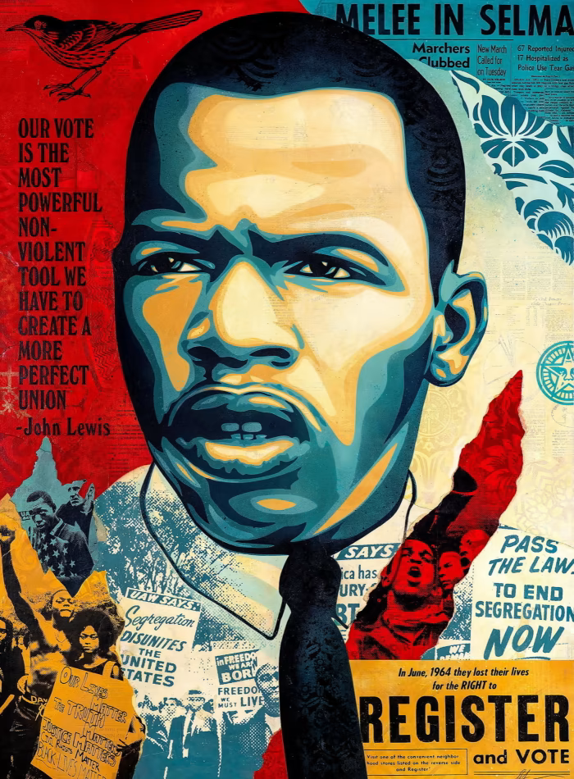
Lesson 4: Creating a Digital Artwork
Follow These Steps:
1) Adding Textures and Patterns:
- Use brushes and patterns to add depth.
2) Incorporating Text and Other Design Elements:
- Add impactful text that complements the artwork.

Slide 8
Feeling confident? Follow this video tutorial for step-by-step instructions for how to create your Shepard Fairey inspired digital artwork.
Photoshop & Illustrator Tutorial

Slide 9
Self-Assessment
Exceeding (Level 7-9)
I have created a high-quality digital artwork that effectively emulates Shepard Fairey’s style.
My use of Photoshop and Illustrator tools is proficient and demonstrates a clear understanding of the techniques.
The colour palette, textures, and patterns are chosen thoughtfully to enhance the overall design.
Meeting (Level 4-6):
I have created a good-quality digital artwork that represents Shepard Fairey’s style.
My use of Photoshop and Illustrator tools is adequate but may need some refinement.
The colour palette, textures, and patterns are appropriate but could be improved for greater impact.
Working towards (Level 1-3):
I have created a digital artwork, but it may lack clarity in representing Shepard Fairey’s style.
My use of Photoshop and Illustrator tools needs more practice and improvement.
The colour palette, textures, and patterns are not effectively used to enhance the design.

Slide 10
