Slide 1
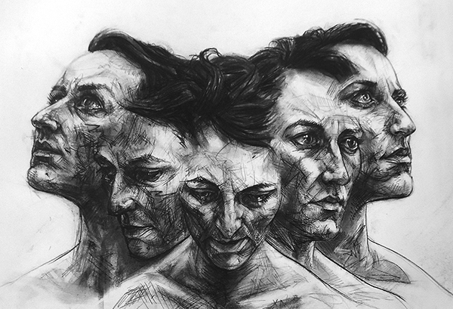
Unit 2
Researching & Responding to Photographers
Editing in the style of David Theron

Slide 2
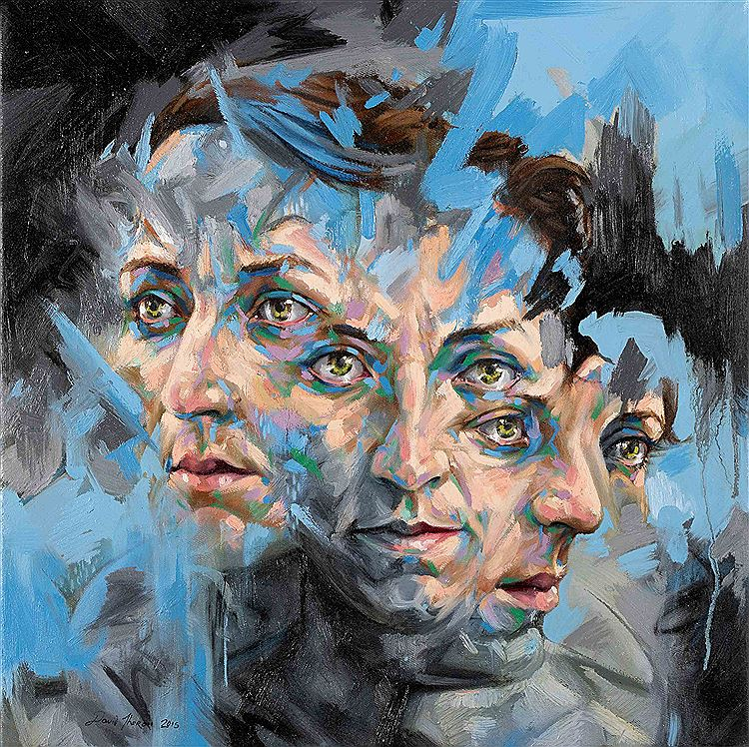
What can you tell me about these images by David Theron?

Slide 3
Learning Intentions
AO2: Refine work by exploring ideas, selecting and experimenting with appropriate media, materials, techniques and processes.
To explore a range of photo editing skills using Photopea and Photoshop in the style of David Theron.

Slide 4
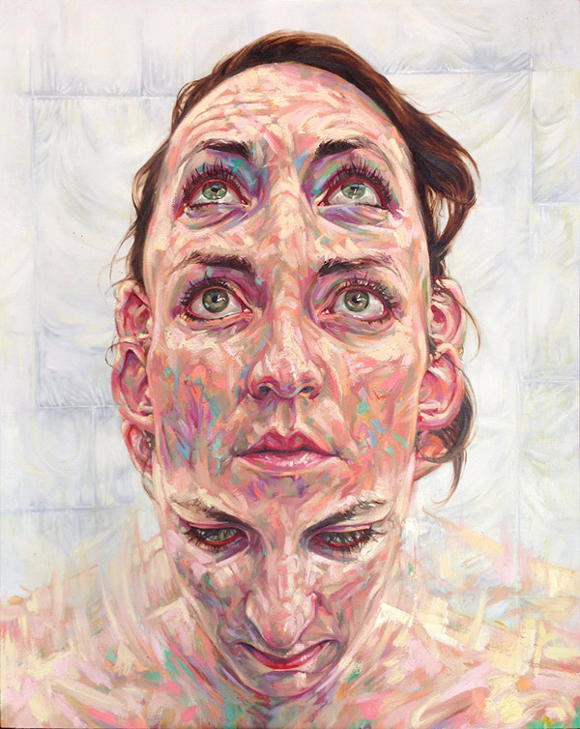
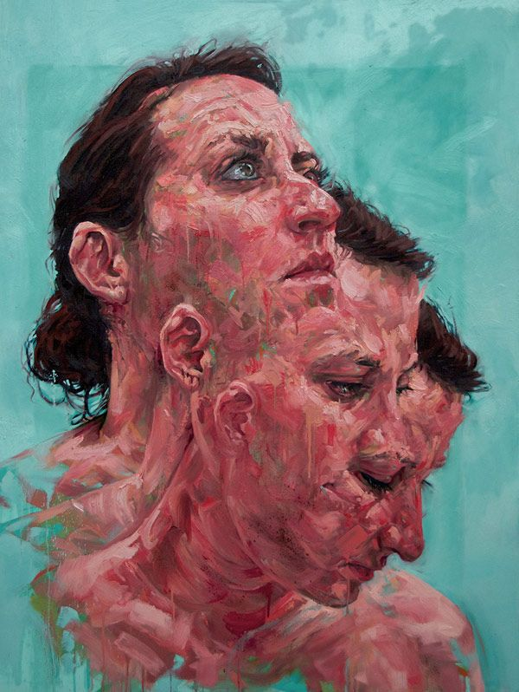
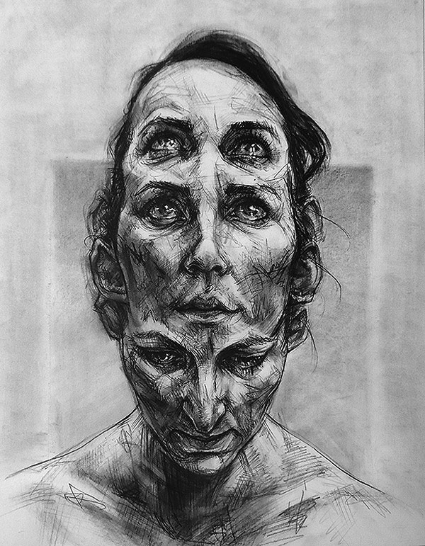
David Theron

Slide 5
David Theron
Follow the tutorial to create your own version of his work and to learn how to replicate his technique.
Use your own photos, feel free to take the photos quickly in the lesson against a white wall.
You will need three portrait photos of the same person from slightly different angles. Upload the originals below the edit to show the images you have edited together.
Open the video split screen with photoshop so you can watch it, pause then have a go at a section etc.
Create a sketchbook page about the artist, including your own photographic edit in his style.

Slide 6
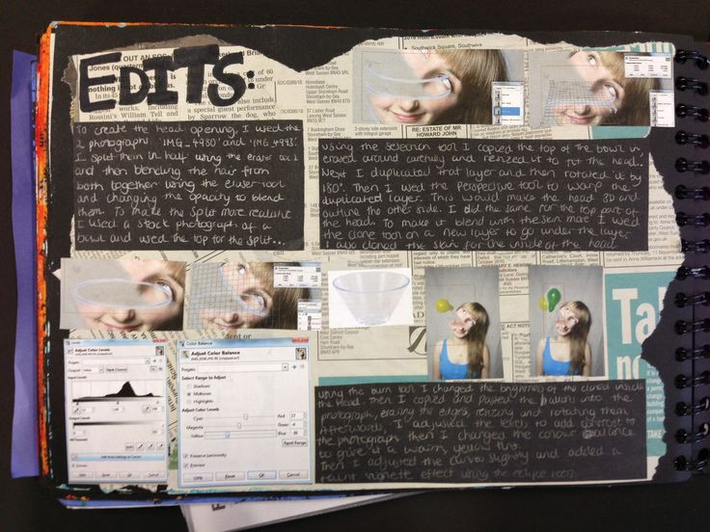
Extension Task
Create an A1 sized edit for your portfolio. document the process of editing the work by taking screenshots of the entire process and show this as a timeline in your sketchbook. If you can, explain how you are using digital manipulation techniques to express an idea or concept behind your work.

Slide 7
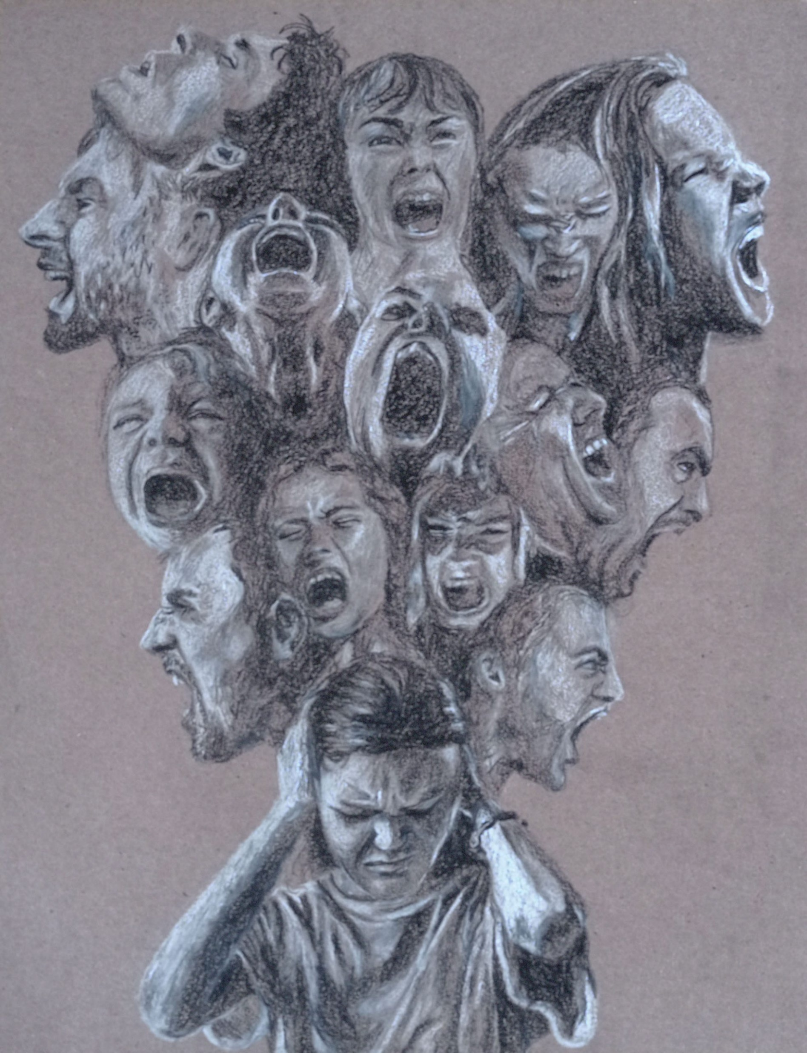
EXIT
Going for gold? Why not try to recreate this image using your own photographs?

