Slide 1
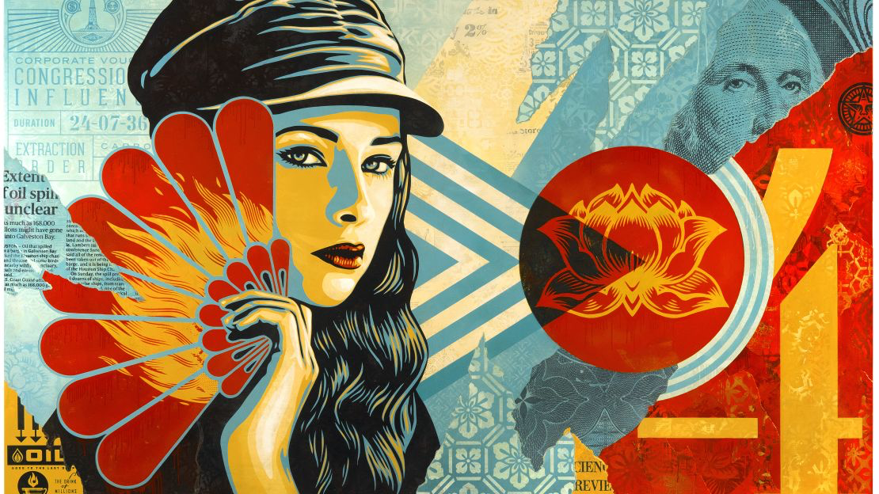
HEROES & LEADERS
Year 9: Art Activism Unit
Lesson 6: Me as a Leader

Slide 2
Learning
Intentions
Creative Exploration: Take creative risks by exploring and experimenting with ideas independently to create your own original artwork while making connections to the work of artists and designers.

Slide 3
Starter Task In pairs, discuss this artwork by Shepard Fairey. Consider the following:
The Key Characteristics of Shepard Fairey’s Artwork
Line: Describe the types of lines used.
Tone: Explain the use of light and dark areas.
Colour: Discuss the colour palette and its significance.
Texture: Describe any visual or physical textures.
Pattern: Identify patterns in the artwork.Shape and Form: Discuss the shapes and forms present.
Contrast and Scale: Explain the use of contrast and scale.
Proportion and Emphasis: Describe the focus areas and proportions.
Balance, Harmony, Rhythm, and Movement: Discuss how these elements create a sense of harmony and movement.

Slide 4
Task Create a PowerPoint slide about yourself imagining yourself as a leader or activist. This slide should be a fact file of things you believe in, with images that link to your beliefs.
Activity 1: Artist’s Intentions and Meaning
Content of Slide:
Title: [Your Name] - What I Stand For
Beliefs: List your core beliefs and causes you support.
Images: Include images that represent your beliefs and causes.
Actions: Describe what actions you would take to support these causes.
Impact: Explain the impact you hope to make.
Qualities: List the qualities and characteristics you think are necessary for a leader.

Slide 7
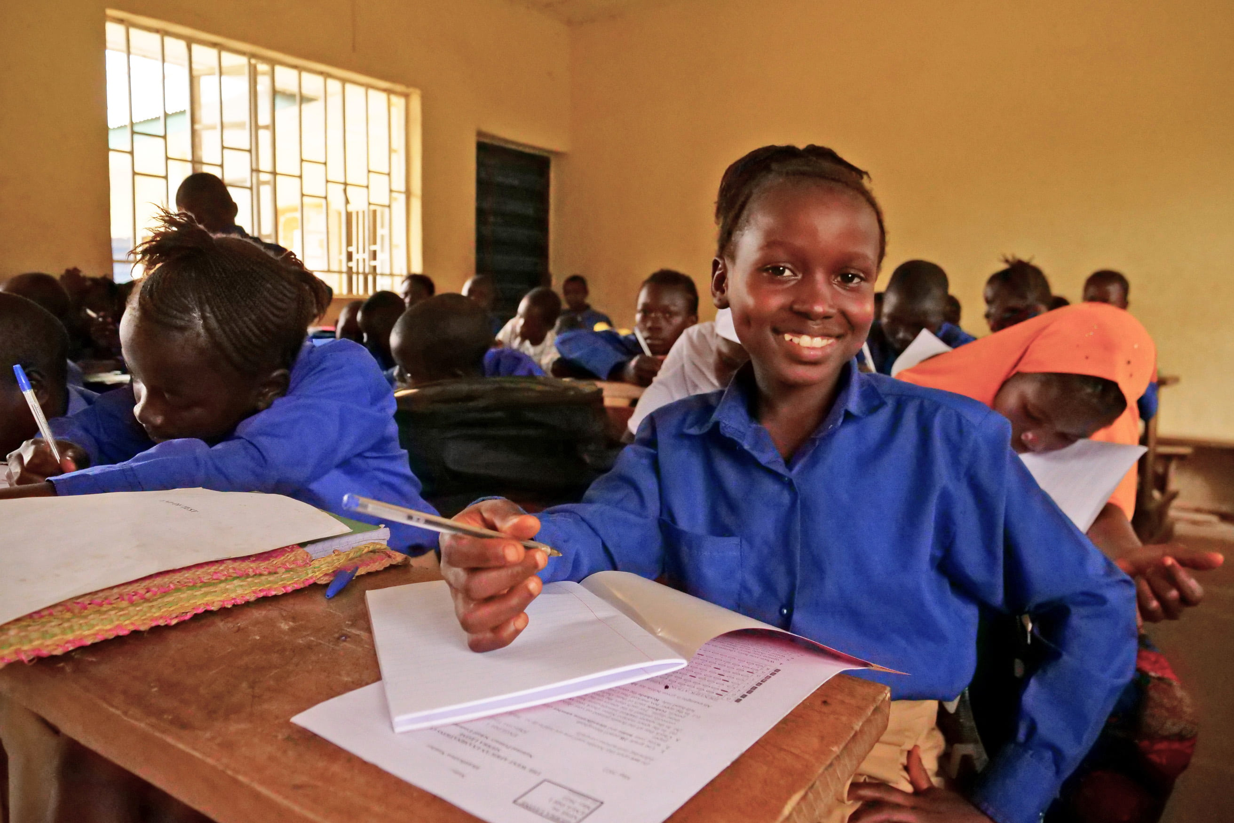
Layout Example
Mr Mitchell - What I Stand
Beliefs
Actions
Environmental sustainability
Social justice
Education for all
Promote recycling programs in schools
Advocate for equal rights
Support initiatives for global education
Impact
Qualities
What I Stand For
Aim to reduce waste and pollution
Work towards a more inclusive society
Ensure all children have access to quality education
Compassion
Determination
Leadership
As a passionate advocate for environmental sustainability, social justice, and education for all, I strive to make a meaningful impact in my community and beyond. I believe in the power of collective action to address the pressing challenges of our time, aligning my efforts with several of the United Nations' Sustainable Development Goals (SDGs). My commitment to Goal 13: Climate Action drives my work in promoting recycling programs and reducing waste, aiming to create a cleaner, healthier planet. In support of Goal 10: Reduced Inequalities, I advocate for social justice and equal rights, working towards a society where everyone has the opportunity to thrive regardless of their background. Additionally, I am dedicated to Goal 4: Quality Education, championing initiatives that ensure all children have access to quality education, empowering them to build a better future. Through my actions, I hope to inspire others to join me in creating a more sustainable, just, and educated world.

Slide 8
Self-Assessment
Exceeding (Level 7-9)
I have created a detailed and well-researched PowerPoint slide about myself as a leader.
My slide includes all key information about my beliefs, actions, impact, and qualities.
I have clearly explained what I stand for and included relevant, high-quality images.
My slide is visually engaging and well-organised.
I have expressed my personal opinion thoughtfully and insightfully.
Meeting (Level 4-6):
I have created a PowerPoint slide with most of the key information about myself as a leader.
My slide includes my beliefs, actions, impact, and qualities but may lack some detail.
I have included relevant images, though some may not be high-quality.
My slide is organised and includes some creative elements.
I have expressed my personal opinion with some insights.
Working towards (Level 1-3):
I have created a PowerPoint slide but it lacks key information about myself as a leader.
My slide is missing details about my beliefs, actions, impact, and qualities.
I have included a few images, but they are not all relevant or high-quality.
My slide is somewhat disorganised and lacks visual appeal.
I have expressed my opinion, but it is not well-supported or insightful.

Slide 9
