Slide 1
ALIVE
Year 8: Photography Unit
Lessons 1 & 2: Compositional Rules

Slide 2
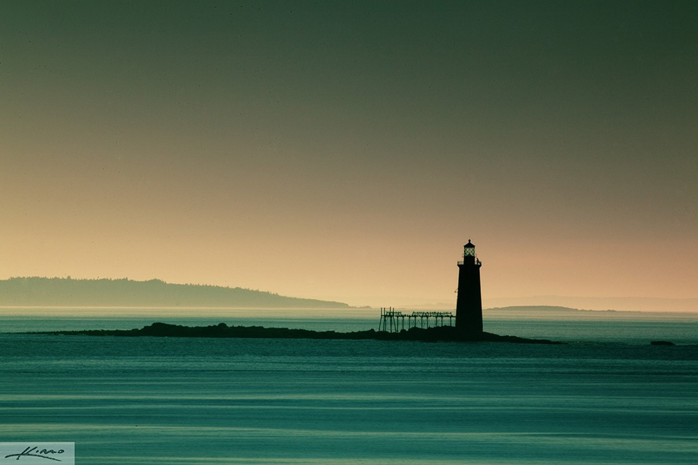
What makes this photograph so powerful?

Slide 3
Learning Intentions
Introduce students to various compositional rules used in photography.
Develop an understanding of how these rules enhance the visual impact and effectiveness of an image.
Encourage critical thinking about composition in photography.

Slide 4
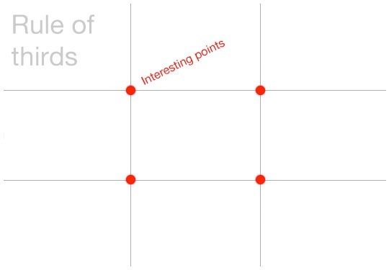
Rule of Thirds
The rule of thirds is a rule of thumb or guideline which applies to the process of composing visual images, designs, films, paintings and photographs.
It has 9 equal parts by two equally-spaced horizontal lines…
and two equally-spaced vertical lines.

Slide 5
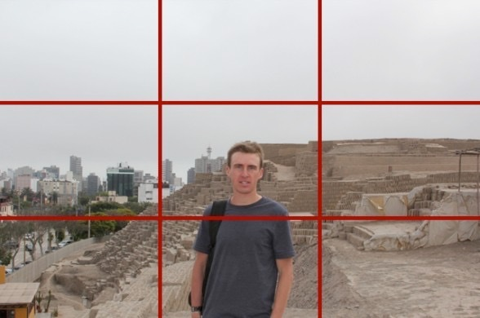
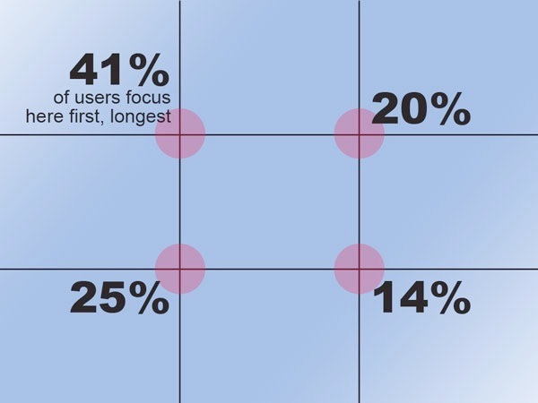
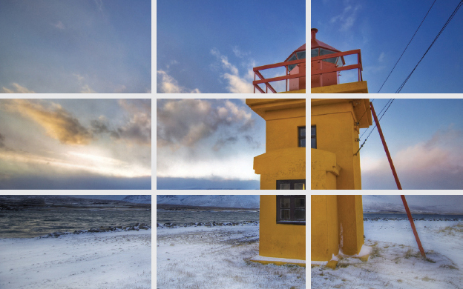
Central Focal Point
Rule of Thirds
Focal Point Using
The Rule of Thirds

Slide 6
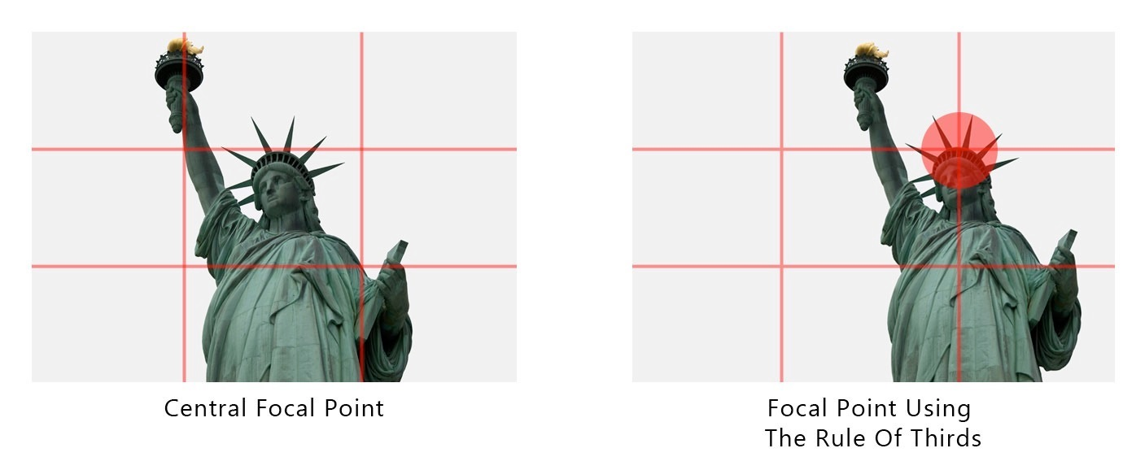
Rule of Thirds

Slide 7
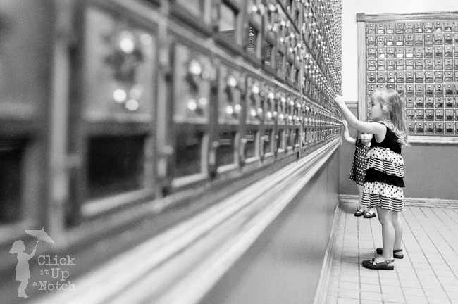
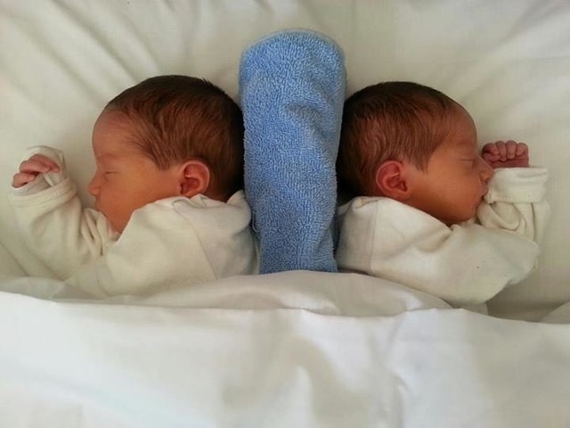
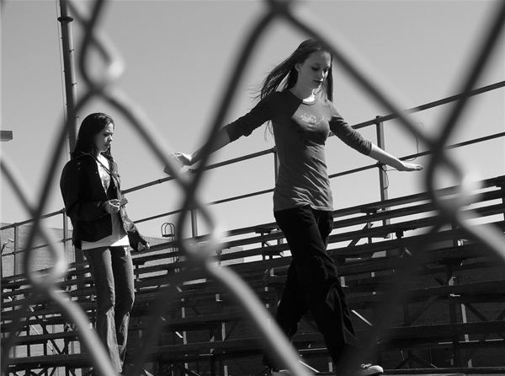
Compositional Rules
Compositional Rules
Symmetry
Leading Lines
Framing
Juxtaposition
To Discuss

Slide 8
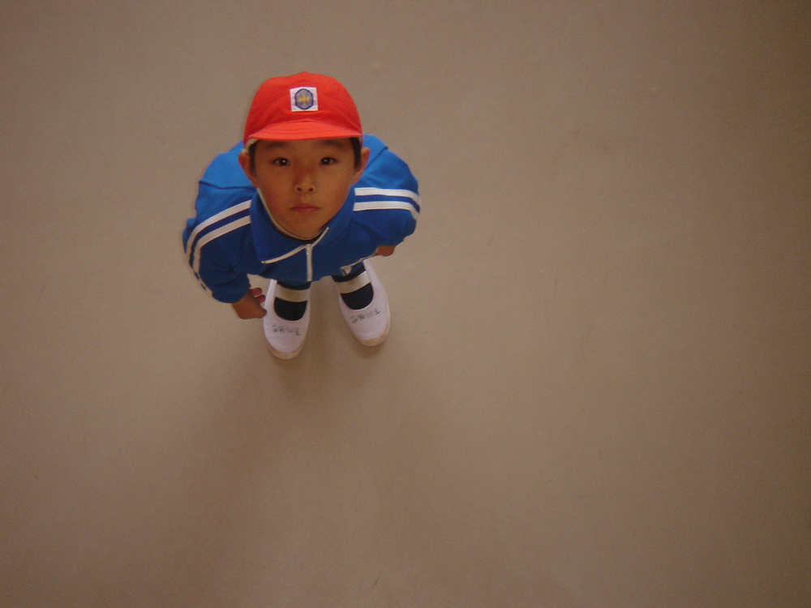
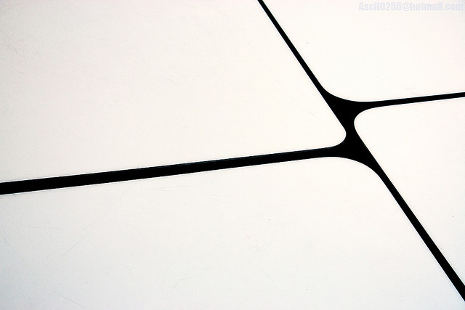
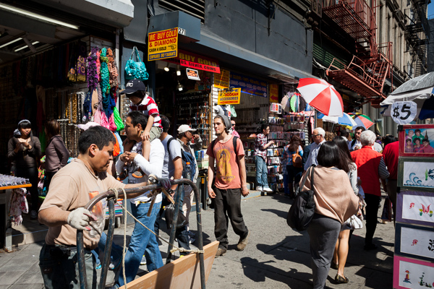
Compositional Rules
Minimalist
Angles and Perspective
Maximalist
Golden Ratio
To Discuss

Slide 9
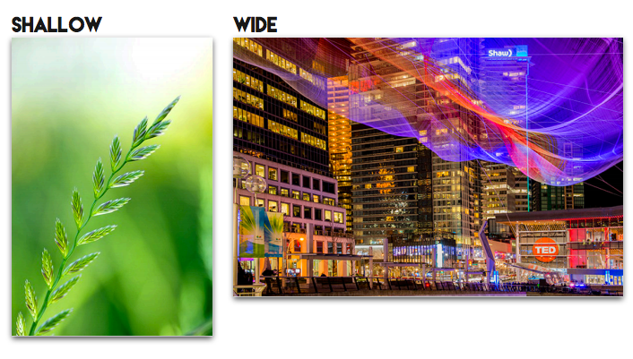
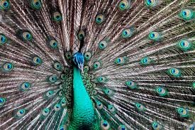
Compositional Rules
Rule of Thirds
Depth of Field
Filling the Frame
Horizon Line
To Discuss

Slide 10
Task 1
Exploring different composition rules in photography
Instructions
Each of you will receive a set of printed photographs. These photographs represent different subjects and styles and showcase various composition techniques. They will serve as our visual playground for this task.
Open your sketchbooks and create a double page spread for the photographs you receive. Make sure there is enough space for annotation and analysis between each photograph you stick down.
Take a close look at each photograph. Your task is to identify the compositional rules that have been applied.
As you identify each compositional rule, annotate your observations and analysis directly on the page dedicated to that photograph. Describe how the rule is applied and discuss its impact on the overall composition and visual appeal.
After annotating all the photographs, take a moment to reflect. Which compositional rule do you find most effective? Why do you think it has a strong impact? Consider how you can apply these compositional rules in your own photography or artwork.
Let's explore the following rules together:
a) Rule of Thirds: Look for elements in the photograph that align with the imaginary gridlines dividing the image into thirds.
b) Leading Lines: Identify any lines or shapes that guide your eyes through the image.
c) Framing: Notice if the photograph utilizes natural or man-made elements to frame the subject.
d) Symmetry and Balance: Look for elements that create a symmetrical or balanced composition.
e) Depth and Layers: Observe if the photograph has elements in the foreground, middle ground, and background, creating a sense of depth and layers.
f) Point of View: Think about the photographer's chosen perspective or angle from which the photograph is taken.

Slide 11
Which composition rule(s) has this image used?

Slide 12
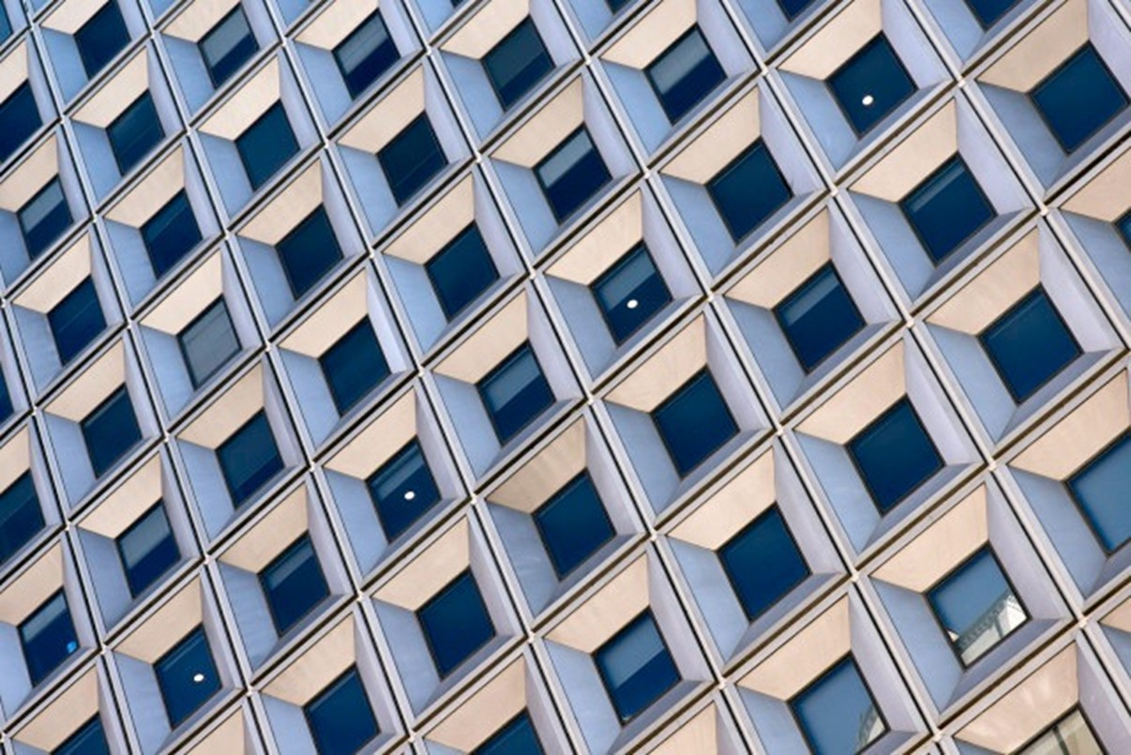
Which composition rule(s) has this image used?

Slide 13
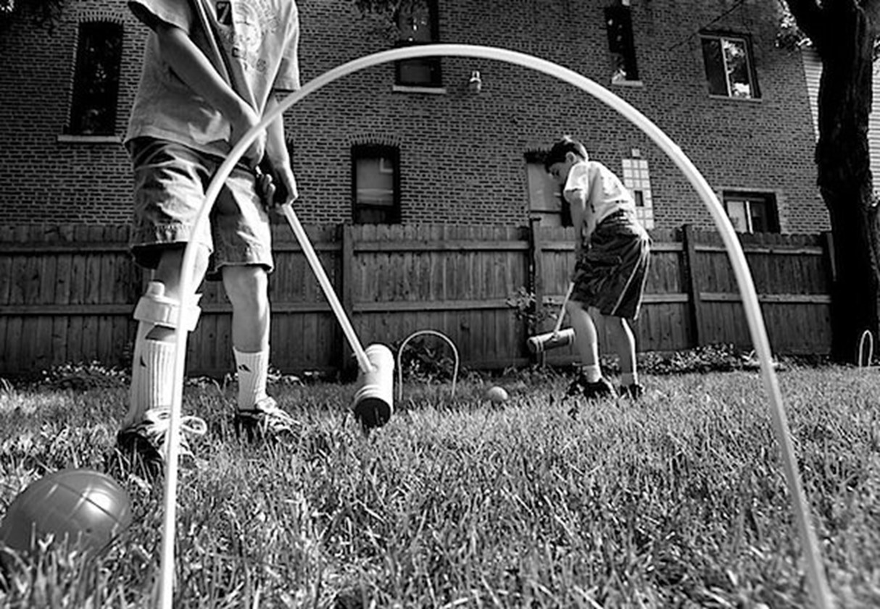
Which composition rule(s) has this image used?

Slide 14
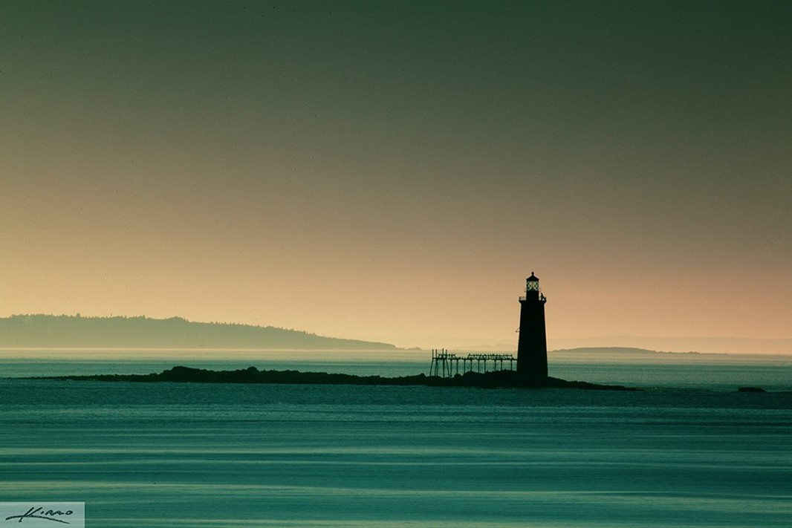
EXIT
Which Assessment Objectives have we hit this week?

Slide 15
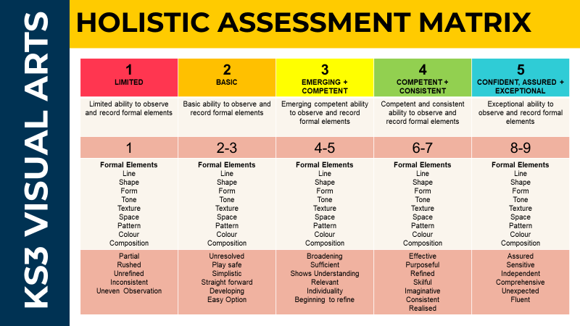

Slide 16
Task 1 Images

Slide 17
Task 1 Images

Slide 18
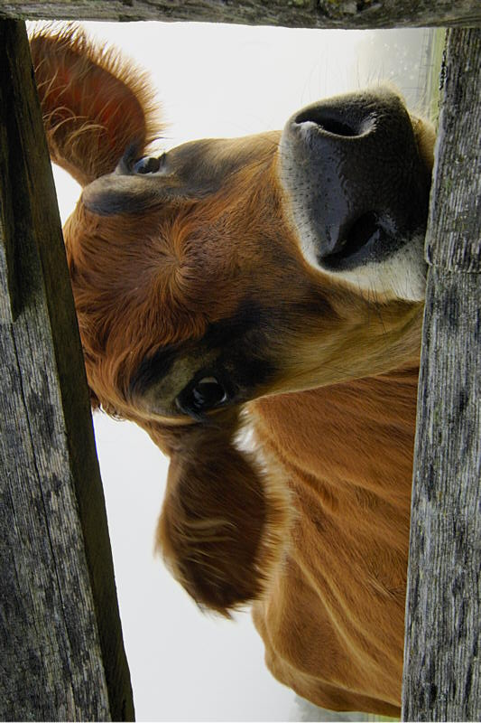
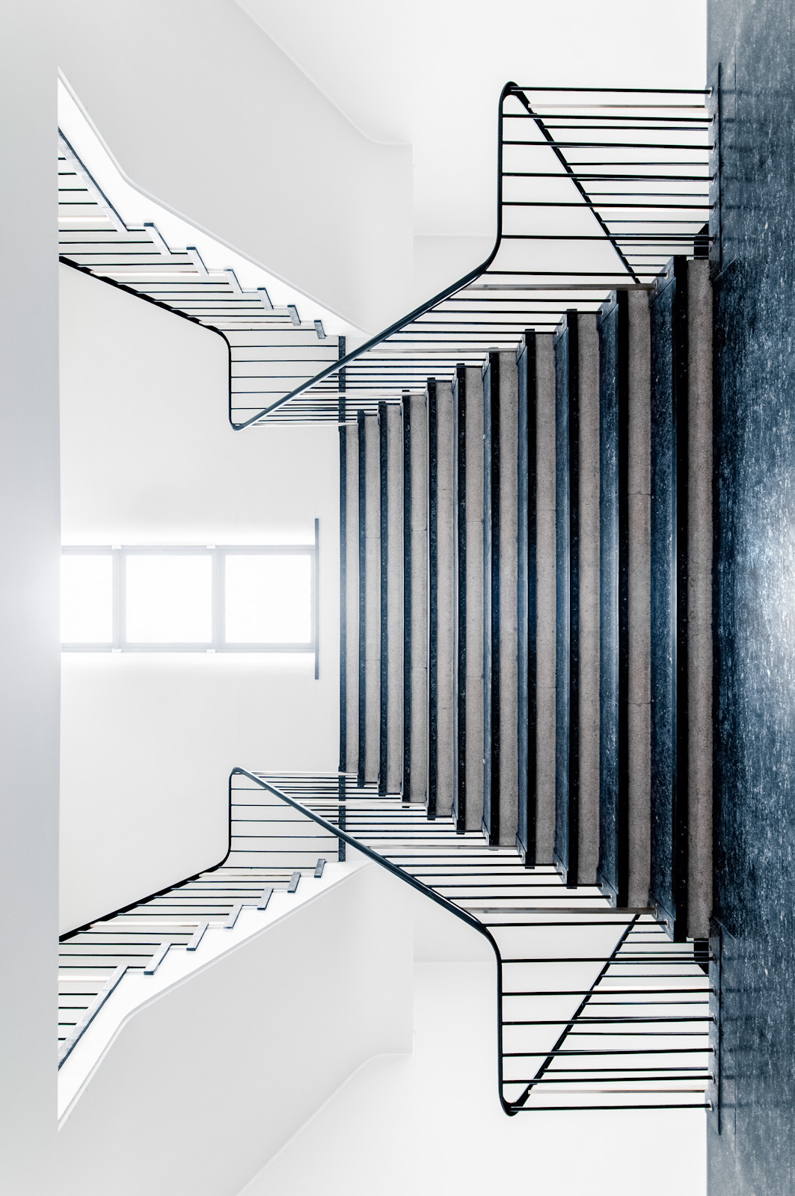
Task 1 Images

Slide 19
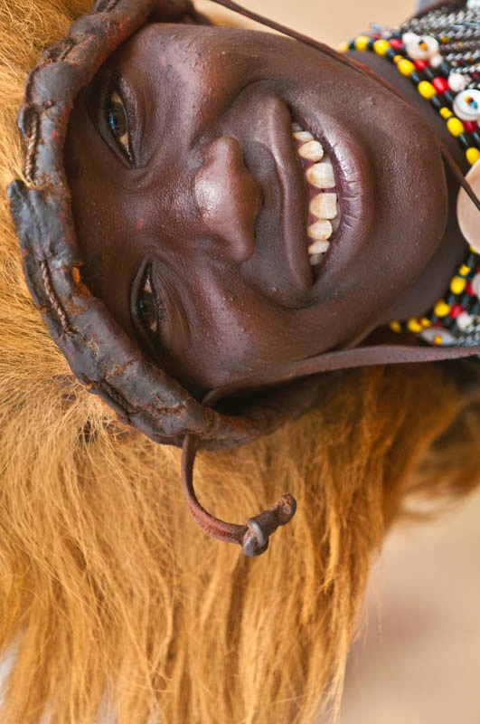
Task 1 Images

