Slide 1
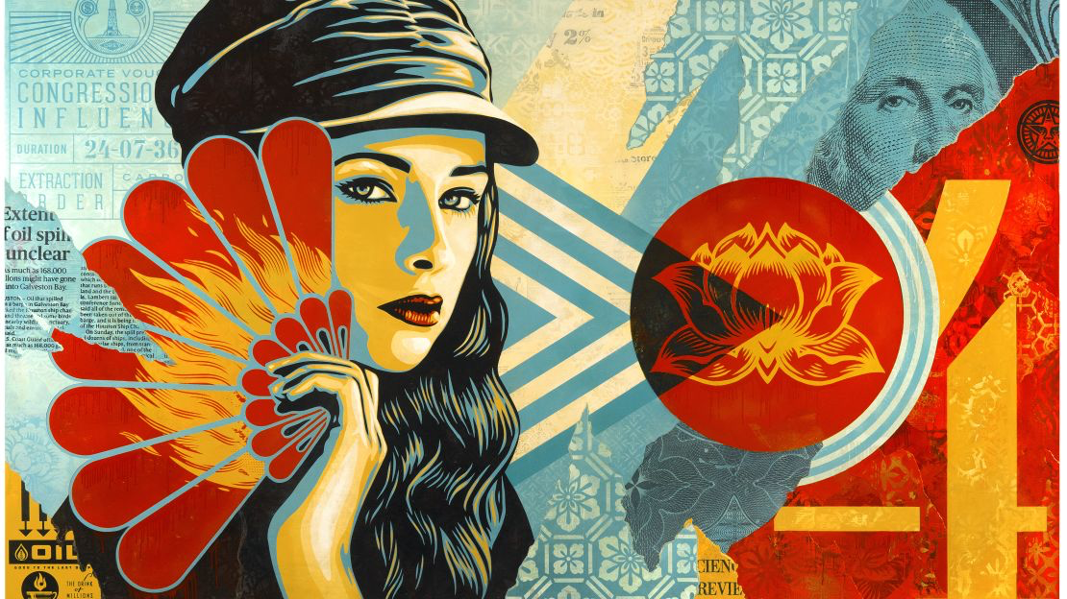
HEROES & LEADERS
Year 9: Art Activism Unit
Lesson 3, 4 & 5: Art Analysis

Slide 2
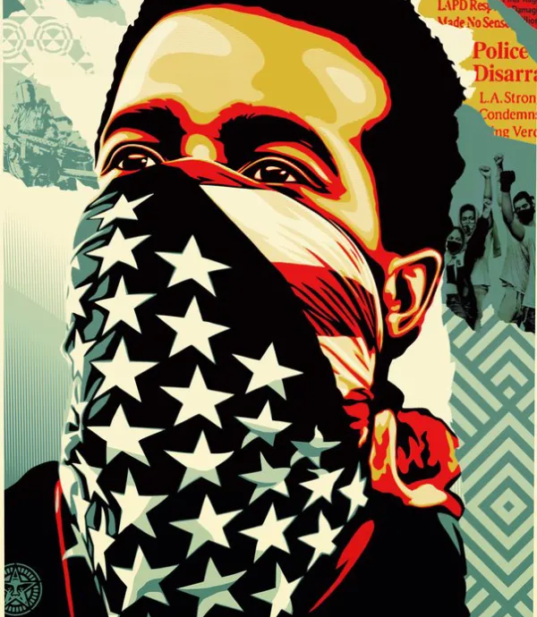
Learning
Intentions
Interpret and Explain: Learn to interpret and explain how ideas and meanings are conveyed by artists, considering historical and cultural contexts.
Creative Exploration: Take creative risks by exploring and experimenting with ideas independently to create your own original artwork while making connections to the work of artists and designers.

Slide 3
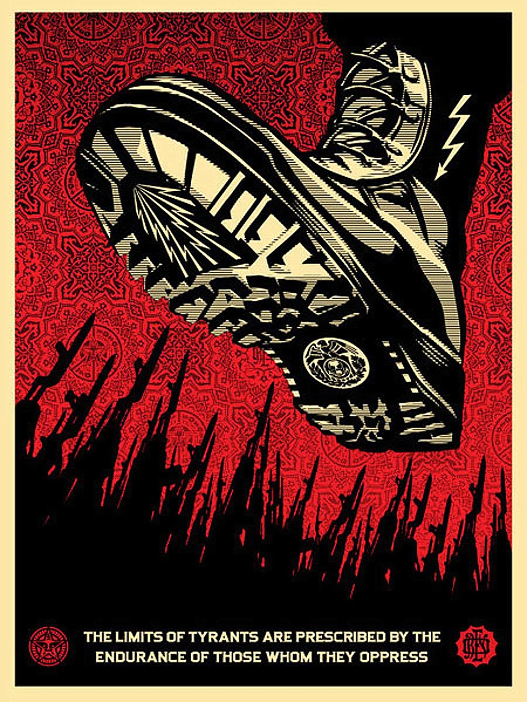
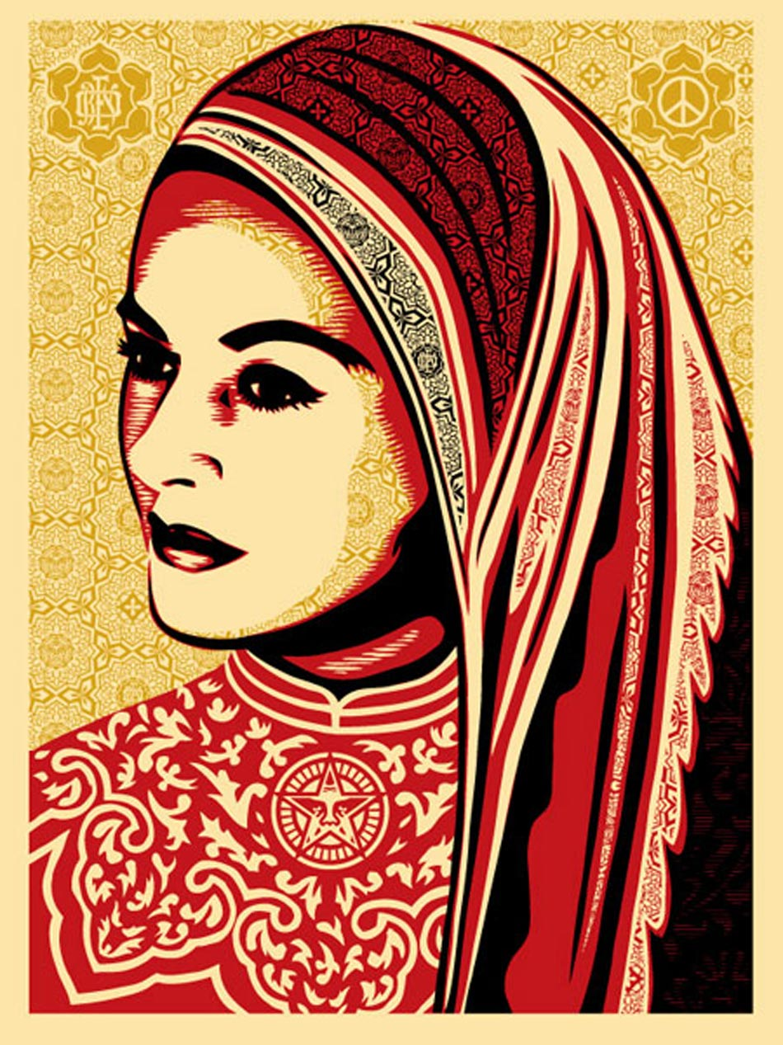
Task Create a new PowerPoint slide titled ‘The Key Characteristics of Shepard Fairey’s Artwork’. Use the Formal Elements of Art and the Principles of Design to describe what you see in his artworks (e.g. Line, Tone, Colour, Texture, Pattern, Shape, Form, Contrast, Scale, Proportion, Emphasis, Balance, Harmony, Rhythm, and Movement).
Activity 1: Key Characteristics of Shepard Fairey’s Artwork
Notes:
Fairey's work often addresses themes such as racial bias in policing, criminal justice, and media culture.
Include relevant images to illustrate these characteristics.

Slide 4
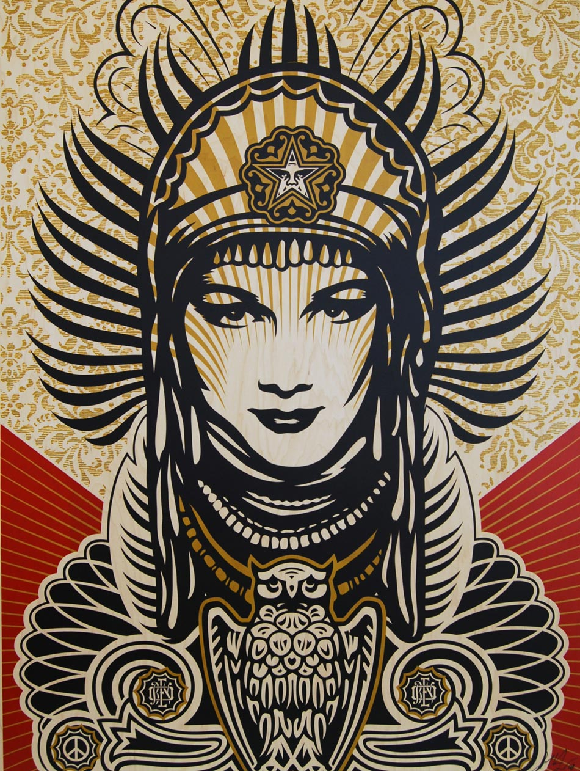
Task On the same PowerPoint slide, write the title ‘Artist’s Intentions & Meaning Behind Shepard Fairey’s Artworks’. Consider the subject matter of Fairey’s artworks: What actually features in his artworks? What inspires his work? What stories do they tell? What causes do they represent and why?
Activity 2: Artist’s Intentions and Meaning
Notes: See the example on the next slide

Slide 5
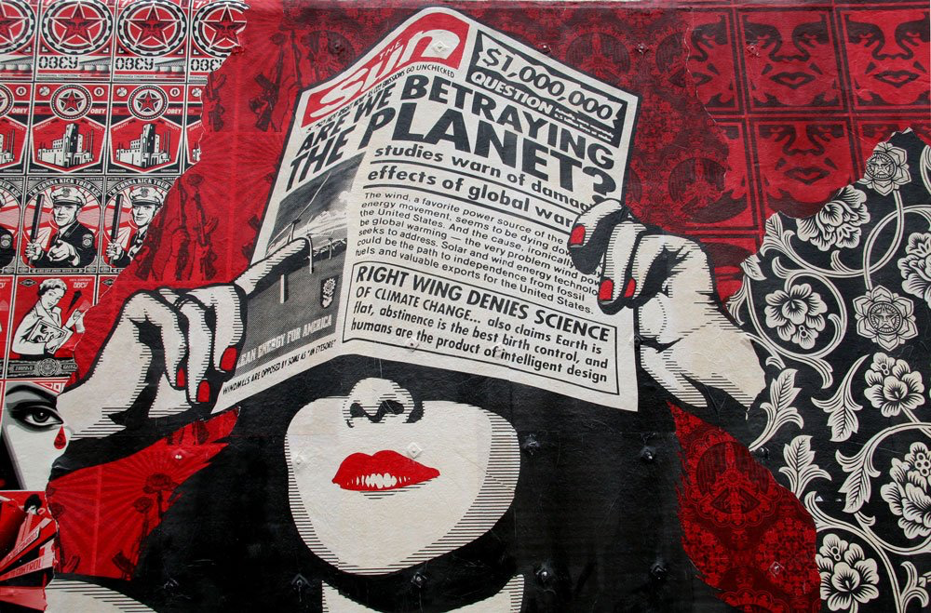
Layout Example
‘The Key characteristics of
Shepard Fairey’s Artwork’
Shepard Fairey's artwork is characterised by bold, clean lines and stark contrasts between light and dark areas, creating a dramatic effect. His limited colour palette, primarily reds, blacks, and whites, evokes urgency and intensity. Visual texture is achieved through intricate patterns and layered elements, such as newspapers and floral backgrounds. Geometric and stylised shapes, like the rectangular newspaper and circular face, create a dynamic composition. Proportion and emphasis focus on the eyes and hands, highlighting awareness and information. Balance is achieved through symmetrical arrangements, while harmony is maintained with cohesive colours and patterns. The repetition of motifs and directional lines creates rhythm and movement, guiding the viewer's eye. Fairey's work often explores themes of media culture, racial bias, and criminal justice, as seen in this piece.
Title: Media:
Artist: Size:
Date:
Artist’s intentions & meaning behind Shepard Fairey’s artworks’
Shepard Fairey's artworks critique media manipulation and raise awareness of social and political issues. In this image, he highlights environmental concerns and misinformation through dramatic lines and a limited colour palette. The oversized newspaper and alarming headlines emphasise the impact of media on public perception, urging viewers to question information reliability and think critically.

Slide 6
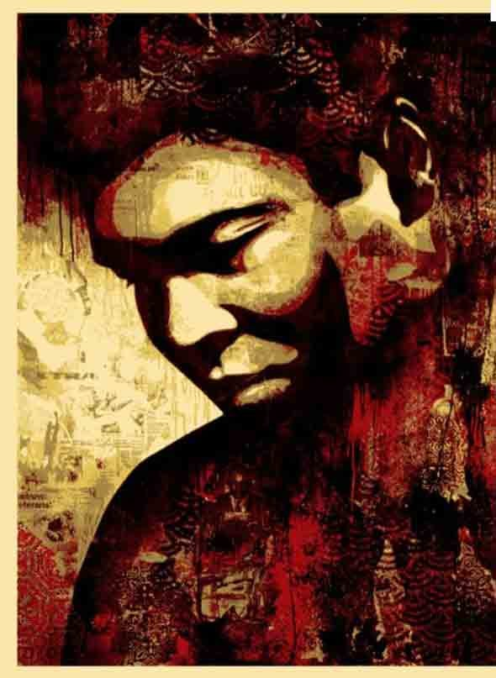
Task Research a great leader who inspires you and create a word/canva document with your findings. Present your research creatively! Use images and headlines to outline who they are, their accomplishments, and why they inspire you.
Activity 3: Developing Your Own Artwork - Research a Leader
Notes: Fairey’s work on campaigns like Adidas’s "Impossible Is Nothing" featuring Muhammad Ali can serve as inspiration.
Adidas built its "Impossible Is Nothing" campaign around Muhammad Ali in 2004.

Slide 7
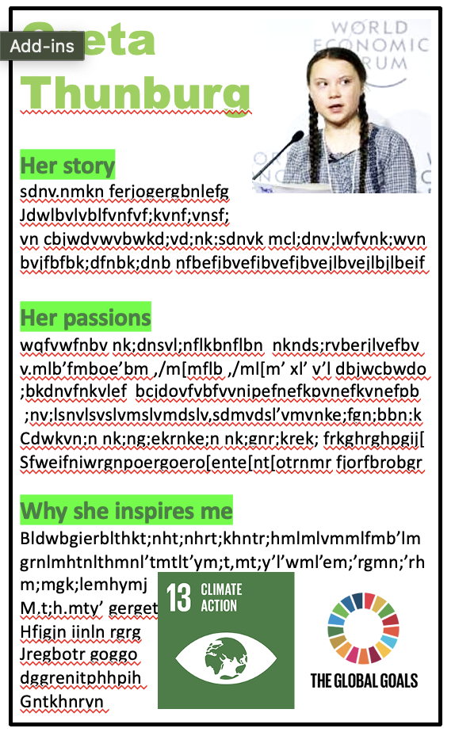
Who are they and where are they from? What actions have they taken to address one or several of the UNICEF Global Goals for Sustainable Development? What impact have their actions had in making a positive difference? What characteristics or personal qualities do you think they have that contributed to their success? Why did you choose this leader and how do they inspire you? Ensure your document includes: Images and headlines. Clear, full sentences in your own words. An image of the global goal(s) they have worked towards.
Questions to Guide Your Research

Slide 8
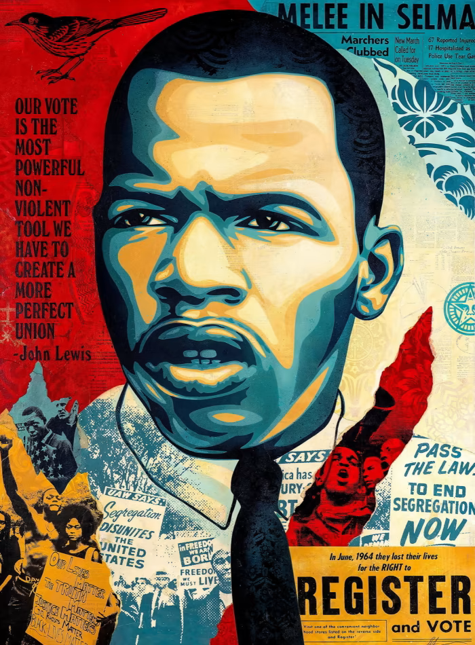
Who is Shepard Fairey? Where is he from? What and where did he study? What subjects does his artwork cover? How and where does he create his artworks? What materials, techniques, and processes does he use? Why does he create his artworks? What is the meaning or purpose behind his artwork?
Key Questions to Guide Your Research

Slide 9
Self-Assessment
Exceeding (Level 7-9)
I have created a detailed and well-researched document on a great leader.
My research includes all key information, such as who they are, where they are from, their actions, and their impact.
I have clearly explained the leader's characteristics and personal qualities.
My document is visually engaging, with relevant images and creative headlines.
I have expressed my personal opinion on why this leader inspires me, with thoughtful insights.
I have included an image of the global goals they have worked towards.
Meeting (Level 4-6):
I have created a research document with most of the key information about a great leader.
My research includes who they are, where they are from, their actions, and their impact, but may lack some detail.
I have mentioned the leader's characteristics and personal qualities.
My document is organised and includes some relevant images.
I have expressed my opinion on why this leader inspires me, with some insights.
I have included an image of the global goals they have worked towards.
Working towards (Level 1-3):
I have created a research document but it lacks key information about a great leader.
My research is missing details such as who they are, their actions, and their impact.
I have briefly mentioned the leader's characteristics and personal qualities.
My document is somewhat disorganised and lacks visual appeal.
I have expressed my opinion on why this leader inspires me, but it is not well-supported.
I have not included an image of the global goals they have worked towards or the images are not relevant.

Slide 10
