Slide 1
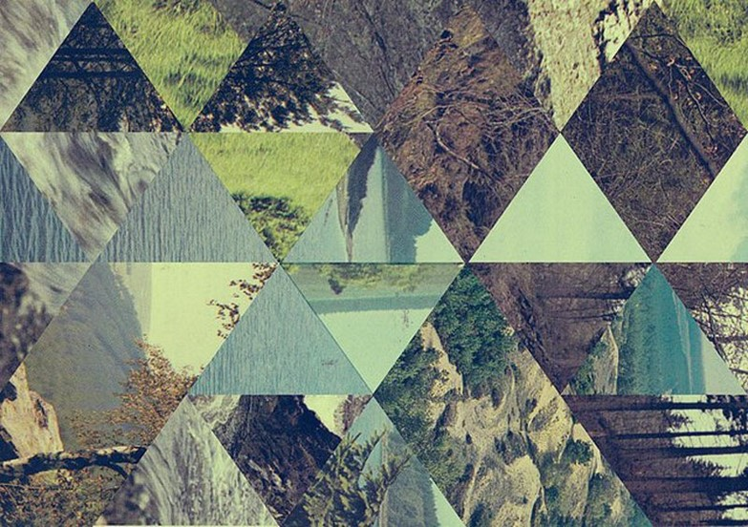
An Introduction to Photo Editing
Year 10: GCSE Photography
Winter Break: Editing in the style of Jelle Martens

Slide 2
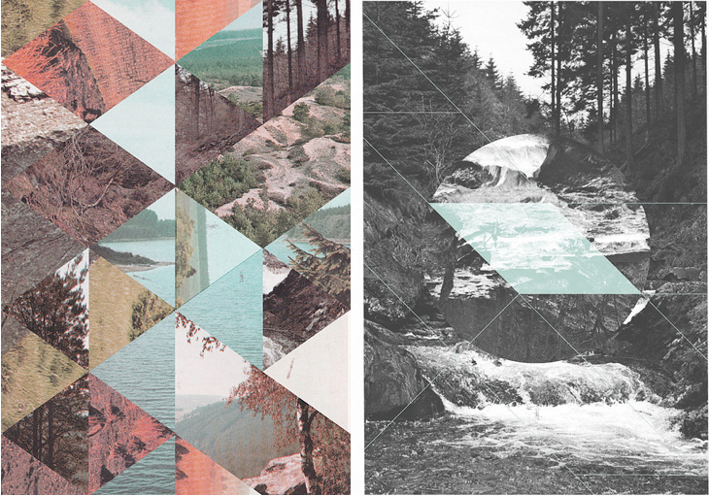
What can you tell me about these images by Jelle Martens?

Slide 3
Learning Intentions
AO2: Refine work by exploring ideas, selecting and experimenting with appropriate media, materials, techniques and processes.
To explore a range of photo editing skills using Photopea and Photoshop in the style of Jelle Martens.

Slide 4
Jelle Martens
Guidelines:
For this edit, save the pattern picture on the next slide and open it in Photoshop/Photopea.
Find and save 5 or 6 landscape photos (these should be photographs that you have taken), looking for variety in colour and contrast, then follow the tutorials to complete your own version of this photographer's work.
Create a research page in your sketchbook about Jelle Martens and present your outcome.

Slide 6
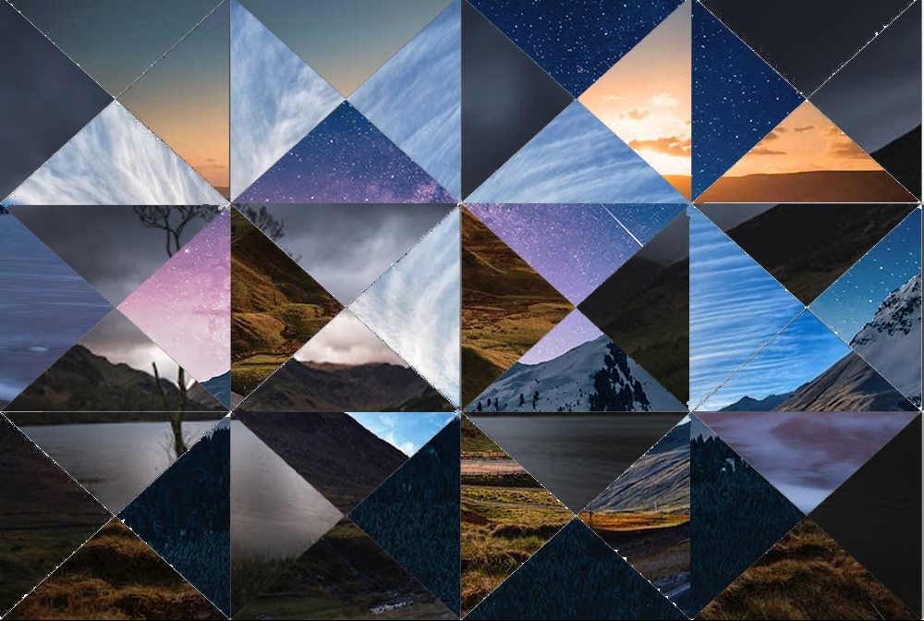
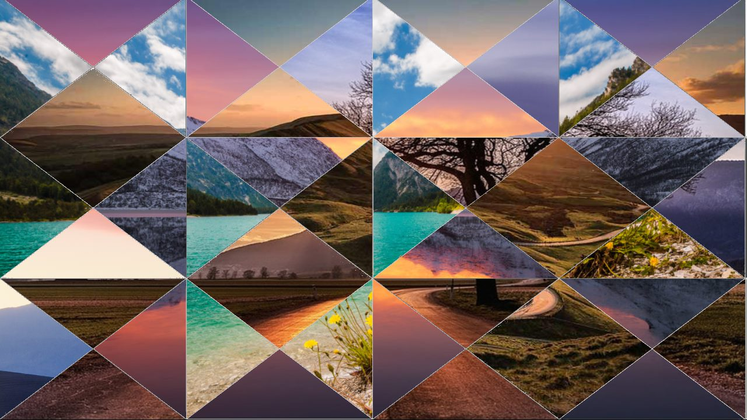
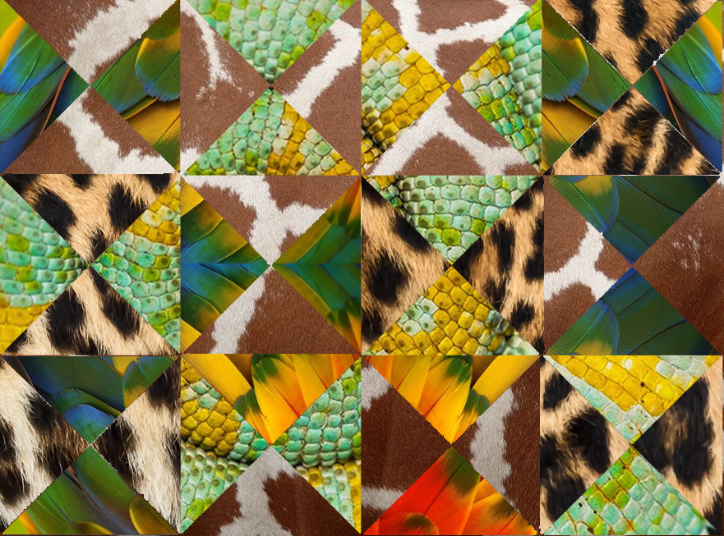
Student Examples

Slide 7
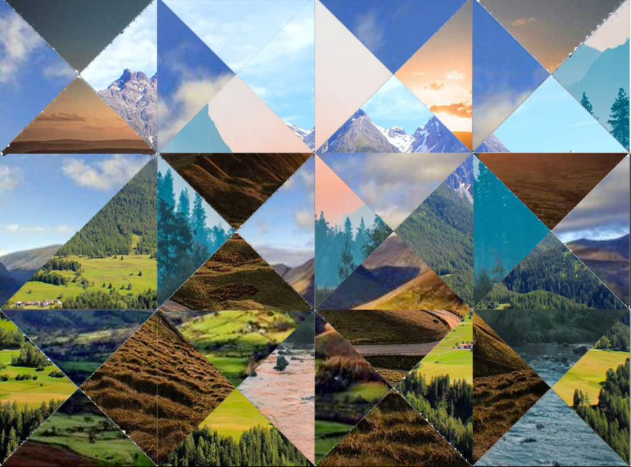
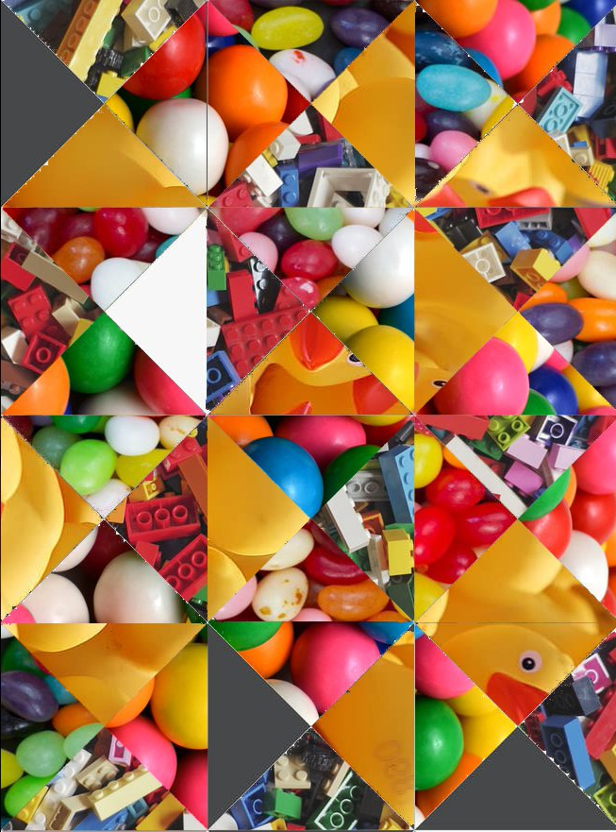
Student Examples

Slide 8
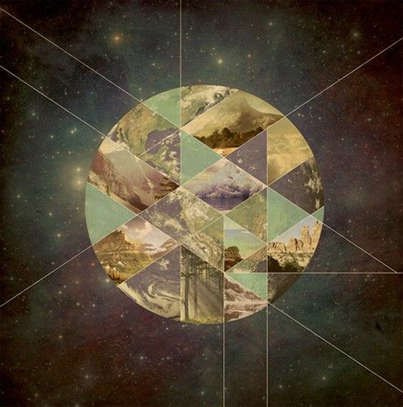
EXIT
What evidence do you now have in your sketchbook to meet AO2?

