Slide 1
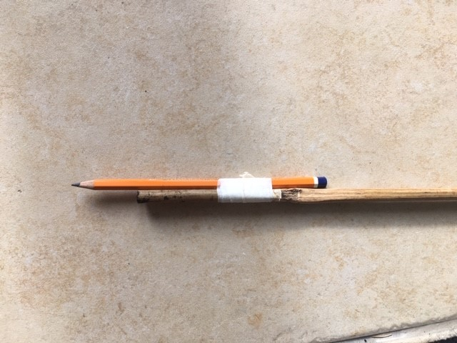
Task 2 - EXTENDED ARM - 2 lesson task
An extended arm drawing involves having your media (pencil, charcoal, pen etc) attached to the end of a stick. This creates a challenge and helps to develop your control.
You will need a pencil, sellotape/masking tape and a long stick - this could be a piece of garden bamboo. Tape the pencil to the end of your long stick like the pictures below...making sure that it is secure.
A piece of A3 paper.

Slide 2
Attach your pencil/pen/charcoal securely to the stick using masking tape. Ensure that it is secure and doesn’t wobble.

Slide 3
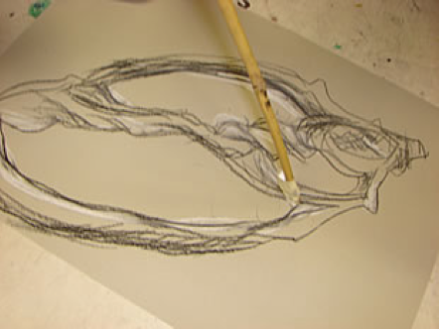
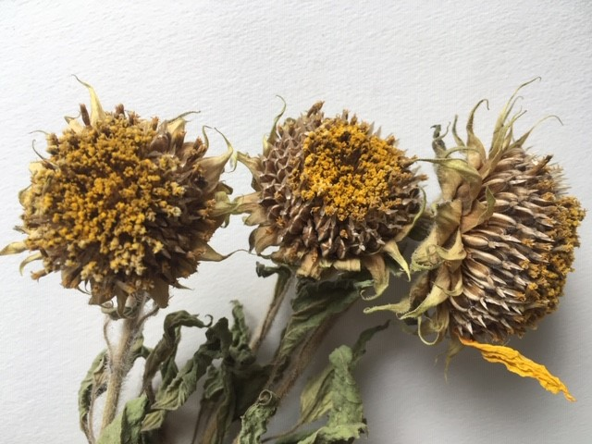
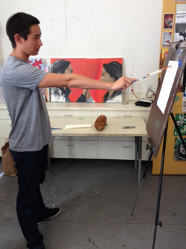
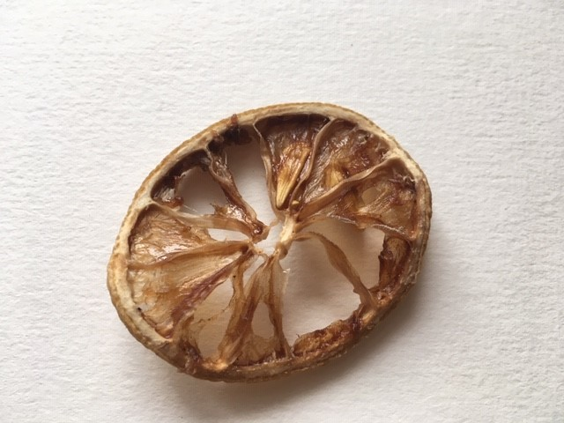
Extended arm drawings
Part 1 - Extended Drawing
Select 3 different objects to draw from your selection, they should be an organic form vegetables fruits or natural objects like shells, stones, seeds or flowers.
Using a pencil attached to a stick with masking tape, produce 3 observational drawings on A3 paper ( this could be two pieces of A4 paper taped together)
Concentrate on shape, form, proportion and scale. You may work with your paper on the wal on the floor, stick it with blu-tack or tape to stop it from moving.

Slide 4
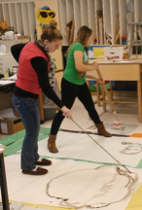
Part 2 - GO BIG
Now using a larger piece of paper at least A2 in size, create a large-scale extended arm drawing.
You can work with your paper on the floor or stick it to the wall.
Concentrate on shape, form, proportion and scale.

