Slide 1
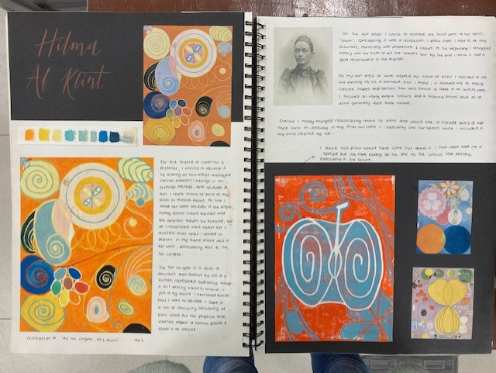
Artist Research
For this unit you will need 2 x artist research double pages. These should be artists whose work links to your project ideas in some way.
You should include:-
A title – the artist’s name
At least two images of the artist’s work.
A recreation – this can be an enlarged section of the artwork.
Describe, Analyse, Interpret, Judge – use the helpsheet in your book
Critcal and contextual analysis – why has the artist made the work, what is the message that the artist wants to convey. Is the work a reaction or reflection of events that were happening in the world at the time that the artist made it?
Talk about how this artist/work will influence your project – is it their ideas that link to your work? Do you want to explore the techniques/media and materials that they use?

Slide 2
Suggested Layout
Artist’s name
Purpose and Meaning.
Introduction to the artist and their work - Give a brief outline of the artist’s life, education, style of art, meaning of their work
Artist Image
Choose a piece by the artist to analyse. Add image and give source
Analysis of Formal Qualities -scale, colour, material, structure etc. positive and negative space - look at (worksheet in your sketchbook)
(Analysis means explaining why something looks the way it is?)
Recreation of one of the artworks that you have chosen
Description of work- (what is it? What does it look like?)
Put title of work, date, artist, ,media and place of installation.
What people said about the piece.
What do I think?
Artist Image
Choose a piece by the artist to analyse. Add image and give source
Add another image here perhaps. (different viewpoint)
Put title of work, date, artist, ,media and place of installation.
Sources:

Slide 3
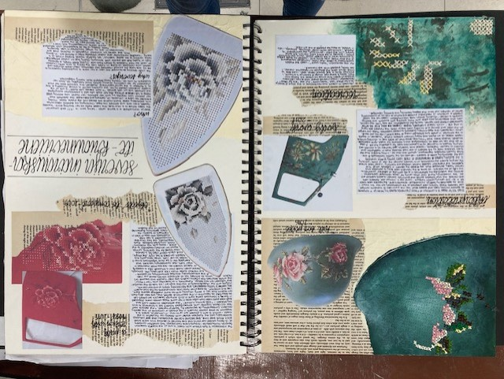
Artist Research examples

Slide 4
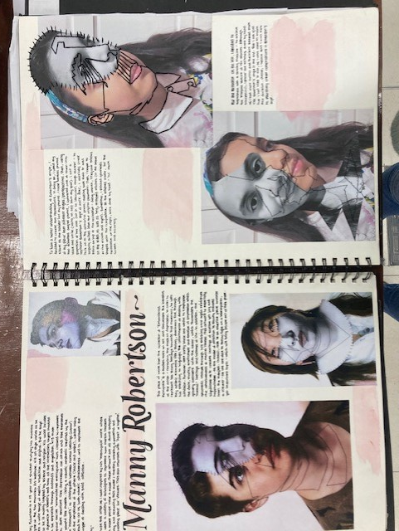
Artist Research examples

Slide 5
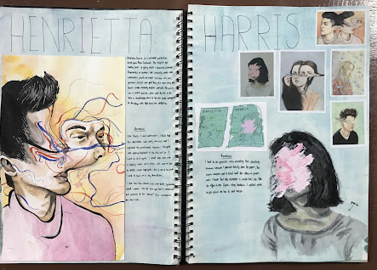
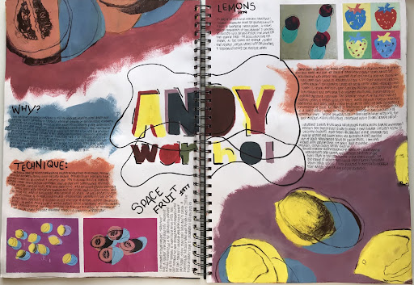
Artist Research examples

Slide 6
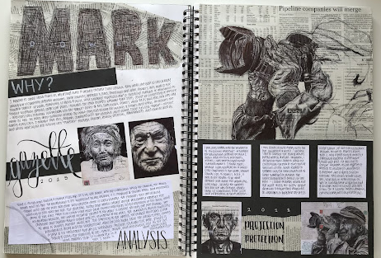
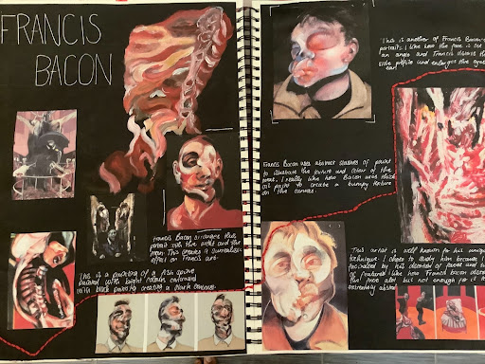
Artist Research examples

Slide 7
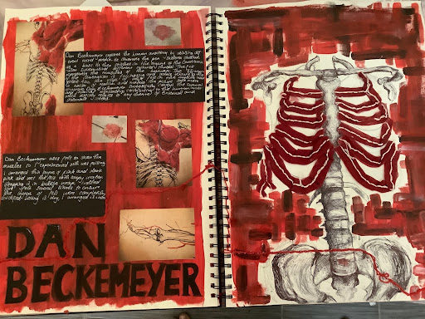
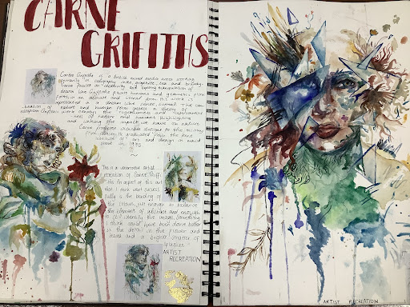
Artist Research examples

Slide 8
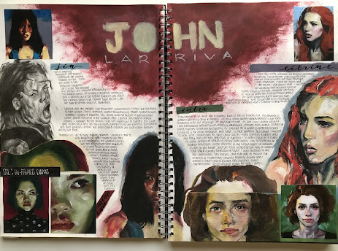
Artist Research examples

Slide 9
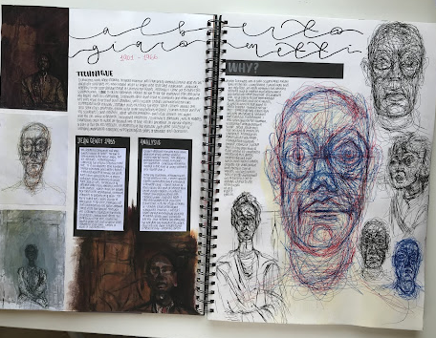
Artist Research examples

