Slide 1
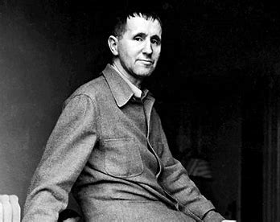
Year 8 Home Learning Project
Drama - Brecht

Slide 2
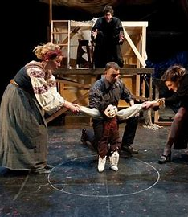
Title: Exploring Brecht: A Research Task for KS3
Objective:
To introduce students to the life and works of Bertolt Brecht, a prominent figure in 20th-century theatre, and to encourage critical thinking about his contributions to drama.
Task:
Your task is to conduct research on Bertolt Brecht, a significant playwright, and theatrical theorist of the 20th century. Follow the steps below to guide your research and compile your findings into a presentation or written report

Slide 3
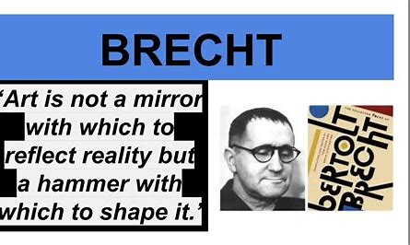
What do I need to do? Slides 1 and 2
Biography: Research and summarize the key biographical details of Bertolt Brecht's life. Include information such as his early life, education, major life events, and significant accomplishments.
Theatrical Techniques: Investigate Brecht's innovative theatrical techniques, such as "Verfremdungseffekt" (alienation effect) and "Epic Theatre." Explain what these techniques entail and how they were utilized in his plays to engage audiences and provoke critical thinking.

Slide 4
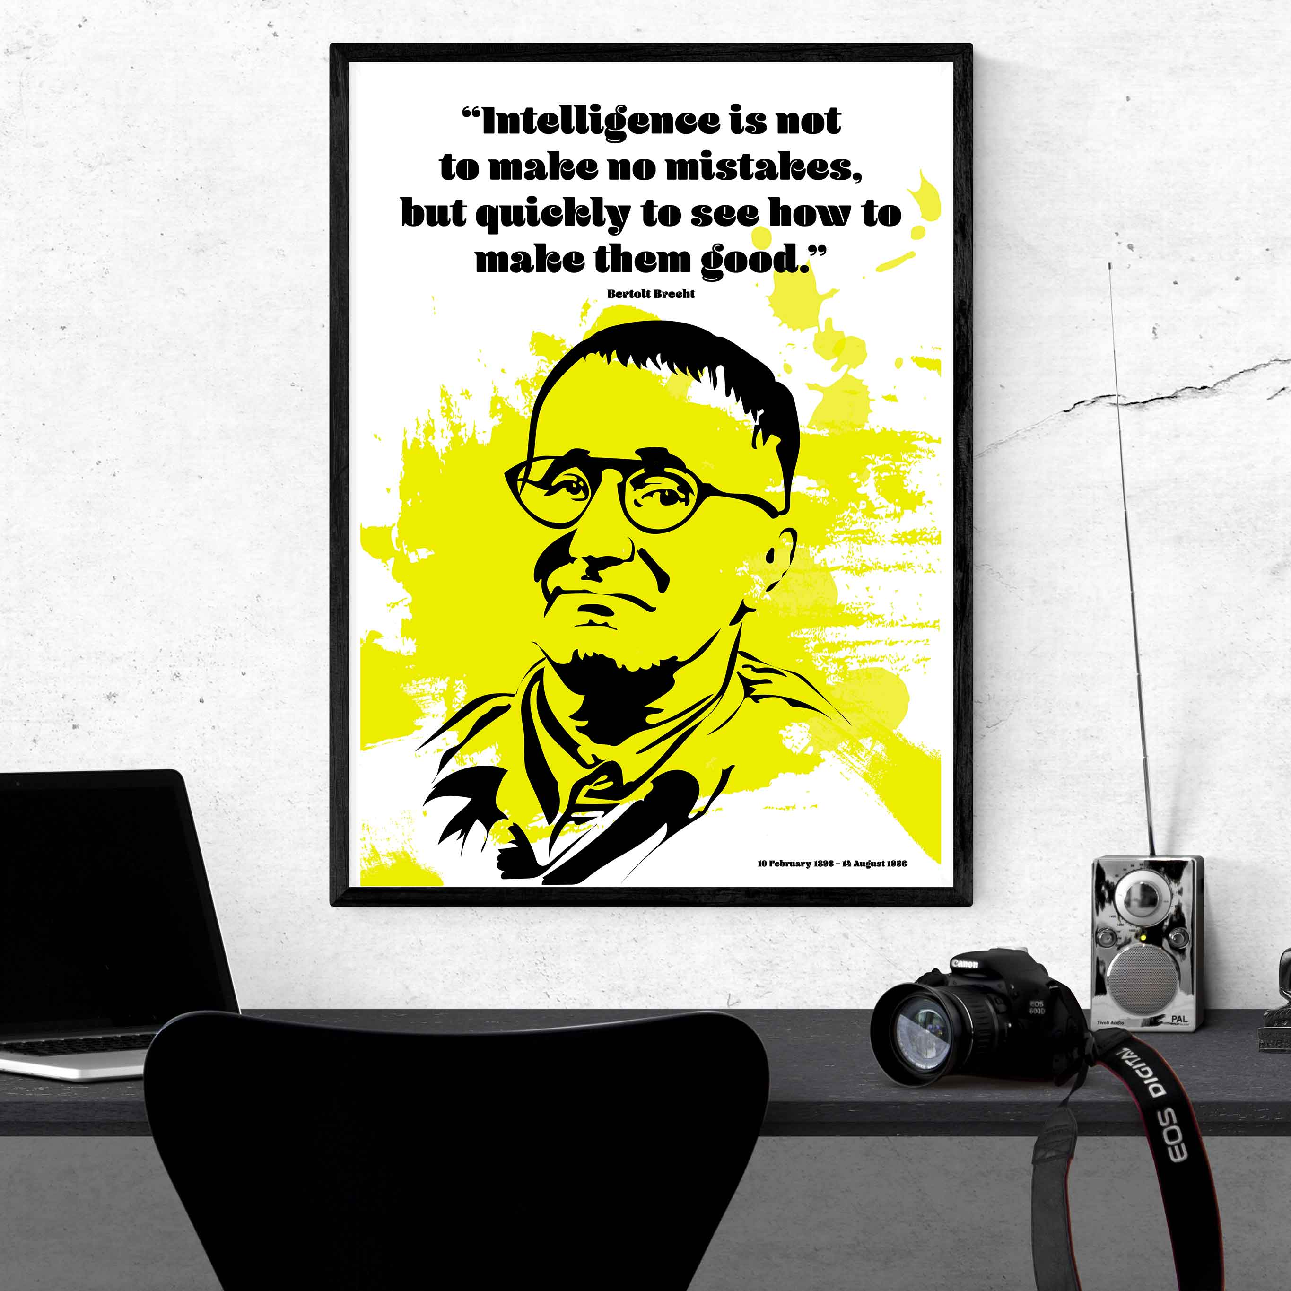
Slides 3 and 4
Major Works: Identify and analyze at least three of Brecht's major works. Choose plays such as "The Threepenny Opera," "Mother Courage and Her Children," and "The Caucasian Chalk Circle." Discuss the themes, characters, and stylistic elements present in these works.
Influence and Legacy: Explore Brecht's influence on the development of modern theatre and his impact on other playwrights and theatrical movements. Consider how his ideas continue to shape contemporary theatre practices.

Slide 5
Research help
Resources: You may use the following resources to aid your research:
Library books
Academic journals and articles
Reliable websites (e.g., academic institutions, theatre archives, bbc bitesize)
Documentaries or interviews about Bertolt Brecht
Youtube has some BRILLIANT Brecht videos that are short and sweet BUT informative
Remember to cite your sources appropriately and approach your research with a critical mindset. Have fun exploring the world of Bertolt Brecht and his groundbreaking contributions to theatre!

