Slide 1
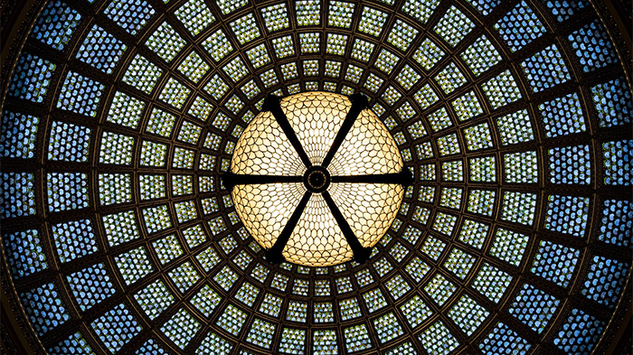
Pattern Project
Year 10: GCSE Photography
Lessons 25 -30: Developing a Series of Experiments as Photographic Outcomes

Slide 2
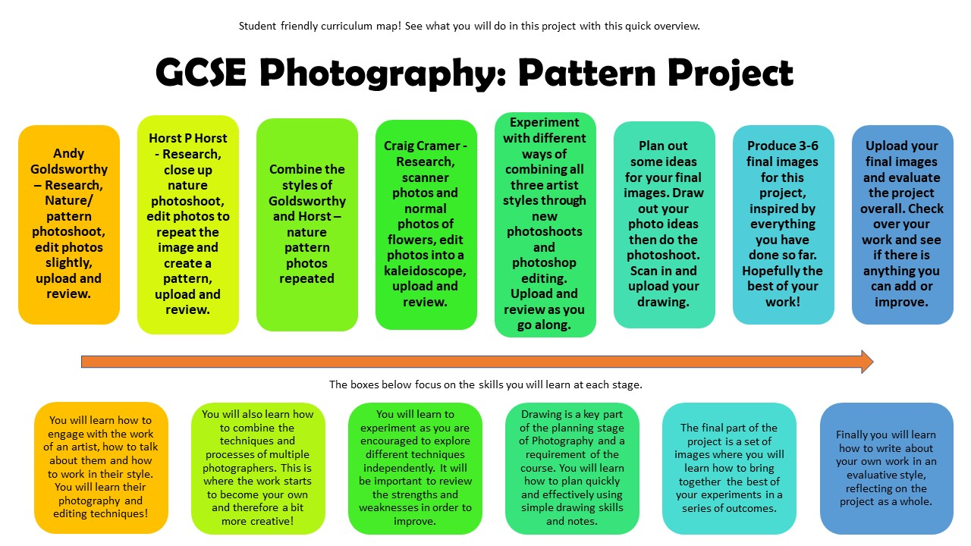

Slide 3
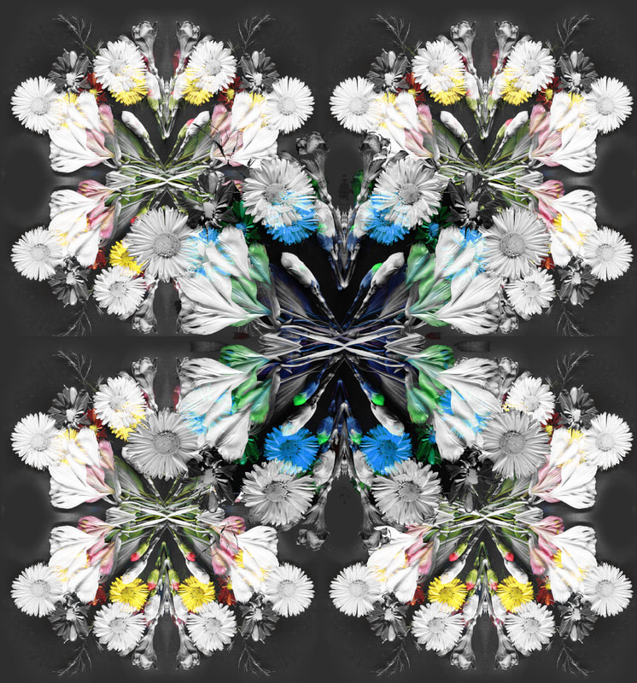
What did we do last week?

Slide 4
Learning Intentions
You are learning how to demonstrate your understanding of the project and the skills you have learnt so far by bringing together your ideas in independent experiments.
You are also learning how to be more independent and think for yourselves by producing your own ideas for experiments!

Slide 5
What Next?
This lesson you will need to start working more independently as you have more choices in the way you work.
For AO2 (25% of your marks) you get marks for experiments that try out different ideas linked to your artists.
Try different ways of combining their techniques in new photoshoots and edits.
Notes:
70 Years of André Kertész's Photography Surveyed | Widewalls

Slide 6
Combining Styles Assessment
As you complete a task, present each one in your black sketchbook as follows:
Title – “Combining the styles of… and…
Contact Sheet or printed images of the original photos before editing if you chose photographs from a previous shoot.
Print your 2 best images slightly larger (unedited) to show these are your favourite ones.
Print your edited photos in the style of your photographers. Include smaller images of the specific photographs that inspired you.
Text – Write a sentence or two to explain HOW you have combined the styles of your photographers, what works well and what could be developed further.
Notes:
https://funny.pho.to/kaleidoscope-photo-effect/

Slide 7
Task 1: Combining Styles Assessment
Work through 3 or more of these photoshoots and editing tasks. In your black book, plan out how you will complete each task then start working through your plans, using any photo from this project so far.
Goldsworthy and Cramer | Cramer and Horst | Cramer and Horst | Goldsworthy and Cramer | Goldsworthy and Horst | Kertesz, Cramer & Horst
Scan Goldsworthy style patterns made from leaves, stones, shells etc. Take new photos, create a contact sheet, then edit 2 or more images. Present in your black sketchbook. | Repeat a photo 8+ times to create a kaleidoscope pattern – leave it in colour. Use existing photos, produce 2 or more edited images. Present in your black sketchbook | Repeat a photo 8+ times to create a kaleidoscope pattern – layer it with black and white version over the top, then rub out sections to reveal some areas of colour. Use existing photos, 2 or more edits. Present in your black sketchbook. | Make Goldsworthy style patterns out of colourful flowers. Take new photos, create a contact sheet, then edit 2 or more images. Present in your black sketchbook. | Create a small area of pattern using different types of leaves, then photograph and repeat it 8 times. Take new photos, create a contact sheet, then edit 2 or more images. Present in your black sketchbook. | Scan Cramer style patterns using kitchen objects or utensils. Take new photos, create a contact sheet, then edit 2 or more images. Present in your black sketchbook.
Notes:
https://funny.pho.to/kaleidoscope-photo-effect/

Slide 8
Homework
Complete all work for Task 1. Make sure all other work for this project is up to date – you sketchbook should be starting to look something like this now…

Slide 9
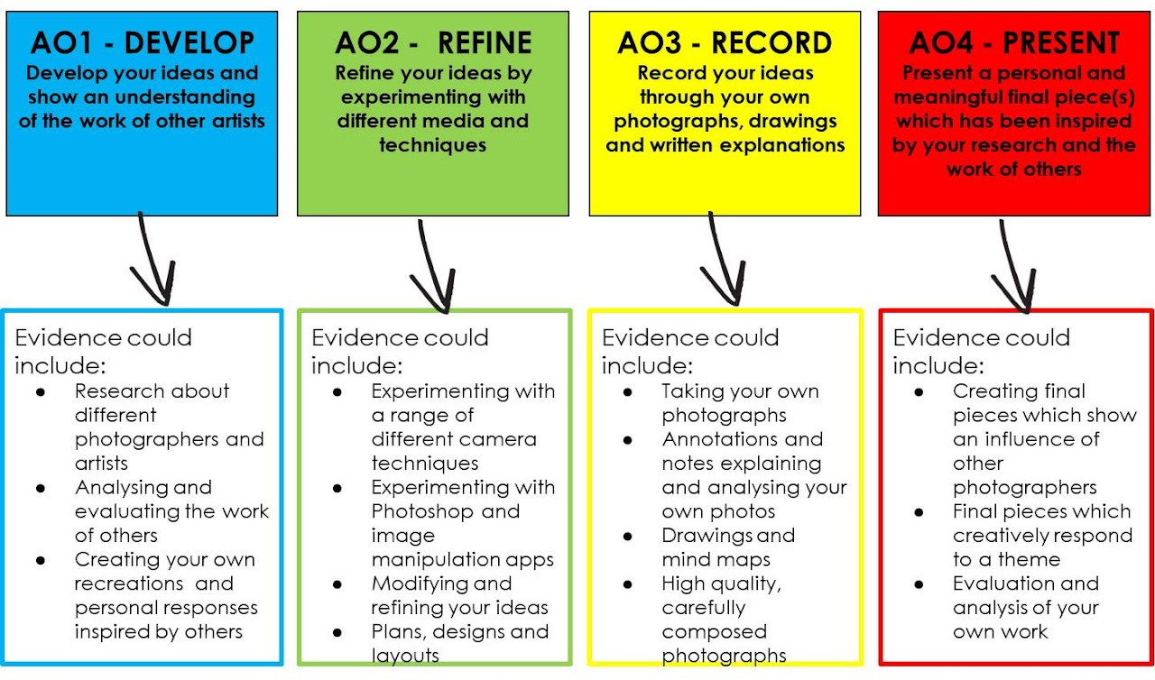
Assessment Objectives

Slide 10
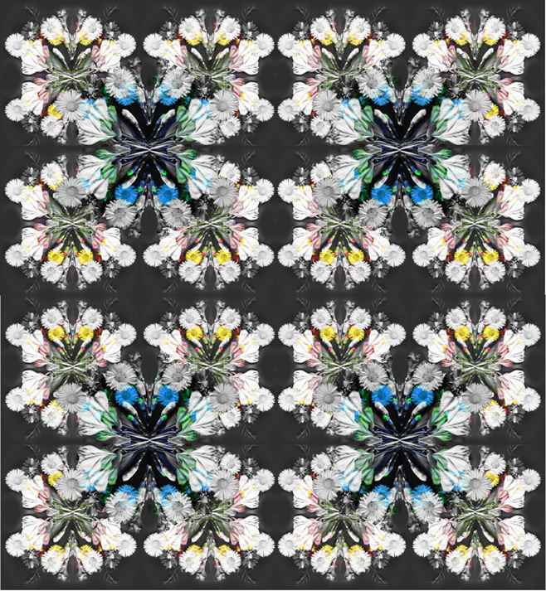
EXIT
Is your sketchbook up to date?

